Slide 1
fire_wm Macros
Helper macros for fire_wm

Slide 2
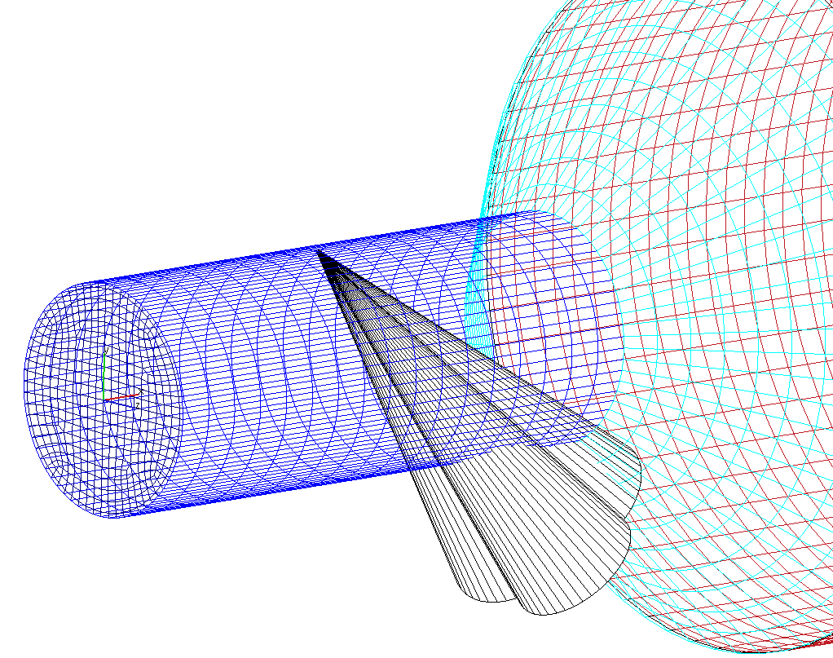
fire_wm Macros
Helper macros for fire_wm

Slide 3
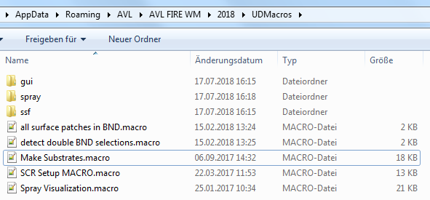
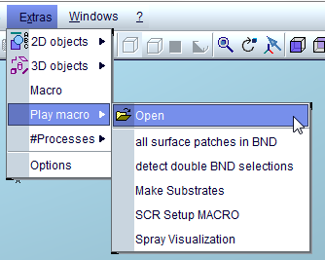
User Defined Macros
From v2018.1 user can specify “User Defined Macros” that are available directly in fire_wm:
All .macro-Files placed in:
~/.avl/avl fire wm/2018/UDMacros/
Or
%APPDATA%\AVL\AVL FIRE WM\2018\UDMacros
Are directly available in Extras/Play Macro/ under their
respective name:

Slide 4
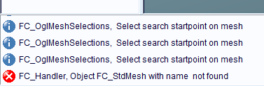
Boundary Patches Macros 1
“All surface patches in BND”:
Select Mesh (surface or volume mesh)
Invoke Macro
If no mesh is selected, error will be shown in info area only:
All external faces are checked if they are in a selection with prefix BND_*
Those not assigned to a BND_*-Selection are put into a selection “RestSel”
Works only for Face Selections, if using surface meshes, all “BND_”-Selections need to be Face Selections! (can be changed to CellSelection in source)
Prefix can be changed in macro source as well

Slide 5
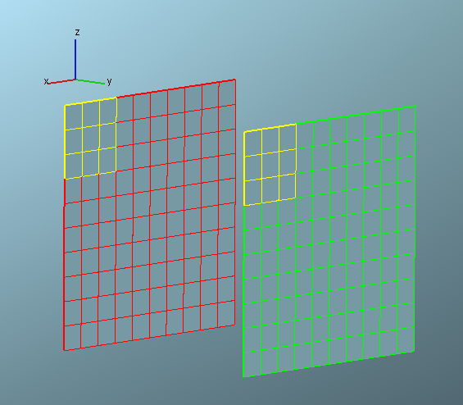
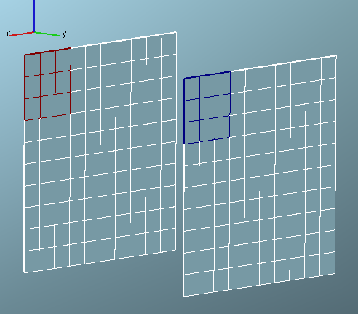

Boundary Patches Macros 2
“Detect double BND selections”:
Select Mesh (surface or volume mesh)
Invoke Macro
All external faces are checked if they are in more than one selection with prefix BND_*
Those in more than one selection will be assigned to a _DoubleDef_sel1_and_sel2-Selection
Works only for Face Selections, if using surface meshes, all “BND_”-Selections need to be Face Selections! (can be changed to CellSelection in source)
Prefix can be changed in macro source as well

Slide 6
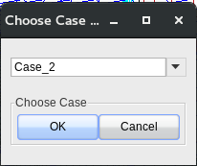
Spray Preprocessing Macro
“Spray Visualization”
Reads ssf, detects nozzles and creates middle line as well as outer and inner cone.
Make sure all ssf’s are saved to disk
Start macro
Select case from dropdown box
SSF file is read, nozzle representation is build

