Slide 1


BANK LOAN ANALYSIS

Slide 2
Overview
Using exploratory data analysis, and continuous monitoring for actionable insights and well-informed decision-making to analyze bank data to increase operational efficiency, identify fraud, and improve customer experience.
This project covers a number of key performance indicators (KPIs), including customer behavior, grade and sub-grade wise statistics, and year-by-year loan amount statistics.
The analysis is based on one excel file and two csv files that have been cleaned and edited to extract important insights.

Slide 3
Dataset Summary
Composition:
Two Excel files.
File 1: 24 columns, 39,715 rows.
File 2: 25 columns, 39,718 rows.
Data Types: Contains string, numerical, date, and alphanumeric data.
Common Column: Both files share a unique identifier column named "Id".
Integration: The dataset can be merged into a single dataset using the "Id" column.
Data Quality: Contains a significant amount of null values.

Slide 4
KPI’S
Year wise loan amount Stats
Grade and sub grade wise Revol_Bal
Total Payment for Verified Status Vs Total Payment for Non Verified Status
State wise and last_credit_pull_d wise loan status
Home ownership Vs last payment date stats

Slide 5
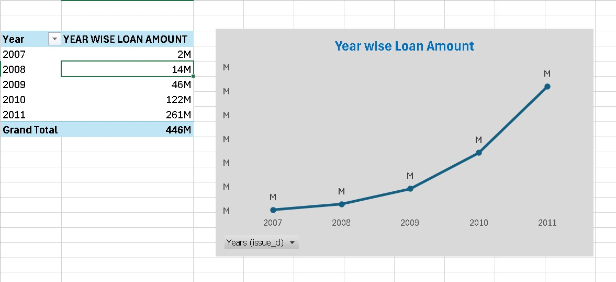
Year wise Loan Amount stats
The loan amount increased progressively between 2007 and 2011 from 2M to 261M.
We note that the loan amount increased significantly between 2010 and 2011.
We can develop specialized loan products, engage customers, and adjust strategies based on seasonal trends for effective targeting and business growth.

Slide 6
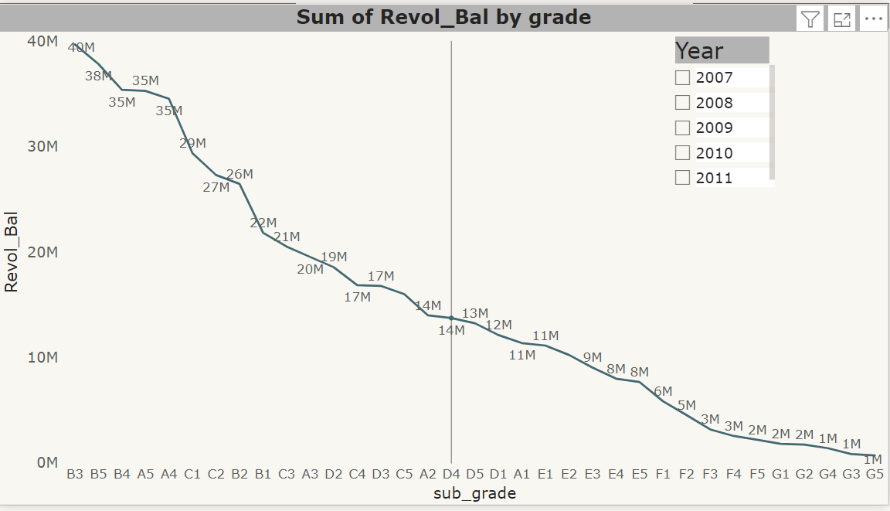
SUB GRADE wise Revol_Bal
In comparison to all other subgrades, the B3 subgrade has the greatest Revol_Bal. Revol_Bal is lowest in G5.
A grade of D would be the average of these.
The total Revol_Bal varies for every grade, going from high to low.
In comparison to the entire year, 2011 yielded the biggest profit.

Slide 7
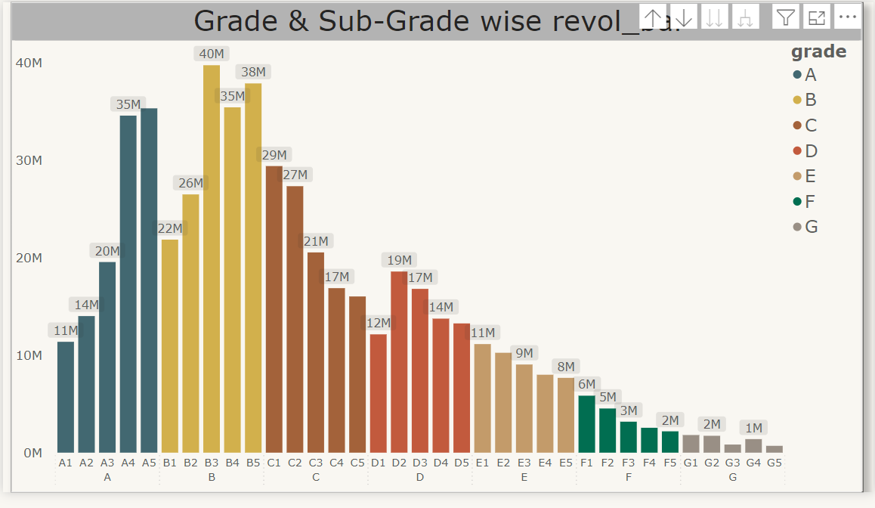
GRADE & Sub Grade wise Revol_Bal
The grades with the greatest Revol_Bal are B and Sub-B3.
Less than a million is the lowest point for G3 and G5 for the entire period.

Slide 8
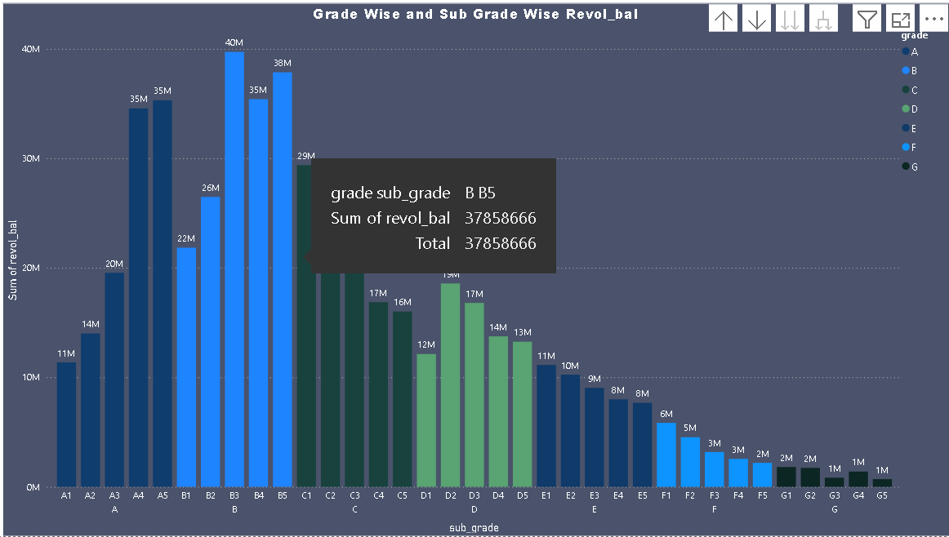
Grade wise and sub grade wise Revol_bal
From 2007 to 2011, Grade B has the greatest Revol_Bal of all the years.
The lowest is 6M's Grade C. There are five subgrades for every grade, and each has a different Revol_Bal for every year.
Leverage this data to optimize risk assessment and customer engagement
Risk Management: Tailor risk evaluation based on revolving balances in different grade/sub-grade segments.
Customer Support: Engage customers with high revolving balances, providing guidance and personalized solutions.

Slide 9
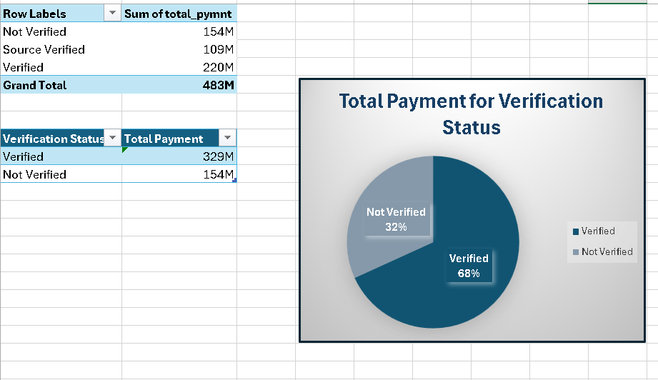
Total Payment for Verified Status Vs Total Payment for Non Verified Status
This KPI illustrates the difference between total payment for verified and non-verified status.
Verified status is more than non-verified status, according to the analysis.
We can analyze, if verification status influences payment behavior. Verification processes, communication, risk assessment, and product offerings accordingly for enhanced customer engagement and risk management.

Slide 10
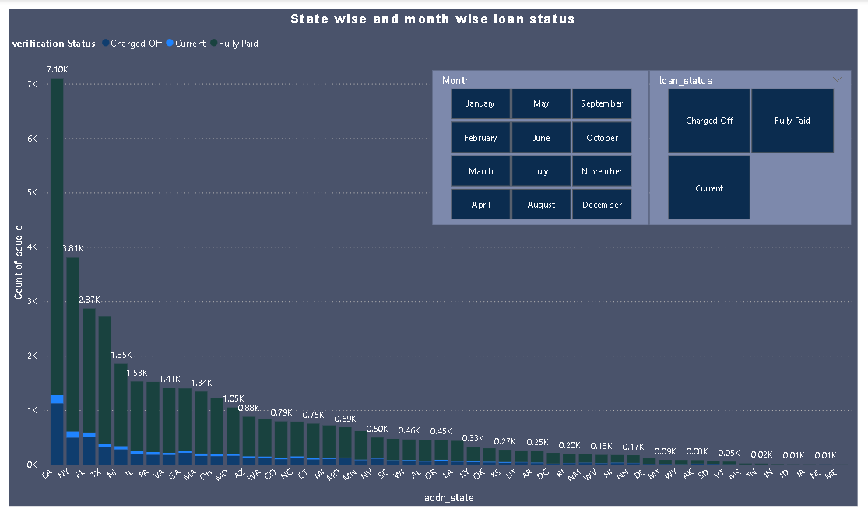
State wise and month wise loan status
With a total count of loan statuses of 32,950, fully paid ranked highest, followed by charged off at 5627 and current at 1140.
It shows loan status by state and last credit pull date, revealing regional loan performance patterns.
From this, we understand that California (CA) has the highest number of loans (7.1k) followed by New York(NY) with 3.8k loans. This indicates that these states have relatively higher demand of loans.
Bank can consider focusing their efforts on states with low loan counts to expand their customer base and increase their lending activities
For states with lower loan statistics, it's essential to explore the underlying factors contributing to this trend. such as offering specialized loan products, targeted marketing campaigns, or partnerships with local businesses and organizations to stimulate loan demand.

Slide 11
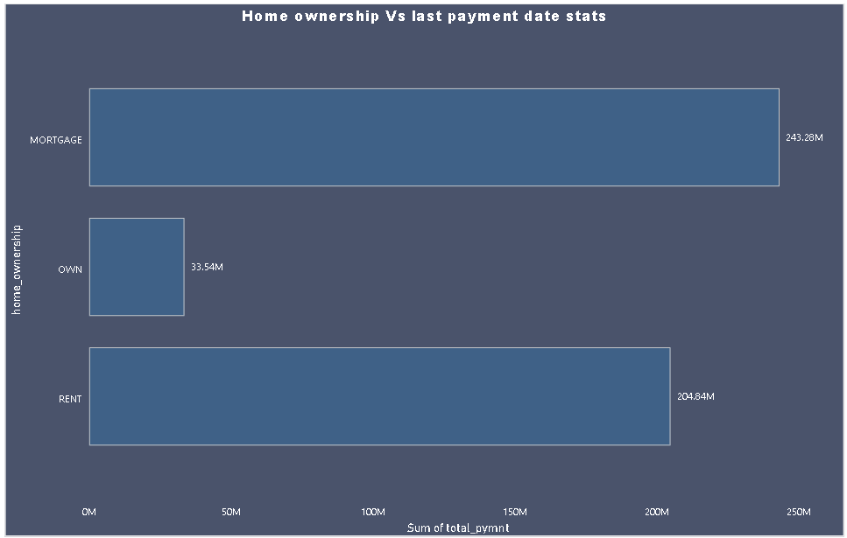
Home ownership Vs last payment date stats
It explores payment patterns based on home ownership status and last payment dates.
As per the analysis mortgage has highest loan count.
Analyze payment behavior by home ownership to communicate, assess risk accurately, offer financial education, and customize products. Develop strategies for customer retention.
Collaborate with real estate agents, property managers, or landlords to establish referral programs. This can help reach potential customers within the real estate industry.

Slide 12
Challenges
True challenge was to assemble our classroom knowledge and to put it into this real-world situation.
Different opinions and priorities to be gathered as a team for each tasks.
Compiling and selecting the best outcomes for presentations.

Slide 13
Conclusion
On the basis of various techniques applied for the financial analysis of Bank loan we can arrive to the conclusion that the financial position and overall performance of bank is satisfactory and loan amount and the customers of bank has increased over the period of time and bank has maintaining the profitability position.
This analysis will provide valuable information to a wide range of stakeholders, from banks and borrowers to investors, regulators, credit rating agencies, economists, and consumers.

Slide 14
Thank You

