Slide 1
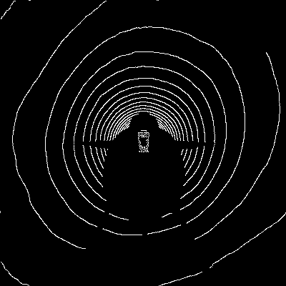
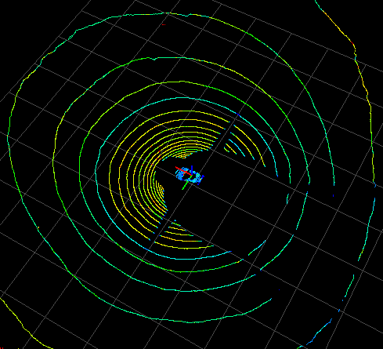
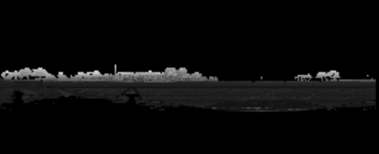
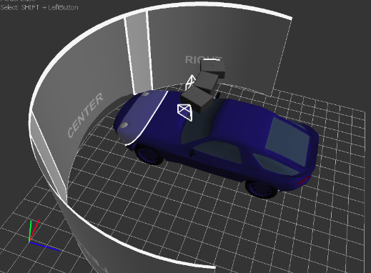
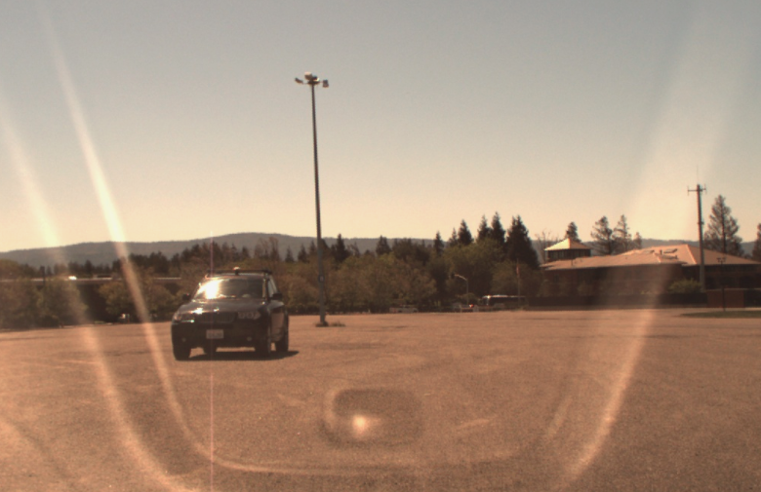
Our solution based on paper[1].
[1] "Multi-View 3D Object Detection Network for Autonomous Driving" - Xiaozhi Chen, Huimin Ma, Ji Wan, Bo Li and Tian Xia , arXiv 2016
[ The ideal case ... ]
end-to-end
deep learning training
top view projection
surround view projection
predicted 3d box of obstacle
lidar + radar in 3d pointcloud space
surround view projection is the full 360 degree cylindrical projection with Velodyne LiDAR at the center
camera image

Slide 2
[ Starter Kit ]
end-to-end deep learning training
top view projection
predicted 3d box of obstacle
surround view projection
lidar in 3d pointcloud space
Because I have problems with time synchronisation and sensor calibration, I provided the starter kit for a simpiifed solution first. You can easily extend it include camera and radar senor data later.

Slide 3
[ step.1 : extracting data from rosbag ]
I want to do offline processing, hence i will save the images to png files and lidar point clouds to numpy npy files. Then I will create the lidar projection images and save as npy files. For the ground truth, I "manually annonated" one train bag to test my systems. I use the train bag from release-2 "1/15.bag'
1. extract lidar data from rosbag.
- my ros environemt: ubuntu 16.04, python 2.7, ros kinetic
reference: https://discussions.udacity.com/t/installing-velodyne-drivers-on-ubuntu-16-04-lts-and-ros-kinetic/240211
a. Install ROS Kinetic (see ros website)
b. Install Velodyne drivers
c. Install RViz viewer
https://github.com/omgteam/Didi-competition-solution
d. Download my python script to dump lidar data into python numpy npy files (saved as structured array)
https://github.com/hengck23/didi-udacity-2017/blob/master/baseline-04/didi_data/ros_scripts/run_dump_lidar.py

Slide 4
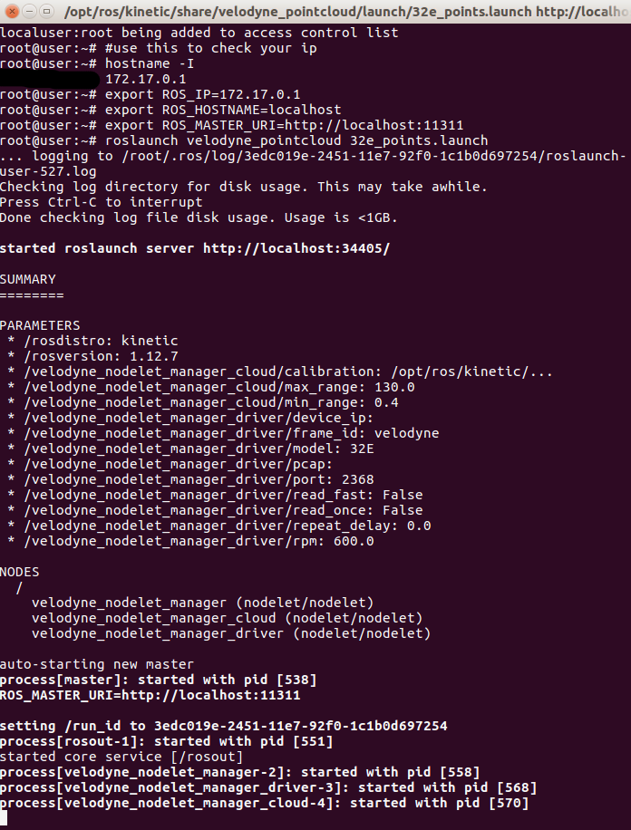
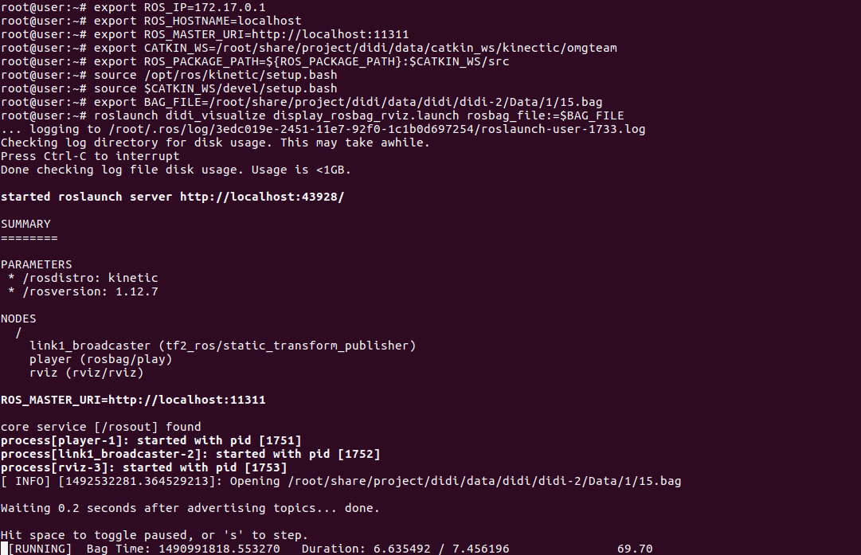
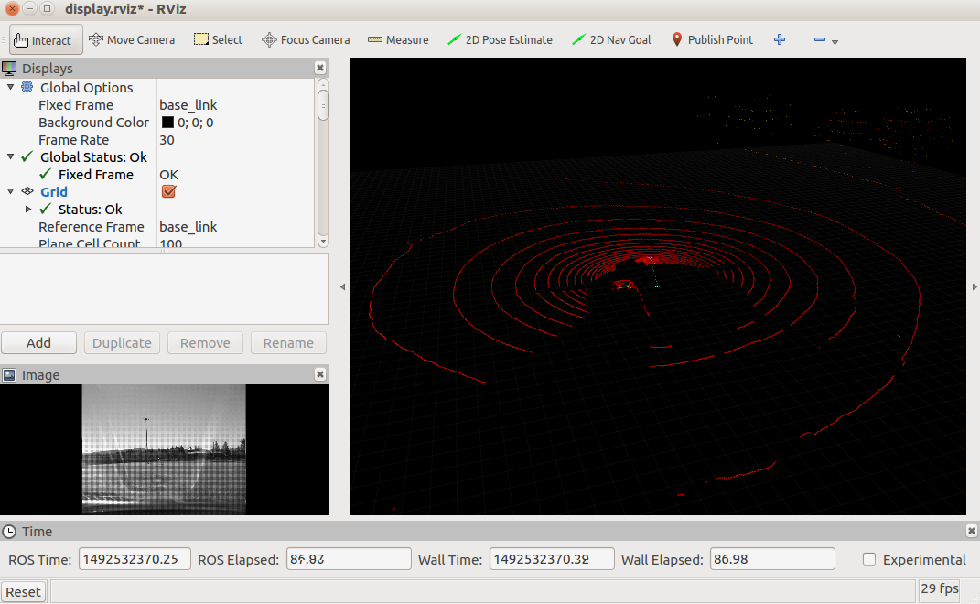
e. Start the following commands in different terminals
terminal1: roslaunch velodyne_pointcloud 32e_points.launch
terminal2: roslaunch didi_visualize display_rosbag_rviz.launch rosbag_file:=$BAG_FILE
terminal3: python run_dump_lidar.py
terminal2
terminal1
RViz viewer is lanuched

Slide 5
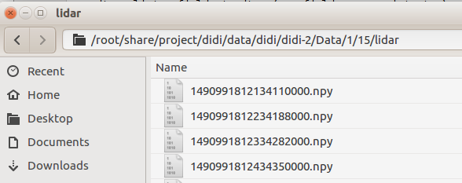
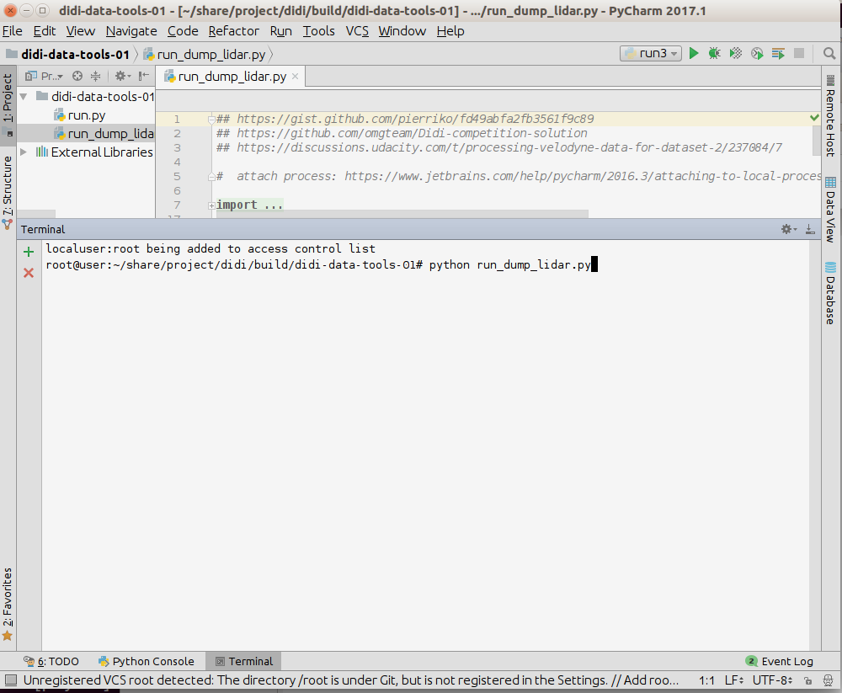
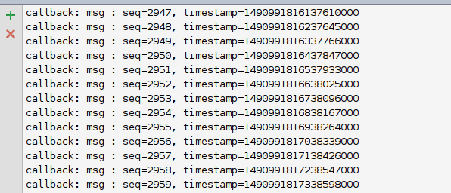
terminal3
you should see it start dumping and saves the lidar pointcloud in npy
To debug code, i) lauch script using external python (becuase pycharm don't read .bashrc is is required
to setup env for ROS) ii) use pycharm 'attach to local process' for debug and stepping through breakpoints

Slide 6
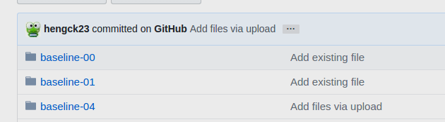
[ step.2 : converting lidar dumy to projection files]
- my tensorflow renvironment: ubuntu 16.04, python 3.6, tf release 1.0
top view projection
surround view projection
lidar in 3d pointcloud space
- software version: baseline-04

Slide 7
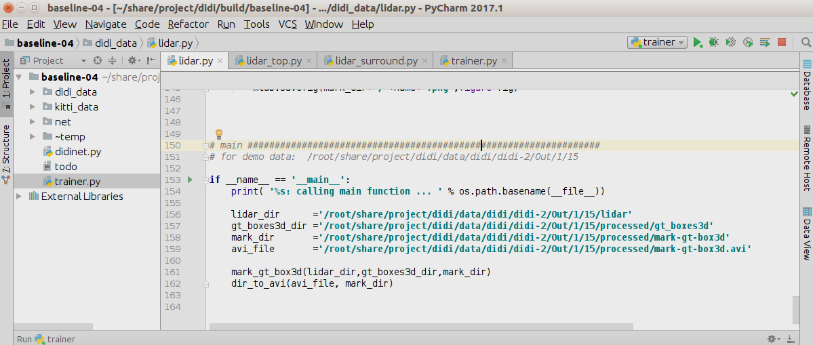
use this to check dump lidar file

Slide 8
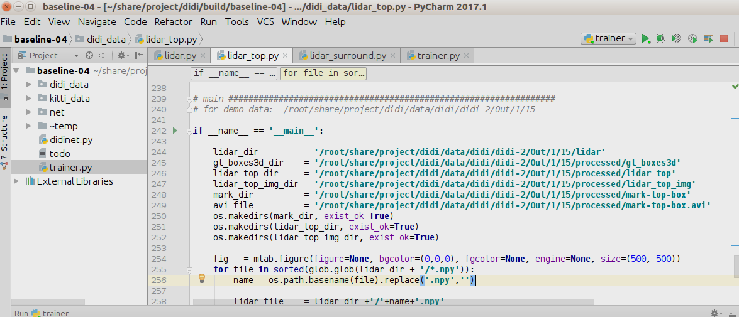
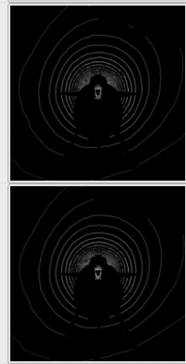
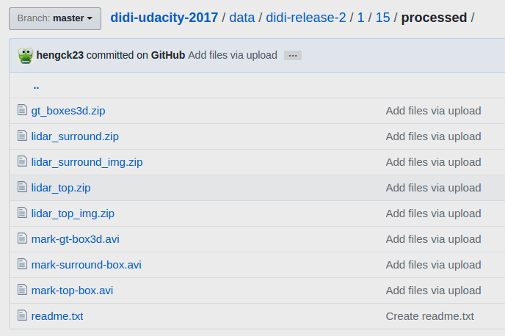
use this to make top view image
my results are found here

Slide 9
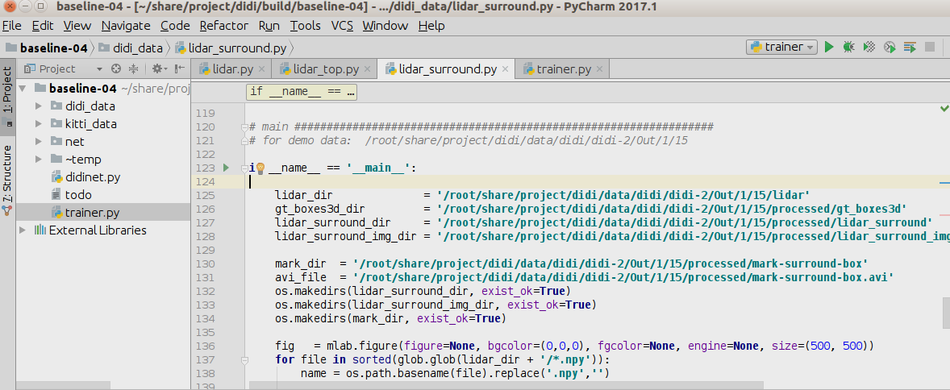
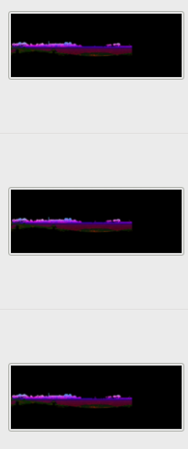
use this to make surround view image

Slide 10
[ step.3 : train a simple CNN ]
project_to_roi3d
3d roi
project_to_surround_roi
surround roi
top roi
fusion_net
roi pooling
top_feature_net
rpn
concate
rcnn classifier
top view projection
surround_feature_net
roi pooling
surround view projection

Slide 11
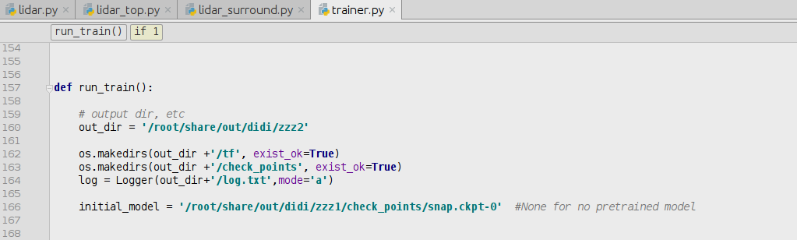
use this to train

Slide 12
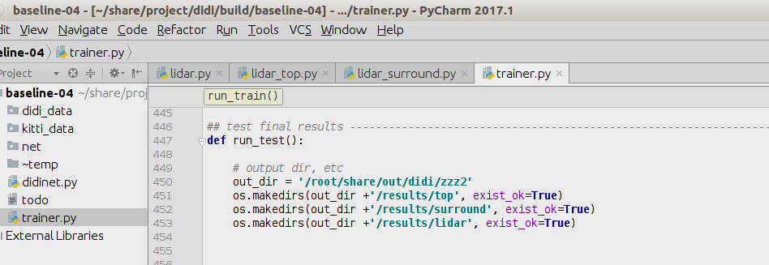
use this to test

Slide 13
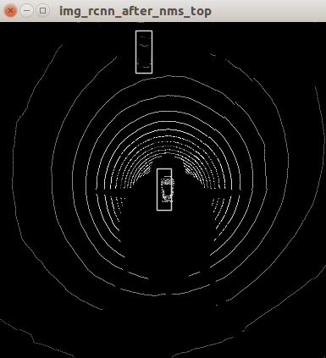
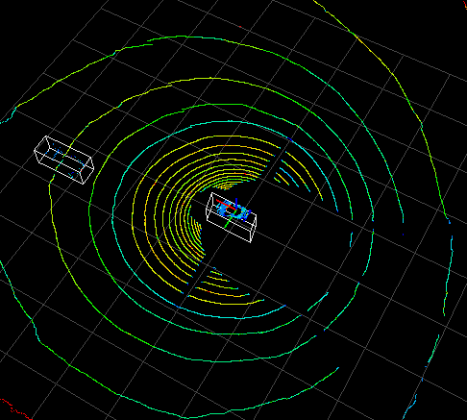
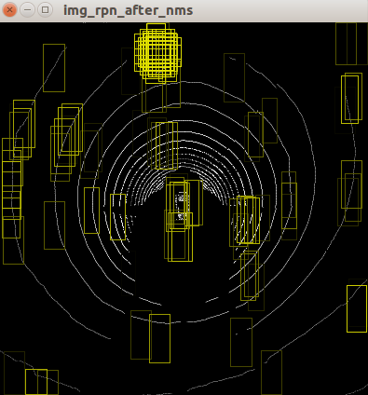
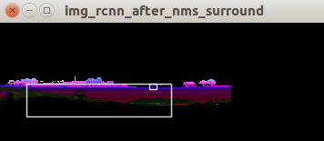
expected results
B
proposals
B
A
lidar view
A
B

