Slide 1
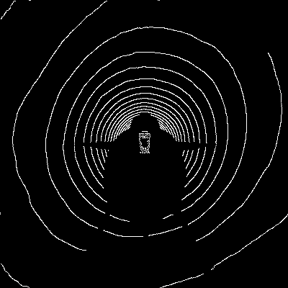
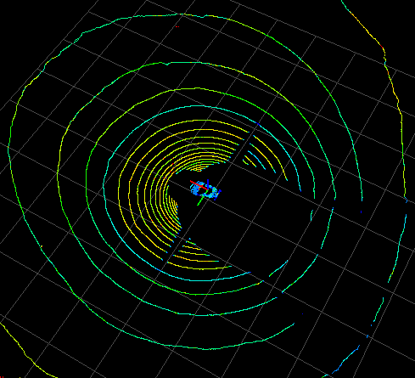
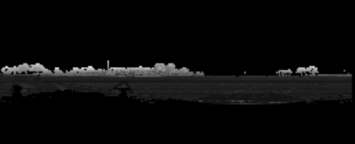
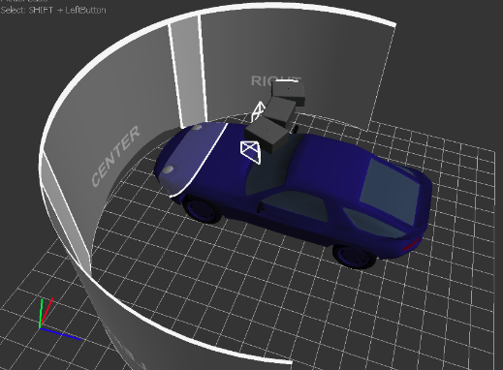
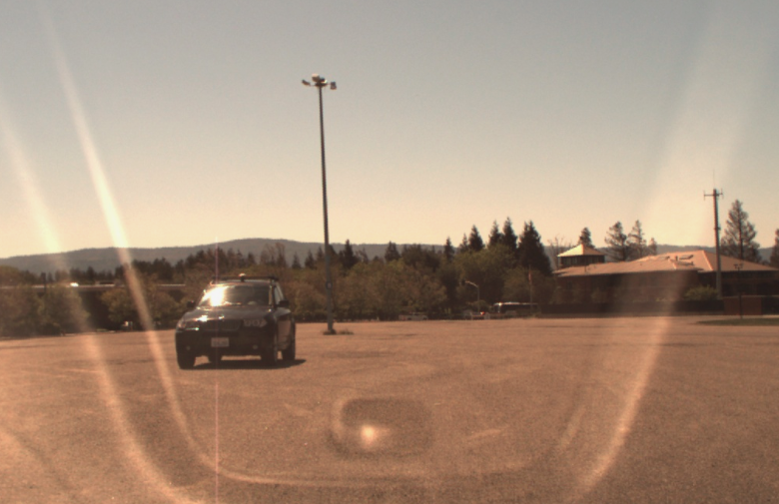
Our solution based on paper[1].
[1] "Multi-View 3D Object Detection Network for Autonomous Driving" - Xiaozhi Chen, Huimin Ma, Ji Wan, Bo Li and Tian Xia , arXiv 2016
[ The ideal case ... ]
end-to-end
deep learning training
top view projection
surround view projection
predicted 3d box of obstacle
lidar + radar in 3d pointcloud space
surround view projection is the full 360 degree cylindrical projection with Velodyne LiDAR at the center
camera image

Slide 2
[ Starter Kit ]
end-to-end deep learning training
top view projection
predicted 3d box of obstacle
surround view projection
lidar in 3d pointcloud space
Because I have problems with time synchronisation and sensor calibration, I provided the starter kit for a simpiifed solution first. You can easily extend it include camera and radar senor data later.

Slide 3
[ step.1 : extracting data from rosbag ]
I want to do offline processing, hence i will save the images to png files and lidar point clouds to numpy npy files. Then I will create the lidar projection images and save as npy files. For the ground truth, I "manually annonated" one train bag to test my systems. I use the train bag from release-2 "1/15.bag'
1. extract lidar data from rosbag.
- my ros environemt: ubuntu 16.04, python 2.7, ros kinetic
reference: https://discussions.udacity.com/t/installing-velodyne-drivers-on-ubuntu-16-04-lts-and-ros-kinetic/240211
a. Install ROS Kinetic (see ros website)
b. Install Velodyne drivers
c. Install RViz viewer
https://github.com/omgteam/Didi-competition-solution
d. Download my python script to dump lidar data into python numpy npy files (saved as structured array)
https://github.com/hengck23/didi-udacity-2017/blob/master/baseline-04/didi_data/ros_scripts/run_dump_lidar.py

Slide 4
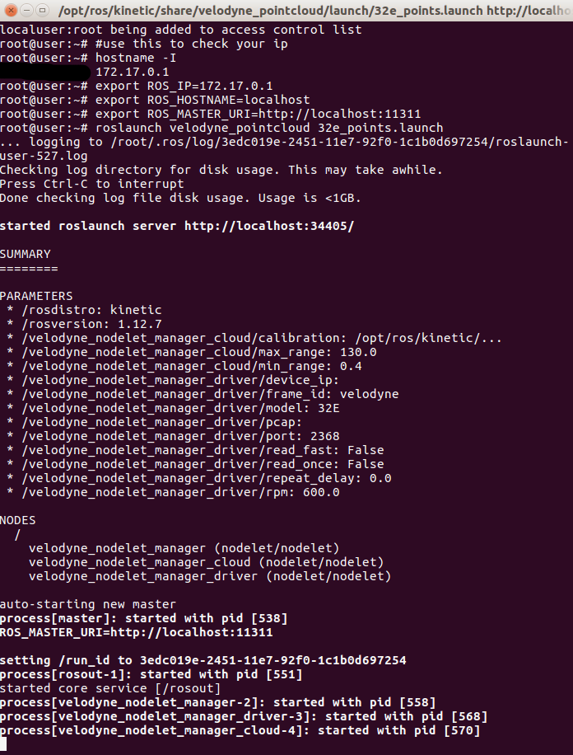
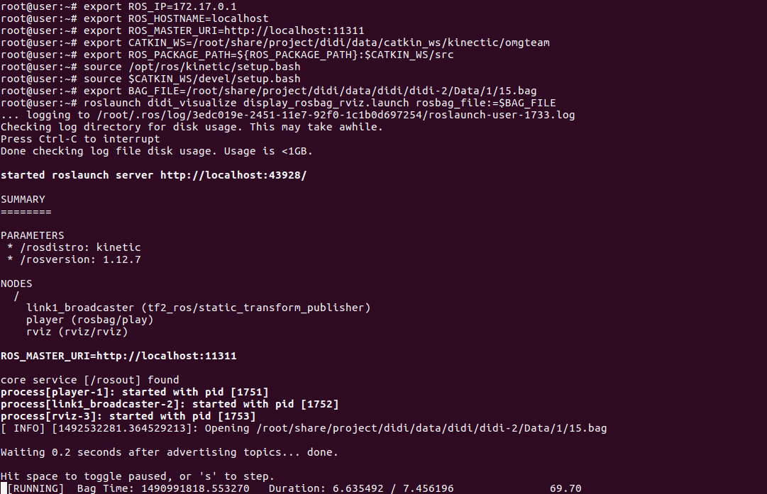
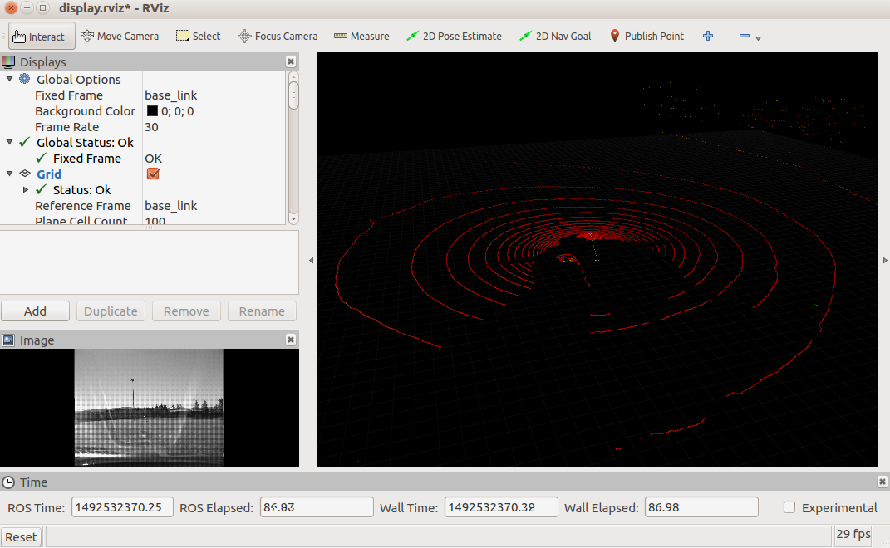
e. Start the following commands in different terminals
terminal1: roslaunch velodyne_pointcloud 32e_points.launch
terminal2: roslaunch didi_visualize display_rosbag_rviz.launch rosbag_file:=$BAG_FILE
terminal3: python run_dump_lidar.py
terminal2
terminal1
RViz viewer is lanuched

Slide 5
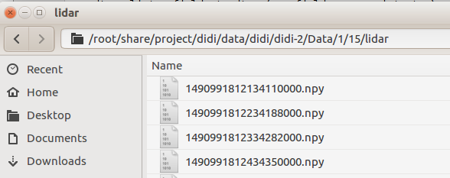
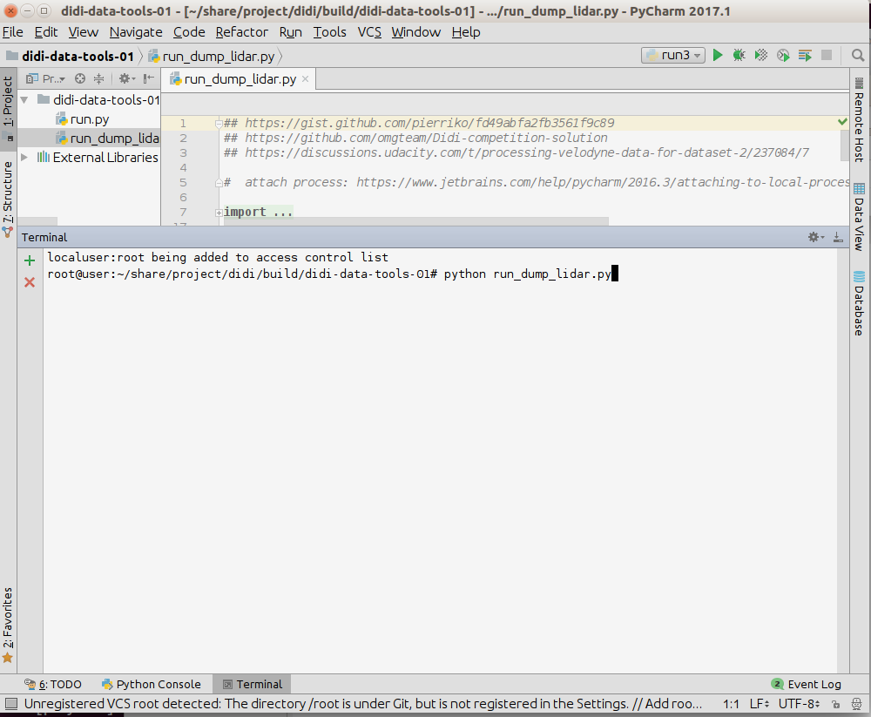
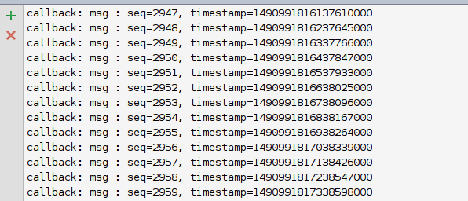
terminal3
you should see it start dumping and saves the lidar pointcloud in npy

Slide 6
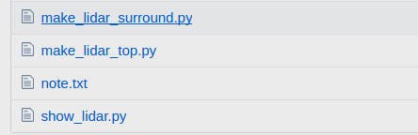
[ step.2 : converting lidar dumy to projection files]
- my tensorflow renvironment: ubuntu 16.04, python 3.6, tf release 1.0
top view projection
surround view projection
lidar in 3d pointcloud space
[to be updated!]
i will explain this tomorrow, you you can take a look at
https://github.com/hengck23/didi-udacity-2017/tree/master/baseline-04/didi_data

