Slide 1

Web Development with Python
Presents

Slide 2
Web Development
It is the work involved in developing a Web site for the Internet or an intranet.
Internet = available for all people
Intranet = restricted to a set of people. How? When you connect to internet of that particular area it opens.
Eg: IIITK Wifi - can’t open now.
IIITK Website - Opens now. LMS Moodle
(Intranet = use to give faculty feedback, Internet = Online classes)

Slide 3
Content in a website
Static = Content is fixed; No changes
Dynamic = Content changes with an event/activity.
Eg: Flipkart. Once you login, items displayed for you to browse changes.
Most of the sites present in internet are dynamic.
How you achieve dynamic content? User Recommendations : How to do this?
Amazon - Prime Recommendation : use case

Slide 4
Frontend and Backend
Frontend = User Interface. (HTML, CSS, JS)
Backend = Brain of your website where all processing happen.
Human Body = frontend, Internal Organs functions to perform = backend
Front end related activities: User Interface, Displaying Dynamic Content, Perform simple activities (display loading button, display ads and offer)
Backend related activities: Data Processing, Connecting to Database(collection of interrelated data).

Slide 5
Request and Response
2 things. Request and Response
Request = ask for some service, Response = service the request
Eg: I asked my friend laptop for attending today’s TCA = request.
My friend provided his laptop for me = response.

Slide 6
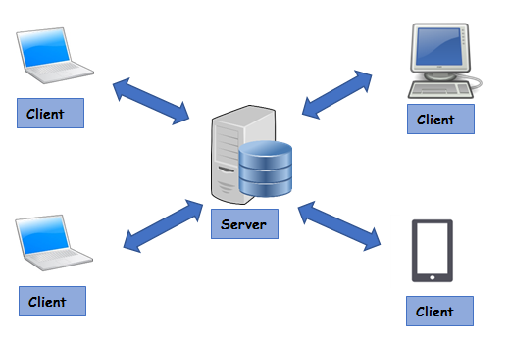
Client Server Architecture
Client and server are computers.
Client computer request service to server
and server provides service as response.
Eg: LMS IIITK Server and My Computer
Protocol = set of rules that establishes communication
Websites uses HTTP protocol. How we know that?
http://www.google.com (or) http://www.lmsiiitkottayam.ac.in
Http = Hyper Text Transfer Protocol ; HTTP is the foundation of data communication for the World Wide Web,

Slide 7
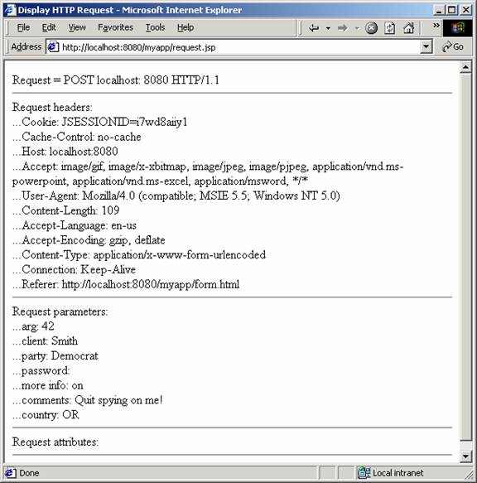
What happens when i type lms.iiitkottayam.ac.in
NIC = Network Interface card; (like a chip in motherboard)
allows to connect to your network
MAC Address = your NIC Card unique number
It sends the request to lms server. What does that file contain ?
Who sends this request : Your Browser

Slide 8
At lms server
Identifies request. Came from this MAC address. MAC Stands for media access control.
Sends the html file as response.
Browser displays that file.
What if request fails? Error codes will be displayed
Important codes:
Successful responses (200–299)
Redirects (300–399)
Client errors (400–499)
Server errors (500–599)
HTTP response status codes - HTTP | MDN (mozilla.org)

Slide 9
Ah Fine!! Enough of theory Now.
I need to implement all these things. Where and what to start?
Underlying Tools.
HTML = To create Web pages.
CSS = style your web page
JavaScript / Python = To create such server architecture, maintain server.

Slide 10
Web Hosting
Web Hosting means making your website live.
Cool? What does live mean. Making it available to access from internet
Interesting? How to do that.
Buy your own server. Deploy code and make it available.
Cloud Hosting. Godaddy, wix.

Slide 11
TechStacks
Django, CGI (Common Gateway Interface), Flask = Python Based
ReactJS, AngularJS, VueJS = Frontend JavaScript
NodeJS,ExpressJS, HapiJS = Backend JavaScript
Do i need to code both frontend and backend? Yes, if you build it on your own.
Wordpress, Wix, GoDaddy ? Domain name???

Slide 12
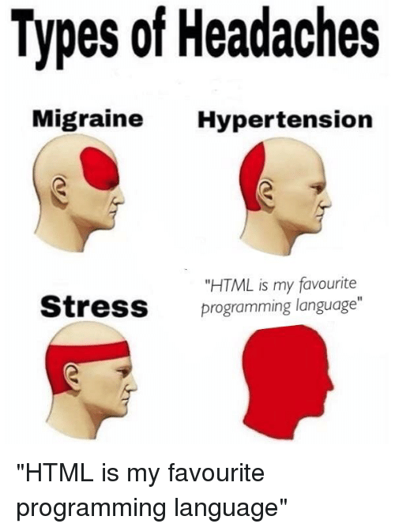
HTML
Not a programming language
Markup Language.
Annotate text and embed tags in accurately styled
electronic documents irrespective of computer platform,
operating system, application or program.
Tags; <html></html>

Slide 13
Hands on HTML
VSCode is my favourite editor.
Reason? Autofill my HTML tags.
Let’s get started

