Slide 1

DSSS-QPSK Signal Generation
By,
Arjun v Srivatsa
Raghavendra m sastekar
T Chethan
Ujwal Naik

Slide 2
INTRODUCTION
Digital Communication has led our world towards modern evolution. There are much of research going on in this field, for improvements and one such major milestone was invention of direct-sequence spread spectrum technique.
Direct-sequence spread spectrum technique primarily used to reduce overall signal interference. The direct-sequence modulation makes the transmitted signal wider in bandwidth than the information bandwidth. After the dispreading or removal of the direct sequence modulation in the receiver, the information bandwidth is restored, while the unintentional and intentional interference is substantially reduced.
• In some communication system applications, we have some concerns that outweigh bandwidth efficiency.
• Mostly in wireless applications, stations must be able to share this medium without interception by an eavesdropper and without being subject to jamming from a malicious intruder to achieve these goals. Spread spectrum techniques add redundancy.
• The usage of spread spectrum techniques adds a strong layer of security for the transmission of information signals without the worry of them getting intercepted in between. This results in a much greater bandwidth than the signal would have if its frequency were not varied.
• One such technique provides efficient transmission over large distances by varying the sequence of the information signal pattern.

Slide 3
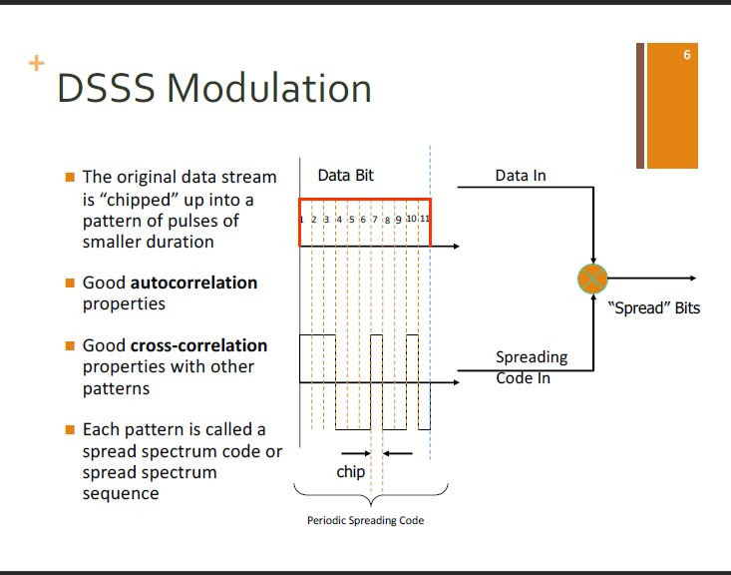
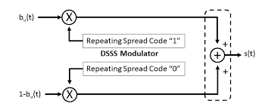
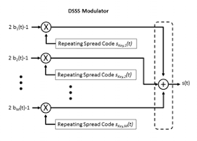
BLOCK DIAGRAM

Slide 4
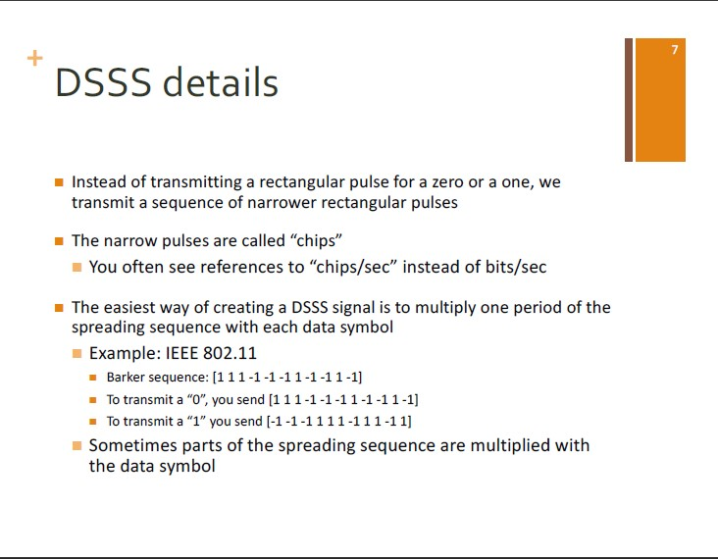
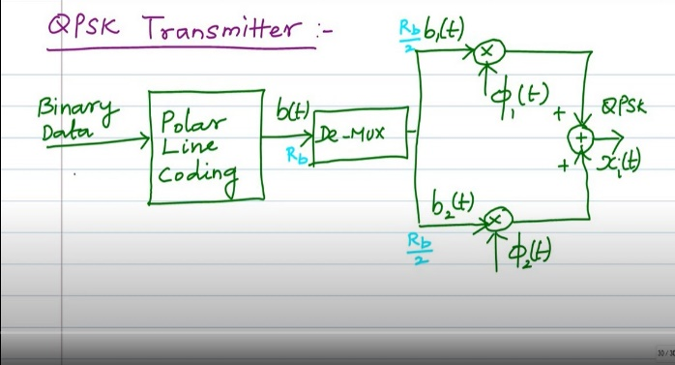

Slide 5
WORKING
The pseudo-noise signal is generated and is polar mapped to generate a sequence. The information carrying sequence is modulated according to PN sequence by multiplying the sequences where the resulting DSSS baseband signal is a combination of the PN sequence in one-time frame and a phase-shifted PN sequence in the next time frame.
This resulting baseband signal is fed into QPSK modulator as input and is demultiplexed into even and odd sequences. These sequences are modulated with the carriers considered where NRZ line coded even sequence is modulated with cosine carrier and NRZ line code odd sequence signal is modulated with sine carrier.
These modulated sequences are fed into a summer and the resulting signal is termed as DSSS-QPSK signal.

Slide 6
ADVANTAGES
This system has a very high degree of discrimination against the multipath signals. Therefore, the interference caused by the multipath reception is minimized successfully.
• The performance of DSSS system in presence of noise is superior to other system such as FHSS system.
• This system combats the intentional interference (jamming) most effectively.
• Sharing of a single channel among multiple users
• Determination of relative timing between transmitter and receiver.
• Since the usage of QPSK modulation increases the efficiency of signal transmission, it is immune to all kinds of interference and jamming and can be only accessed by the receiver.

Slide 7
DISADVANTAGES
• With the serial search system, the acquisition time is too large. This makes the DSSS system slow.
• The channel bandwidth required, is very large. But this bandwidth is less than that of a FHSS system.
• The synchronization is affected by the variable distance between the transmitter and receiver.

Slide 8
APPLICATIONS
• The United States GPS, European Galileo and Russian GLONASS satellite navigation systems; earlier GLONASS used DSSS with a single spreading sequence in conjunction with FDMA, while later GLONASS used DSSS to achieve CDMA with multiple spreading sequences.
• DS-CDMA (Direct-Sequence Code Division Multiple Access) is a multiple access scheme based on DSSS, by spreading the signals from/to different users with different codes. It is the most widely used type of CDMA.
• Cordless phones operating in the 900 MHz, 2.4 GHz and 5.8 GHz bands
• IEEE 802.11b 2.4 GHz Wi-Fi, and its predecessor 802.11-1999. (Their successor 802.11g uses both OFDM and DSSS)
• Used in Automatic meter reading.
• IEEE 802.15.4 (used, e.g., as PHY and MAC layer for ZigBee, or, as the physical layer for Wireless HART)
• Radio-controlled model Automotive vehicles

