Slide 1
DETECTION OF LUNG CANCER USING DEEP CONVOLUTION NEURAL NETWORKS.
Under the guidance of
SHASHIDHAR R
Assistant Professor
Submitted By:
ARJUN V SRIVATSA -01JST18EC012
SHREYAS K MAHESH -01JST18EC088
THANMAY M -01JST18EC102

Slide 2
Introduction
Lung cancer is one of the dangerous cancer in the world, with the share of 25% of all cancer related deaths.
There are 5 stages in this cancer, and majority of the possible cancer related symptoms will be visible in the last stage. Basically, this type of cancer could be detected with the help of X-Rays, which are low cost and reliable, also CT, MRI, PET scans. But there would be some issues like Privacy of the patient etc. For real scanning using these scans.
The concept of Convolution Neural Networks, a technique of deep learning, is the recent concept in the emerging image processing technology.
The project involves training CNN model to analyse the obtained dataset, of the patient and provide more accurate result from the dataset.
The identification of the diseases in the CT images were employed based on the classification of the images using classification algorithms. Rule-based classifiers were employed which identifies the defects by grouping the pixels that were having similar results for rules used into a group.
In medical images the statistical parameters and the intensity-based features were also needed to get the best features from the images. The noise that affects the features of CT images, the widespread use of CT image imaging requires the need for developing filter for decreasing noise.

Slide 3
LITERATURE SURVEY
Name of the Article | Year of Publishing | Methodology | Accuracy
[1] Lung Nodule Detection based on Faster R-CNN Framework . | 2021 | It is used to detect the lung nodules and the training set is used to prove the feasibility of this technique. Has a good accuracy, further assists radiologists in design and development of detection of cancerous cells in lung nodules. | High Accuracy 90%
[2] Lung Cancer Detection Using CT Image Based on 3D Convolutional Neural Network | 2020 | In this research, they investigated that 3D CNN to detect early lung cancer using LUNA 16 dataset. The pre-processed raw image is obtained using thresholding technique. Then Vanilla 3D CNN classifier to determine whether the image is cancerous or non-cancerous. The experimental results show that the proposed method can achieve a detection accuracy of about 80% and it is a satisfactory performance compared to the existing technique. | 80%

Slide 4
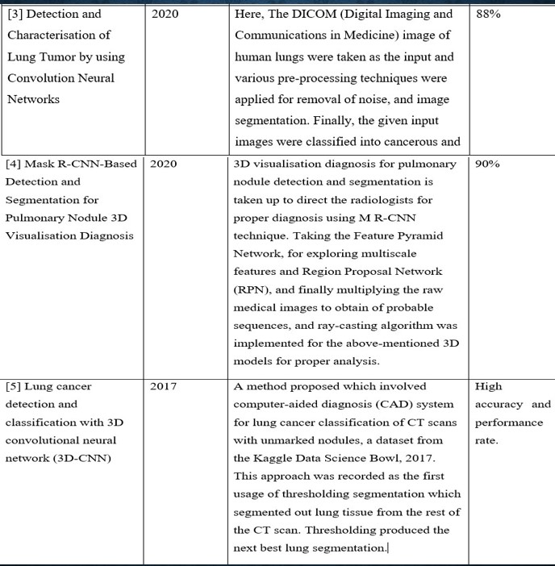

Slide 5
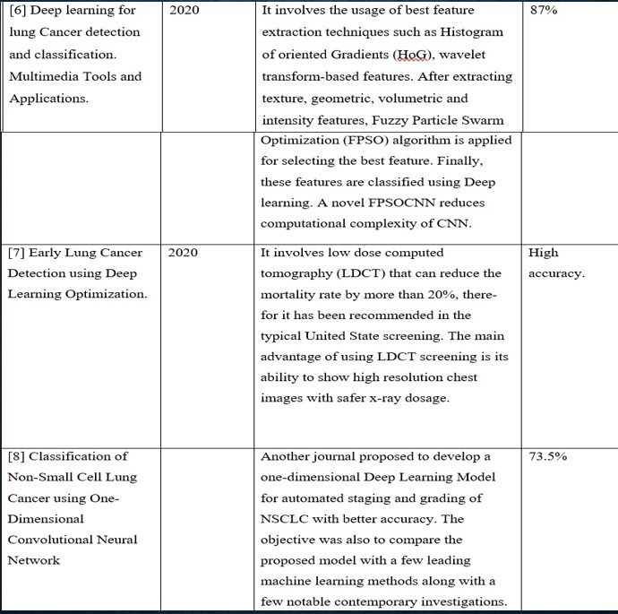

Slide 6
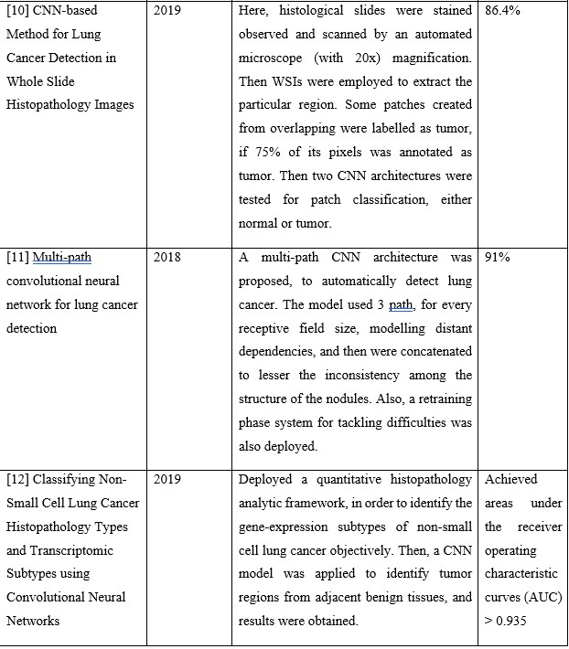

Slide 7
OBJECTIVES
To help the early detection of different stages of lung cancer by using different advanced technologies of digital image processing.
To determine on how the early detection of cancer will significantly reduce the mortality rate by providing appropriate treatment plans for different stages of tumour growth.
To analyse the usage of convolution neural networks and image processing techniques which result in parametric optimization for lung cancer recognition from CT images.
To effectively train the model using test and train datasets to produce more accuracy in obtaining the results.
To make sure that the output data obtained from the fully-trained model will further be reciprocated as valuable resource for the research and development purpose.
To make a significant contribution to the world of medical field and to the cancer research studies.

Slide 8
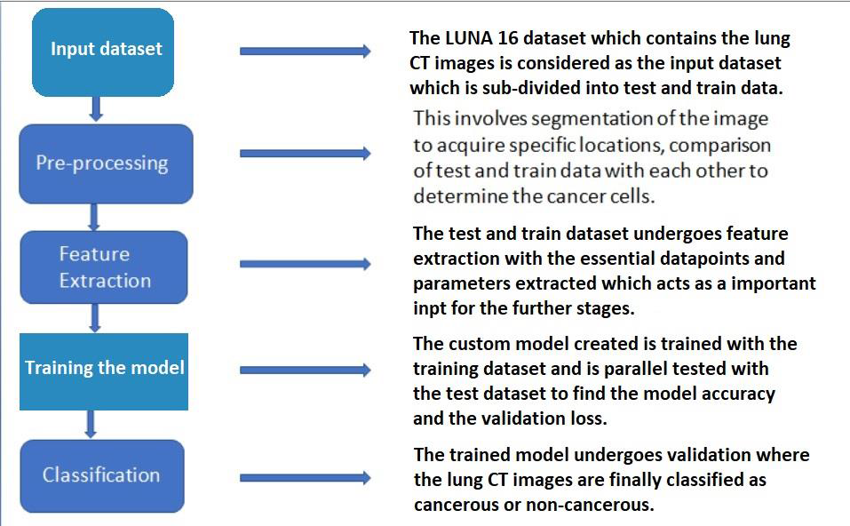
METHODOLOGY
Figure 1. The block diagram for the proposed system

Slide 9
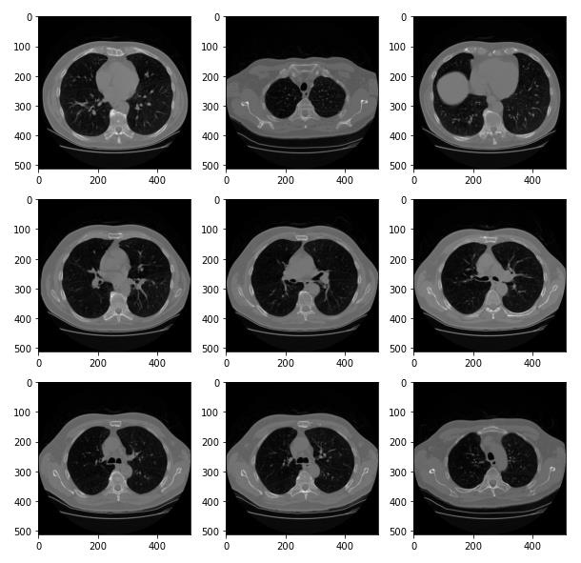
Figure 2: The original dicom slices from Luna16 dataset

Slide 10
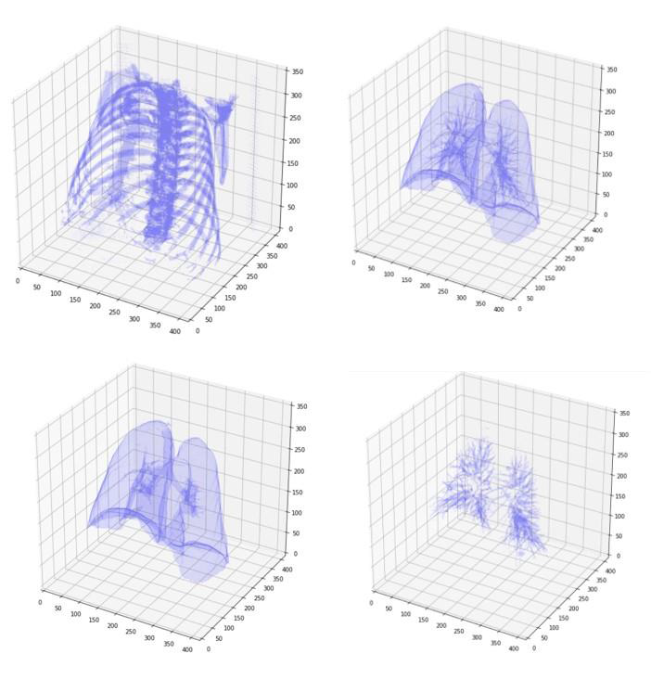
Figure 3: Visualization of three-dimensional image representation for (a) rib cage (b) lung segments with lung nodules (c) outer lung segment (d) lung nodules.

Slide 11
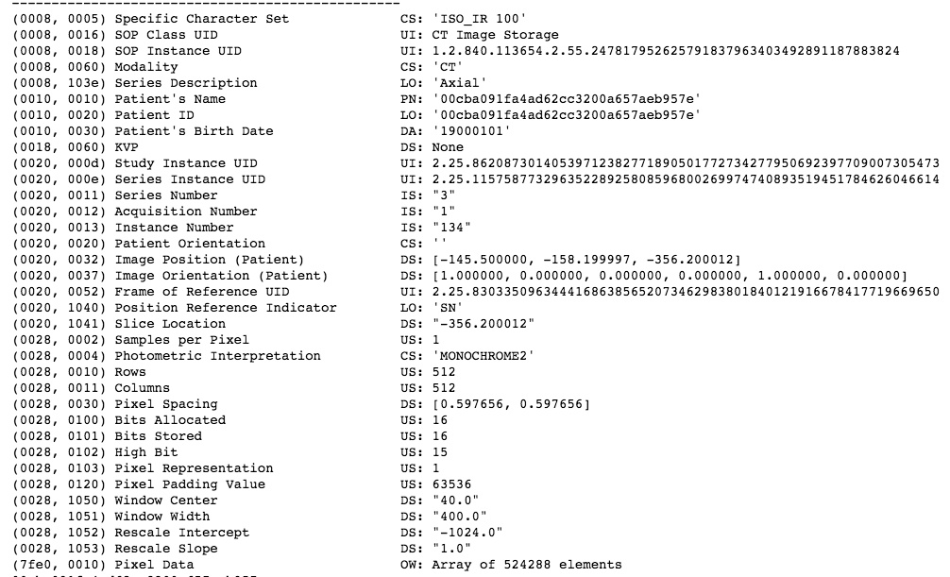
Figure 4: Metadata information in a single dicom slice.

Slide 12
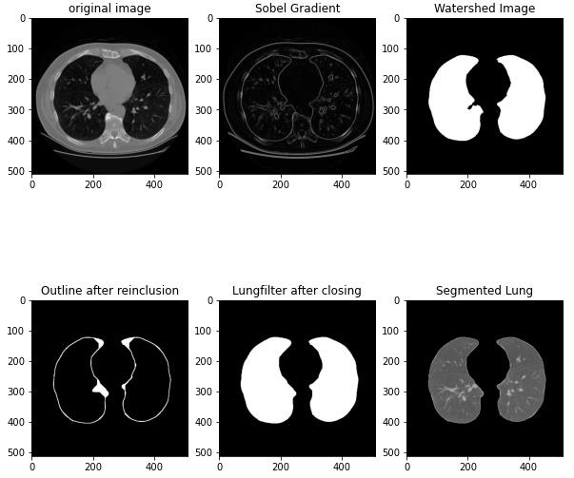
Watershed Algorithm
Figure 5: Image segmentation process visualization.

Slide 13
Feature Extraction & Classification
Logistic Regression.
Decision Tree Algorithm .
Random Forest Classifier .
Support Vector Machine (Linear) .
Support Vector Machine (Radial Basis Function [RBF]) .
Naive Bayes Algorithm .
K-Nearest Neighbours Classifier.

Slide 14
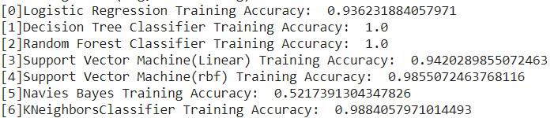
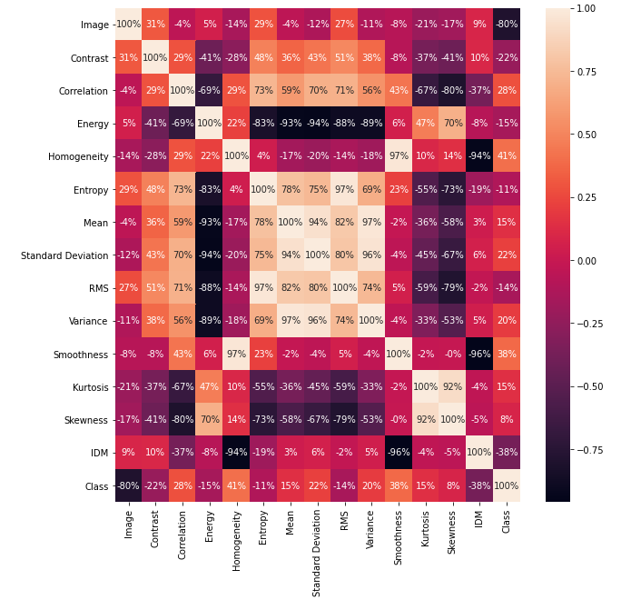
Figure 6: Classification accuracy of different models.
Figure 7: The feature extraction graph for different models.

Slide 15
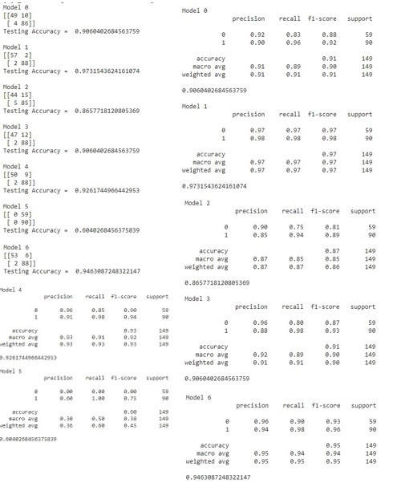
Figure 8: The confusion matrix and the details for all the training models.

Slide 16
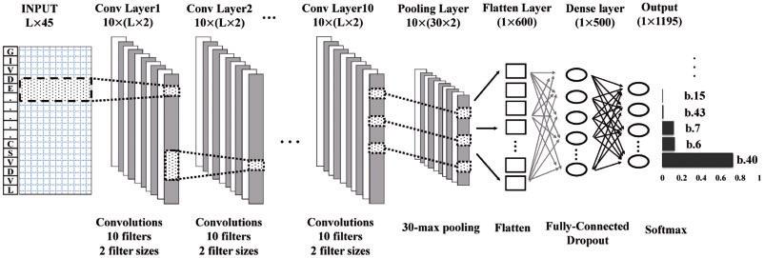
Deep Convolutional Neural Network
Figure 9: Deep CNN network architecture.

Slide 17
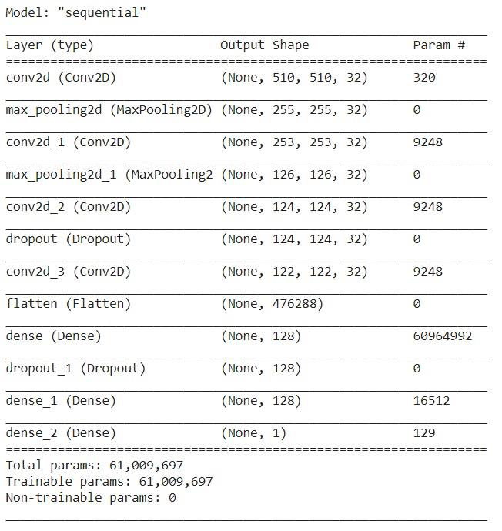
Proposed System Architecture
Case 1:
Figure 10: Model summary for sequential.

Slide 18
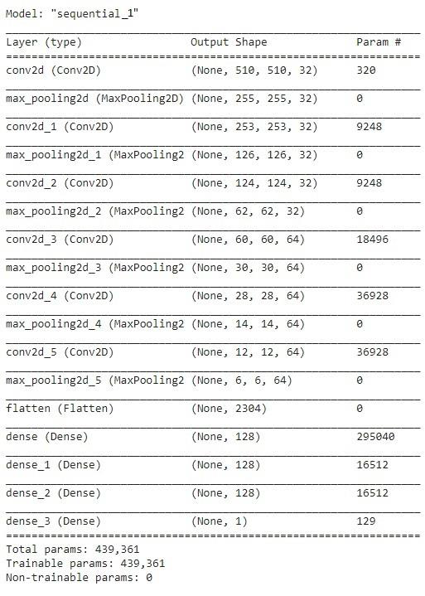
Case 2:
Figure 11: Model summary of sequential_1.

Slide 19
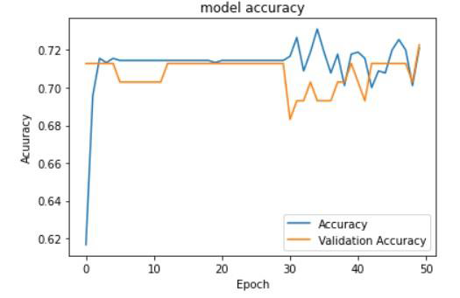
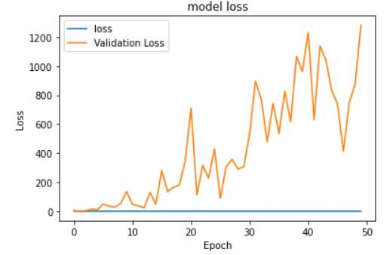
RESULT AND DISCUSSION
Model: sequential
Figure 12: Training and Validation accuracy of model sequential.
Figure 13: Training and Validation loss of model sequential.

Slide 20
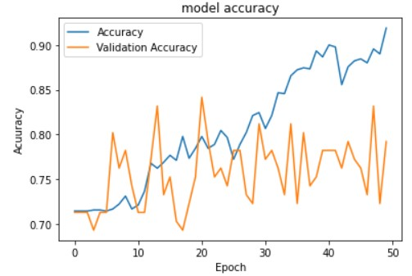
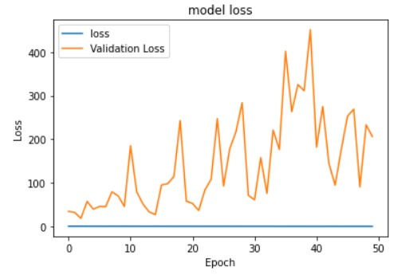
Model: sequential_1
Figure 14: Training and Validation Accuracy of model sequential_1.
Figure 15: Training and Validation loss of model sequential_1

Slide 21
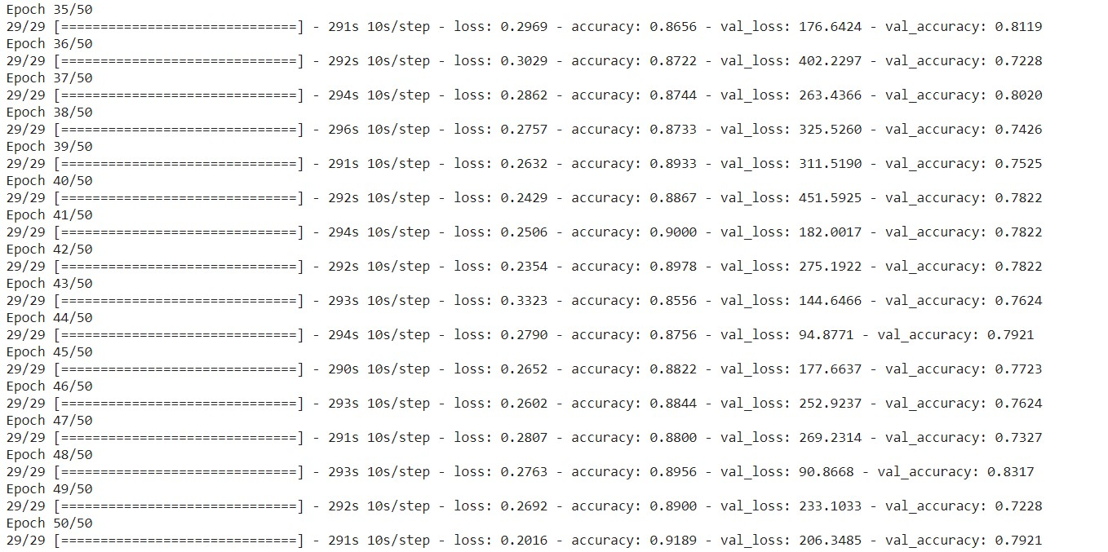
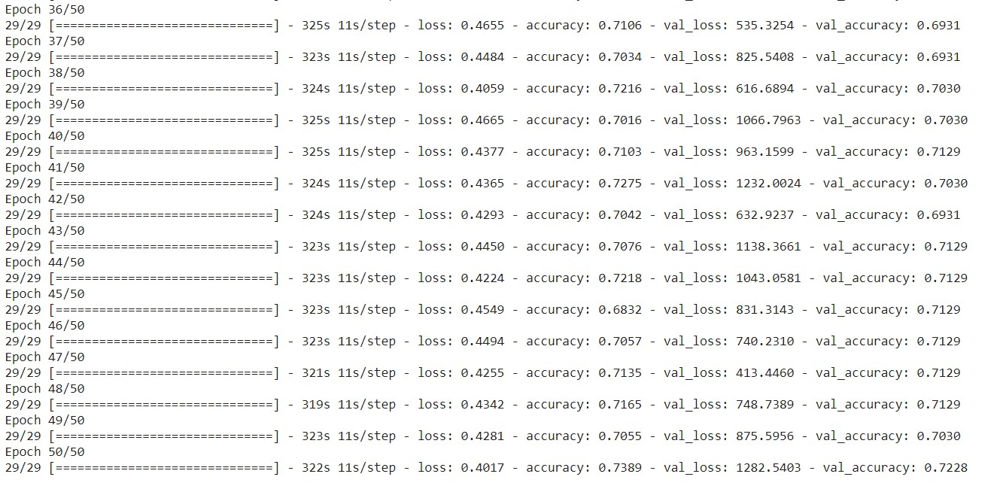
Figure 16: The sequential_1 model training with the epochs.
Figure 17: The sequential model training with the epochs.

Slide 22
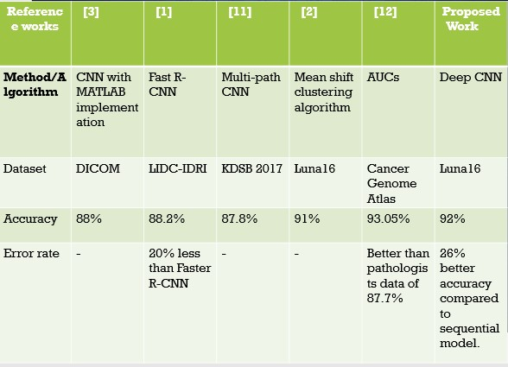
Comparison table
Table 1. Tabular comparison of proposed model with previous models

Slide 23
Conclusion and Future Scope
The deep CNN model considered to be the best approach among the models considered improves the accuracy of the model. The watershed algorithm is applied for the pre-processing of the dataset and image segmentation process. The U-net architecture is used for batch normalization. These components are combined to get the trained model which determines the cancerous and non-cancerous images. The model achieved 92% accuracy which is formidable considering the dataset availability and the resource. This work is compared with the existing works and a conclusion was drawn out.
The training period specified for each of the considered model varies as the dataset considered here does not fit into the resource in which the training process takes place. But the first sequential model gets 29 steps_per_epoch and the second sequential_1 model also gets 29 steps but with the variation in training time. Both these models are trained for 50 epochs and the accuracy varies as well. There are around 7 other models with the input dataset considered to be feature extracted, to which there are confusion matrices generated as well.

Slide 24
Future scope
The training model considered can be further developed by adding some more convolutional layers as well as increasing the epochs. This increases the accuracy and the validation loss is reduced considerably.
Also, many other types of training models can be taken into consideration to make sure that the training gets more efficient.
The proposed work only determines the cancerous and non-cancerous images which can be further developed to generate the malignancy report and suggest the duration of chemotherapy required for each patient with their unique CT scans.

Slide 25
References
Ying Su, Dan Li, Xuedong Chen, “Lung Nodule Detection based on Faster R-CNN Framework”, Computer Methods and Programs in Biomedicine, Volume 200, Science Direct, March 2021.
K. Jalaldeen, M. Malathi, P. Sinthia, M. Vadivel, B.Maruthi Shankar, “An automatic identification of lung tumor by using CNN network and fuzzy-clustering algorithm” Science Direct, 2021.
M. Sangeetha, S. Mythili, “Detection and Characterisation of Lung Tumor by using Convolution Neural Networks”, RASCC 2020, IOP Publishing, 2020.
By Linquin Cai, Tao Long, Yuhan Dai, Yuting Huang, “Mask R-CNN-Based Detection and Segmentation for Pulmonary Nodule 3D Visualisation Diagnosis”, IEEE Access, January 2020.
W Alakwaa, M Nassef, A Badr , “Lung cancer detection and classification with 3D convolutional neural network (3D-CNN) ”, Lung Cancer, 2017 - 13.233.42.234.

Slide 26
Worku Jifara Sori, Jiang Feng, and Shaohui Liu, “Multi-path convolutional neural network for lung cancer detection”, Multidimensional Systems and Signal Processing -SpringerLink 2018.
Kun-Hsing Yu, Feiran Wang, Gerald J. Berry, Christopher Re, Russ B. Altman, Michael Snyder, Isaac S. Kohane, “Classifying Non-Small Cell Lung Cancer Histopathology Types and Transcriptomic Subtypes using Convolutional Neural Networks”, Journal of the American Medical Informatics Association. bioRxiv.org 2019 – DOI: 10.1101/530360.
Asuntha, A., & Srinivasan, A, “Deep learning for lung Cancer detection and classification. Multimedia Tools and Applications”, 2020.
Elnakib, A., M. Amer, H. & E.Z. Abou-Chadi, F, “Early Lung Cancer Detection using Deep Learning Optimization.”, International Association of Online Engineering, 2020.
Dipanjan Moitraa,*,Rakesh Kr. Mandalb, “Classification of Non-Small Cell Lung Cancer using One-Dimensional Convolutional Neural Network”, 2019.
T. Atsushi, T. Tetsuya, K. Yuka and F.Hiroshi, “Automated Classification of Lung Cancer Types from Cytological Images Using Deep Convolutional Neural Networks”. BioMed Research International. 2017. 1-6. 10.1155/2017/4067832

