Slide 1

2025
Christmas
A title for your presentation with a festive twist

Slide 2




Why we love Christmas ?
Christmas is one of the most magical and widely celebrated winter holidays. For many, it’s a season of hope and creating cherished memories.
Decorating the home and Christmas tree with garlands, lights, balls and ornaments is one of the most beloved traditions. Gift-giving is another cornerstone of the celebration. People exchange thoughtful presents, accompanied by heartfelt cards and warm wishes.
One of the most enchanting aspects of Christmas is the story of Santa Claus, who is said to bring gifts to children who have been good throughout the year. His sleigh, led by reindeer, is a delightful symbol of holiday magic.

Slide 3

The Recipe of Christmas Vibes
The Magic
5 %
The Decoration
10 %
Presents and good deeds
15 %
Warmest hugs
25 %
The Family
45 %

Slide 4


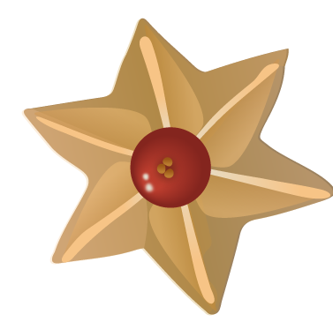
Traditions
West
East
In the UK, Christmas crackers with small surprises are opened during family dinners, adding fun to the celebration.
Scandinavian countries celebrate with warm, cozy gatherings called "hygge," and children eagerly await gifts from local Christmas figures like Father Christmas or Saint Nicholas.
In the United States, Christmas is marked by vibrant decorations, with lights illuminating houses. Families often hang stockings on the mantle for Santa to fill.
A unique tradition in Japan is eating KFC for Christmas dinner.
Chinese people have tradition to give apples wrapped in colorful paper, symbolizing peace, as the word for "apple" in Chinese sounds similar to "peace."
A traditional activity in Philippines is attending Simbang Gabi, a series of nine pre-dawn Masses leading up to Christmas Day.
A traditional Christmas treat in India is plum cake, often shared with friends and neighbors regardless of religion.

Slide 5

8 AM
Santa’s Journey Timeline
4 AM
Americas
On Christmas Eve, Santa embarks on a magical journey around the world, delivering presents to children in every corner of the globe. Guided by his trusty reindeer, he visits millions of homes, spreading joy and holiday cheer.
Africa
2 AM
Europe
12 PM
Asia
8 PM
Australia
6 AM
6 PM
North Pole
- Home Sweet Home.
See you next year!

Slide 6

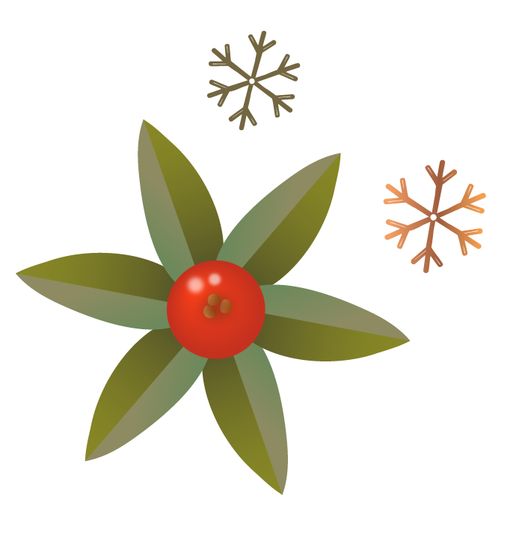

Merry Christmas!
Write here some interesting information about yourself, your up-to-date contact details, heartfelt wishes, warm thanks, or simply anything else that you genuinely want to share.

