Slide 1
Simulation of Anti-Lock Breaking System (ABS) in Simulink
Arjun. V. Srivatsa – 01JST18EC012
Shreyas. K. Mahesh – 01JST18EC088

Slide 2
INTRODUCTION
Human safety on the road not only requires a stringent car design but also involves sound braking being used, the ABS is an effective braking system technology as it saves the life due to sudden application of braking without slippage and it allows the driver to steer in heavy braking condition. ABS prevents locking of wheels during braking. During severe braking or on slippery surfaces, wheels approach lockup. At that time, ABS takes over. ABS modulates the brake line pressure independent of the pedal force, to bring the wheel speed back to the slip level range that is necessary for optimal braking performance.

Slide 3
MOTIVATION
Human safety on the road not only requires a stringent car design but also involves sound braking being used, the ABS is an effective braking system technology as it saves the life due to sudden application of braking without slippage and it allows the driver to steer in heavy braking condition. ABS prevents locking of wheels during braking. During severe braking or on slippery surfaces, wheels approach lockup. At that time, ABS takes over. ABS modulates the brake line pressure independent of the pedal force, to bring the wheel speed back to the slip level range that is necessary for optimal braking performance.

Slide 4
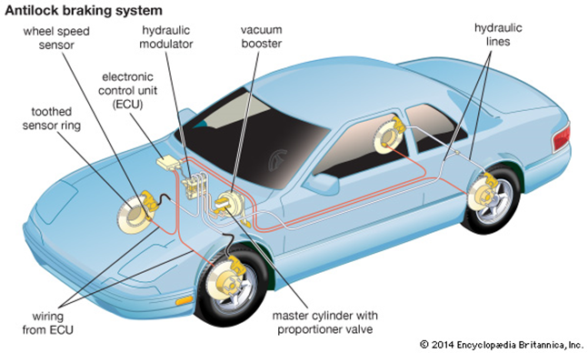
WORKING OF ANTI-LOCK BREAKING SYSTEM

Slide 5
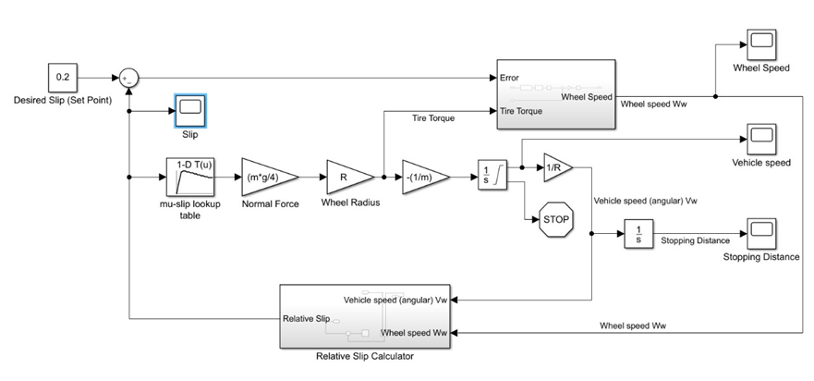

Slide 6
When a wheel lockup is detected or eminent, ECU commands HCU to release the brake pressure to allow the wheel velocity to increase and the wheel slip to decrease. Once the wheel velocity spins up, ECU re-applies the brake pressure to confine the wheel slip to a predetermined value or interval.
HCU Controls hydraulic brake pressure to each disc brake calliper or wheel cylinder based on input from the system sensors, thereby controlling wheel speed. It is assumed the exerted weight is distributed equally among all four wheels of the vehicle and all wheels bear equal amounts of vehicle braking force.
Moreover, it is also supposed that other factors for this quarter-vehicle model such as road roughness and other forces which are related are negligible. The vehicle speed depends on the rotation of wheels which rotate with initial angular speed (1) until the brakes are applied. Integrators are used for the calculation of vehicle speed and the angular speed of the wheel. Two speed calculators are used for calculating the slip (2) is used for the determination of slip. We have introduced the vehicle speed which shown as angular velocity.

Slide 7
In this model, we used an ideal anti-lock braking controller that uses 'bang-bang' control based upon the error between actual slip and desired slip. We set the desired slip to the value of slip at which the slip curve reaches a peak value, this being the optimum value for minimum braking distance.
To control the rate of change of brake pressure, the model subtracts actual slip from the desired slip and feeds this signal into a bang-bang control (+1 or -1, depending on the sign of the error). This on/off rate passes through a first-order lag that represents the delay associated with the hydraulic lines of the brake system. The model then integrates the filtered rate to yield the actual brake pressure. The resulting signal, multiplied by the piston area and radius with respect to the wheel (Kf), is the brake torque applied to the wheel.
The model multiplies the frictional force on the wheel by the wheel radius (Rr) to give the accelerating torque of the road surface on the wheel. The brake torque is subtracted to give the net torque on the wheel. Dividing the net torque by the wheel rotational inertia, I, yields the wheel acceleration, which is then integrated to provide wheel velocity. In order to keep the wheel speed and vehicle speed positive, limited integrators are used in this model.

Slide 8
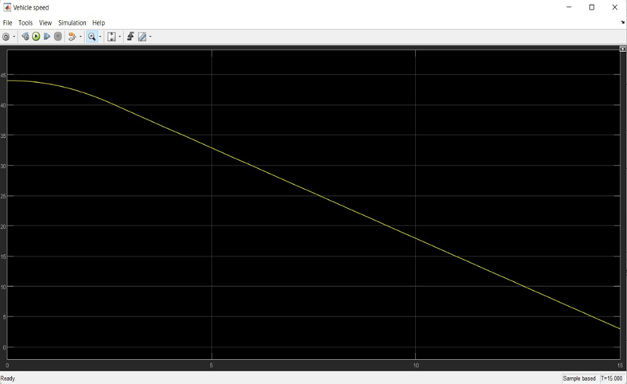
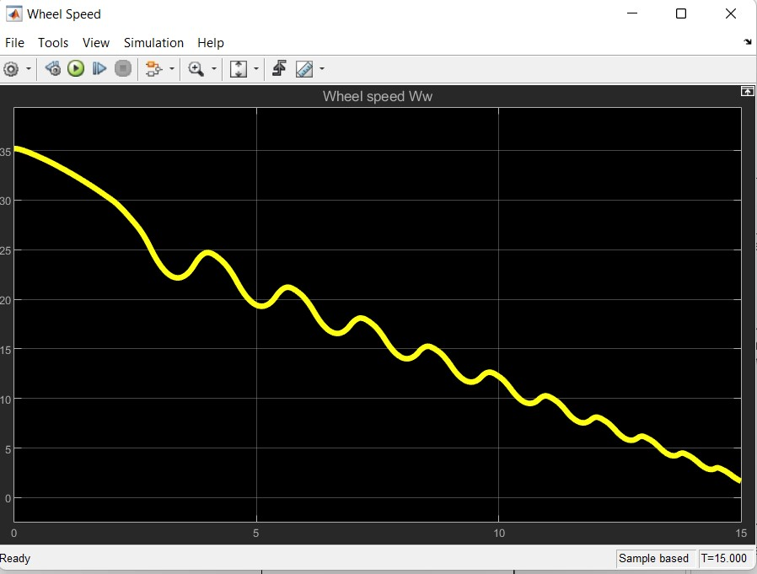
RESULTS

Slide 9
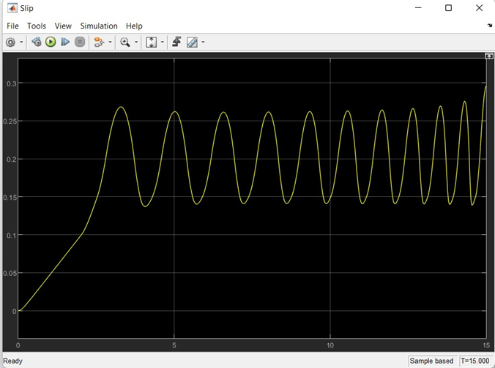
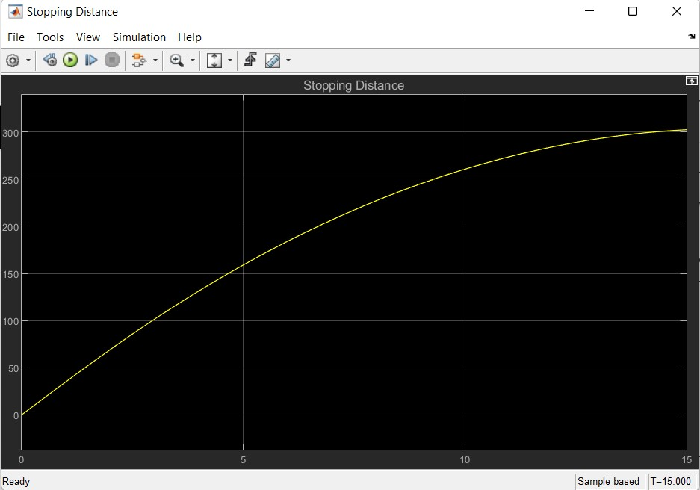

Slide 10
ADVANTAGES AND DISADVANTAGES
Advantages of ABS
Stopping on ice: As mentioned above, an ABS prevents lock-ups and skidding, even in slippery conditions. Anti-lock brakes have been proven to save lives in some situations by helping drivers keep control of a vehicle.
Lower insurance costs: Because it is a thoroughly tested safety device with a track record of effectiveness, insurers often give customers specific discounts for having an ABS system on their vehicle.
Higher resale value: As a feature on a car or truck, an ABS raises the market value of the vehicle. Nowadays, where ABS technology has become standard on many vehicles, not having it could result in a lower price for resale.
Traction control: ABS shares some of the infrastructure of a traction control system, where new technology helps ensure that each wheel has traction on the road. That makes it easy for manufacturers to install both of these features at the factory

Slide 11
Disadvantages of ABS
Inconsistent stop times. Anti-lock brakes are made to provide for surer braking in slippery conditions. However, some drivers report that they find stopping distances for regular conditions are lengthened by their ABS, either because there may be errors in the system, or because the clunking or noise of the ABS may contribute to the driver not braking at the same rate.
Expense. ABS can be expensive to maintain. Expensive sensors on each wheel can cost hundreds of dollars to fix if they get out of calibration or develop other problems. For some, this is a big reason to decline ABS in a vehicle.
Delicate systems. It's easy to cause a problem in ABS by messing around with the brakes. Problems include disorientation of the ABS, where a compensating brake sensor causes the vehicle to shudder, make loud noise or generally brake worse.

Slide 12
REFERENCES
A. B. Sharkawy,‘Genetic fuzzy self-tuning PID controllers for antilock braking systems’; Engineering Applications of Artificial Intelligence, vol. 23, pp. 1041–1052, 2010
Thesis by Parth Bharat Bhivathe, ‘Modelling and development of Anti Lock Braking system’; National Institute of Technology Raurkela
Jeonghoon Song, Woo Seong Che, ‘Comparison between braking and steering yaw moment controllers considering ABS control aspects’; Elsevier, Mechatronics 19 (2009) 1126–1133
Jitesh, Sahil. "Antilock braking system (ABS)." International Journal of Mechanical Engineering and Robotics Research 3, no. 4 (2014): 253.
Gowda, V. D., Ramachandra, A. C., Thippeswamy, M. N., Pandurangappa, C., & Naidu, P. R. (2019). Modelling and performance evaluation of anti-lock braking system. J. Eng. Sci. Technol, 14(5), 3028-3045.
Aly, Ayman A., El-Shafei Zeidan, Ahmed Hamed, and Farhan Salem. "An antilock- braking systems (ABS) control: A technical review." Intelligent control and Automation 2, no. 03 (2011): 186.
Bosch Automotive Electrics and Automotive Electronics: Systems and Components, Networking and Hybrid Drive. (2013). Germany: Springer Fachmedien Wiesbaden.
https://en.wikipedia.org/wiki/Anti-lock_braking_system

