Slide 1


3rd National Conference on Communication and Data Science- 2021
(In Association with IJERT Journal)
Food Grain Storage Monitoring System
Author(s):
Dr U B Mahadevaswamy,
Megha K M,
Arjun V Srivatsa,
Ayushi G Jain,
Bhoomika Rani B.
Paper Id: #NCCDS-21-049
Date: 10.06.2021

Slide 2
Contents
The structure of the talk involves discussions on:
Background
Proposed System
Components calibration techniques
System Architecture
Experimental Results
Comparison with existing systems
Conclusion and Future Scope
NCCDS-2021

Slide 3
Background
The main motivation for this project was the fact that there is more wastage than usage of food grains due to the extended keep even after expiration date of the grains in many storage warehouses. 25 to 30 percent of losses occur during the period from harvesting to marketing. This trend is far worst in storage warehouses which are government-run due to poor maintenance standards. Since farmers invest more time and resources in farming and harvesting of these precious food grains, it comes as an injustice to let the food grains rot at a corner of the warehouse.
Thus, implementing a system which communicates with the client about the changes in the parameters of the food grains kept over a long period of storage becomes essential. This retains the food grain quality by its nutritional standards and make sure that the maintenance of the warehouse becomes easier and reliable.
NCCDS-2021

Slide 4
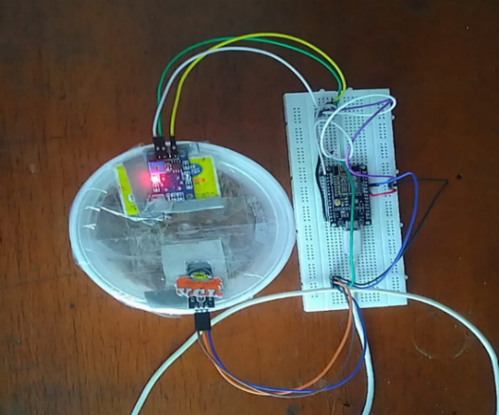
Proposed System
The proposed model is a food grain monitoring system based on IoT for implementation in storage warehouses that consists an ESP8266 NodeMCU module interfaced with a DHT11 temperature and humidity sensor and MQ-135 air quality sensor (CO₂). The basic working includes the sensors collecting the data of the parameters inside the storage system which mainly contribute to the spoilage of food grains and communicating with the user if there are variations detected, so that necessary control measure gets applied
NCCDS-2021

Slide 5
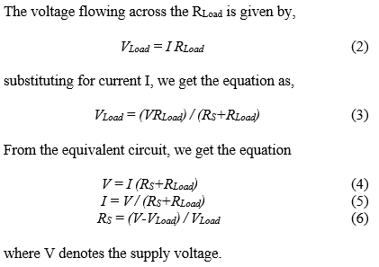
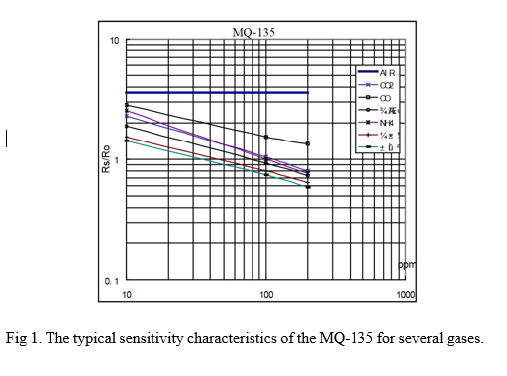
Component calibrations
Note: DHT11 sensors are pre-calibrated at laboratories.
For MQ 135 Gas sensor
In order to determine the concentration of CO₂ present in the air, there is a need to find the ratio (R_{S}/R_{O}). R_{O} and R_{S} represents the internal resistance values of the sensor. Using this, the value of R_{S} from V_{RL} (voltage flowing across R_{Load}) needs to be found. This is done by using the ESP8266 microcontroller to find the value of voltage (V_{RL}) across the load resistance R_{Load}. A formula is derived to find the R_{Load} from V_{RL}.
NCCDS-2021

Slide 6
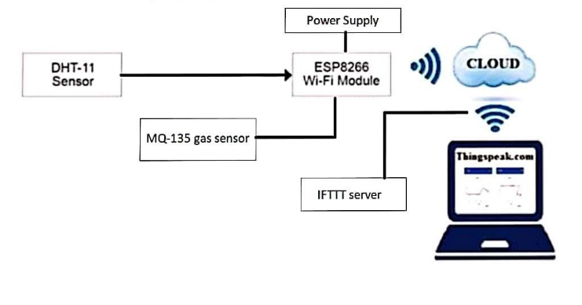
Architecture
Step 1: The food grains are stored inside the storage space with the sensors in direct contact to the environment inside acting as an input to the module.
Step 2: If there is a change in the temperature or humidity, this is sensed by the DHT11 sensor module and the signal is sent the ESP8266 module which is in turn connected to the Wi-Fi. The received data is stored on ThingSpeak database.
Step 3: If there is a change in the concentration of CO₂ gas, the MQ135 sensor is activated and triggers the microcontroller in sending a response over the Wi-Fi and the received data is stored on ThingSpeak database.
Step 4: The stored data are in graphical representation which records the changes in the parameters like temperature, humidity, and CO₂ gas concentration (in ppm) with respect to the time.
Fig 2. Block Diagram
Step 5: In case there is an abnormal change in the mentioned parameters, the data is sent to the ThingSpeak cloud and there is a spike in values represented on the either graph on the ThingSpeak website.
Step 6: Also, this triggers an email notification by the IFTTT webhooks service which sends a predetermined service message of the current status to the registered user email.
ThingSpeak can also be accessed through the android app making it accessible through the smartphone.
NCCDS-2021

Slide 7
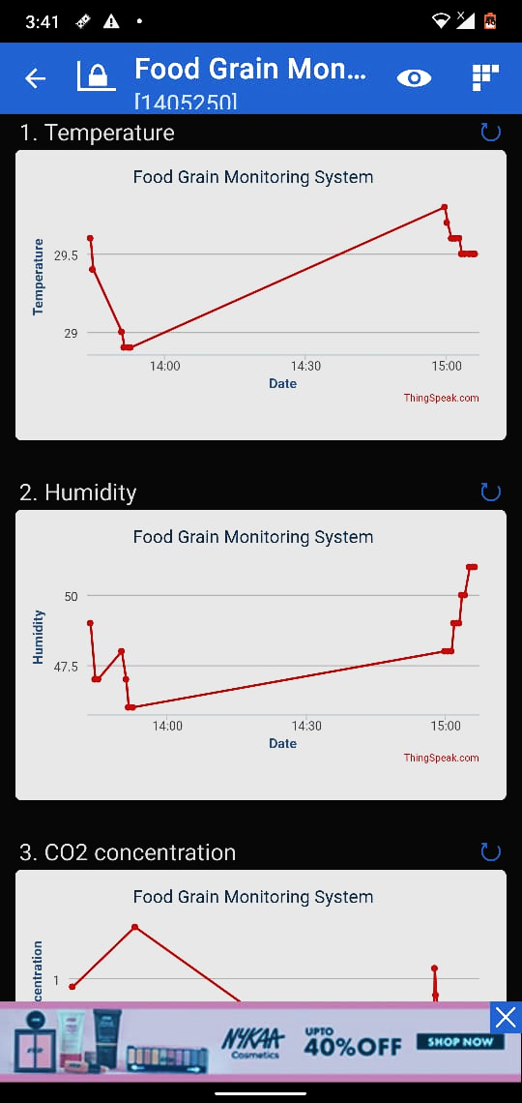
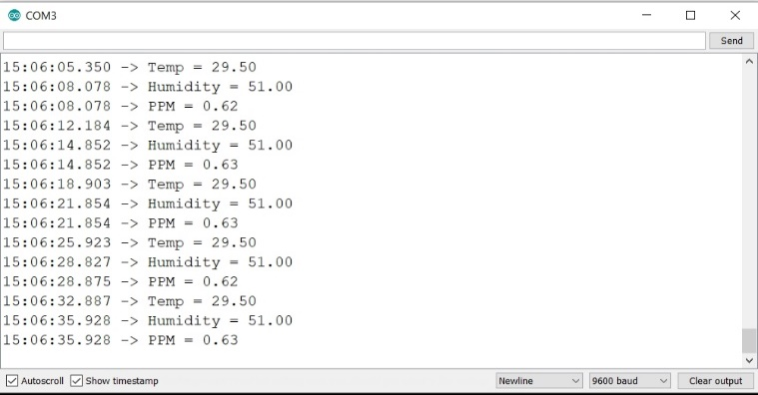
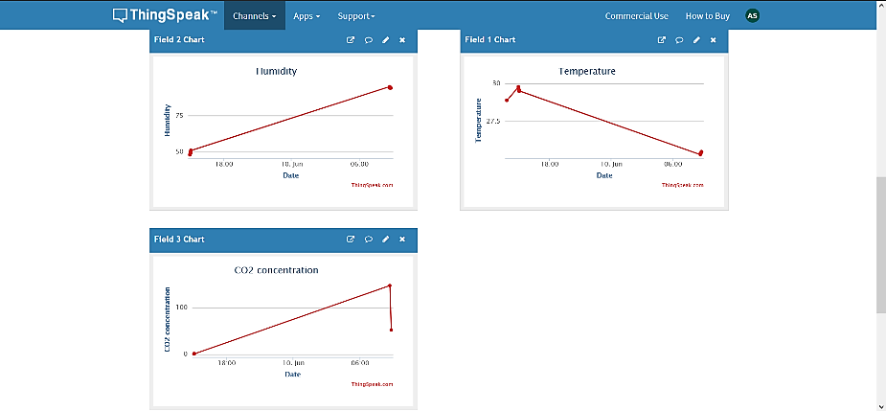
Experimental Results
A. Under normal storage conditions
The food grain storage monitoring device is used to read the temperature, humidity and CO₂ percentage values at the storage warehouse from which the data can be represented in three forms. The figures show the variations in the temperature, humidity and CO₂ concentration in ppm on
1. serial monitor display of the Arduino IDE.
2. the data in the form of graphs on the website which is loaded from the ThingSpeak database
3. the ThingSpeak user interface accessed through an android application.
NCCDS-2021

Slide 8
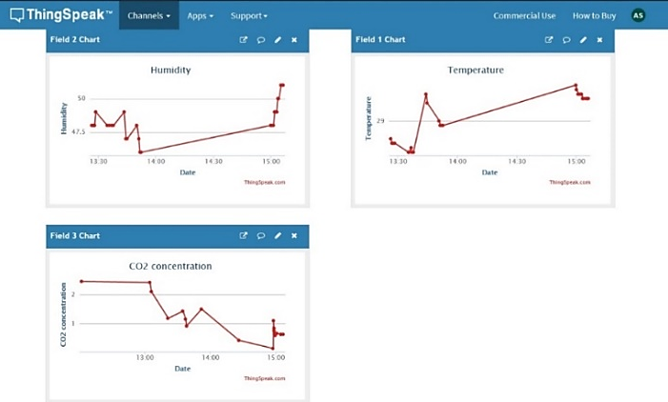
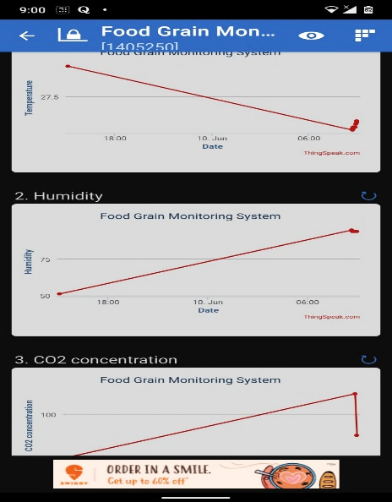
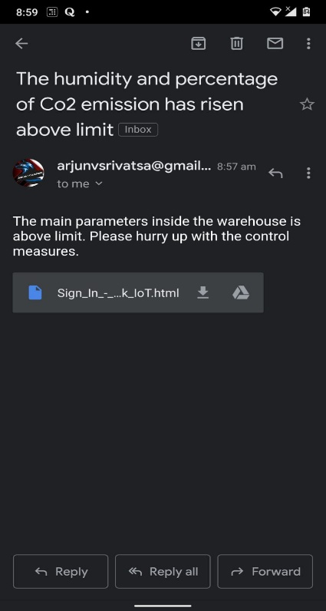
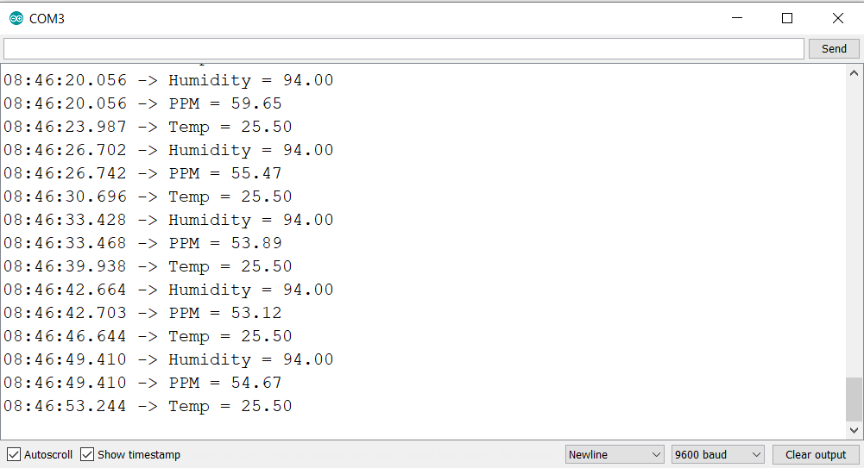
Experimental Results contd..
B. Under food grain degradation
When the food grains inside the warehouse starts to degrade due to the breakdown of glucose, this results in the spike of the parameters which is observed as follows.
1. the values of parameters on a serial monitor of Arduino IDE.
2. the data in the form of graphs on the website which is loaded from the ThingSpeak database.
3. the ThingSpeak user interface accessed through an android application and email notification sent for the same.
NCCDS-2021

Slide 9
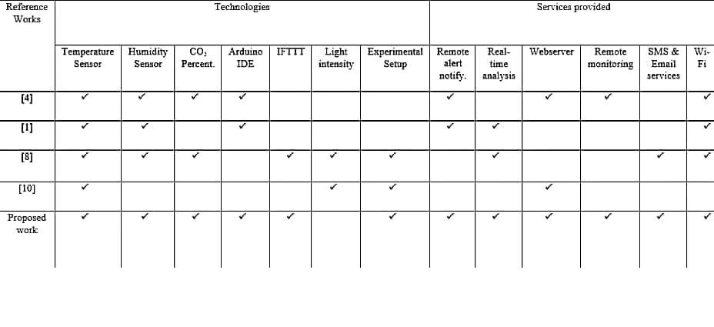
Comparison with existing works
NCCDS-2021

Slide 10
Conclusion
This project deals with the real-world scenarios, which makes it a tremendous resource for research and development. It also gives an insight into food grain-management relations, and human health. Thus, the hardware approach taken in this project is a simple solution that can be implemented, and demonstrates its effectiveness over the long term. In addition, there is a strong need for concepts that can improve the storage techniques of food grains in warehouses. This project is primarily concerned with the maintenance of all such storage systems, which are easier to implement due to the continuous monitoring of changes in the parameters over time.
NCCDS-2021

Slide 11
Future Scope
In the proposed work, the parameters such as temperature, humidity, and CO₂ levels measured is only limited to the storage system environment. The monitoring system can be further enhanced and implemented in applications which include the measurement of quality of the soil, the amount of pesticides and insecticides required to use, and measuring the amount of rainfall received during the year. They can help consumers to make intelligent decisions about the safety of the food that they eat, and also be used for the improvement of agriculture practices. Also, various grains have different parameters as well as specifications which is hard to maintain in a multi-grain storage facility. Inputting all these parameters and maintaining them remotely over the server can be implemented as well.
NCCDS-2021

Slide 12
References
A. Sagaya Selvaraj and S. Anusha “RFID Enabled Smart Data Analysis in a Smart Warehouse Monitoring System using IoT” Conference Series 1717 (2021) 012022 IOP Publishing.
K. G. Manishkumar Dholu, “Internet of things (iot) for precision agriculture application,” in 2018 2nd International Conference on Trends in Electronics and Informatics (ICOEI), 2018.
H. Fan, “Theoretical Basis and System Establishment of China Food Safety Intelligent Supervision in the Perspective of Internet of Things,” in IEEE Access, vol. 7, pp. 71686-71695, 2019.
R. K. Kodali, J. John and L. Boppana, “IoT Monitoring System for Grain Storage,” in 2020 IEEE International Conference on Electronics, Computing and Communication Technologies (CONECCT), 2020.
Julius, Olorunfemi..“Post-Harvest Loss and Grain Storage Technology- A Review” in Turkish Journal of Agriculture - Food Science and Technology. 9. 75-83, 2021.
S.Muthukumar, W.Sherine Mary.W “Sensor based warehouse monitoring and control” in IEEE Conference Record # 42487, 2018.
E. A. G. K. A. V. Robert N. Dean, Jeffery D. Craven, “A pcb sensor for status monitoring of stored food stocks,” in IEEE Sensors Letters, vol. 3, 2019.
Aviara, N.A. & Fabiyi, O & Ojediran, John & Ogunniyi, O & Onatola, I. “Application of Computer Vision in Food Grain Quality Inspection, Evaluation and Control during Bulk Storage”, 2016.
Deepika Uppala et al.,“Rice Crop Discrimination Using Single Date RISAT1 Hybrid (RH, RV) Polarimetric Data, Photogrammetric Engineering & Remote Sensing”,Volume 81, Issue 7, 2015.
Shah, Mehul & Bhatt, Chetan & Dave, Jaimin. “Temperature Dependent NIR Spectroscopic Analysis for Food Grain Samples” in Indian Journal of Science and Technology, 2016.
Mona Haji , Laoucine Kerbache , Mahaboob Muhammad and Tareq Al-Ansari, “Roles of Technology in Improving Perishable Food Supply Chains”, 2020.
Gamal ElMasry, Nasser Mandour, Salim Al-Rejaie, Etienne Belin and David Rousseau , “Recent Applications of Multispectral Imaging in Seed Phenotyping and Quality Monitoring—An Overview”, 2019.
NCCDS-2021

Slide 13
Q & A
Thank you !
NCCDS-2021

