Slide 1

WEBBERS
TEAM

Slide 2

Contents
About us
Idea
Tech Stack
Implementation

Slide 3
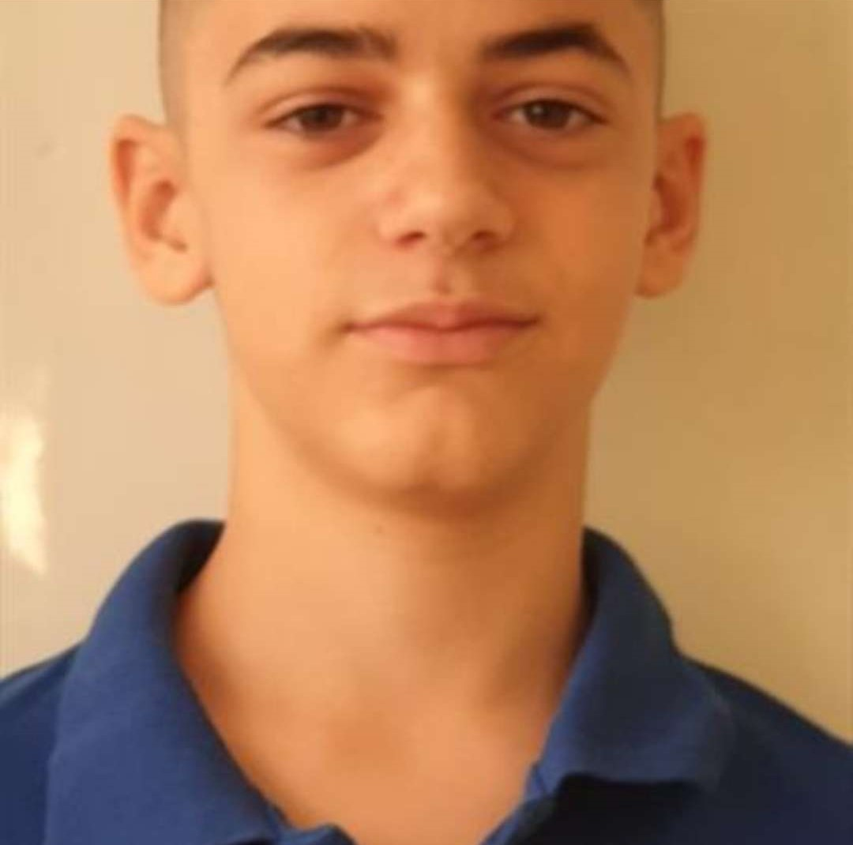
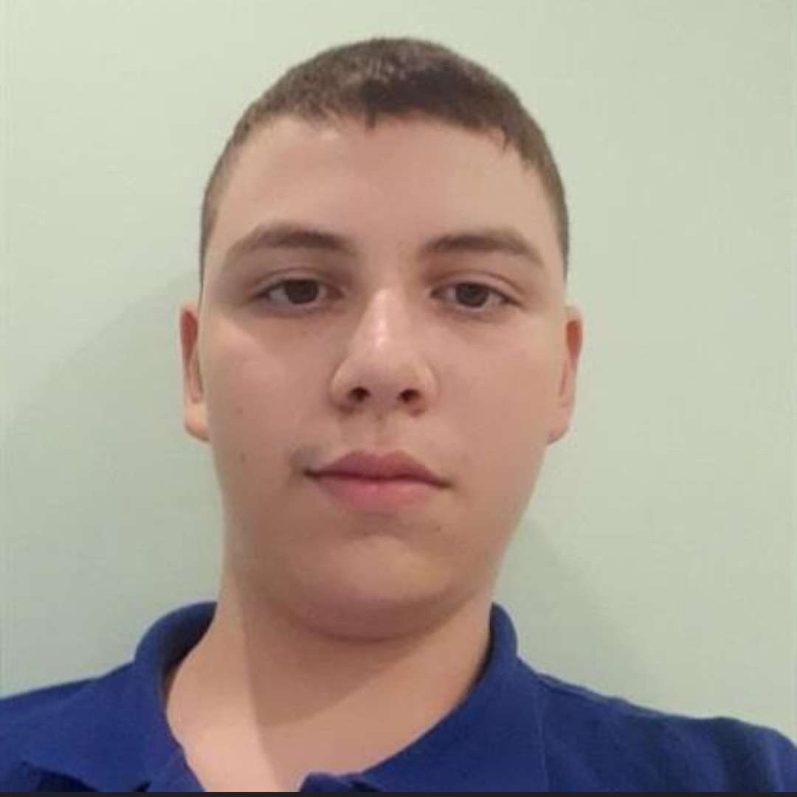

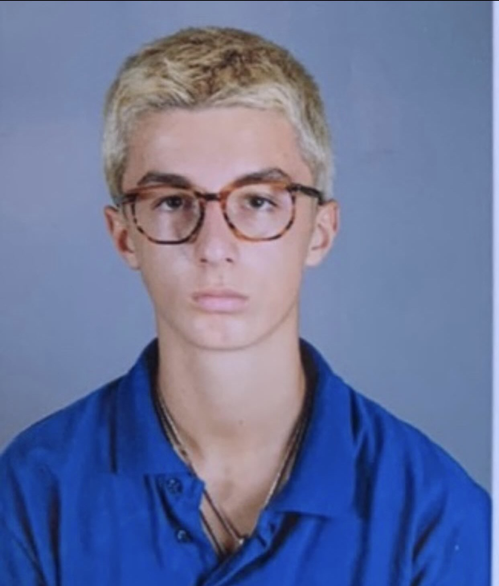
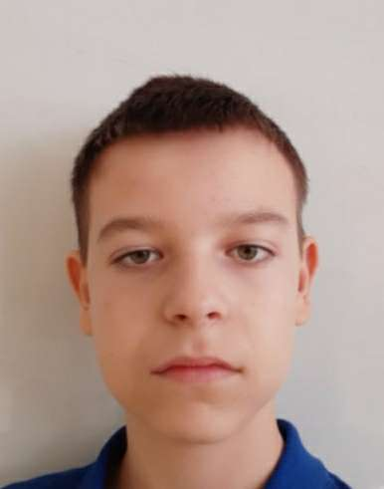
Our team
Boris Rusinov
Scrum Trainer
Daniel Kostadinov Ivelin Voinov
Front-End Developer Designer
Alexandar Stanev Alexandar Lalev
Scrum Trainer Front-End Developer

Slide 4

The idea
The goal of our project is to get people to know more about Global Warming.

Slide 5





Tech Stack

Slide 6
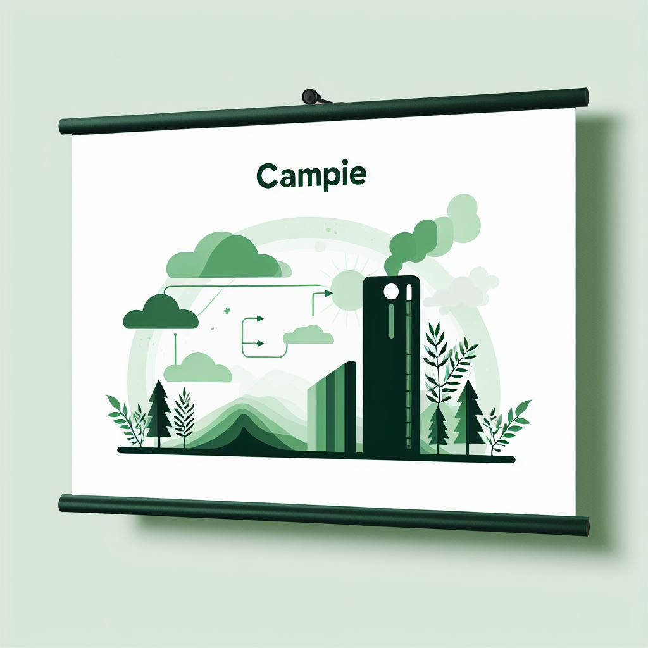
Implementation
We built our application from the ground up in the span of three weeks, meaning that our project will hopefully be deemed successful.
This time around though, our time for set up and organization could have gone better. That however didn’t discourage us from working stably throughout the rest of our given time.

Slide 7
Thanks for listening!

