Slide 1


Action Templates
and Causalities
in the ODP Computational Viewpoint
Raúl Romero and Antonio Vallecillo
Dpto. Lenguajes y Ciencias de la Computación
Universidad de Málaga, Spain
{jrromero, av}@lcc.uma.es
WODPEC’04

Slide 2

Contents
Introduction
Action Templates
  issues and proposal
Causalities
  issues and proposal
Conclusions

Slide 3
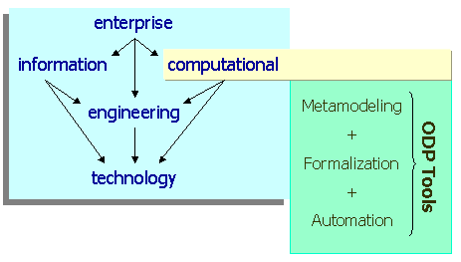
Background: we are working on the formalization of the ODP viewpoints, using Maude (formal language and system based on re-writing logic)
Goals: Provide tool support for the specification of ODP systems (beyond their formal specification)
Introduction
We found some inconsistencies when trying to formalize the Computational V.
Current revision work of ODP at ISO ⇒ a great moment to discuss!

Slide 4
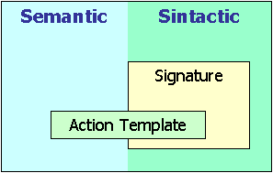
According to Part 2
Template: the specification of the common features of a collection of <X>s in sufficient detail that an <X> can be instantiated using it.
Action Template: the specification of the common features of a collection of actions in sufficient detail that an action can be instantiated using it.
1) Action Templates
According to Part 3
[7.1.12a] An announcement signature is an action template.
[7.1.12b] An interrogation signature comprises an action template.
[7.1.11] A signal interface signature comprises a finite set of action templates, one for each signal type in the interface. Each action template comprises the name for the signal, the number, names and types of its parameters and an indication of causality (initiating or responding, but not both) with respect to the object which instantiates the template.
Issues
Action templates and signatures seem to be used interchangeably.
There seems to be some confusion between the syntactic and semantic aspects of action templates and signatures.

Slide 5
Use the term “signature” to refer to syntax only (i.e. name for the action, the number, names and types of its parameters, and an indication of causality)
Use “action template” to refer to the syntax+behaviour
Define a term to refer just to the syntactical information specified by an action template: Interaction Signature.
  Announcement, interrogation, termination, signal and flow signatures are Interaction Signatures.
  Interface signatures comprise a finite set of Interaction Signatures.
  Interaction signatures are part of the specification of Action Templates (they provide their syntactical information)
1) Action Templates
Proposal

Slide 6
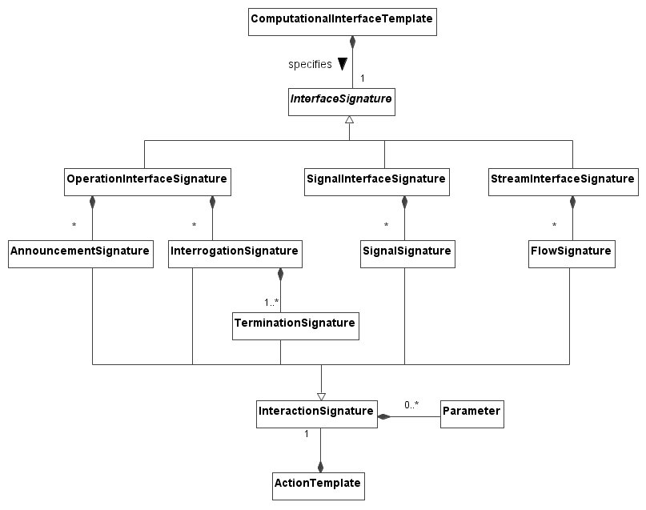
1) Action Templates
Proposal

Slide 7
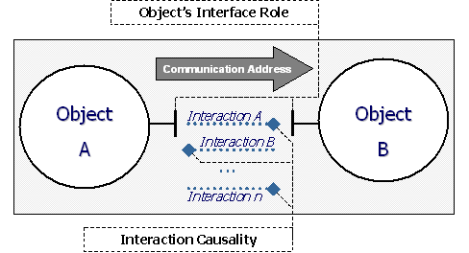
According to Part 2
The identification of causality allows the categorization of roles of interacting objects. […]
2) Causalities
According to Part 3 : Indication of causality
  Clause 7.1. Indication of causality for
  Signal / stream interfaces ⇒ at the action template level
  Operation interfaces ⇒ at the object interface signature level
  Clause 7.2.2. [Interaction Rules] ⇒
  Signal and flows ⇒ at the object interface signature level
  Operations ⇒ in terms of 2 or 4 signals
Issues
Granularity?

Slide 8
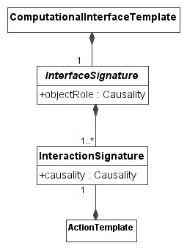
We need to differentiate between causalities at different levels:
Causalities
‘objectRole’ ⇔ at the object interface level
Proposal
causality ⇔ at the interaction level
They are related in some cases:
  In operations, the causality defined at the interface signature level determines the causality of the individual interactions.

Slide 9
Conclusions
We discovered (just) two issues when trying to formalize the ODP Computational Viewpoint:
  The confusion sometimes between the terms Action Template and Signature, and the need of an independent term for referring to the signature of an Action Template, and
  the way in which Causalities are currently defined and handled.
The rest of the Computational viewpoint concepts “survived” our review
Future work (specific)
  Define the term “signature” in part 2
General recommendations for ODP:
  More documentation in order to help ODP newcomers understand the framework (e.g. an “ODP Guide”)
  More examples and case studies
  Define specific language for the viewpoints (examples)
  Tool support

