Slide 1




Monterey - 2004

Slide 2
ARCHITECTING FRAMEWORKS
FOR SPECIFIC APPLICATIONS
WITH RM-ODP
Moacyr Martucci Jr
Dib Karam Jr
Sandro Antonio Vicente
Ana Paula Gonçalves

Slide 3
CASES (3 thesis)
CONVERGENT SYSTEM
CRM
MIDDLEWARE
FOR INTEGRATION

Slide 4
CONVERGENT SYSTEM
Application 2
Application 2
Application 1
Application 2
Application 1
Application 1
Protocol and
Protocol and
Object distributed
Object distributed
Digital TV
Application 3
Digital TV
Application 3
Application 3
Internet
Internet
Mobile
Mobile
Application 4
Application 4
Application 4
Phone
Phone
Application 7
Application 7
Application 5
Application 7
Application 5
Application 5
Application 6
Application 6
Application 6

Slide 5
CONVERGENT SYSTEM
- Computational viewpoint
User
Object
Connection
Object
Convergence
Services Objects
User
Information
and
Connection
Services
Communication
Services
Middleware
Services
Channels

Slide 6
CONVERGENT SYSTEM
- Engineering viewpoint
Convergence
Convergence
User
User
Services
Services
Integration
Integration
Interface
Stub
Interface
Stub
Stub
of different
Stub
of different
technologies
technologies
Binder
Binder
Binder
Binder
Protocol
Protocol
Protocol
Protocol
Connection
Connection
P1
P1
P2
P2
P3
P1
P3
P1
P2
P2
P3
P3

Slide 7
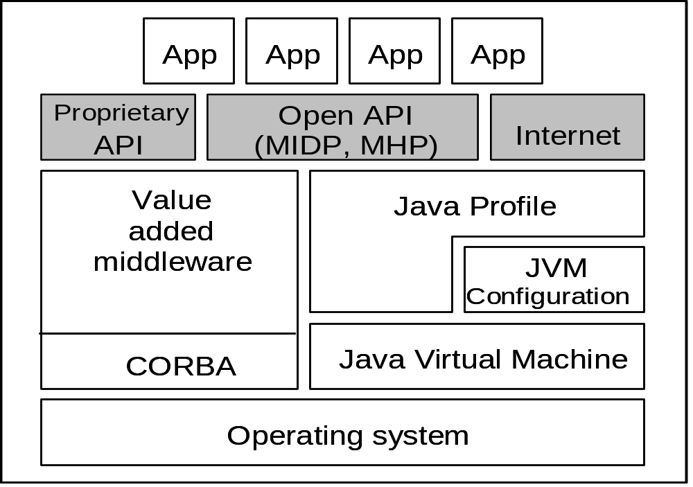
CONVERGENT SYSTEM
- Technology viewpoint

Slide 8
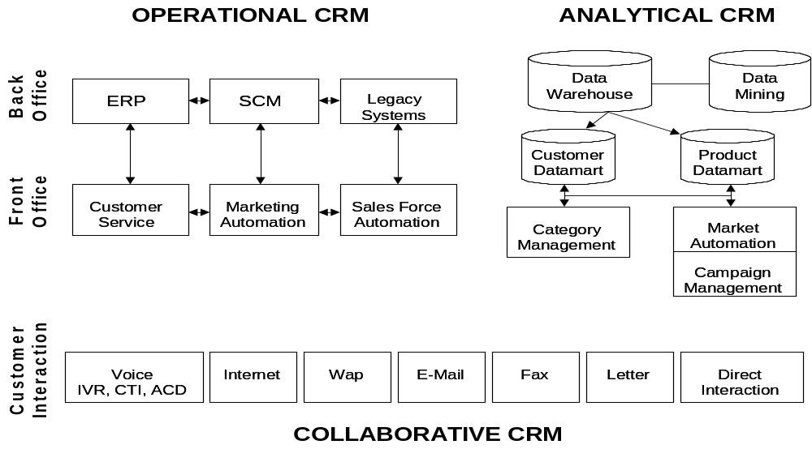
CRM

Slide 9
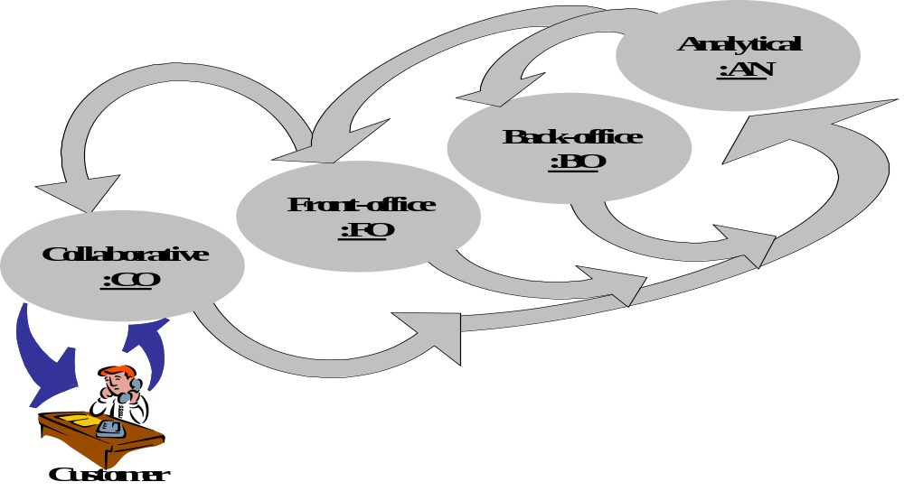
CRM
- Enterprise viewpoint

Slide 10
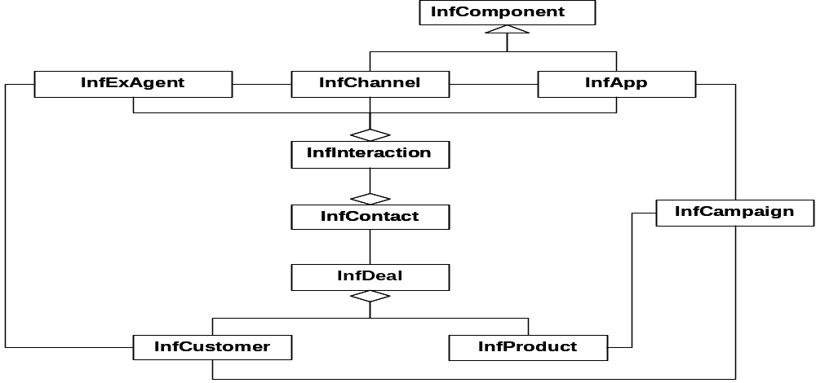
CRM
- Information viewpoint

Slide 11
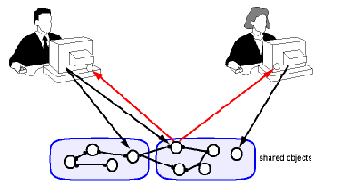
MIDDLEWARE FOR INTEGRATION

Slide 12
MIDDLEWARE FOR INTEGRATION - Enterprise viewpoint
REQUESTER
EXECUTOR
Middleware

Slide 13
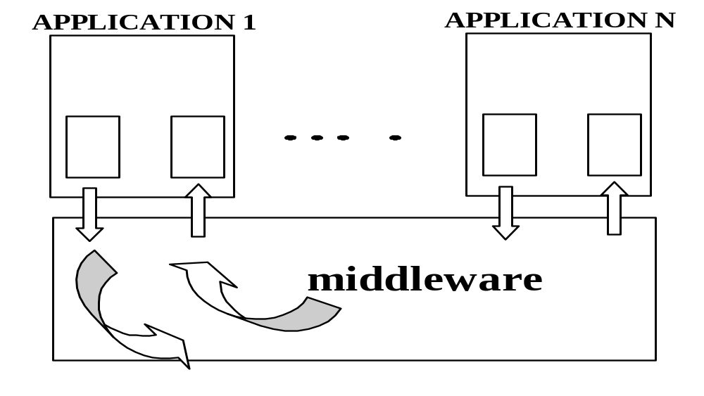
MIDDLEWARE FOR INTEGRATION - Information viewpoint

Slide 14
CONCLUSIONS
RM-ODP is appropriate to determine the architectural patterns
RM-ODP can be properly used for the specification and modeling of distributed systems targeting different problems (systems)
Weak point when it was used for modeling systems where one or more blocks are legacy systems
Lack of compatibility between RM-ODP and distributed objects architectures like CORBA and J2EE
RM-ODP is not proper to formally specify an entire system

Slide 15
Moacyr Martucci Jr – moacyr.martucci@poli.usp.br
Dib Karam Jr – dib.karam@poli.usp.br
Sandro Antonio Vicente – sandro.vicente@poli.usp.br
Ana Paula Gonçalves – apaulacg@uol.com.br

