Slide 1
Applying Model Driven Development to Business Systems using RM-ODP and EDOC
Daisuke Hashimoto
hashimoto@tech-arts.co.jp
Miwa Sato
msatoh@tech-arts.co.jp
Yoshihide Nagase
yoshi@tech-arts.co.jp

Slide 2
Agenda
Model Driven Development
Our MDD Process
Case Study
Discussion on possible RM-ODP revisions

Slide 3
Model Driven Development

Slide 4
Objective
Improving development efficiency and maintainability for business systems requires
a seamless development process, and MDD (Model Driven Development) plays a key role.

Slide 5
Fundamental
System development based on MDA (Model Driven Architecture).
MDA has 3 viewpoints of model.
  CIM (Computation Independent Model)
  PIM (Platform Independent Model)
  PSM (Platform Specific Model)
Each model of viewpoint is defined using model language based on MOF (Meta Object Facility).
Model transformation based on MOF enable seamless and traceable development.
We applied MDD to business systems using
RM-ODP (reference model) and EDOC (modeling language).

Slide 6
MDA and RM-ODP viewpoints
RM-ODP viewpoints correspond with MDA viewpoints.
CIM
PIM
Enterprise Viewpoint
Information Viewpoint
Computational Viewpoint
Engineering Viewpoint
Technology Viewpoint
PSM

Slide 7
UML Profile for EDOC
Enables to develop models compatible with three viewpoints (CIM and PIM part): Enterprise, Information, and Computational viewpoints.
Enables viewpoint correspondence.
Contained Profiles in UML profile for EDOC
  CCA (Component Collaboration Architecture) Profile
  Entity Profile
  Relationship Profile
  Event Profile
  Business Process Profile
  Pattern Profile

Slide 8
Our MDD Process

Slide 9
Our MDD Process
Capture, model, and analyze business requirements
Enterprise Viewpoint
Analyze Information
of ODP system
Analyze Function
of ODP system
Information Viewpoint
Computational Viewpoint
Engineering Viewpoint
Apply technology
and transform model
design system architecture
Technology Viewpoint

Slide 10
Enterprise Viewpoint
Objective
  Capture, model, and analyze business requirements.
Items of work
  Define Objectives for the system.
  Define Communities that are decomposition objective.
  Define Business Processes that are process for accomplishing Objective of each Communities.
  Define Policies that are constraints and requirements on Communities and Processes.
EDOC profiles
  Business Process Profile
    represent business processes.
    represent information used and functions used in the business Process.
  Event Profile
    represent event-driven business processes.

Slide 11
Information Viewpoint
Objective
  Analyze Information of ODP system.
Items of work
  Derive information model based on Business Processes.
  Define Entity Components that are components of information.
  Define Invariant Schemas that are constraints of information.
  Define Static Schemas that are snapshot (e.g. initial values) initial values of information.
  Define Dynamic Schemas that are state machine of Entity.
EDOC profiles
  Entity Profile
    represent Information Objects by Entity Data.
    represent Entity Components.
  Relationship Profile
    represent detail relationship between information objects.

Slide 12
Computational Viewpoint
Objective
  Analyze Function of ODP system.
Items of work
  Define functional model based on Business Processes.
  Define Process Components that are functionality components.
  Connect Process Components to Entity components.
  Define interactions between components.
  Define interfaces of components.
EDOC profiles
  CCA (Component Collaboration Architecture) Profile
    represent Computational Objects by Process Component.
    represent interfaces of Process Component.
    represent interactions between Process Components
  Entity Profile
    represent Entity Components.

Slide 13
Engineering Viewpoint
Objective
  Design system architecture.
Items of work
  Define physical component.
  Design system environment and deployment model.
  Design transaction models.
  Design security domains.

Slide 14
Technology Viewpoint
Objective
  Apply technology.
  Transform to PSM (Platform Specific Model).
Items of work
  Apply technologies.
    OS : Windows?, Linux?, Mac OSX?
    Language : Java?, C#?, C++?
    Application Server : Web Logic?, Web Sphere?, Sun ONE?
    Database : Oracle?, DB2?, SQL Server?
  Design mapping rule between PIM and PSM.
  Transform to PSM based on the mapping rule.

Slide 15
Case Study

Slide 16
Electronic Health Record System
EHRS = Electronic Health Record System
Target
  Establish standard development approach for EHRS specification and EHRS with components.
Organizations
  JAHIS (Japanese Association of Healthcare Information Systems Industry)
  INTAP (Interoperability Technology Association for Information Processing)
  CBOP (Consortium For Business Object Promotion)
Achievement in 2002 (This project is still active ongoing)
  EHRS models (Enterprise model, Information model, Computational model)
  Pilot system developed
    The Enterprise Viewpoint part of these models are an accomplishment of “The Development of Electronic Health Record System through Standardizing Components” as a special science research theme awarded by the Ministry of Health, Labor and Welfare in the fiscal year 2002.

Slide 17

What is EHR System ?
EHRS = Electronic Health Record System
EHRS is to integrate information systems in a hospital.
…Enterprise System !
Radiological
department
system
Consultation results,
Examination reservation,
Prescription order…
EHRS
Accounting
for Medical
department
system
Examination results,
Pharmaceutical history,
Patient state…
EHRS of
Other hospital

Slide 18
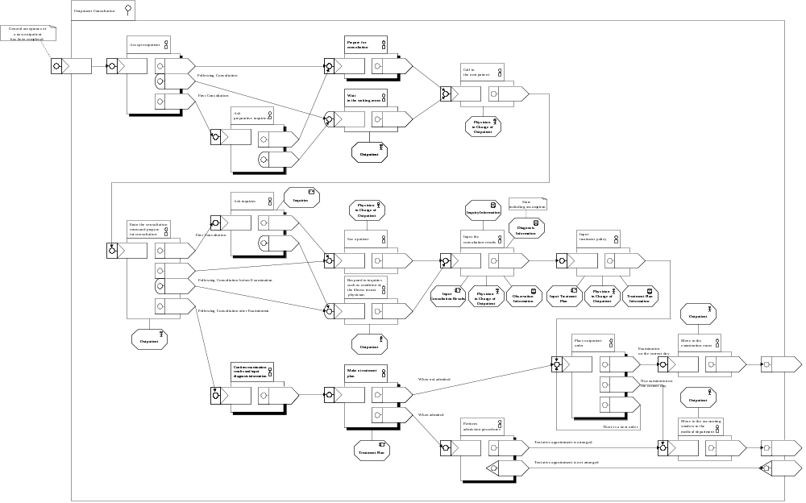
Enterprise Model
Input the
consultation
results
Business Process
Input
Consultation
Results
Physician
in Charge of
Outpatient
Consultation
Information
Zoom in..

Slide 19
Information Model
Information structure
Entity
Component
Entity Data
<<Entity Data>>
Chief Complaint
<<Entity Data>>
Treatment Plan
Consultation Date
Contents
<<Entity>>
Treatment Policy
Consultation
Store Consultation
Information
<<Entity Data>>
Observation
<<Entity Data>>
Findings
<<Entity Data>>
Diagnosis
Decision Date
Target
Contents
Decision Date
Target
Contents
Diagnosis Date
Illness Name
Reasons for Diagnosis

Slide 20
Computational Model
Component structure
Process Component
<<Process Component>>
Choreography
(behavior)
Input Consultation
results
Input Consultation
Store Consultation
results
Information
<<responds>>
Input Consultation result
<<Entity>>
Consultation
<<initiates>>
Store Consultation
Information
Store Consultation
Information
Entity
Component

Slide 21
Engineering Model
Client
Deployment model
Business Logic
Common Service
Application
Facade
Data Access
Component
Node
Database Server
Node
Database

Slide 22
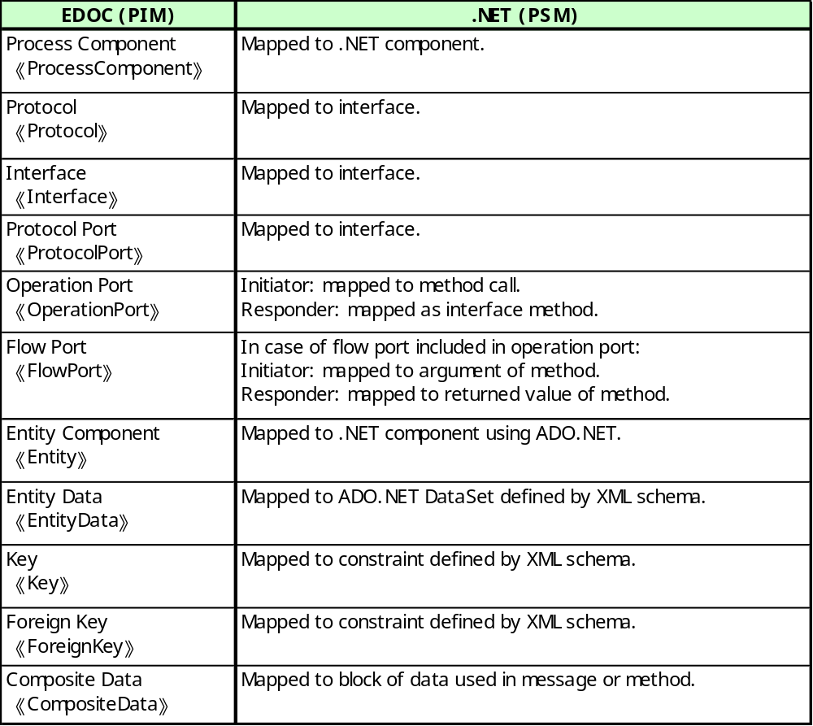
Technology Model
P
P
O
F
E

Slide 23
Viewpoint Correspondence
Enable seamless development and to ensure the traceability.
In EDOC, Business Process Profile (used in EV), Entity Profile (used in IV) are defined as specializations of CCA Profile (used in CV), and thus there exists stronger correspondence between those and CCA Profile.
Once the mapping is done, and the final model is represented in CCA Profile, the resulting model will be considered as a Computational Viewpoint Model.
Enterprise Viewpoint
BP
Entity
CCA
Next phase..
Information Viewpoint
Computational Viewpoint

Slide 24
Discussion on possible RM-ODP revisions
  Communication between coarse-grained computational objects
  Dynamic evolutions of models
  Human-System Interaction
  Policy Language

Slide 25
Communication between coarse-grained computational objects
When we extend “object interactions” to cover communication between coarse-grained objects such as objects representing enterprise systems, there is a need to consider whether:
  current object interactions still meet the needs,
  current object interfaces still meet the needs, and
  current behavior definition capability still works.

Slide 26
Composite interaction
Issue
  To describe coarse-grained computational viewpoint specification, a means is needed to represent composite interaction, which may be a composition of:
    Signals, Operations, and Flows (Stream)
Example: buy-sell interactions
Composite interaction
Interface for
composite interaction
Order
Company A
Company B
Shipping
payment
As computational object X
As computational object Y
The introduction of “composite interaction” and “composite interface” will provide modelers with more flexibility.

Slide 27
Composite interface
Issue
  Current interface definition is very fine-grained.
Action templates
Client side Operation interface I
Interrogation signature S1
invocation
termination
Announcement signature S2
termination
termination
Computational
Object
invocation
Interrogation signature S3
invocation
termination
Announcement signature S4
termination
termination
invocation
Composite interface definition including activity definition at the interface will enable high level and simpler modeling.

Slide 28
Asynchronous communication
Issue
  Communication or interaction between objects in Computational Viewpoint is basically synchronous, but asynchronous communication, or message-based interaction, is in fact used widely.
  Client side activity description depends on the interaction style.
business-to-business transaction example:
asynchronous communication
Company A
OrderRequest
Other
Order
Company B
communication
Response
Needs elaboration on interfaces for asynchronous communication, e.g. message queue management.

Slide 29
Components (summing up)
Issue
  Computational Object is rather fine-grained.
According to “Objects, Components, and Frameworks with UML (The Catalysis Approach),” Component is a coherent package of software implementation that
  1) has explicit and well-specified interfaces for the services it provides.
  2) has explicit and well-specified interfaces for services it expects from others.
  3) can be composed with other components, perhaps customizing some of their properties, without modifying the components themselves.
If composite interactions and interfaces are acceptable, it would be natural to introduce those concepts with “component” concept.

Slide 30
Dynamic evolutions of models
Issue
  Dynamic evolutions of models are not describable consistently.
The dynamic evolutions of models means:
  model elements may be added or changed or deleted at some point to evolve into the model in the next phase. (e.g. community creation)
Guideline is needed regarding:
  how these evolutions or changes (transition) should be described in each viewpoint, and
  what concepts in which viewpoint is required to achieve this.
  NOTE: The results may be applicable to “as-is model” to “to-be model” evolution in Enterprise Architecture.
as-is model
evolution
to-be model

Slide 31
Human-System interactions
Issue
  In the Viewpoint Languages today, there is no place for describing Human-System Interaction.
If we could have concept(s) for this purpose in viewpoint languages, the following may be an example of applicable specification area:
  Specification of Human-System interactions for the system providing similar services through multi-channels
  (Web, telephone, fax, e-mail, and letter)
    Screen/Screen flow design
    Voice navigation design
    Email and back-end system integration design
    Easy to use menu design etc.

Slide 32
Policy language
Issue
  The current policy concepts are meta-model level concepts, may be
  used as policy categories, but not concrete enough to apply in the
  real world specifications.
The policy will initially be described in natural languages.
Therefore, the following elements may be required,
as a minimum, to create a complete policy statement.
If we tried to associate those with Enterprise Viewpoint Language concepts, the following may apply to some cases.
  PolicySubject <- Enterprise Object | Role | Community
  PolicyVerb <- Action including Obligation etc. | Process
  PolicyObject <- Enterprise Object | Role | Community
  PolicyCondition <- Predicate | Guard Condition
Example:
  If an emergency patient come to the hospital (Condition), a doctor (subject) has an obligation (Obligation) to see the patient (verb, object)
  or find a suitable doctor to request to see the patient (verb, object).

Slide 33
Summary
RM-ODP and EDOC enables seamless development process from business models to program codes.
  The EDOC provides means to describe various aspects of business systems in detail
Since EDOC has great affinity for RM-ODP, it is the most appropriate modeling language in building CIMs and PIMs.
Our next goal is to apply this MDD process,
  1) to implement an EHRS of practical scale, and
  2) to other domains for its refinement.
We have identified several candidate revision items for RM-ODP standards:
  Communication between coarse-grained computational objects
  Dynamic evolutions of models
  Human-System Interaction
  Policy Language

Slide 34

Thank you very much
for your attention!
RM-ODP version 2!
We are here!

