Slide 1
A Model-Driven Approach For Information System Migration
Raymonde Le Delliou¹, Nicolas Ploquin², Mariano Belaunde³, Reda Bendraou⁴, Louis Féraud⁵
1 Electricité de France, 2 SOFT-MAINT, 3 France Télécom, 4 LIP6, 5 IRIT
1 juliette.le-delliou@edf.fr, 2 nploquin@sodifrance.fr, 3 mariano.belaunde@rd.francetelecom.com, 4 Reda.Bendraou@lip6.fr, 5 Louis.Feraud@irit.fr

Slide 2
Outline
The TRAMs Project
RM-ODP standard as an IMM
COBOL to JAVA Demo
Coupling RM-ODP/AS
Conclusion
The TRAMs project (2002-2003)
RM-ODP Standard as an Intermediate Metamodel (IMM)
The COBOL to JAVA Demonstrator
Coupling RM-ODP and Action Semantics standards
Conclusion and further works

Slide 3





Aims
The TRAMs Project
RM-ODP standard as an IMM
COBOL to JAVA Demo
Coupling RM-ODP/AS
Conclusion
Define a methodology
Provide an open and modular migration framework
In order to
  Insure IS migrations in a cost effective manner
  Experiment metamodels and model transformation techniques

Slide 4




TRAMs: a methodology and a Framework
The TRAMs Project
RM-ODP standard as an IMM
COBOL to JAVA Demo
Coupling RM-ODP/AS
Conclusion
The preparing migration phase
  Identify the migration nature (business or technologic)
  Identify the Metamodels to be used
  Model the migration process (eg. in SPEM)
  Specify the transformation components
The execution phase
  Monitored by a management component
  Insured by several tools and components
  Includes the execution of manual actions/interactions
TRAMs
Framework
Preparing Migration
M
M
Expertise
Process
•
Components
Pattern
•
Library
I.S.
Vn
I.S.
Vn
+1
Business,
Framework Management
Component
Business,
data,
data,
software
software
+ Changes
M
M
Transformation tools
Source
•
Target
•
IMM
•
Migration development
M
M
meta
-
model
Notes:
.
In the preparation phase of a migration process one has to
identify the nature of the IS migration to measure complexity (does the migration impact the business process or is it purely a technical change. We experimented in our prototype changing a COBOL-BMS interface to a JAVA interface?)
identify the MM needed (in our example the BMS MM and the Java MM)
model the process using SPEM notation and try to reuse pre-existing migration process patterns
specify the transformation components
The models are stored in a MOF-based repository and the pre-existing components in a library.
Then in the execution phase
the management component will monitor the migration process having the information on what components and tolls are to be used in each activity, each step of the migration, and what are the manual actions or interactions to be performed
TRAMs framework is open. It does not impose any process (though TRAMs proposes a generic one) or any tool (reverse, CASE, repository, transformer, generator).

Slide 5









The TRAMs generic migration-process
The TRAMs Project
RM-ODP standard as an IMM
COBOL to JAVA Demo
Coupling RM-ODP/AS
Conclusion
Intermediate
Metamodel based on
RM-ODP
Metamodel (A)
Metamodel (B)
Transformation rules
(A) -> IMM
Transformation rules
IMM->(B)
In Conformity
In Conformity
In Conformity
Model (A)
IM
Model (B)
Reverse
Modeling
Transformation engine
Transformation engine
Generation
Source (A)
I.S. improvement/changes
Target (B)

Slide 6
Why an Intermediate Metamodel?
The TRAMs Project
RM-ODP standard as an IMM
COBOL to JAVA Demo
Coupling RM-ODP/AS
Conclusion
To decrease significantly the number of model transformers to be developed
To decrease time and cost for further migrations of the Information System
Point to point Migration
Migration using an Intermediate Metamodel
1 1
2 2
3 3
. .
. .
n n
1 1
2 2
3 3
. .
. .
n n
IMM
For n formalisms → n(n-1) set of transformation rules
For n formalisms → Only 2n
set of transformation rules

Slide 7
IMM Specification : RM-ODP standard
The TRAMs Project
RM-ODP standard as an IMM
COBOL to JAVA Demo
Coupling RM-ODP/AS
Conclusion
RM-ODP (Reference Model Open Distributed Processing) as an Intermediate Metamodel
Why RM-ODP?
- Generic, stable and rigorous concepts
- Concern separation based System Specification: the Viewpoints (Enterprise, Information, Computational, Engineering et Technology)
- Used in several domains.

Slide 8







The COBOL to Java Demonstrator
The TRAMs Project
RM-ODP standard as an IMM
COBOL to JAVA Demo
Coupling RM-ODP/AS
Conclusion
Migration of a sample of an insurance company application
Focusing on the user interface with limited business features
Choice of RM-ODP Computational Viewpoint as an Intermediate Model
Intermediate
Metamodel
(Computational VP)
Metamodel COBOL
Metamodel JAVA
Transformation rules
(A) ->Computational (IMM)
Transformation rules Computational (IMM)->(B)
In Conformity
In Conformity
In Conformity
Model COBOL
IM
Model JAVA
Reverse
Modeling
Transformation engine
Transformation engine
Generation
Source COBOL
Target JAVA
COBOL to Java migration using RM-ODP Computational Viewpoint

Slide 9
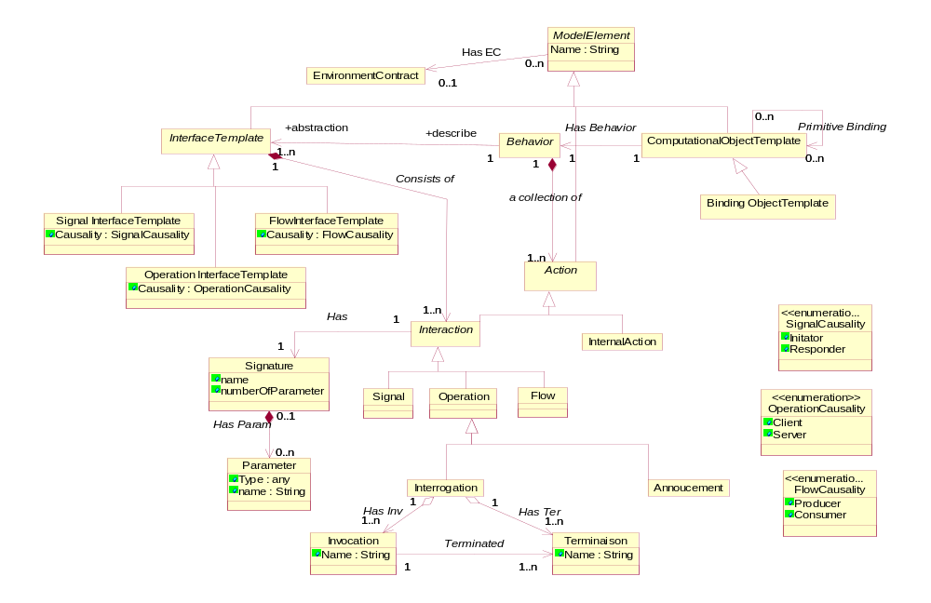
The ODP Computational viewpoint
The TRAMs Project
RM-ODP standard as an IMM
COBOL to JAVA Demo
Coupling RM-ODP/AS
Conclusion
The Computational Viewpoint Metamodel

Slide 10
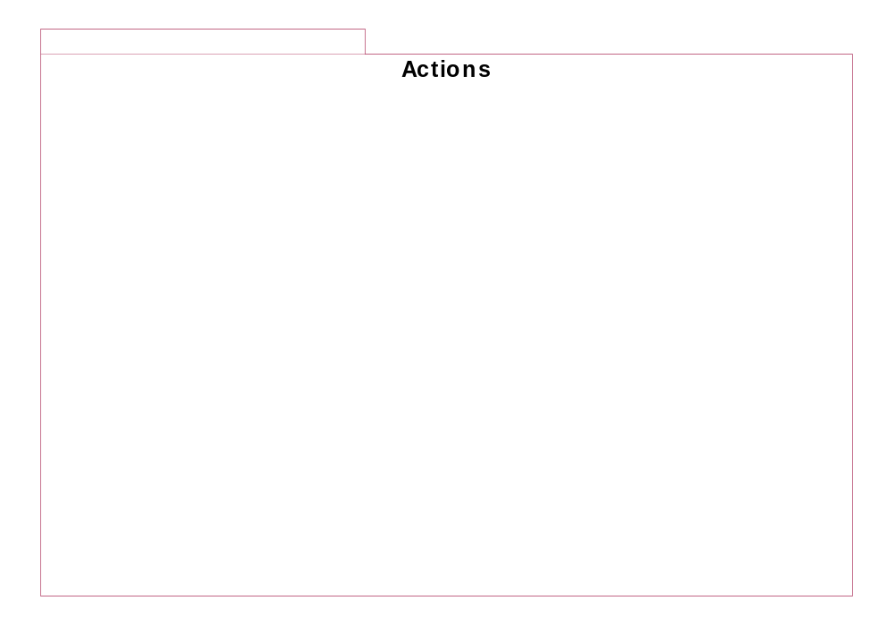
UML Action Semantics standard
The TRAMs Project
RM-ODP standard as an IMM
COBOL to JAVA Demo
Coupling RM-ODP/AS
Conclusion
Action Semantics: an extension to UML
Allows a precise specification of the behavior
Comes in form of a package: Actions
Composite
Read Write
Computation
Collection
Actions
Actions
Actions
Actions
Messaging
Actions
Action
Foundation
Jump Actions

Slide 11
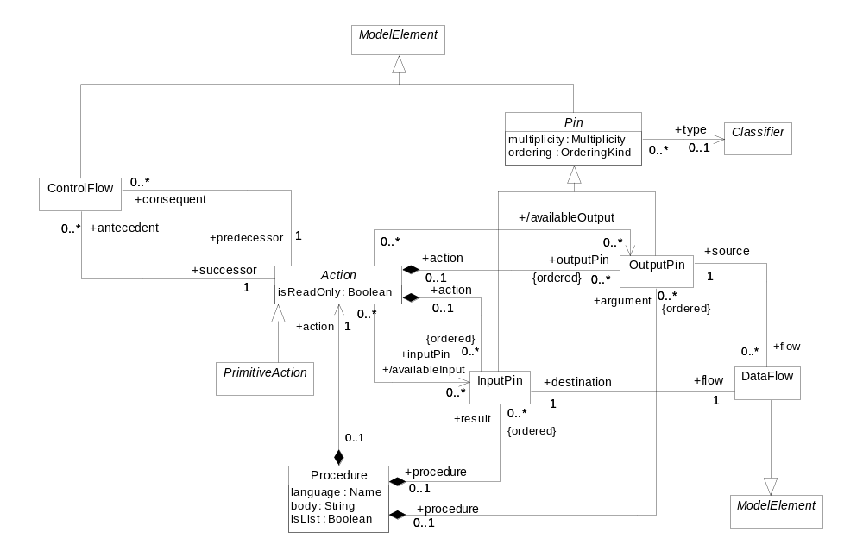
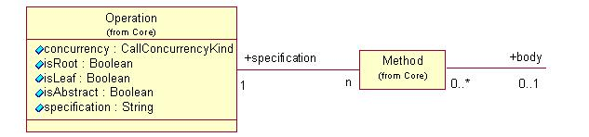
The Action Foundation package
The TRAMs Project
RM-ODP standard as an IMM
COBOL to JAVA Demo
Coupling RM-ODP/AS
Conclusion
The Action Foundation package: the core of Action Semantics

Slide 12


RM-ODP vs Action Semantics
The TRAMs Project
RM-ODP standard as an IMM
COBOL to JAVA Demo
Coupling RM-ODP/AS
Conclusion
RM-ODP
Action Semantics
Stability
+
well founded semantics
+
A precise behavior specification
Rigor
+
Links between viewpoints
+
+
Comes in the scope of the MDA
+
A complete intermediate MM

Slide 13
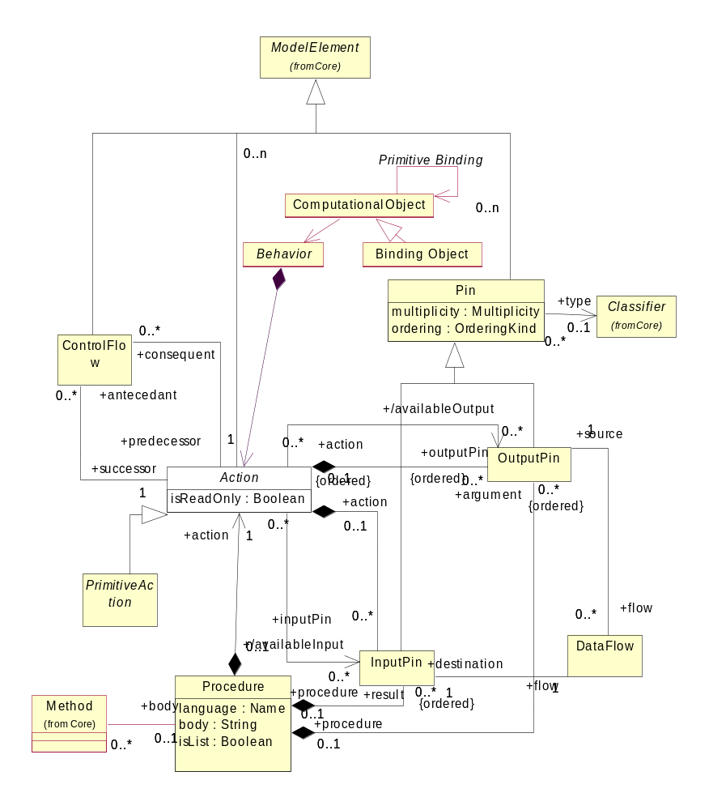
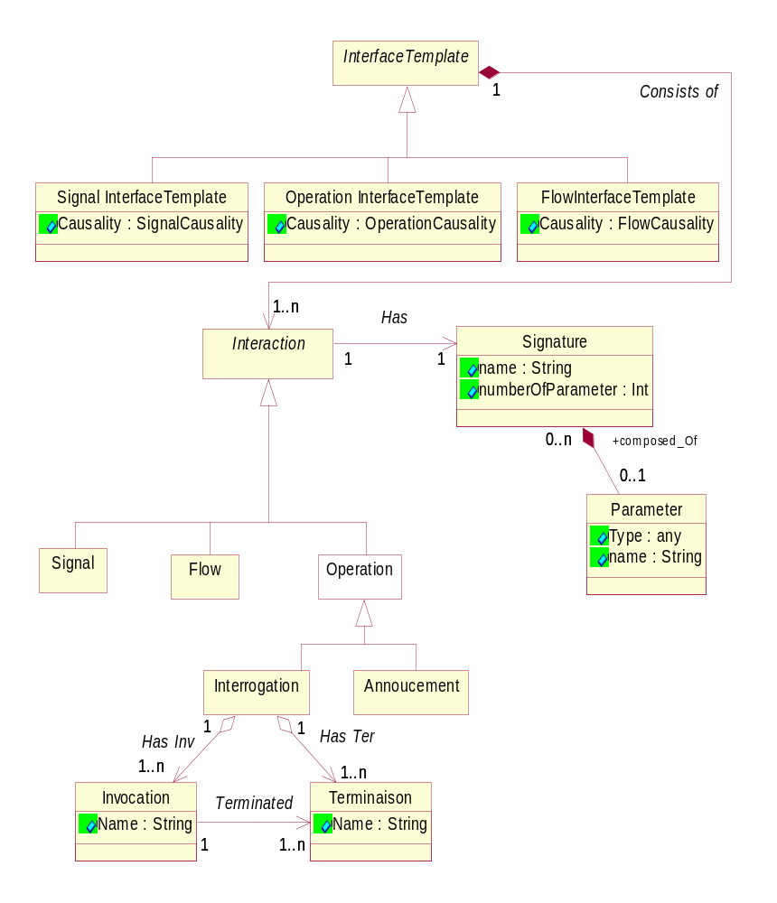
Integrating the two standards
The TRAMs Project
RM-ODP standard as an IMM
COBOL to JAVA Demo
Coupling RM-ODP/AS
Conclusion
1. n +abstraction
Abstraction
0..n
+describes
1
1
1
a collection of
1.n
1 + specification
+specifies
0..n
n
Action Semantics

Slide 14







The final COBOL to Java Demonstrator
An optimized migration with precise rules
Intermediate
Metamodel
(RM-ODP + Action Semantics)
Metamodel COBOL
Metamodel JAVA
Transformation rules
(A) ->Computational (IMM)
Transformation rules Computational (IMM)->(B)
In Conformity
In Conformity
In Conformity
Model COBOL
IM
Model JAVA
Reverse
Modeling
Generation
Source COBOL
Target JAVA
COBOL to Java migration using RM-ODP and Action Semantics

Slide 15
Conclusion and further works
The TRAMs Project
RM-ODP standard as an IMM
COBOL to JAVA Demo
Coupling RM-ODP/AS
Conclusion
TRAMs framework and methodology have
  Improved existing migration tools and best practices
  Influenced OpenQVT
TRAMs Intermediate MM
  Concrete semantics not needed
  Good complementarity of the two standards
Still to come…
  Improve code analysis
  Extend the business aspects in the migration

