Slide 1



A new viewpoint for change management in RM-ODP systems
Nesrine Yahiaoui^{1,2}, Bruno Traverson¹, Nicole Lévy²
1 EDF R&D - 2 UVSQ PRiSM
Workshop on ODP for Enterprise Computing
WODPEC 2005
Enschede, September 19
Versailles University

Slide 2
Contents
Problem Statement
Links for Change Management
Design Framework
Implementation with Eclipse/EMF
Conclusion

Slide 3
Problem Statement
Designing a system is a complex task
  The system is divided into several views (models),
  Each view represents the system according to a particular concern,
  The basic concepts of a particular concern are described into a viewpoint (meta-model).
Systems are continuously changing
  A change may occur on any view,
  A change may impact several views.

Slide 4
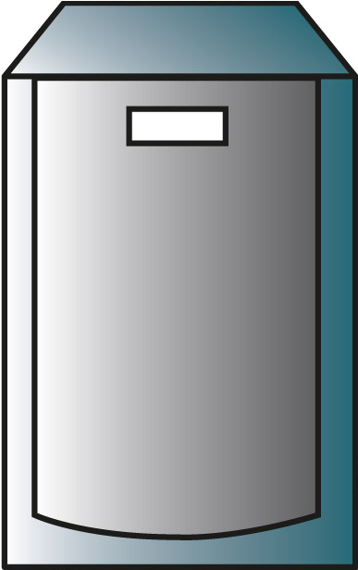
Reference Model for Open Distributed Processing ISO-10746
Enterprise
Information
Computational
Engineering
Technology

Slide 5
Discussion
Issues
  RM-ODP abstractly specifies correspondence rules between concepts defined in different viewpoints
    how to verify that they are satisfied ?
Some solutions
  ODAC (LIP 6), DASIBAO ( EDF R&D), EDOC ( OMG)
    Formalize the viewpoints using meta-modeling (MOF)
    Define UML Profiles to specify the views
    Guarantee consistency between views by construction
Problem
  These rules are not memorized

Slide 6
Discussion
Our objective is to study the impact of modification on a view
Our solution
  Introduce traceability between views
  Use the traceability to manage the impact of a modification
  Introduce correspondence link
    To memorize the correspondence between views
    To be able to verify the satisfaction of the correspondence rules

Slide 7
Correspondence Rule
Describes a constraint applied to concepts from two different viewpoints in order to achieve a consistency between views.
RM-ODP defines a set of rules in an abstract way
  Enterprise and Computational
    an enterprise object corresponds to computational object or a configuration of computational objects.
  Enterprise and Engineering
    a policy may correspond to and determines transparency requirements that engineering objects support.
  Computational and Engineering
    a computational binding, primitive or via a binding object, corresponds to a local or distributed binding (via a channel).

Slide 8
Correspondence Link
Introduce a new viewpoint that specifies the correspondence link concept
  Explicit binding between instances of concepts belonging to two different views.
  Bi-directional, possibility to navigate from any of the two views
  Constrained by a rule

Slide 9
Link Meta-model
EnterpriseMM
ComputationalMM
EngineeringMM
Concept
Concept
Concept
1..*
1..*
1..*
LinkMM
*
References
*
References
*
References
Enterprise-EndPoint
Computational-EndPoint
Engineering-EndPoint
1
1
1
1
1..*
Identifies
1..*
Identifies
1..*
Identifies
1..*
Identifies
Enterprise-Computational Link
Computational-EngineeringLink
Constrain
Rule
link
1..*
1

Slide 10
Illustration
Rule:
Rule1
Enterprise View
EnterEnp
enp1
Role:
ProduceElectricity
Ent-ComLink:
Corres1
CompEnp
enp2
Rule:
Rule2
CompEnp
enp3
Link View
Com-EngLink:
Corres2
EngEnp
enp4
Computational View
InterfaceOperation:
startProduction
Engineering view
InterfaceEngineering:
manageStopProduction
InterfaceOperation:
stopProduction

Slide 11
Design Framework
The models ( views) are described according to their respective meta-models (viewpoints)
The description of a link model explicitly binds the elements of different models.
The Impact management is triggered in the other views when one view is modified
  The modification in a view is described by a scenario
  Kinds of impact management
    Manual
    Semi-automatic
    Automatic

Slide 12
Design Framework
Evolution descriptor
meta-models
repository
use
Impact management
Evolution management
Models
repository
Parser
manipulate
Impact scenario builder
Local consistency controller
Integrator
Link-model
Repository
manipulate

Slide 13
Design Framework
Evolution descriptor
meta-models
repository
Δx
use
evolution management
Impact management
Parser
Models
repository
manipulate
Impact scenario builder
Local consistency controller
Δx
Integrator
Link-model
Repository
manipulate
Δy
Automatic
Semi-automatic
Δy
Manual

Slide 14
Implementation with Eclipse/EMF
Eclipse is
  Universal platform for integrating development tools
  Open, extensible architecture based on plug-ins
Eclipse Modeling Framework
  Eclipse plug-in
  Models and meta-models
  Code generation facility
  Serialization and loading

Slide 15
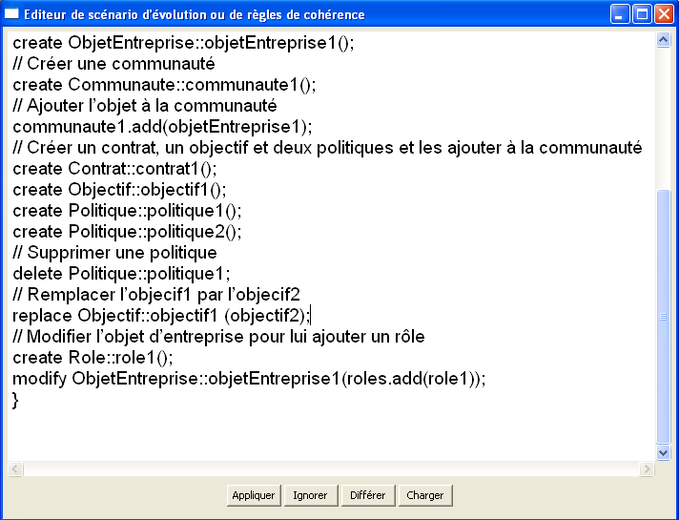
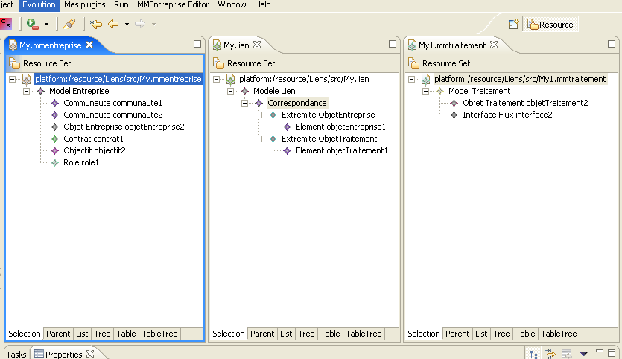
Implementation with Eclipse/EMF
Description of evolution
Execute button
Link view
Enterprise view
Computational view

Slide 16
Conclusion
Assets
  We proposed the concept of link that binds the elements that are in correspondence.
  We proposed a design framework that uses the correspondence links to manage modifications impact.
    Implementation is based on Eclipse/EMF.
Issues
  How can we make the impact management more automatic ?

