Slide 1
Modeling the ODP Computational Viewpoint with UML 2.0: The Templeman Library Example
José Raúl Romero, Antonio Vallecillo
Universidad de Málaga, Spain
Dept. Lenguajes y Ciencias de la Computación
{jrromero,av}@lcc.uma.es
Notes:
Abstract:
Six years after its final adoption as ITU-T Recommendation and ISO/IEC International Standard, the Reference Model of Open Distributed Processing (RM-ODP) is increasingly relevant, and we are now witnessing many major companies and organizations investigating RM-ODP as a promising alternative for specifying their IT systems, and for structuring their large-scale distributed software designs. Nevertheless, the fact that the RM-ODP is notation-independent may hinder the development of commercial tools for writing and analysing ODP system specifications, and hence its widespread acceptance and use.
The wide adoption of UML by industry, the number of available UML tools, and the increasing interest for model-driven development and the MDA initiative, motivated ISO/IEC and ITU-T to launch a joint project in 2004, which aims to define the use of UML for ODP system specifications (ITU-T Rec. X.906 | ISO/IEC 19793). Thus, ODP modellers could use the UML notation for expressing their ODP specifications in a standard graphical way, and UML modellers could use the RM-ODP concepts and mechanisms to structure their UML system specifications.
This talk discusses how UML can be used to model ODP concepts and mechanisms, and presents the current status of ITU-T Rec. X.906 | ISO/IEC 19793.

Slide 2

The Reference Model for Open Distributed Processing (II)
Viewpoint languages and notations
ODP Viewpoint languages are abstract, i.e., ODP does not prescribe any notation for expressing viewpoint specifications
Without a concrete syntax…
  it is difficult to write ODP specifications
  there is no tool support
  no analysis of the specifications (formal or informal)
  the industrial acceptance and application of ODP may be hindered.
Formal methods are convenient for precise/unambiguous interpretation of ODP concepts and specifications (eg. Z, Object-Z, LOTOS, maude, …)
… but traditionally useless
O
We need a general-purpose modeling notation, familiar to developers, easy to learn and to use, with commercial tool support …

Slide 3
ISO/IEC 19793 | ITU-T Rec X.906:
Use of UML for ODP system specifications
A standard defining:
  a set of UML Profiles for expressing a system specification in terms of viewpoint specifications
  possible relationships between the resultant ODP viewpoint specifications and how they are represented
  the structure of a system specification expressed as a set of UML models using ODP viewpoint profiles
Target audiences of ISO/IEC 19793
  UML Modelers, that need to structure (somehow) their LARGE system specifications
  ODP Modelers, that need some (graphical) notation for expressing their ODP specifications and tool support
  Tool vendors

Slide 4




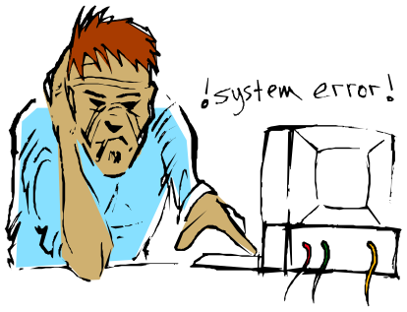
The Reference Model for Open Distributed Processing (III)
The RM-ODP viewpoints
Enterprise
Information
Business aspects
who? why?
ODP
System
Information, changes,
constraints
Technology
Hard- and software components
That implement the system
Computation
Configuration of objects
interacting at interfaces
Engineering
Mechanisms and services
for distribution transparencies

Slide 5
The Reference Model for Open Distributed Processing
Computational specifications
The Computational Viewpoint describes the functionality of the ODP system and its environment through the decomposition of the system into objects, which interact at interfaces, in a distribution transparent manner.
A Computational Specification describes the functional decomposition of an ODP system as:
  A configuration of computational objects;
  The internal actions of those;
  The interactions among those objects;
  Environment contracts for those objects and their interfaces.

Slide 6
Graphical notation for the ODP-CV (I)
Previous approaches
UML 1.4 originally proposed for ODP computational VP modeling:
  UML Profile for EDOC (Component Collaboration Architecture – CCA)
  Distributed System design within the DSE4DS Project (Akehurst et al.) + CQML (for environment contracts)
Very complete and precise approaches, but …
There is a big gap between the ODP and UML 1.5 concepts,
which made them too large and complex for a widespread industrial acceptance
ODP-CV Concepts
Mapping to UML elements
UML 1.X

Slide 7
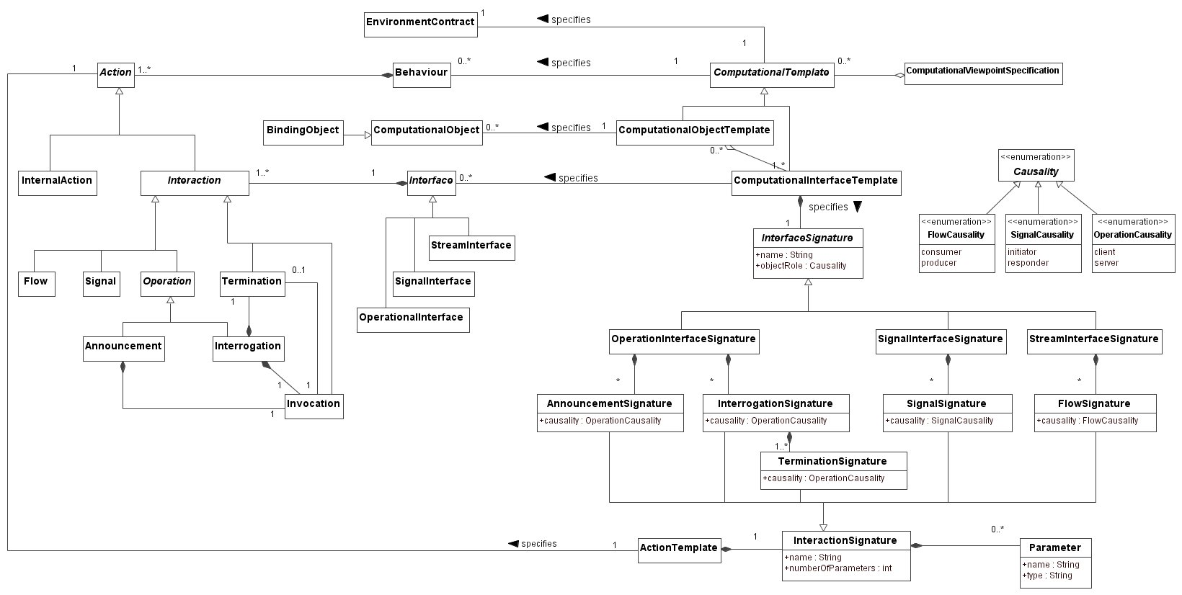
Graphical notation for the ODP-CV (and II)
Unified Modeling Language v2.0
UML 2.0 provides several improvements to UML 1 that make it more suitable for modeling the software architecture of large distributed systems
  The addition of new diagrams (e.g., interaction overview diagrams, timing diagrams, etc.) and enhancements to the existing ones (e.g., the component diagram)
  The influence of the mature SDL language
  The fully alignment of OCL with UML 2.0
  The enhancement of the language extension mechanisms
ODP-CV Metamodel
Mapping to UML elements
UML 2.0 Profile for the ODP Computational Viewpoint

Slide 8
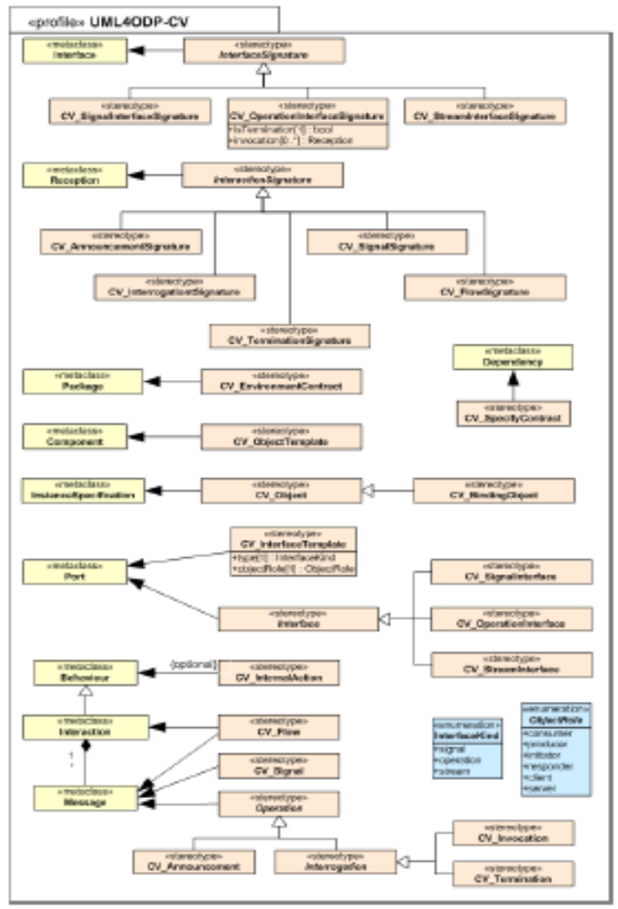
Modeling the ODP-CV in UML 2.0 (I)
The UML 2.0 Profile for the ODP Computational Viewpoint
The UML Profile defines the stereotypes, tags and constraints that allow us to use the specific domain terminology
  It serves as input to the WG19 work on ISO/IEC 19793 | ITU-T X.906:
  UML for ODP system specifications

Slide 9
Modeling the ODP-CV in UML 2.0 (II)
Computational objects and interfaces
ODP concept | UML element
Computational object template | Component <<CV_CompObjectTemplate>>
Computational object | InstanceSpecification (from Component) <<CV_Object>>
Computational interface template | Port <<CV_CompInterfaceTemplate>> Tags {objectRole, type}
Computational interface | Interaction point (Port at instance level) <<CV_SignalInterface>> <<CV_OperationInterface>> <<CV_StreamInterface>>
Computational interface signature | Interface <<CV_SignalInterfaceSignature>> <<CV_OperationInterfaceSignature>> <<CV_StreamInterfaceSignature>>

Slide 10
Modeling the ODP-CV in UML 2.0 (III)
Interactions
ODP concept | UML element
Signal | Message <<CV_Signal>>
Operation and Flow | In terms of Signals <<CV_Invocation>> <<CV_Termination>> <<CV_Announcement>> <<CV_Flow>>
Interaction signature | Reception <<CV_SignalSignature>> <<CV_InterrogationSignature>> <<CV_TerminationSignature>> <<CV_AnnouncementSignature>> <<CV_FlowSignature>>

Slide 11
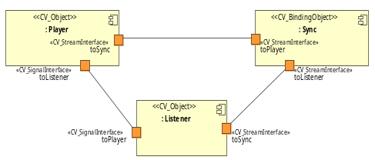
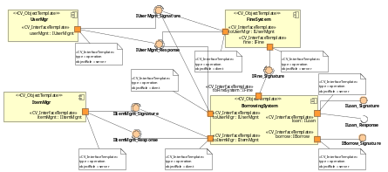
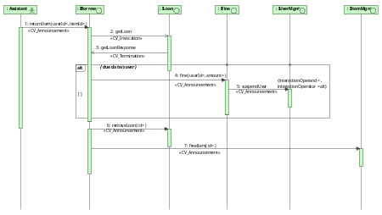
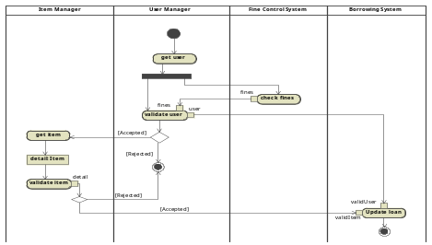
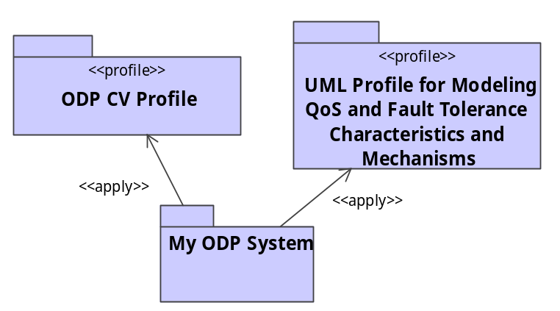
Modeling the ODP-CV in UML 2.0 (IV)
Specifying ODP Computational specifications
Component diagrams are used to describe the Structure
Behaviour is described in terms of:
Interaction models (message passing)
Activity models (sequence, i/o, …)
Statecharts (changes caused by events, …)
Environment contracts are modeled:
using UML restriction mechanisms (OCL, timing models, …)
applying other UML profiles (e.g., UML Profile for Modeling QoS Characteristics)

Slide 12
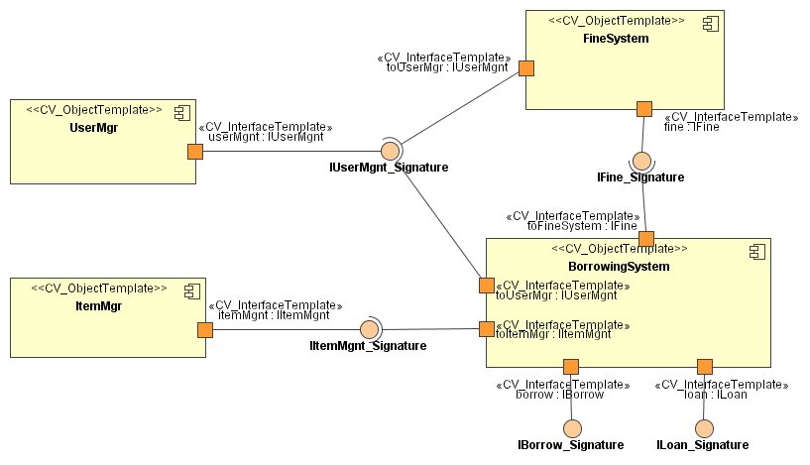
Modeling the ODP-CV in UML 2.0 (V)
Example: Structure specification

Slide 13
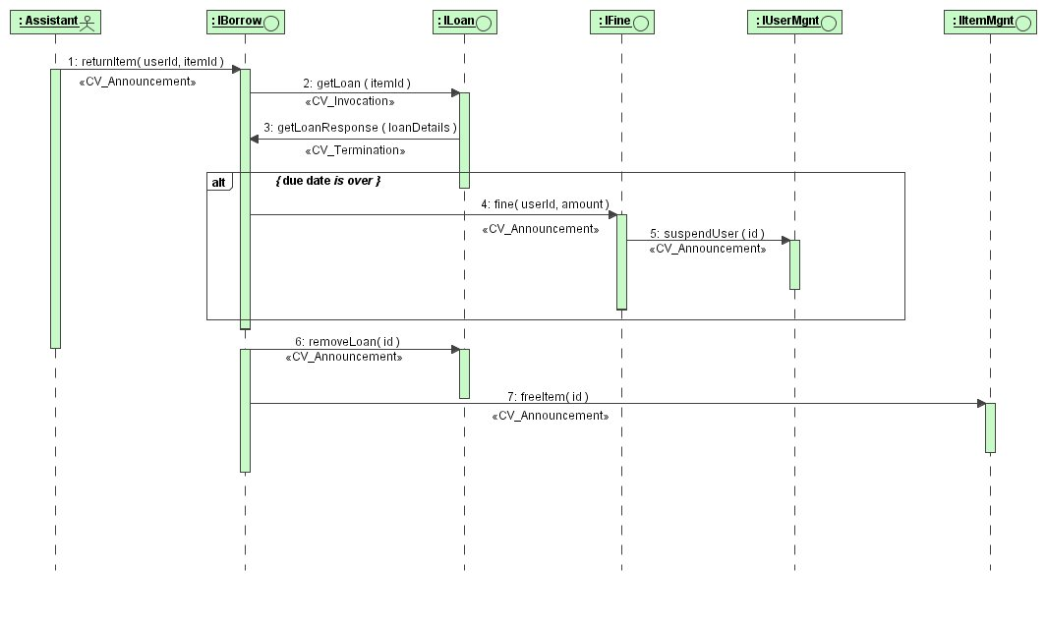
Modeling the ODP-CV in UML 2.0 (VI)
Example: Behaviour specification

Slide 14
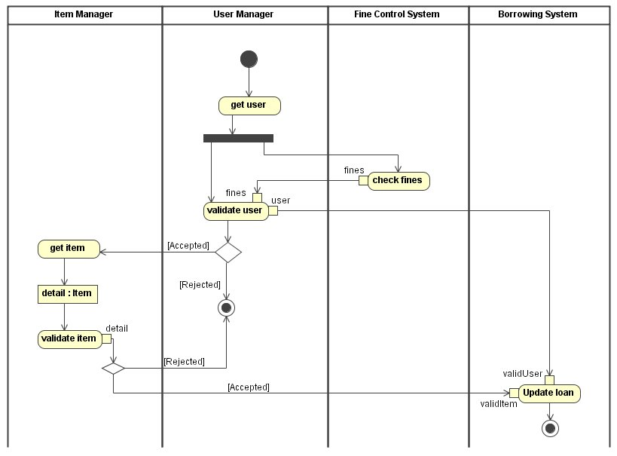
Modeling the ODP-CV in UML 2.0 (VII)
Example: Behaviour specification

Slide 15
Issues
Differences between the ODP and UML object models
  The UML object model assumes that classes are first-class citizens, organized into a single hierarchy. Objects are instances of these classes. The ODP model considers objects as first-class citizens. Types are predicates on objects, and classes are collections of objects.
  In UML, invariants and operations are owned by individual objects. ODP uses “collective state” for invariants, and “collective behavior” for operation and interaction specifications
Terminology conflicts
  ODP object vs. UML object
  ODP type vs. UML type
  ODP interface vs. UML interface;
  ODP class vs. UML class
Structuring rules
  In ODP, signals with different causalities can coexist in an interface. UML requires different UML interfaces for signals with different causalities.
  ODP computational objects can instantiate interface templates. UML ports cannot be individually instantiated.

Slide 16
Conclusions
UML 2.0 may help represent ODP Computational concepts in a more natural manner than UML 1.5
There is no “perfect” match, although the results are not bad (in general)
Still to do:
  Correspondences with other viewpoint specifications
  Connection with analysis tools

Slide 17
Thank you!

