Slide 1


Adopting the Practice of Enterprise Analysis in a Mid-Sized Company
Mary Burns Furr
Adaptis, Inc
Seattle, Washington USA
Notes:
Good Afternoon!
I am delighted to be here.
A year ago, in Monterey, when I getting first getting my feet wet in regards to the RM-ODP, I would never have dreamed that I would be here with you today.
It’s truly an honor to be here with you today.
My goal today is to share my first-year experiences in introducing the practice of enterprise analysis at the company where I work:
Approach
Results
Challenges
Lessons Learned
Next Steps
Needs
Ideas for promoting the use of the RM-ODP in mid-sized companies

Slide 2

Introduction
Adaptis A mid-sized company
  Founded in 1996
  Over 150 employees
  Headquarters in Seattle, Washington
Focus Healthcare insurance administrative services
  Business process outsourcing
  Professional services

Slide 3
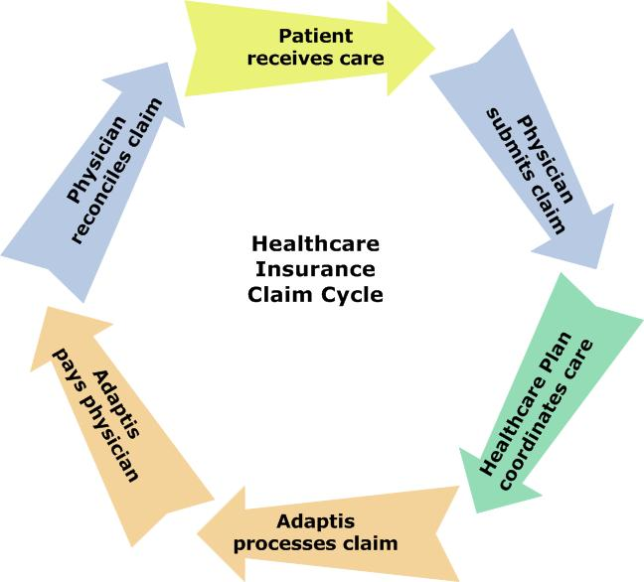
Introduction (continued)
Core competencies
  Customer facing
    Claims processing
    Eligibility/benefits management
    Medical management
    Reimbursement
    Customer service
    Decision support
  Back office
    Operations management and support
    Account management
    Database services
    Networking
    Security
    System administration
    Product management
    System development
    System implementation
Notes:
Two broad categories of core competencies
Customer facing
Back office
Customer facing
In the United States
Most people have healthcare insurance to cover their medical needs, so the healthcare delivery cycle is overlaid with an associated revenue cycle
Although federal and state mandates are forcing standardization, the business processes for administering a person’s healthcare insurance are highly variable, business-rule laden, and exception-based
In this diagram, the role of the
Patient is in yellow PATIENT RECEIVES CARE
Physician is in blue PROVIDER SUBMITS CLAIM
Healthcare insurer plan is in green INSURER COORDINATES BENEFITS
BPO outsourcer in orange BPO PROCESSES CLAIM/PAYS PHYSICIAN
PHYSICAN RECONCILES CLAIM
Back office
This is where outsourcers add significant value in terms of systemizing and streamlining administrative processes and enabling electronic data interchange (EDI) and web services.
To meet these needs, Adaptis is developing a service-oriented architecture and the capability to support multiple customers in multiple jurisdiction across multiple lines of business.
So, besides being experts in the administration of healthcare insurance, we also are experts in data processing and business-to-business and business-to-customer services.
However, we also sell our proprietary claims processing system. So, in many ways, product management and systems development/implementation are the backbone of our business.
Move to the right of the screen
when describing the cycle

Slide 4
Introduction (continued)
Distributed processing environment
  Adaptis headquarters
  Remote operations center
  Outsourcing partners
    United States and other countries
  Customers
    Health insurance plans, physicians, patients
    Multiple locations throughout United States
Competitive edge
  Scalable, cost-effective business framework, processes and practices that are always on track to consistently meet contractual service level agreements
Notes:
Although I’ve not heard anyone at Adaptis describe it as such, we do operate in a distributed processing environment.
Adaptis HQ in Seattle
ROC in 200 miles away in Eastern Washington
Outsourcing partners in US and other countries
Customers throughout the US
Competitive edge
Not just a marketing pitch
Why enterprise analysis and the RM-ODP are of value to Adaptis

Slide 5
Enterprise analyst position created 2004
Goals for first year
  Establish the enterprise analysis activity
  Prepare for collaborative modeling in 2005
Exploration was key activity
  No intent to adopt a silver bullet
  Learning was the primary objective

Slide 6
Approach
Define the practice of enterprise analysis within Adaptis
  What is
    A business?
    A domain?
    An enterprise?
  How is enterprise analysis different than
    Business analysis?
    Domain analysis?
    Enterprise architecture?
Develop straw models
  Create a stable basis for future work by leveraging
    Standards
    Industry models
Notes:
Two-fold approach
Define the practice of enterprise analysis
Develop straw models
Why was defining the practice of enterprise analysis so important? Two reasons:
It was already difficult to guide the level and topic of discourse between business requirements, product management requirements, and system requirements.
Adding enterprise requirements would have added to the confusion and introduced unnecessary churn if it were not defined and differentiated with business analysis and domain analysis.
Creating the Enterprise Analyst position introduced change within the organization. People wanted to know what the duties and deliverables of the position were and how the new position would impact their job, status, and influence within the organization.
Straw modeling approach
Increasing stability and interoperability across customers, lines of business, domains, etc., was one of the primary goals of investing in enterprise analysis.
Industry standards and adopted models were viewed a good way to quickly gain knowledge and stable conceptualizations.

Slide 7
Results
To get started
  Explored the Zachman Framework for Enterprise Architecture
  Results
    Planner’s perspective most useful
    Kept analysis grounded when complexity became overwhelming
To discover stable conceptualizations
  Explored industry classifications and standards
    North American Industry Classification System (NAICS)
    Process frameworks and data models
    ASC X12 electronic data interchange (EDI) standards
  Results
    Helped categorize and differentiate business services and processes
    Reduced time to develop straw models
    Provided a concise summary and definition of industry concepts
Notes:
Zachman Framework for Enterprise
Initial focus because of organizational interest
Still valued as a means of classifying relationship between SDLC activities and artifacts
Planner’s perspective (top row) kept analysis grounded
Stable Conceptualizations
NAICS
Context
Finding relevant standards by business sector
Process frameworks and standards
High-level, comprehensive views of processes and business concepts
Why reinvent the wheel?
ASC X12 electronic data interchange (EDI) standards
Business concepts and vocabulary

Slide 8
Results (continued)
To define viewpoints and levels of abstraction
Method Value Added
  RM-ODP EV Concise, powerful enterprise specification
  TOGAF 8 ADM Business architecture and scenarios
  OMG MDA Mapping artifacts between approaches
  Off-the shelf models Industry acceptance = stable models
  Ontologies Not used (incomplete, immature)
To harmonize concepts and terms across industries
  Planned to create domain models where they added significant value
  Results
    To be determined…
Notes:
RM-ODP
Applied the RM-ODP to a new project launched early in 2005 involving integrating COTS with the existing claims processing system. Project was loaded with scoping issues driven by different perceptions and priorities on the part of stakeholders.
Was impressed with the power of the UML model to concisely express the enterprise viewpoint. Easy to sketch out and quickly summarized context, communities, roles, policies, roles, objects, and interactions. Saved a whole lot of text AND helped to quickly identify interdependencies.
TOGAF 8 ADM
Used the ADM approach to develop a business architecture and business scenario for the same project that I developed the UML model of the RM-ODP enterprise viewpoint.
The business scenario was especially useful in working with stakeholders to define the “as is” and “to be” business, processing, and technical environment before and after the COTS implementation.
OMG MDA
Anticipated that the concepts of CIM, PIM, and PSM would be of most value. In fact, what was of most value was the mapping of Zachman Framework and TOGAF concepts.
OMG standards are tracked carefully by Adaptis. We are especially interested in emerging standards for business rules.
Off-The-Shelf Models
As mentioned earlier, reduced cost by avoiding reinvention of the wheel and hopefully will promote concept, model, and semantic stability.
Ontologies—not used (X12 standards more useful)
Domain models—not built due to change in organizational leadership and priorities

Slide 9
Challenges
Knowledge and technology transfer barriers
  Powerful Enterprise analysis vs agile and lean
  perception
  Need for RM-ODP interactions vs use cases
  translation RM-ODP policies vs business rules
  Ineffective Sound bites vs organizational learning
  communication
Notes:
Knowledge and echnology transfer challenge
Competing Methodologies
Sound bite communications
Impatience with non-technical viewpoints
Must leverage “learning opportunities”
Shared semantics are essential
Enterprise analysis versus agile and lean
Perceived value of EA
Reduce development and maintenance costs
Enable customization of products for new customers and lines of business
Knowledge
ALL OF WHICH ARE INTANGIBLE IT ASSETS THAT CREATE COMPETITIVE EDGE
RM-ODP Translation
The UML modeling approach for specifying interactions would have been, in the COTS project mentioned earlier, more effective as a basis for detailed requirements. However, due to schedule and resource pressure, it was simply impossible to introduce the RM-ODP to the organization. I ended up translating the EV model to a traditional use case map.
Policies are business rules…again a translation and education overhead…and it conflicts with the Business Motivation Model definition of business policies published by the Business Rules Group (which is working with OMG)
Sound bites
Hard to explain new techniques and concepts in a sound bite…but that’s the challenge that must be met

Slide 10
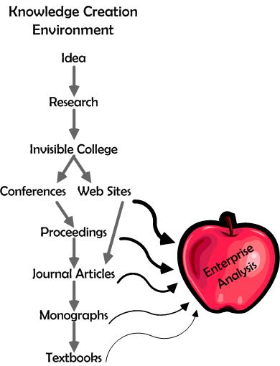
Challenges (continued)
1. Finding information
Notes:
Created a picture of what I experienced in the last year.
The Knowledge Creation Environment is a familiar model to librarians and information scientists.
Lots of information, but comparing and digesting approaches was hard.
Found most articles at web sites and in proceedings.
However, the information that was most useful to me as a business practitioner was the explanation of approaches, such as the ZFEA and the RM-ODP, in books written for the novice developer or technical leader.
So in the course of my research, I created this beautiful apple of knowledge concerning the practice of enterprise analysis.

Slide 11
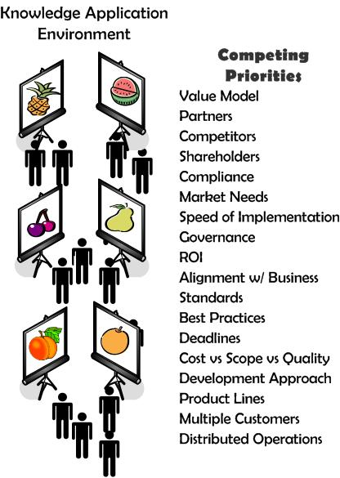
Challenges (continued)
2. Generating interest
Notes:
On the other hand,
I found that my colleagues had different goals on their radar screens…different priorities and different ideas.
It was difficult to generate interest in enterprise analysis.

Slide 12
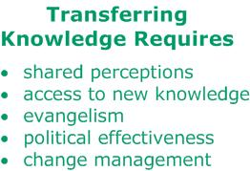

Lesson learned
Notes:
My conclusion is that I face primarily a knowledge and technology transfer challenge:
To be successful, I will need to:
Foster shared perceptions
Provide access to new knowledge
Evangelize the benefits of enterprise analysis
Strengthen my political skills
Continually recognize need for, and practice, change management
I put “shared perceptions” at the top of the list because it’s my conclusion that
Knowledge alone doesn’t motivate people to a superior technology
To be willing to experiment/accept a new technology, people must believe that it will help them meet whatever they believe is in their own self-interest
The only way to align self-interests is to collaborative create shared perceptions of
Strengths
Weaknesses
Opportunities
Threats

Slide 13
Needs
Literature
  Practical advice, examples, best practices
Conferences
  Shared successes in business language
Tool support

Slide 14
Next steps
Introduce enterprise analysis at beginning of projects
Leverage the influence of the enterprise architecture team
Prepare a “sales pitch” for stakeholders
Recognize and capitalize on “teaching moments”
Keep learning and experimenting

Slide 15
Conclusion
RM-ODP is a powerful tool
To facilitate its adoption, continue to
  Compare and differentiate RM-ODP with other approaches
  Provide examples of business value
  Publicize successes at conferences and in business journals
Thank you!
Questions?

Slide 16
Lesson learned

