Slide 1
UML 2 Models for ODP
Engineering/Technology Viewpoints
– An Experiment －
Daisuke Hashimoto
hashimoto@tech-arts.co.jp
Hiroshi Miyazaki
miyazaki.hir-02@jp.fujitsu.com
Akira Tanaka
akira.tanaka.pr@hitachi.com

Slide 2
Agenda
Introduction
UML 2.0 profile and models for Engineering Viewpoint
UML 2.0 profile and models for Technology Viewpoint
Considerations
Conclusions

Slide 3
Introduction

Slide 4
Background and objective
The ISO/IEC and ITU-T joint project, “Use of UML for ODP system specifications,” made a decision to shift from UML 1.4 to UML 2.0 based profile.
Therefore it is necessary to examine that UML 2.0 model elements can appropriately represent necessary ODP concepts.
The above project is an international collaboration, and we are interested in Engineering and Technology viewpoints for promising connection with OMG’s MDA initiative.
Here I am to present this paper.

Slide 5
This paper is Based on...
Authors are members of INTAP (Japan) ODP committee.
    Developed “A Guide for using RM-ODP and UML Profile for EDOC” (2003)
This paper is based on:
  RM-ODP Part 2, Part 3, and Enterprise Language standards
  CD document of ISO/IEC and ITU-T’s joint project “Use of UML for ODP system specifications”
    INTAP ODP committee has liaison with Japanese committee for SC7/WG19 on RM-ODP activity.
  INTAP Technical Report “Applying EDOC and MDA to the RM-ODP Engineering and Technology Viewpoints” (2003)
    Profile developed with the same objective, but based on UML 1.4
  UML 2.0 superstructure specification from OMG

Slide 6
UML 2.0 profile and models for Engineering Viewpoint

Slide 7
Target Architectural Diagrams
Five architectural diagrams are quoted here from RM-ODP Part 3 Engineering Language.
Those diagrams are grouped into two:
  Diagram 1 to 3 for Node structure modeling discussion
  Diagram 4 to 5 for Channel modeling discussion

Slide 8
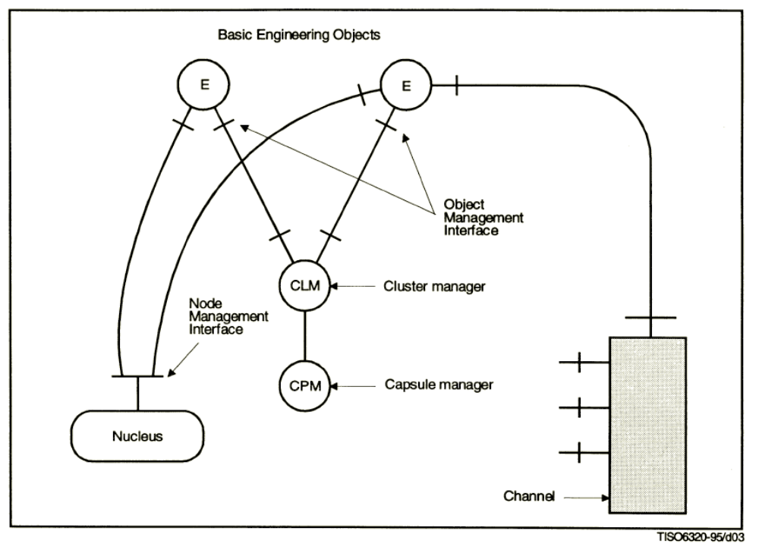
Target Architectural Diagrams -1
Example structure supporting a basic engineering object (from RM-ODP Part 3, Clause 8 Figure 4)

Slide 9
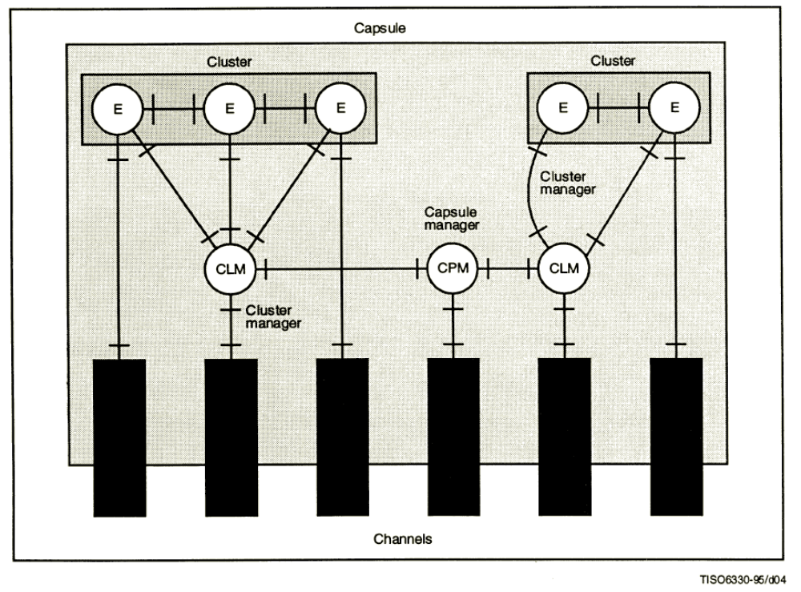
Target Architectural Diagrams -2
Example structure of a capsule (from RM-ODP Part 3, Clause 8 Figure 5)

Slide 10
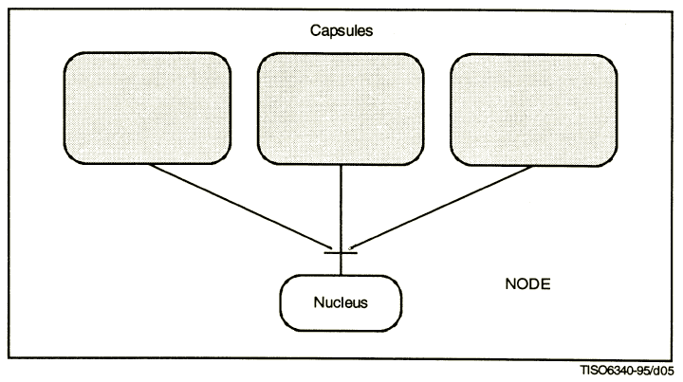
Target Architectural Diagrams -3
Example structure of a node (RM-ODP Part 3, Clause 8 Figure 6)

Slide 11
Major elements from those diagrams
Need to cover at least the following major elements in UML 2.0 diagrams:
  Basic Engineering Object (BEO)
  Capsule
  Capsule Manager (CPM)
  Cluster
  Cluster Manager (CLM)
  Node
  Nucleus

Slide 12
Candidate UML diagrams
Deployment diagram
  Deployment diagram has some constraints.
    Node:
      UML 2 only allows certain types of modeling elements
      (e.g. Node, Artifact) to be placed within a Node.
      Artifact is poor to represent internal structure of capsule.
    Communication path:
      This diagram’s communication path is association between Nodes
      (not communication path between capsules).
Class diagram and Component diagram
    Component and Class (structured classifier) can have parts.
    Those diagram is powerful to represent internal structure of Node.
Which one?
  Will be discussed in the following slides.

Slide 13
Issue: modeling engineering objects
Candidates for modeling engineering objects.
  Class: may be more abstract than component?
  Component: may give an impression of software component?
Concept of ODP’s Object is close to Object concept in UML.
  But, Object is used to represent snapshot in UML world.
  (UML modeling is class based)
  Object is defined by element of Instance specification in UML2.0.
  Instance specification is not classified (Class? Component?)
Our choice in this paper is…
  Using Component for profile definition.
  Using Component instance for diagramming.
class
component
specification
class
component
instance
object
component
instance
InstanceSpecification

Slide 14
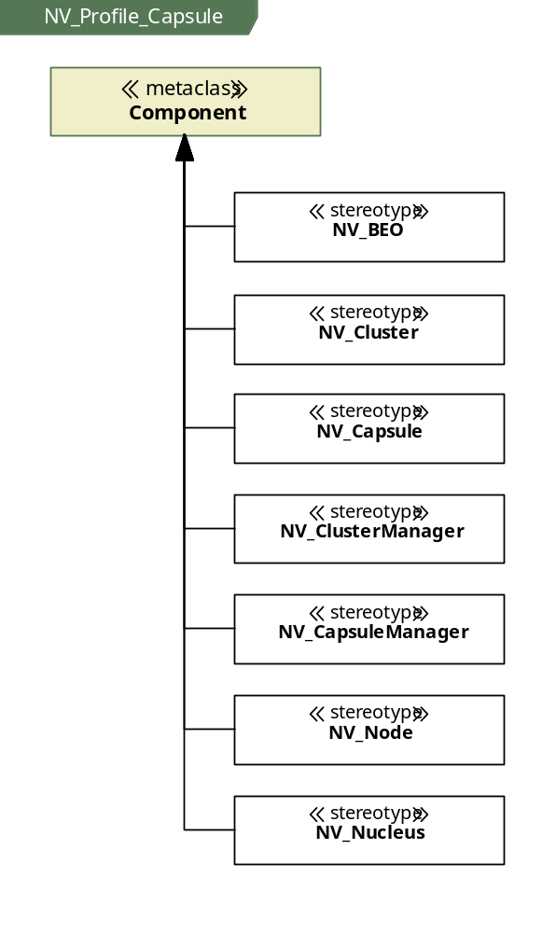
Profile definition (1/3)

Slide 15
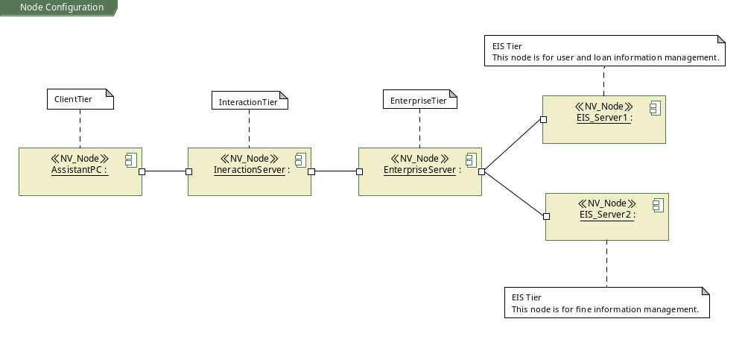
Example UML 2.0 Model: Nodes

Slide 16
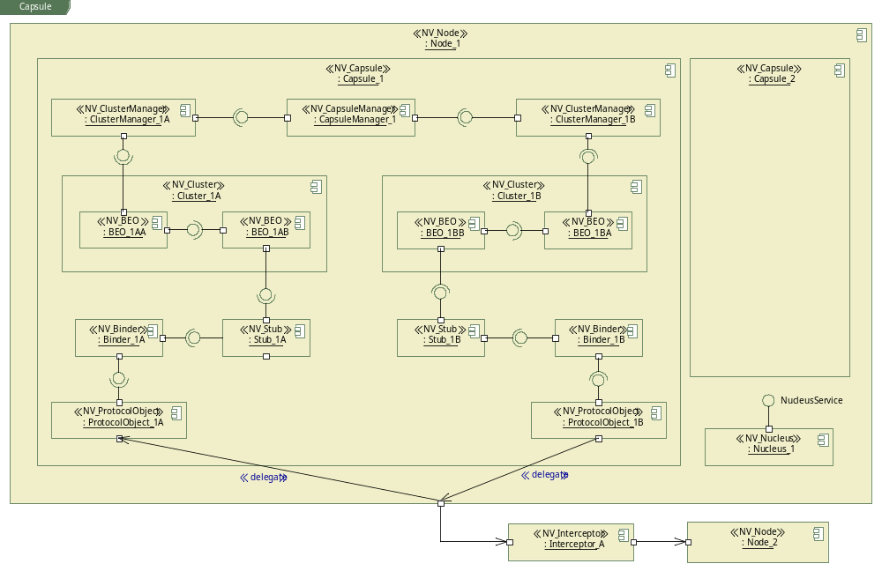
Example UML 2.0 model: Node(internal)

Slide 17
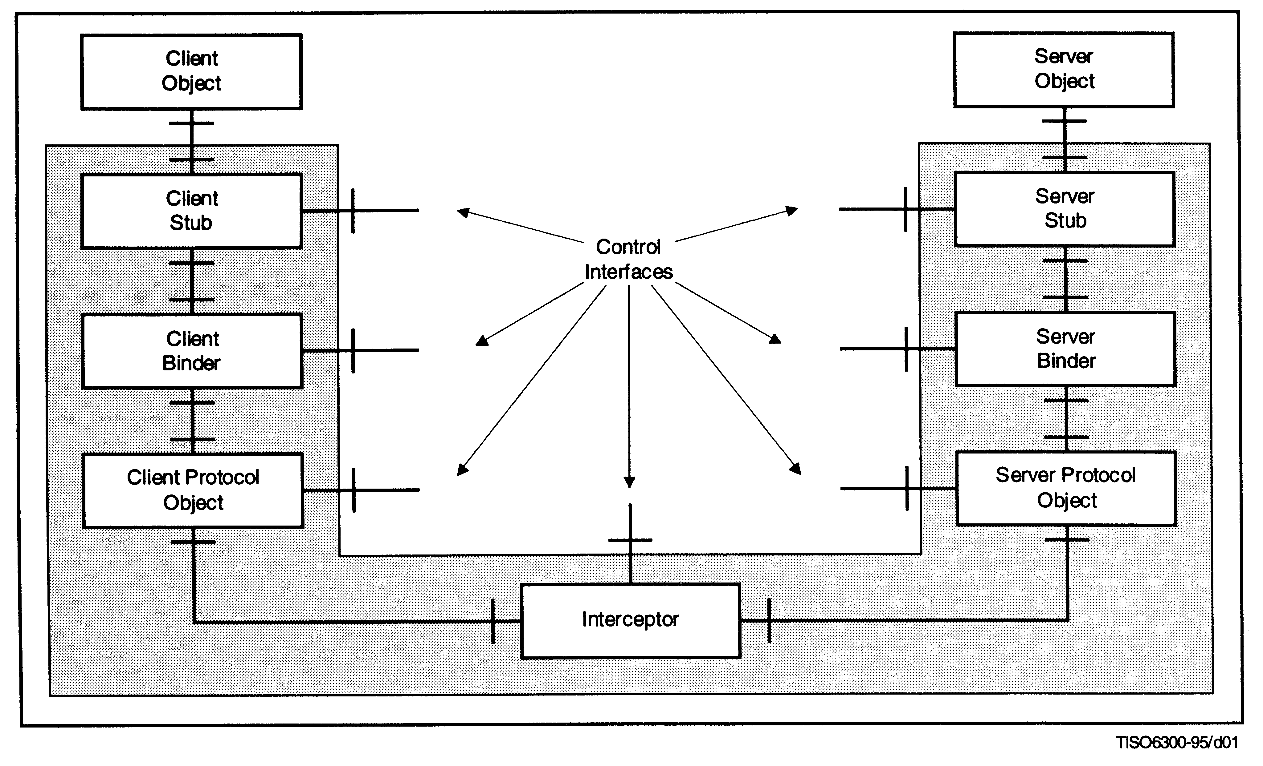
Target Architectural Diagrams -4
An example of a basic client/server channel (RM-ODP Part 3, Clause 8 Figure 2)
Notes:
Second diagram group is Channel.
This diagram is basic client/server channel.
Channel is contained Stub, Binder, Protocol Object and Interceptor.

Slide 18
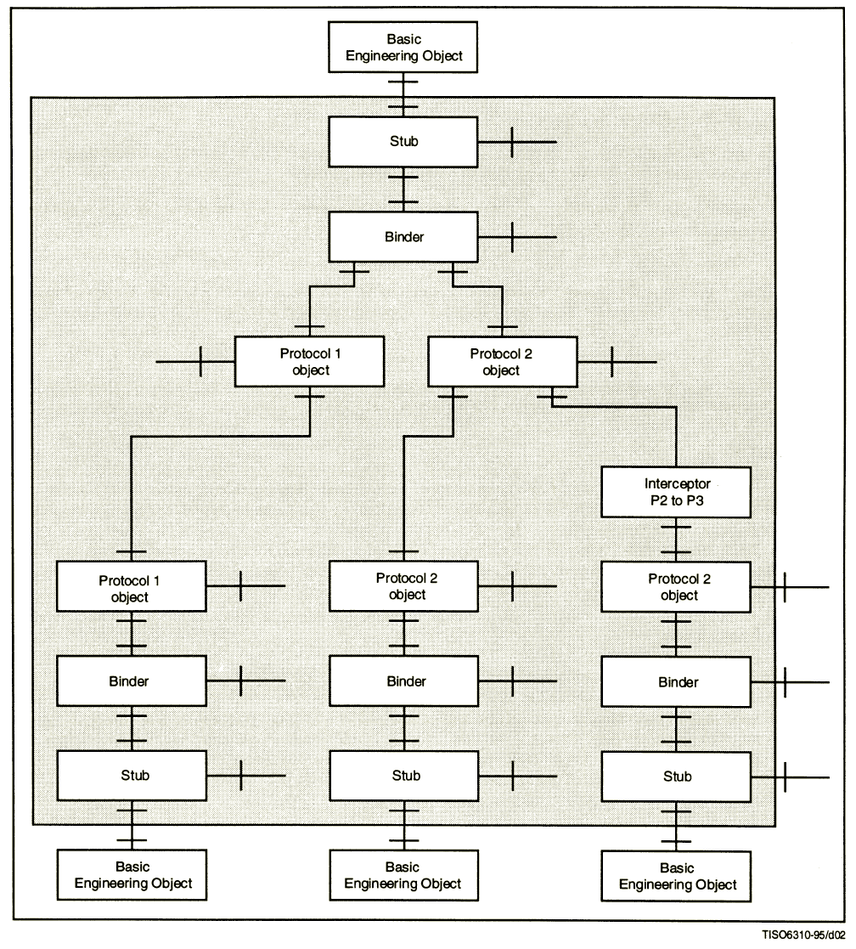
Target Architectural Diagrams -5
An example of a multi-endpoint channel (RM-ODP Part 3, Clause 8 Figure 3)

Slide 19
Major elements from those diagrams
Channel
Stub
Binder
Protocol Object
Interceptor
Candidate diagrams
  Composite structure diagram
    Represent configuration of channel in this aspect.
    Class or component has capability to represent it.
  Package diagram
    Not able to represent the structural aspects.

Slide 20
Issue: modeling channel
Node and Channel shares the same Engineering objects
(Stub, binder, Protocol Object), i.e. ideally overlapping diagram are needed to represent this situation.
UML 2.0 does not provide “overlapping diagram” capability.
Possible approaches:
  two separate diagrams (double occurrence of the same engineering object)
  one structural diagram and one package
Our choice in this paper – Structural diagram for Node and
use of package for Channel
Channel
Node A
Node B
Engineering object

Slide 21
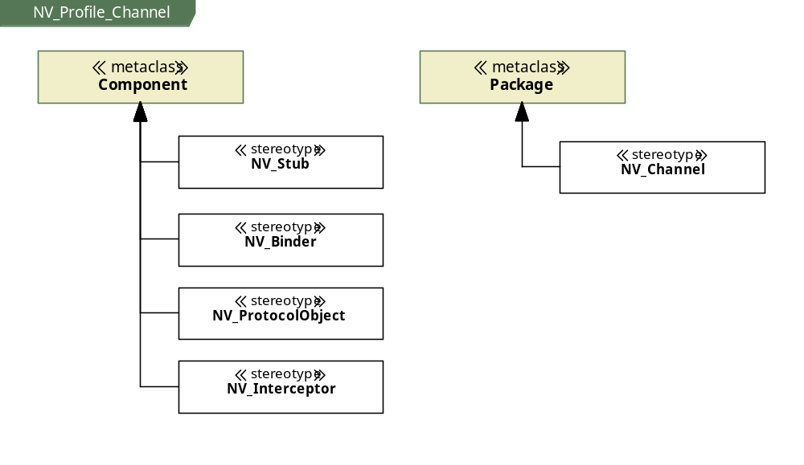
Profile definition (2/3)

Slide 22
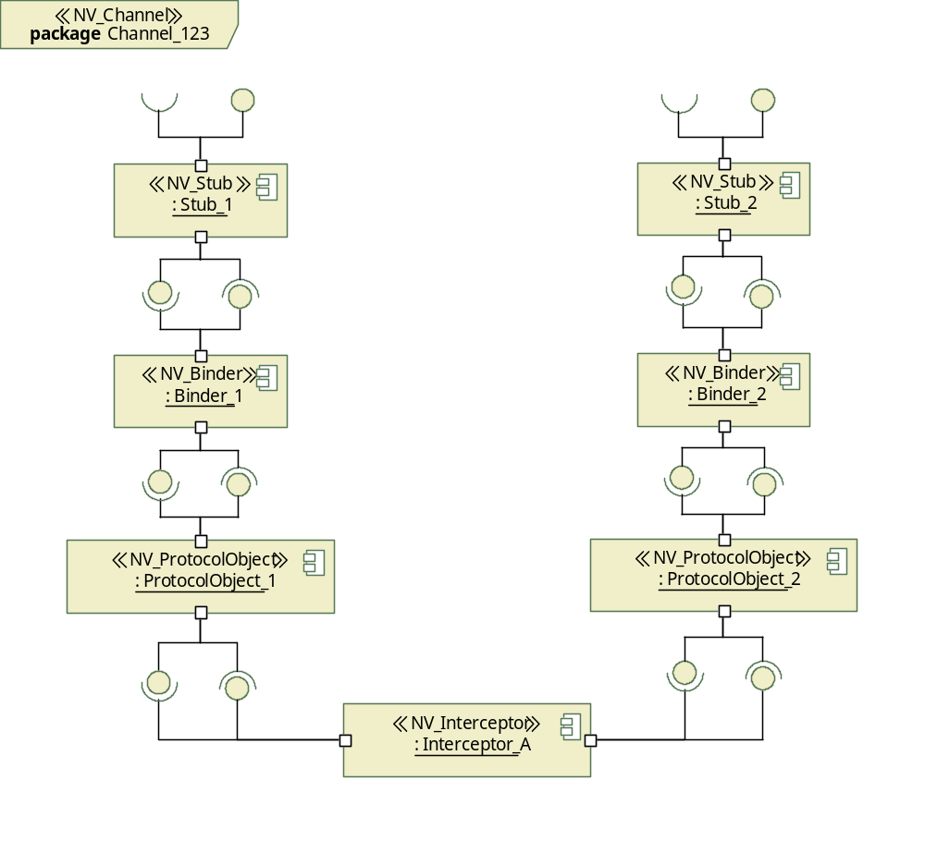
Example UML 2.0 model: Channel
Note: Interface connection may be omitted.

Slide 23
Objects and domains
A domain is a set of objects: which UML element can represent ODP domain concept properly?
  <X> Domain: A set of objects, each of which is related by a characterizing relationship <X> to a controlling object.
Three candidates for modeling domain
  Class: members are parts (classes) <structured classifier>
  Component : members are parts (components)
  <structured classifier>
  Package: members are any model element.

Slide 24
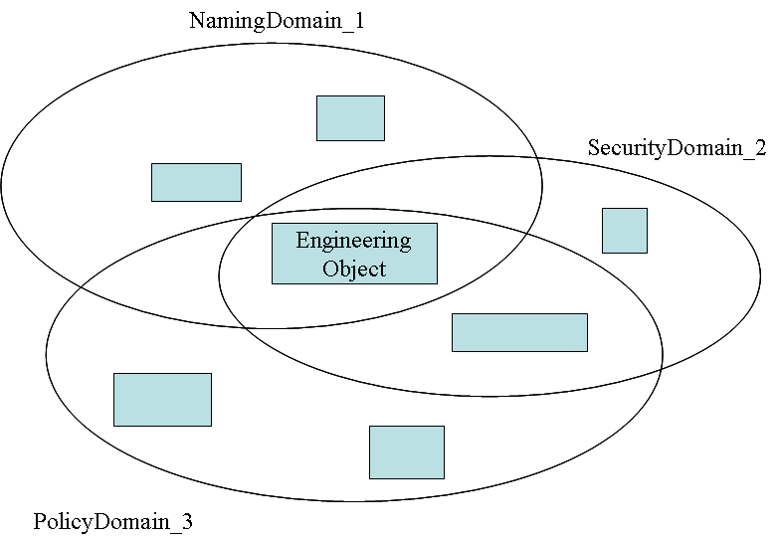
Issue: modeling domain
A member may belong to multiple domains, i.e. domains may share the same objects
  Class: parts can be shared [use of dotted line box]
  Component: can parts (component) be shared?
  Package: «import»/«access» may be used to share
Our choice in this paper - Package

Slide 25
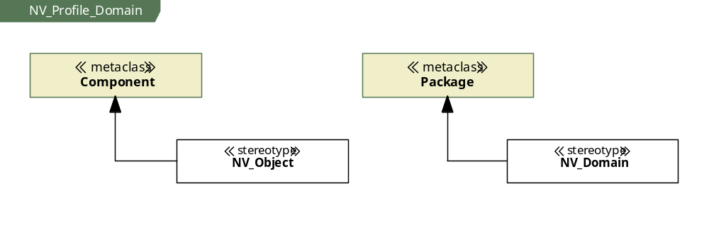
Profile definition (3/3)

Slide 26
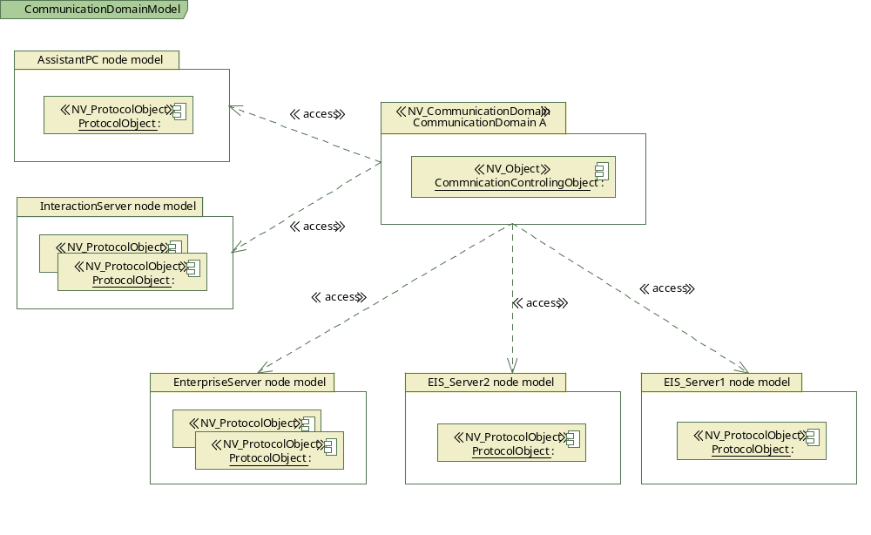
Example UML 2.0 model: Domain and objects

Slide 27
Issue: Correspondence
Engineering Viewpoint to Computational Viewpoint
  Assumption: Each BEO has one to one relationship to corresponding Computational Object (from Engineering to Computational, not vice versa).
  Correspondence could be expressed as
  dependency from BEO sub-Package in Engineering Viewpoint Package to Computational Objects in Computational Viewpoint Package in UML
The issue
  How to best express this correspondence in UML
CV
NV

Slide 28
UML 2.0 profile and models for Technology Viewpoint

Slide 29
Major Elements in this viewpoint
Technology Object
Implementable Standard
Implementation
IXIT
Candidate diagram
  Deployment diagram

Slide 30
Issue: rich set of concepts in UML
The issue: extent for defining UML Profile for Technology Viewpoint
  Since UML 2 provides a similar set of modeling elements
    e.g. artifact, artifacts, device, document, executable, executionEnvironment, file, library, node, script, source, etc.
  What is the added value of «TV_Object» other than ODP context, if «TV_Object» is applied to both Node and Artifact?
    Double stereotype like «TV_Object, artifact» maybe used.
  Implementable Standard?
    Maybe as a target of «manifestation »
  Implementation?
    Maybe related to software engineering process like the one in OMG’s SPEM
  IXIT?
    Useful for providing additional information for testing

Slide 31
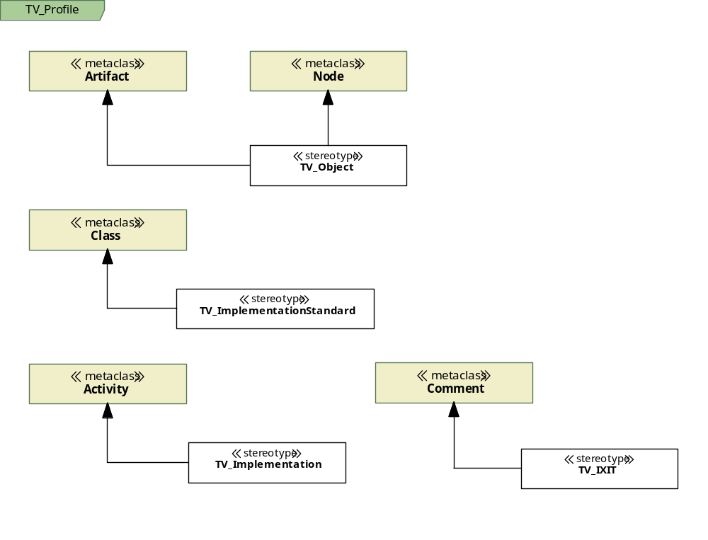
Profile definition

Slide 32
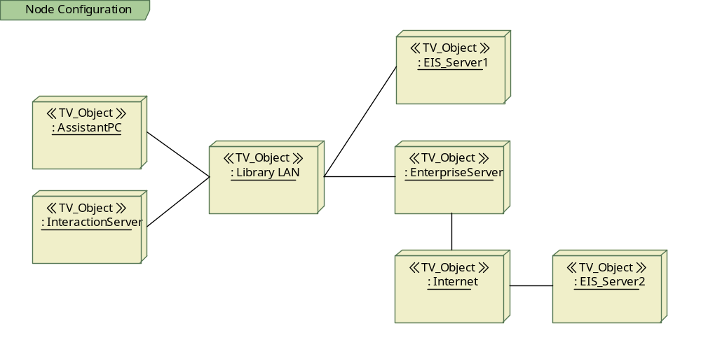
Example UML 2.0 model: Nodes and networks

Slide 33
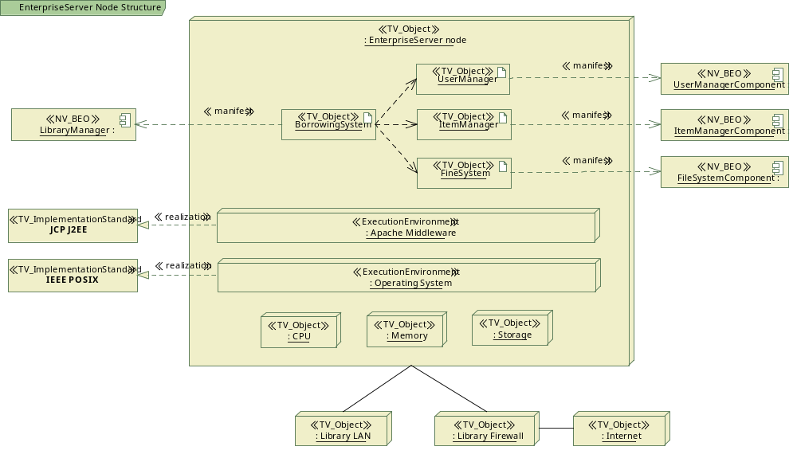
Example UML 2.0 model: Node structure

Slide 34
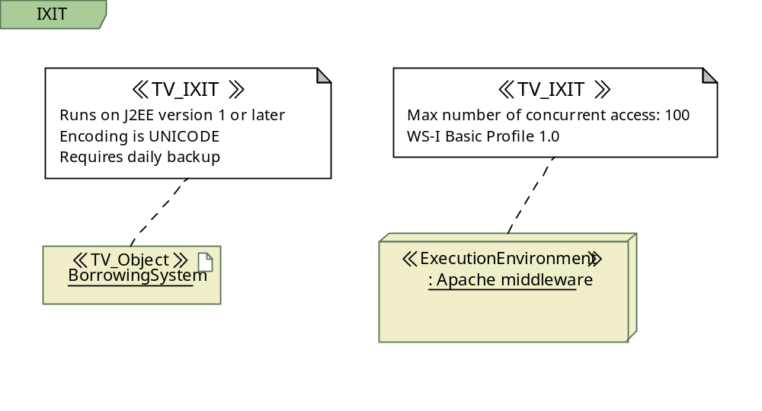
Example UML 2.0 model: IXIT

Slide 35
Issue: Correspondence
Technology Viewpoint to Engineering Viewpoint
  Each Technology Object has one to one relationship to corresponding Engineering Object.
  Could be expressed as dependency from Technology Objects in Technology Viewpoint Package to Engineering Objects in Engineering Viewpoint Package.
The issue
  How to best express this correspondence in UML
NV
TV

Slide 36
Some comments

Slide 37
Consideration needed on
Consistent modeling
Recursive application of viewpoints
Choice of consistent base classes
Relationship/correspondence (specification)

Slide 38
Issue: UML tools
UML 2.0 capabilities differ from tool to tool.
  Different Profile definition mechanisms
  Different UML 2.0 Implementation levels
    Different diagramming capabilities
    Different base class support
    Different constraint implementation
    Different OCL support
    …
  (Almost) No interoperability for profile definition data
Development of profile data for major UML 2.0 tools and making them available, through international collaboration, is expected.

Slide 39
Conclusions

Slide 40
One possible use of UML 2.0 or profile demonstrated – We can use UML 2.0 tools to describe ODP specifications, and hope MDA tools to help implement the ODP systems.
Consistent and practical modeling approach is important for UML4ODP.
Openly available profile definitions are also important.

Slide 41
Thank you very much
for your attention!

