Slide 1
Services, contracts, policies and eCommunitites
– Relationship to ODP framework
Workshop on ODP Enterprise Computing
Lea Kutvonen and Janne Metso
Lea.Kutvonen@cs.helsinki.fi, Janne.Metso@cs.helsinki.fi

Slide 2
Contents
Introduction
Between ODP and SOA
Computational vs. business services
Use case
Measurements
  What was measured
  Results
Conclusions

Slide 3

Introduction
B2B middleware for eCommunities
Community lifecycle management
  eContracting (partner selection, negotiation, monitoring)
  Breach management
Interoperability management
  Pragmatic : process, policies
  Semantic: Information, abstract processing
  Technical: Abstract channel
Generic
infrastructure
services for
eContracting and
interoperability
Business
applications
Notes:
Required foundations
(similar to themes in RM ODP)
Metainformation services & contracts
Federated architecture model

Slide 4
Between ODP and SOA
collaboration
application services
internal process logic, capsuled information,
internal computational, engineering and technical solutions
B2B middleware
communication services
with selectable
transparency sets
population
state mgmt
lifecycle
negotiation
trader
type
rep.
monitoring
DOC middleware

Slide 5
ODP foundations are in use
Separation of type and template
Trading service + type repository
Environment contract
Domains and federations
Behaviour aspects of services
Enterprise viewpoint descriptions
SOA encapsulation of services
Service discovery and selection (UDDI) – types!
WS: grounding
Virtual organization management by agents
Inter-enterprise BPM, workflows
eContracting

Slide 6
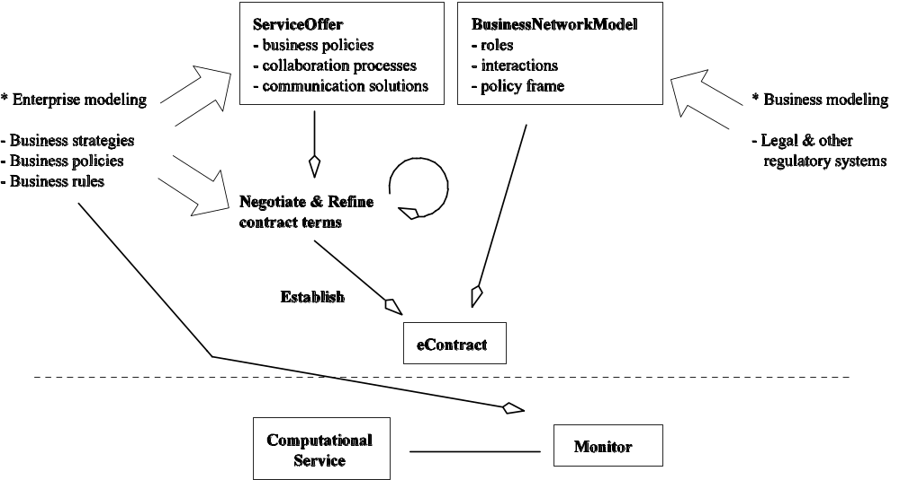
Computational vs. business services
Notes:
Kuva jossa alakertana comput + monitori
Kertomuksessa
Computational service constellation
Enterprise publishes service offer with associated commitments (in business terms: binding offer)
eCommunity establishment starts by selection of business network model that carries business and regularotry constraints → become inherent in the negotiated contract which is binding in business terms
At operational time the contractual context information is used to monitor that the computational service does not exceed the ”policitcal boundearies” – the implementation is expected to have at least the capabilities marketed, and more
No quareantee that the associated properties are true: monitoring has to protect form misuse
When breaches detected, agents cause recovery processes to be run -→ sanctions, recovery, etc possible
Enterprise policies also affect the monitoring, causing nondeterminism

Slide 7
Use Case
Client
Tourist Service
Hotel Service
Payment Service
Payment Service

Slide 8
Feasibility analysis
Cost of population by
  Number of roles: linear growth
  Policies: linear growth
  Offer match ratio: 1/x development
Synthetic use case
  Build-up of eCommunity
  Execution
  Termination of eCommunity

Slide 9
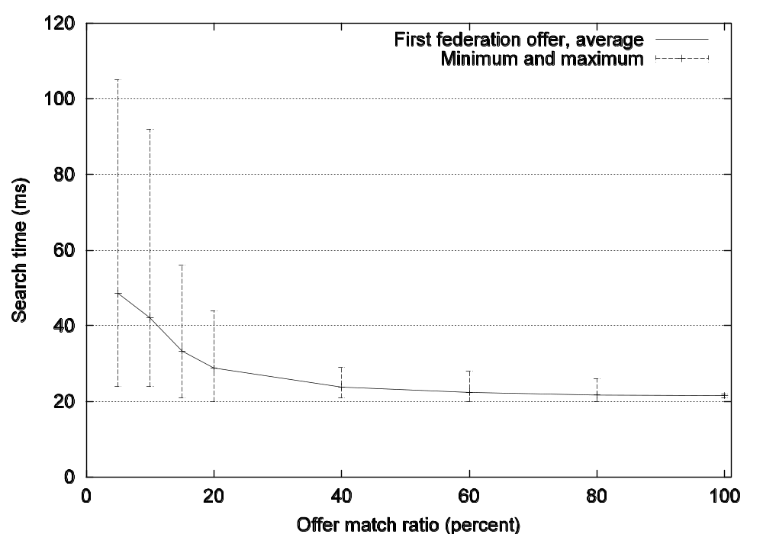
Offer match ratio

Slide 10
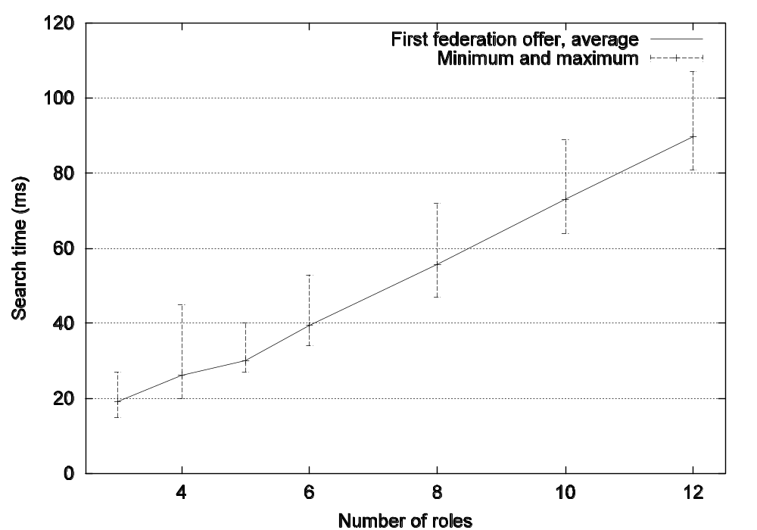
Number of roles

Slide 11
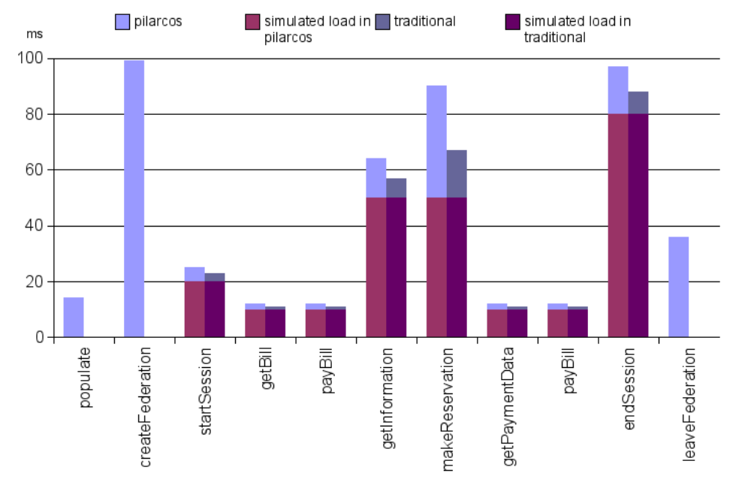
Cost of eCommunity management

Slide 12
Conclusions
ODP concepts mainly visible in SOA
  use of metainformation services
  federated vs. unified model
Not visible
  Enterprise policies
  Type repositories
  Nonfunctional aspects in collaboration
Most significant cost is build-up
  eCommunity population has acceptable impact
  Service usage does not suffer from eCommunity management

