Slide 1

Generic model for services: health domain study
Zoran Milosevic
Deontik, Australia
zoran@deontik.com

Slide 2
Outline
Motivations
Service - economic, legal and business views
Health domain examples
Enterprise viewpoint considerations
Computation viewpoint + SOA and EDA
Conclusions

Slide 3
Motivations
Health domain → broad enterprise concerns
  Different nature of ‘business processes’
    Long lived while need for dynamic adaptations
    Consumer centric → care continuum but privacy
  Service delivery while respecting policies
    multiple jurisdictions → added complexity
  Rich ground for studying generic service aspects
Work on enterprise architecture in e-health
  SOA hype → obscures broader service meaning
Small input into ODP revision processes
Notes:
Some other enterprise concerns: safety and quality of care of consumers
Examples of Long-lived and to be changed -> care plans and chronic disease management

Slide 4
Service – different perspectives
Economics → ‘something done to benefit others’
  service provision - a process that creates benefits to consumers by facilitating
    a change in consumers,
    a change in their physical possessions,
    or a change in their intangible assets
Legal → concerned with promises to deliver
  implies guarantees from service providers
Business → in terms of value of service offers
  when accepted by consumers → legally binding contract
  Business contracts law → intersection with legal aspects

Slide 5
Service in current ODP standards
‘A particular abstraction of behaviour expressing guarantees offered by a service provider’
  from a note in RM-ODP Foundations (part 2)
Not regarded as a first class concept
Useful → consider it from different viewpoints
  similarly as with Object concept
  value → clarify some SOA inconsistencies

Slide 6
E-health example
Business
Improve service delivery
objective
Clinical
Pathway
process
Continuity of care community
(roles, process, policies …)
Patient
consent
policies
Evidence-based
Processes & policies
Application
Information
Security
functions
Electronic Health
Record
Community
Information
Messaging
Applications
Workflows
EHR lists
medications
allergies ….
Providers
Information
Event
Summaries
Management
Applications
Read/
Update
functions
Demographics
Data
UI functions
Pharmaceutical
Technology
SOA
Web Services
ebXML
messaging
DB2
TCP/IP
HL7 messaging
Notes:
This slide shows how concepts in business architecture can be linked to the concepts in application (corresponds to ODP Computation viewpoint) and information (corresponds to ODP Information viewpoint) architecture .
The main point is to start discussing various enterprise modelling concepts (policies, objectives, roles etc) and their importance for a broader notion of service (than in SOA).

Slide 7
Enterprise viewpoint
Enterprise service
  an abstraction of behaviour of a service provider in terms of economic/legal activities through which the provider offers services with the corresponding guarantees
  partially filled business contract
New modelling elements needed
  Guarantees → subclass of contract (part 2)
  Service provider and Consumer → subclasses of Party (EL)

Slide 8
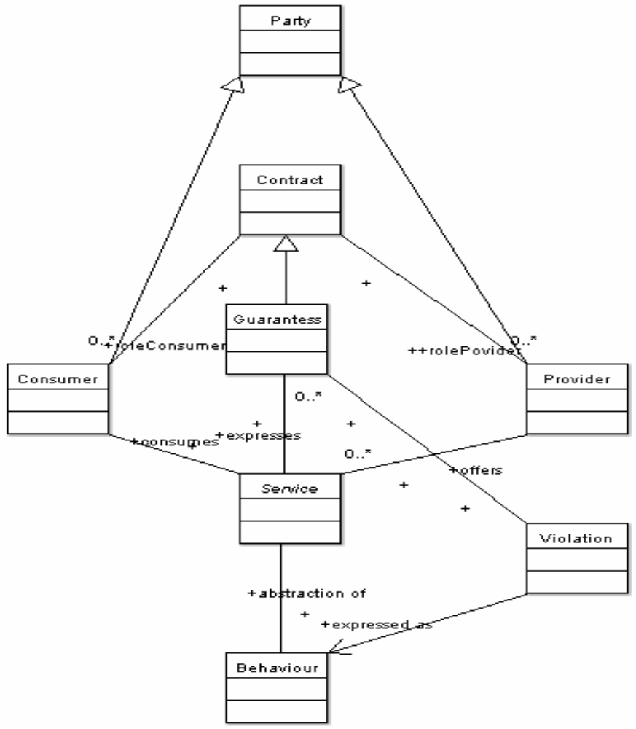
Simplified meta-model

Slide 9
Computational viewpoint
Computational service
  abstraction of behaviour of a server object
    computation function made available to other objects
  computational activities e.g. conveyance of information back to the client object
    the synchronous interaction (e.g. RPC)
    asynchronous interactions (e.g. publish-subscribe)
Can be fully expressed with current ODP computational concepts
  SOA and EDAs → special cases

Slide 10
Linking it all
Health Domain
concepts
1
Abstract modelling concepts
ODP Enterprise
Viewpoint Concepts
2
ODP Computational
Viewpoint Concepts
3
3
SOA
concepts
EDA
concepts
4
4
Web Services
JMS,
WS-eventing…

Slide 11
Conclusions
Initial ideas for a broader views on service
Part 2 definition is a good starting point
More work needed
  Enterprise service concerns
  Relationship between enterprise and computational services
  Health domain → a fertile areas for analysis

