Slide 1
Recommendation of nearest cafe or restaurant in Moscow
Alexander Vasiliev

Slide 2
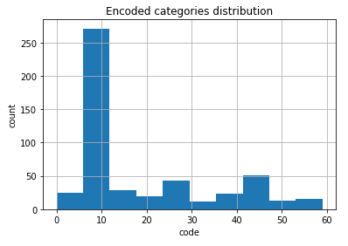
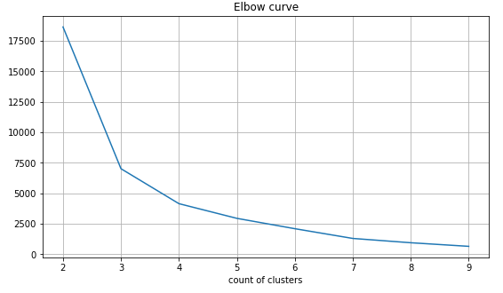
Data analysis
60 unique categories, the most frequent are café (238 objects) and caucasion restaurant (22)
clustering analysis result is 4 clusters

Slide 3
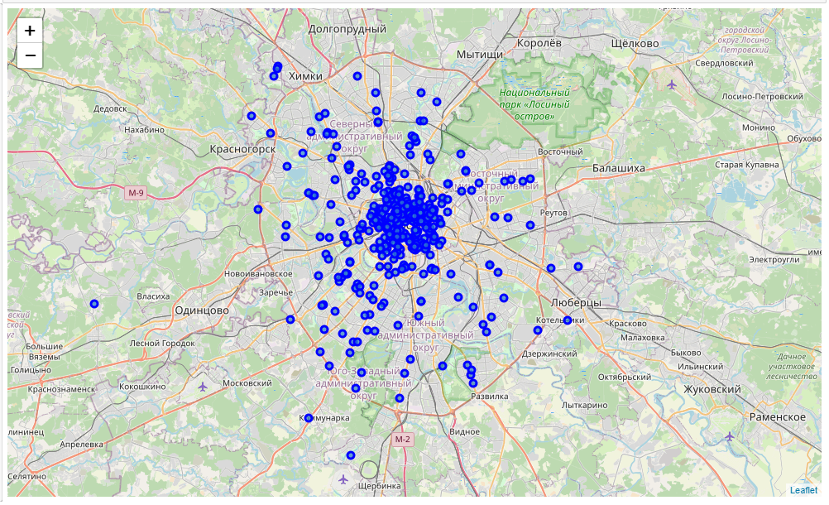
Visualizing objects

Slide 4
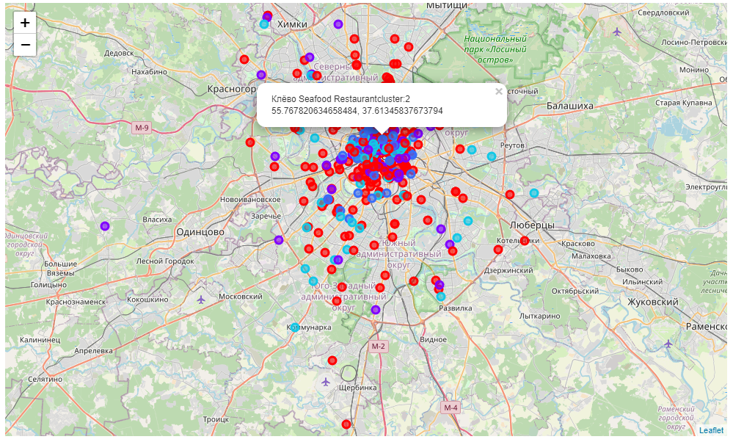
Visualizing clusters

Slide 5
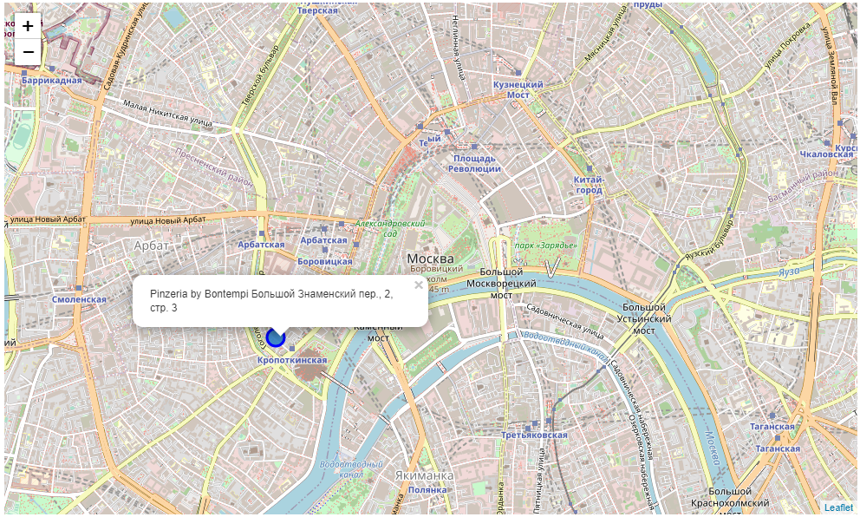
Making prediction for example
Hello, the nearest Restaurant to you
is Pinzeria by Bontempi it`s address
Большой Знаменский пер., 2, стр. 3
you can see it on map under )

Slide 6
Thank you for your attention

