Slide 1
General remarks
Please submit your results as documented program code and a suitable presentation format containing the created visuals (e.g., architecture, charts, API documentation).
Explain the steps that brought you from the input data and problem description to the final deliverable.
Provide a methodology explanation in addition to the program code.
Utilize a markup environment with analytics implementation (e.g., iPython/Jupyter Notebooks) if possible.
Completing all examples is not necessary; the focus is on the approach taken.
Try to complete one of the given examples (failure prediction or regression analysis) with the information given in this presentation, without requesting more details.

Slide 2
Failure prediction with aggregated data
First example

Slide 3
First example Description
The first challenge evaluates your approach to predictive maintenance in a real-world scenario.
The goal is to model and predict component failures. Decide which vehicle should undergo a preventive technical action.
The provided data is already prepared and filtered, and each instance/vehicle is classified as "DAMAGE" or "NO DAMAGE."
Each row corresponds to a unique vehicle identified by an anonymized chassis number, with a limited number of features for this challenge.
The cost for the technical action per vehicle is €600 and for a reactive action (fixing after failure) is €2,000, and a decrease in customer satisfaction and company reputation.

Slide 4
First example Possible Tasks to Perform
Exploratory Data Analysis: Start by performing EDA to understand the data's distribution, identify any patterns, and gain insights into the relationship between features and the target variable. This will help in making decisions about feature selection and engineering.
Data Preprocessing: Clean the data and handle any missing values. Convert categorical variables to numerical representations if needed.
Feature Engineering and Selection: Analyse the features' relevance and importance in predicting component failure. Since interpretability is desired, the candidate may choose to select a subset of features or create new features that are more informative and interpretable. For instance, they could aggregate or combine related features or derive domain-specific metrics.
Algorithm Selection: Given the preference for interpretability, the candidate may first try simple, interpretable models. Then, they can gradually move to more complex models, comparing their performance and interpretability.
Model Training and Evaluation: Split the data into training and validation sets. Train the selected models on the training set and evaluate their performance on the validation set using appropriate binary classification metrics.
Final Model Selection: Based on the evaluation results, the candidate should choose the best-performing model that meets the interpretability requirements for predicting component failures.
Cost-Benefit Analysis: Apply developed model on the vehicle fleet and decide which vehicles need technical interventions.
Visualization: Create visualizations that can help to understand the model's performance, stability and its behaviour.
Reporting: Provide an explanation of your modelling approach, feature selection, model evaluation process and the reasons behind choosing the final model and argue your cost-benefit analysis.

Slide 5
First example Overview of the data
Feature | Description
PSEUDO_VIN | Encrypted VIN for identification of individual instances
TONDUR | A variant of an operating hours counter
EngSpDist_K{1,14} | Distribution of the residence time in 14 disjoint areas of the engine speed range; the idling of the engine takes place in the area of class K1 (sorted in ascending order)
AmbTempDist_K{1,10} | Distribution of the residence time in 10 disjoint areas of the outside temperature; the temperature increases from K1 to K10 (sorted in ascending order)
MILEAGE | Mileage of the vehicle during the diagnosis
DIAGNOSIS_DATE | The date of the readout
REPAIR_DATE | Date of repair (if present, the vehicle has the label "DAMAGE")
TACHOMETER_IN_KM | Mileage during the repair (if present, the vehicle has the label "DAMAGE")
LABEL | Certain class affiliation based on repair history; Target variable for the binary classification

Slide 6
Data Engineering Workflow
Bonus

Slide 7
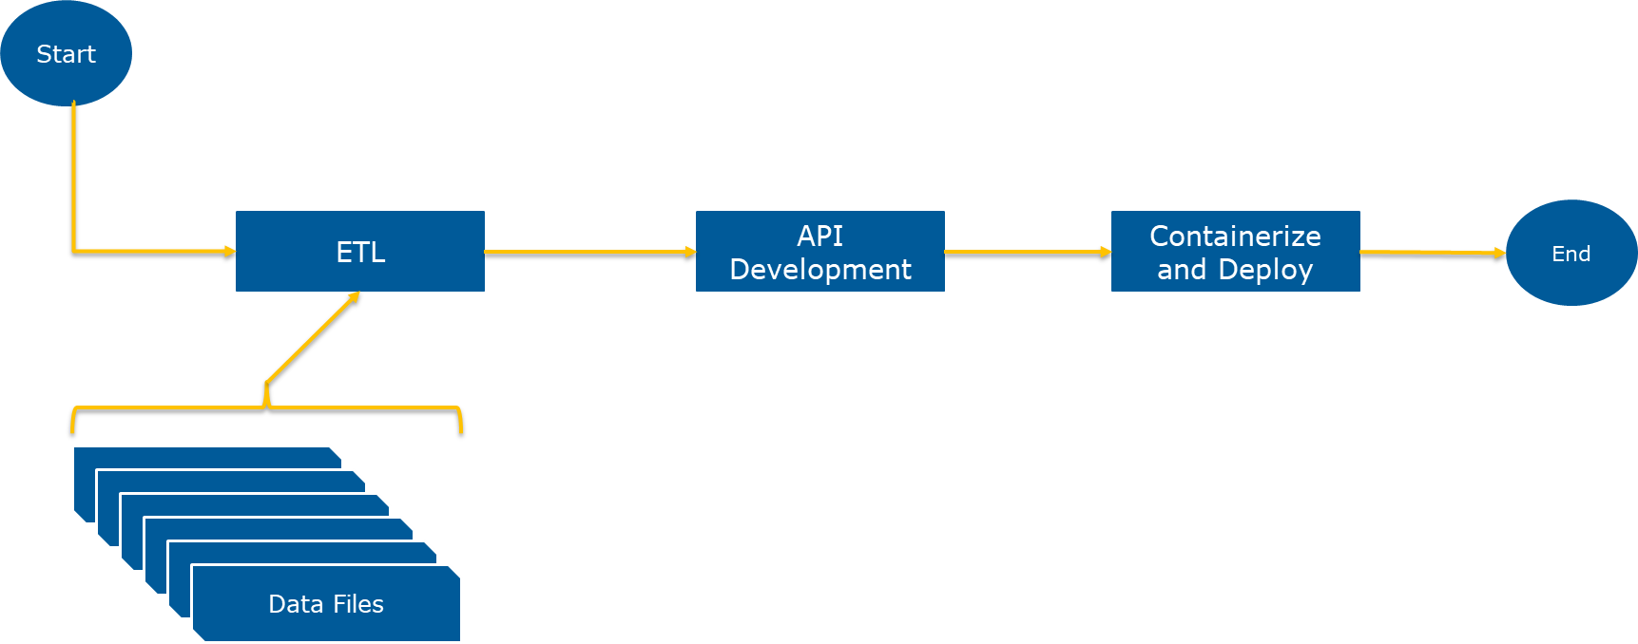
Data Processing Workflow
You will get bonus points if you can use the following process workflow for any of the previously mentioned tasks:

Slide 8
Workflow Steps
Build up a simple ETL pipeline
Extract meta-data and signals of interest from the raw measurements
Create a simple database schema and store the extracted data in a database you prefer
Write a few SQL statements to load the data from the database
API Development
Develop an API that interacts with the database created within the ETL process
The API should include at least one endpoint of type POST, GET and DELETE
The API should have the inference endpoint (in case of a developed model)
Containerize your solution and deploy the build and serve it locally

