Slide 1

CLASSIFICATION OF CORONARY HEART DISEASE USING NEURAL NETWORKS
Presented by:
Vikranth Ale [1873995]

Slide 2
Official Statistics
What is the need for official statistics ?
Statistics published by government agencies or other public bodies such as international organisations as a public good.
Official statistics provide us qualitative or quantitative information on major areas such as economic and social developments, living conditions, health, education and environment.
Helps users to develop knowledge on a particular topic or geographical area, make comparison between countries, understand changes over time.
Assessing government polices etc
Data obtained from Official Statistics assists us in
Proper planning
Decision making
Getting accurate information

Slide 3
Official statistics enables data provided is:
ACCURACY AND VALID - clear, meaningful and consistent
OBJECTIVITY - Transparent and ethically correct
APPROPRIATENESS - it should be able to meet our goals
AVAILABILITY - Data should be periodic, well-timed and regular
COMPARABILITY - Should be able to differentiate between units , groups and areas and Dissemination of information impartially
USABILITY - being able to find, accessible ,manageable usable and analysable and interpretable
Data meets the national and international standards
Data is sensitive to distribution (by gender, disability, region and similar socio-economic features)

Slide 4
DataSet: Framingham Heart Study
The Framingham Heart Study started in 1948, it is one of the most important epidemiological studies ever conducted with the underlying analytics that led to our current understanding of cardiovascular disease. In the late 1940s, the US government set out to better understand patterns of the disease. The plan was to track a large cohort of initially healthy patients over their lifetimes.
The Framingham city was chosen because it has an appropriate size with stable population that doesn’t move too much, the doctors and residents were quite cooperative. The study included 5,209 patients aged 30 to 59, who were given a questionnaire and an examination every two years whose physical and behavioral characteristics along with test results were recorded.

Slide 5
Cont’d…
In this dataset we will identify the risk factors or the independent variables that increase the chances of developing a disease and to predict coronary heart diseases (CHD) in Ten Years time.
The dataset has 4500 observations
Variables according to
Demographic risk factors like Sex,Age,Education level etc
Behavioral risk factors like current smoker, No of cigarrette on average per day etc.
Medical risk factors like Blood pressure medication, hypertensive,prone to stroke, diabetes etc,
Physical examination factors like cholesterol, systolic & diastolic blood pressure, heart rate, BMI and glucose levels of the patients.

Slide 6
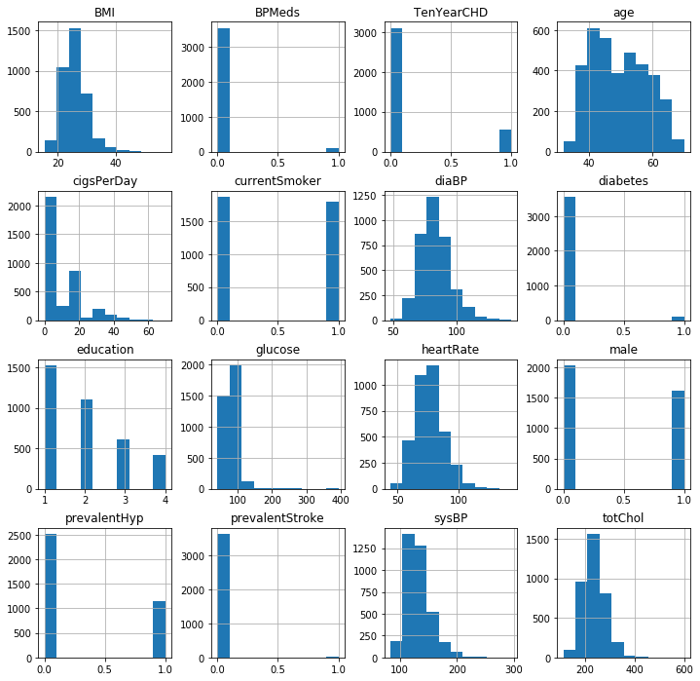
Distribution of each variable

Slide 7
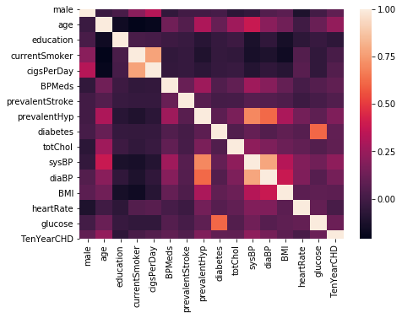
Correlation Among variables

Slide 8
Data Preprocessing
Missing value replacement
Removal of distort statistical values and NaN
Customised feature variables analysis
transforming data types from objects to integers

Slide 9
Observations from Data:
There is an increased risk of TenYearCHD as the patient age increases.
Male patients are more susceptible to coronary Heart Disease than female counterparts.
Having prevalent Heart stroke is not a possible cause for a TenYear CHD.
Prevalent Hypertension can be a potential cause for TenYear CHD.
Patient with smoking Habits has a increased risk of developing the disease.
From our data we can observe that there is only 5% probability that a person with Diabetes is susceptible to TenYear CHD.

Slide 10
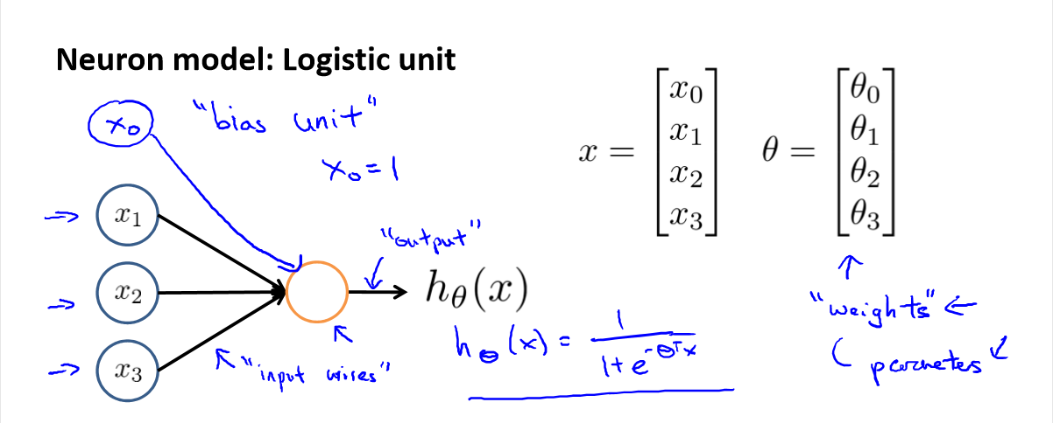

Slide 11
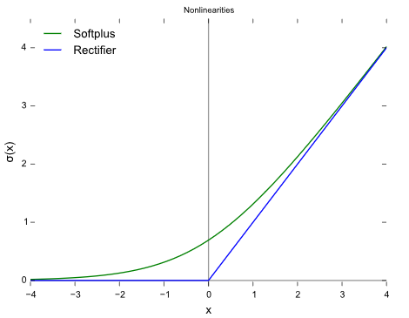
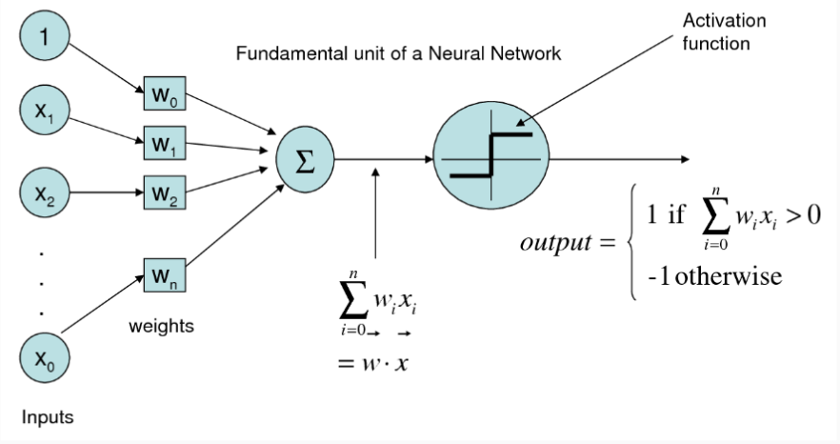
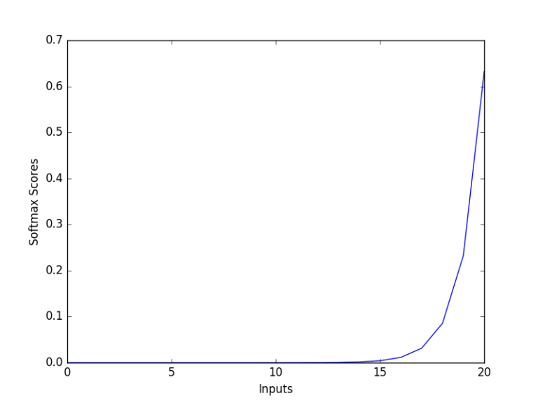

ACTIVATION FUNCTION
RELU Activation Function
SOFTMAX Activation Function
It is similar to Sigmoid function but it can handle many classes
We use Softmax in output layer to attain probabilities of each input
f(x) = max(0,x) -> ReLU
f(x) = x if x>=0
= 0 if x< 0

Slide 12
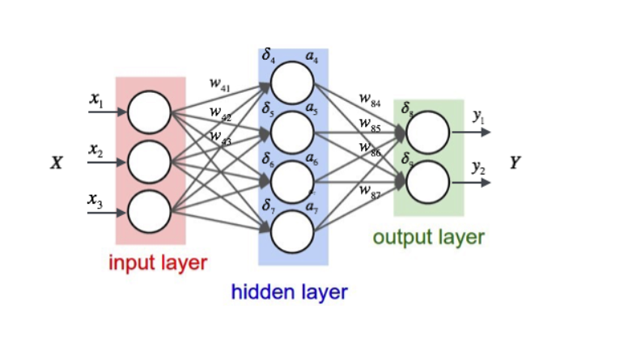
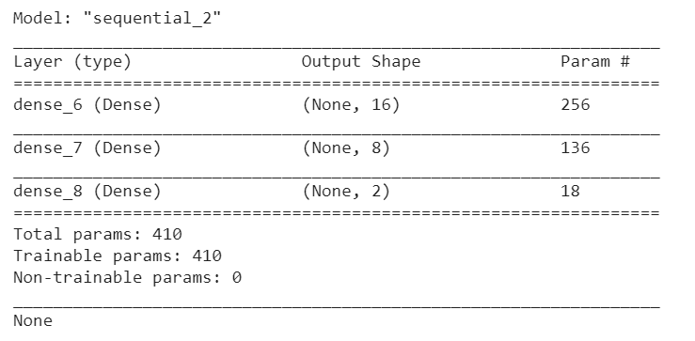
BUILDING A NEURAL NETWORK MODEL
Y* = F( sum(W* ⋅ h*) + b*) <= Output’s
h* = F(sum(W* ⋅ X*) + b*) <= Hidden layer calc

Slide 13
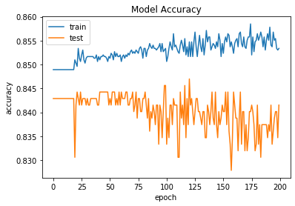
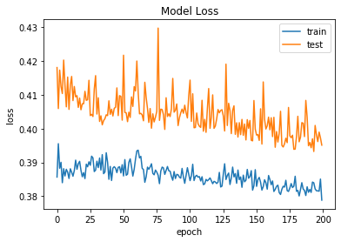
RESULTS
Original Model Accuracy and Loss

Slide 14
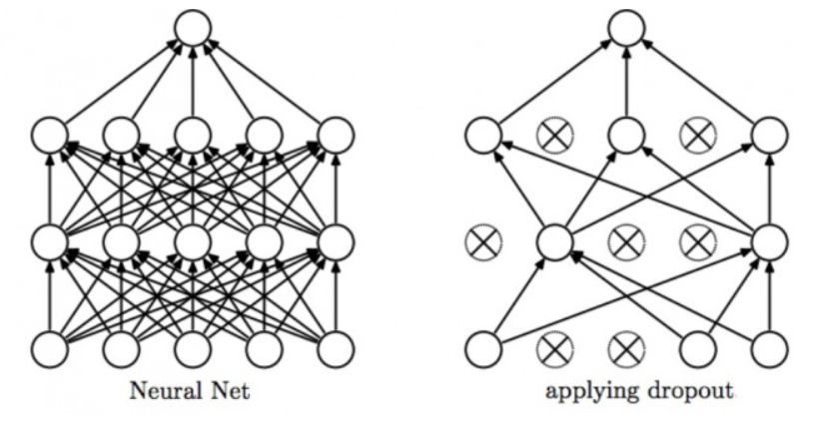
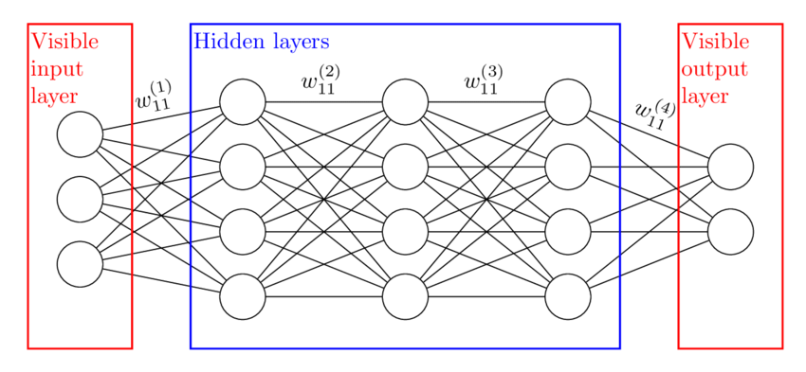
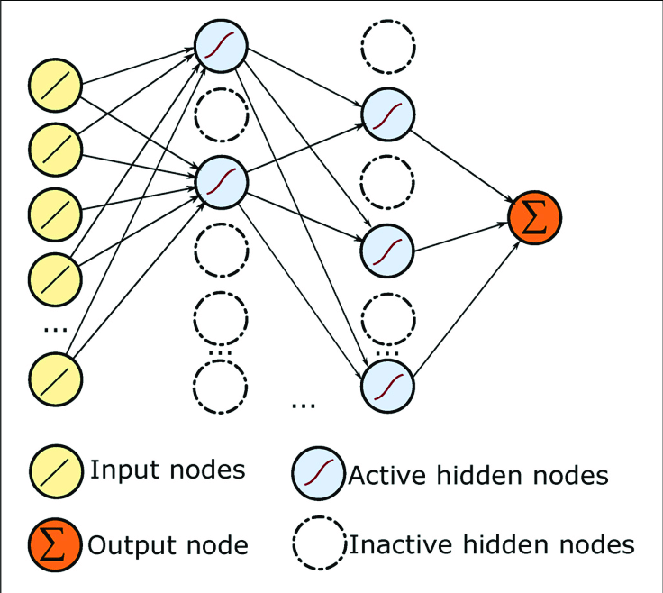
Reduced Model:
h* = F(sum(W* ⋅ X*) + b*) <= Hidden layer output
Y* = F( sum(W* ⋅ h*) + b*) <= Output value

Slide 15
Dropout
Dropout is a regularization technique used to improve over-fit on neural networks
We use dropout only during training, half of neurons on a particular layer will be deactivated to improve generalization.
The reason to implement dropout here is it avoid a situation where the network will memorize the training examples.

Slide 16
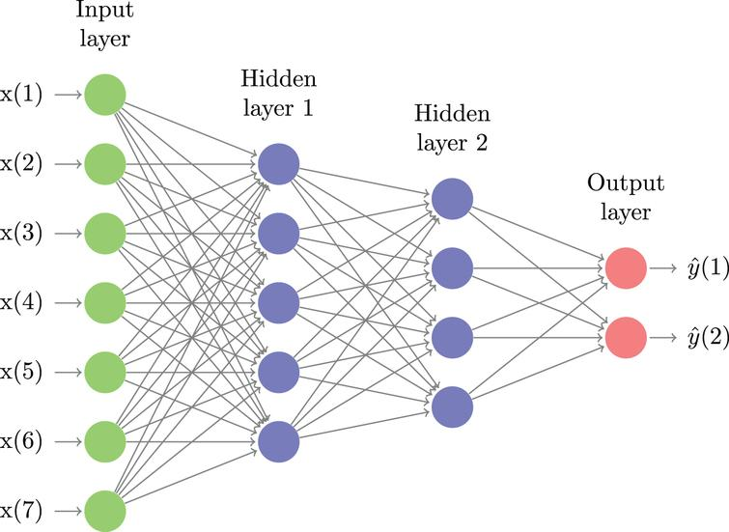
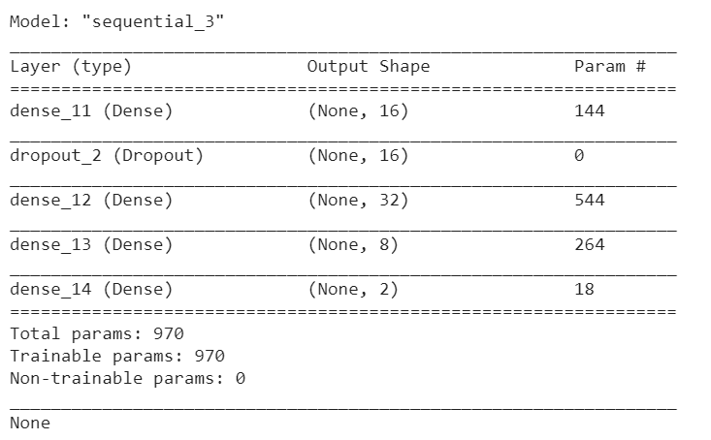
Cont’d….IMPROVING THE MODEL
Y* = F( sum(W* ⋅ h*) + b*) <= Output’s
h* = F(sum(W* ⋅ X*) + b*) <= Hidden layer calc
Neural Network with added layers and Dropout

Slide 17
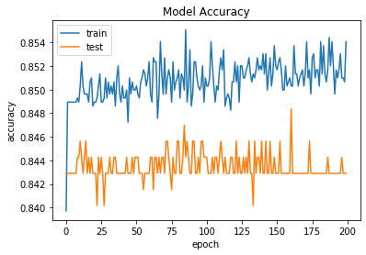
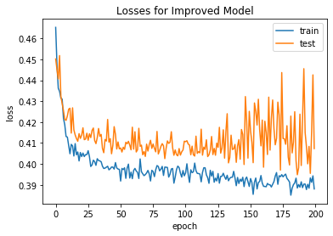
Improved Model Accuracy and Losses

Slide 18
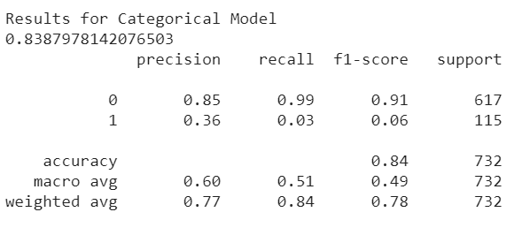
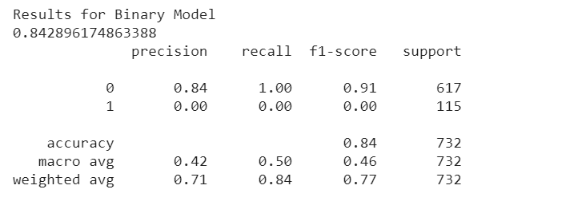
Results Comparison

Slide 19
Conclusions
From the above analysis, it is important to notice that the patient health condition is susceptible to a TenYearCHD with possible risk factors like Prevalent Hypertension and Total Cholesterol levels.
It is noticed that Coronary Heart Disease [CHD] is more common with patients from age group 40 this also coincides with the actual fact due to the formation of plaque in the walls of arteries as we age by narrowing the channel through which blood flows.
Uncontrolled High Systolic/Diastolic Blood Pressure is a possible risk factors among certain individuals which in result in hardening and thickening of the arteries.
From the observed data Diabetes contribute to 5% chances for a TenYearCHD, this can be due to small sample size, having more data can help us to draw right conclusions.
Our Model predicts with 84.28 percent accuracy, considering the various factors involved

Slide 20

References
BDOS lecture slides
https://unstats.un.org/Unsd/nationalaccount/workshops/2018/rio/UNSD.PDF
https://unstats.un.org/unsd/goodprac/bpaboutpr.asp?RecId=1
https://unstats.un.org/Unsd/nationalaccount/workshops/2018/rio/UNSD.PDF
https://www.guru99.com/learn-hadoop-in-10-minutes.html
https://bradleyboehmke.github.io/HOML/deep-learning.html
https://victorzhou.com/blog/keras-cnn-tutorial/
Andrew Ng Course on Machine Learning - Coursera

Slide 21



