Slide 1

Azure SignalR incontra Blazor
Antonio Venditti
Senior Developer Blexin

Slide 3
What is SignalR
Application framework for two-way communication
Supports many communication patterns
1 to 1
1 to many
client to server
server to client
Server is .Net, clients in many languages
Support many tranports

Slide 4
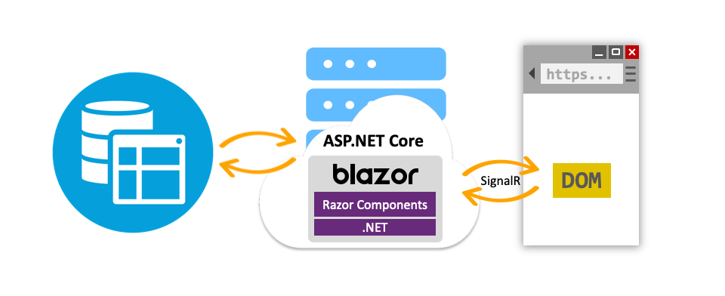
Blazor Server

Slide 5
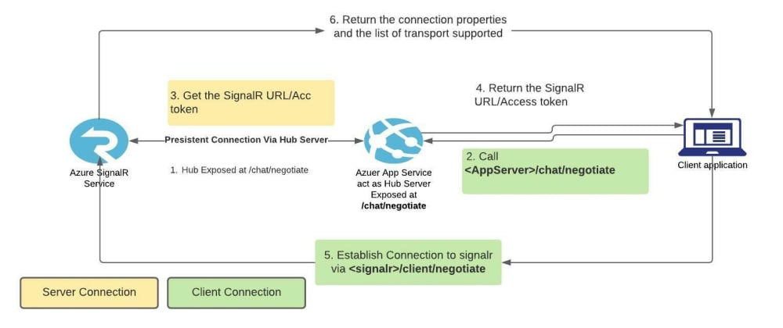
SignalR Negotiate

Slide 7
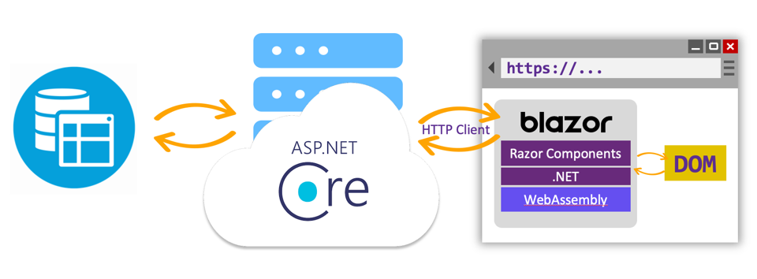
Blazor Wasm + Azure SignalR

Slide 8
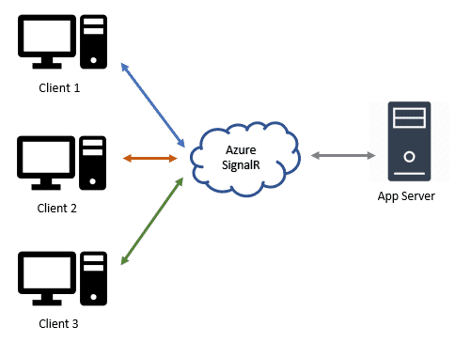
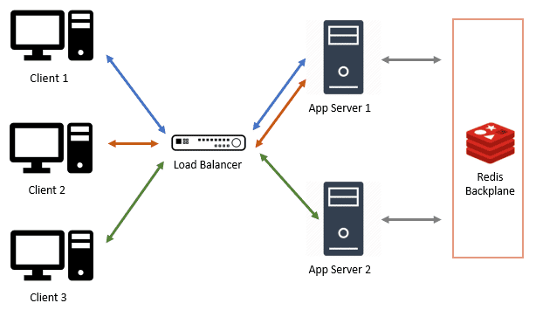
Blazor Wasm + Azure SignalR

Slide 10
Questions?

Slide 11
Thank You!!!

