Slide 1
Fatal Crashes in North Carolina for the Year 2021
Presentation by Aline Vo, Brian Stumm,
and Annie Joseph Serlie Rajan

Slide 2
Introduction
1,659 persons were killed in car crashes in NC in 2021
When are the high-risk times that these fatal accidents occur?
Hour of the day
Day of the week
Month of the year
Where are the accidents occurring?
Urban and rural
By County
Notes:
My best friend works as a telecommunicator for the NC State Troopers and she is always concerned about my road safety, because she sees the worst of it all day long.
We have been best friend since kindergarten, and we plan on living/traveling together when we retire, losing me would be the worst LOL.
She is most concerned when I am on the road early in the morning like 5-6AM because according to her, this is when the worst accidents happen.
I thought, well lets find out if she’s right!
Our group focused on data for Fatal Car Crashes in North Carolina in 2021
Per our data, 1,659 persons were killed in car crashes in NC
When are the high-risk times that these fatal accidents are occurring?
We decided to examine the hour of the day, day of the week, and month of these crashes
We also examined where these accidents were occurring.

Slide 3
Who would benefit?
General public
Traffic enforcement
Civil planning
Legislature
Hospitals
Insurance companies
Notes:
Who would benefit from this data?
Well, first, us, we, the general public would benefit. It’s good to know when to not be on the road if we can help it for safety’s sake.
Traffic enforcement can use this data to determine high fatality areas and where they may need to put their resources
Civil planning can see if certain roads are prone to high fatality accidents
Legislature can enact laws to make roads safer
Hospitals can be aware that they are near a high risk area and be better prepared for emergencies
Insurance companies can determine how safe an area is and price their policies accordingly or even if they want to start offering more coverage in particular areas

Slide 4

The Data
Sources and Interpretation
Notes:
Brian - We are now moving onto our Data

Slide 5

Data Sources
NHTSA – The National Highway Transportation Safety Administration
FARS – Fatality Analysis Reporting System
FARS is a nationwide census providing NHTSA, Congress and the American public yearly data regarding fatal injuries suffered in motor vehicle traffic crashes.
Data goes as far back as 1975 and files are organized by year
Notes:
Brian

Slide 6
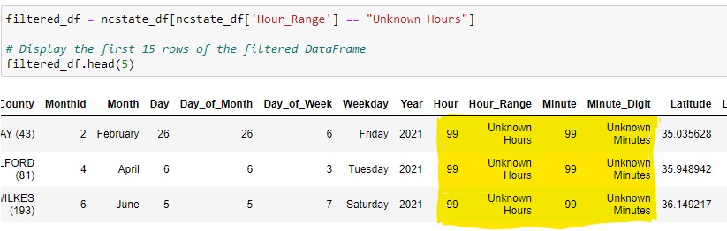
Data Cleaning
- Retrieved FARS data from nhtsa.gov
- Removed extra columns from file
- Narrowed search to just North Carolina
- Dropped rows that contained an hour range as “Unknown Hours”
- Create CSV file of fatalities for North Carolina only
Notes:
Add before and after of DF89

Slide 7
SQL Database
Created table and imported the data into SQL
Wrote SQL scripts used to generate graphs for the dashboard (Slemma)
Built interactive reports using the SQL scripts generated

Slide 8
Data Analysis
Visualizations

Slide 9
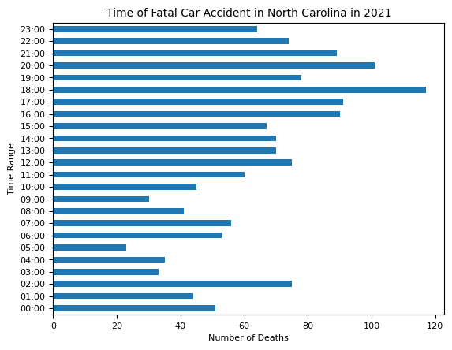
Time
Method:
Imported Matplotlib.pyplot
Split ‘Hour Range’ Column to show the first hour, then formatted to military time
Created new data frame with groupby and count
Results:
The most fatal accidents occur at 6:00PM (117) with 8:00PM (101) coming in second
The least amount of fatal accidents is at 5:00AM (23)
Notes:
Well, my best friend was wrong, the time that most fatal accidents occurred was at 6:00PM with 117 fatalities and the least amount was at 5:00AM with 23 fatalities.
I am going to say that it makes sense, because people wouldn’t be speeding in the morning hurrying to work, BUT they will be trying to hurry home after work.
I used Matplotlib and pyplot to create a horizontal bar graph. The time is in military time and starts at the bottom at 0:00 or 12AM

Slide 10
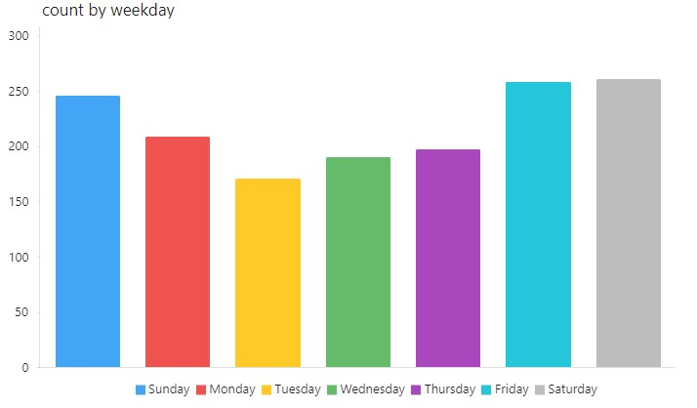
Days of the Week

Slide 11
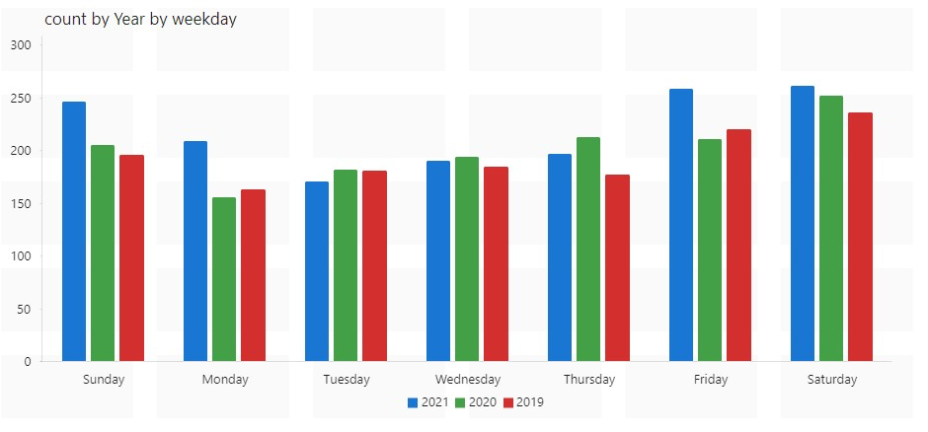
Comparison of Years for Weekdays

Slide 12
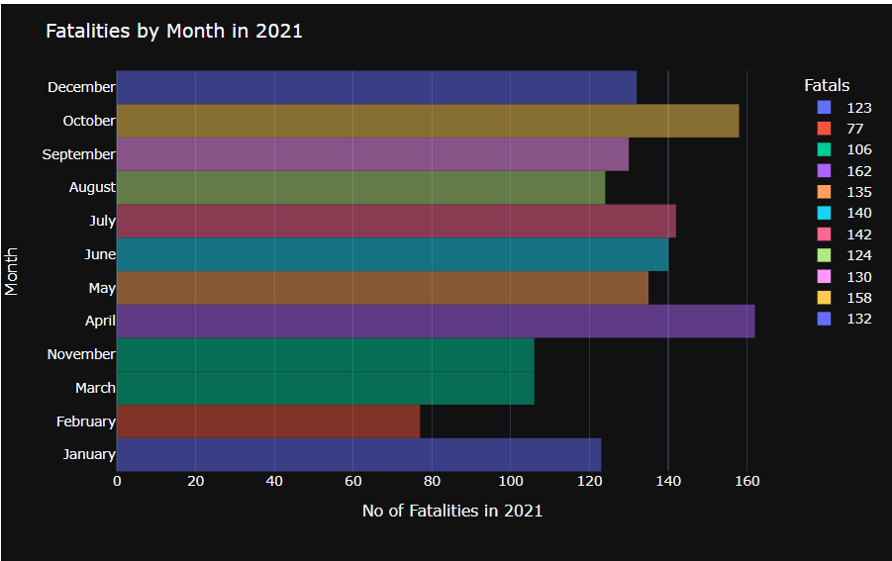
Months of the Year
Tool Used: plotly.express module
Data Clean Up:
Import the data
Select only North Carolina data for the year 2021
Created new data frame with desired columns
Changing the data types,rearranging the columns, extract the month names from Date
Using groupby(), count() method to get the desired DataFrames
Using the Data Frames visualize the data in different charts

Slide 13
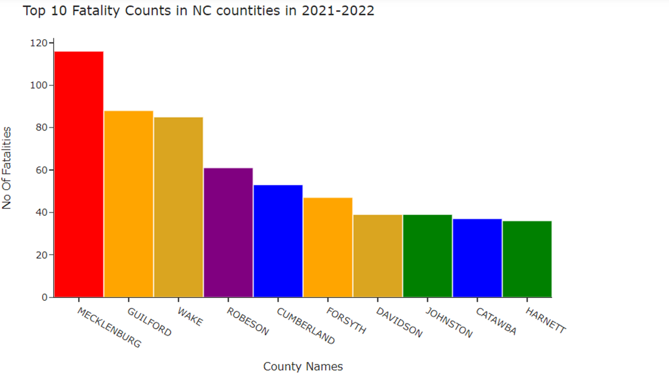
Top 10 Counties

Slide 14
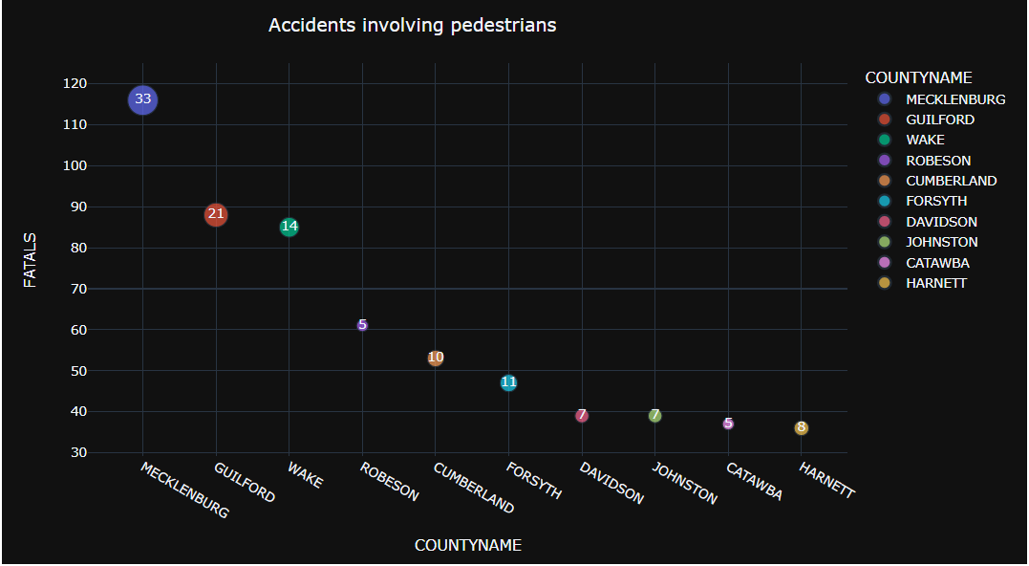
Pedestrians

Slide 15
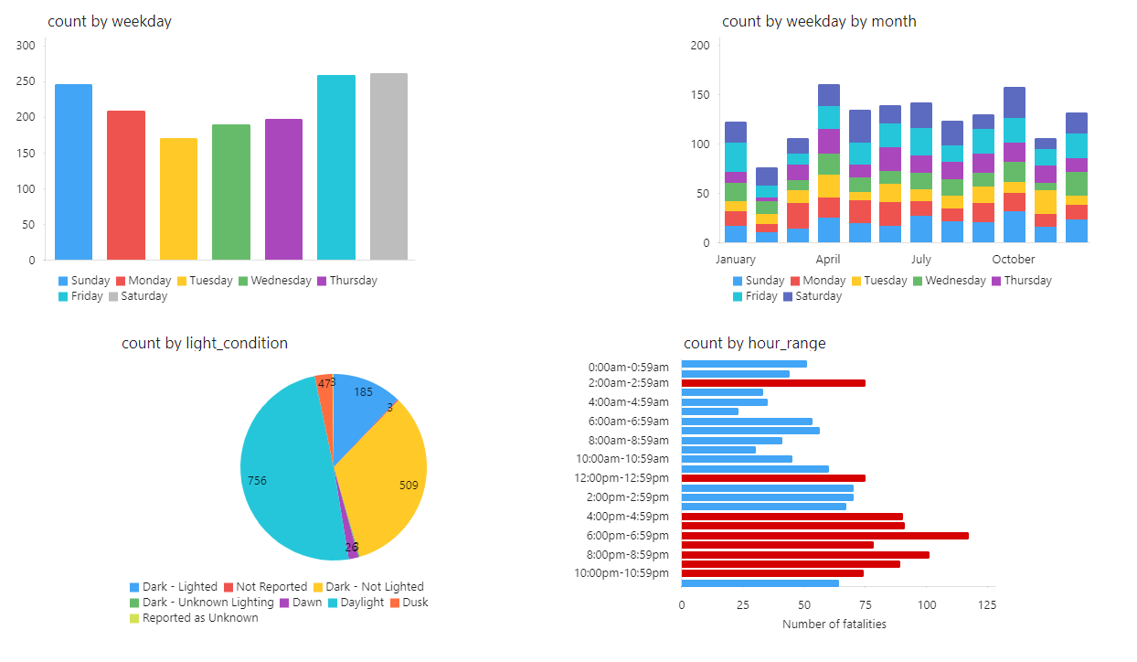
Slemma Demo

Slide 16
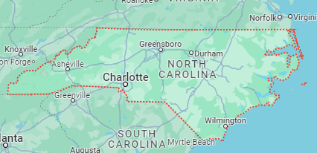
Maps – Explain what Folium is

Slide 17

Ethical Considerations
Your ability to communicate effectively will leave a lasting impact on your audience
Effectively communicating involves not only delivering a message but also resonating with the experiences, values, and emotions of those listening

Slide 18
Conclusion
Consistent rehearsal
Strengthen your familiarity
Refine delivery style
Pacing, tone, and emphasis
Timing and transitions
Aim for seamless, professional delivery
Practice audience
Enlist colleagues to listen & provide feedback
Seek feedback
Reflect on performance
Explore new techniques
Set personal goals
Iterate and adapt

Slide 19
Q&A
Thank you

