Slide 1

Data Analysis and Mining with RAVEN
RAVEN workshop
Presenter: Joshua J. Cogliati
PHYSOR 2016 – May 1st 2016, Sun Valley (ID)

Slide 2
Outline
Introduction
Clustering Methods in RAVEN Dimensionality Reduction in RAVEN Clustering Example
Dimensionality reduction example
Basic Statistics with Time Dependence in RAVEN

Slide 3
Data Mining
Extraction of implicit, previously unknown and potentially useful information from data
Exploration and analysis, by automatic or semi-automatic means, of large quantities of data in order to discover meaningful patterns
Alternative Names
Knowledge discovery (mining) in databases (KDD)
Knowledge extraction
Data/pattern analysis
Data archeology
Information harvesting

Slide 4
Why Data Mining?
Data mining is fairly new in the context considered here….
Opportunity
During uncertainty quantification/sensitivity analysis lots of data is being collected and warehoused
Computers and electronic storage are cheaper and faster
Needs
Need to understand/gain knowledge on both input and output space
Drowning in data but starving knowledge
Extraction of interesting knowledge (rules, regularities, patterns, constraints) from data in large databases
Answer to the question “Why, by whom?” uncertainty is generated

Slide 5
Clustering
Automatically determining different groups in the data
Useful for finding different regions in the output
RAVEN implements a variety of methods:
Gaussian mixture models
K-Means
Affinity
Mean shift
Spectral clustering
DBSCAN

Slide 6
Dimensionality Reduction
Used when datasets have many dimensions
Used to avoid the “curse of dimensionality”
Available methods in RAVEN
Principle Component Analysis
Truncated Singular Value Decomposition and Latent Semantic Analysis
Independent Component Analysis

Slide 7
Gaussian Mixture Clustering Example
This is the postprocessor that calculates the Gaussian Mixture based clustering:
< PostProcessorname="G aussian M ixtureBlobs" subType="DataMining"verbosity ="quiet">
< KDD lib="SciKitLearn”>
< Features >x1 , x2</ Features >
< SKLtype >mixture| GMM</ SKLtype >
< covariance_ type >full</ covariance_ type >
< random_ state >0</ random_ state >
< n_ components >3</ n_ components >
< n_iter >10000</ n_iter >
< init_ params >wc</ init_ params >
</ KDD >
</ PostProcessor >

Slide 8
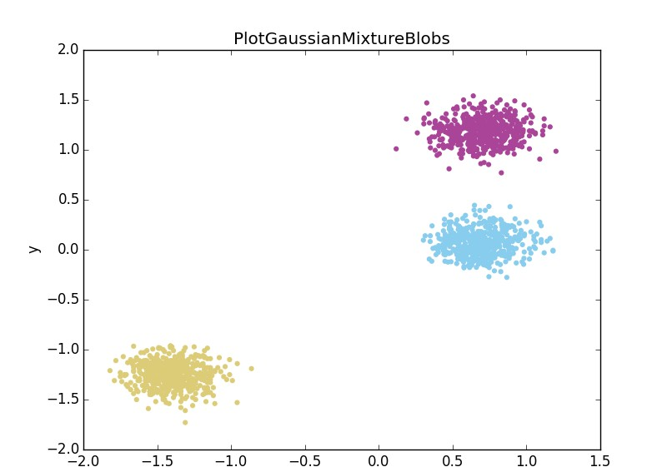
Gaussian Mixture Cluster Example Output

Slide 9
Means Shift Clustering Example
This is the postprocessor that calculates the Means Shift based clustering:
< PostProcessorname="Mean ShiftBlobs" subType="DataMining"verbosity ="quiet”>
< KDD lib="SciKitLearn”>
< Features >x1 , x2</ Features >
< SKLtype >cluster| MeanShift</ SKLtype >
< bin_ seeding >True</ bin_ seeding >
</ KDD >
< DataObject class="DataObjects" type="PointSet">DataSets</
DataObject >
</ PostProcessor >

Slide 10
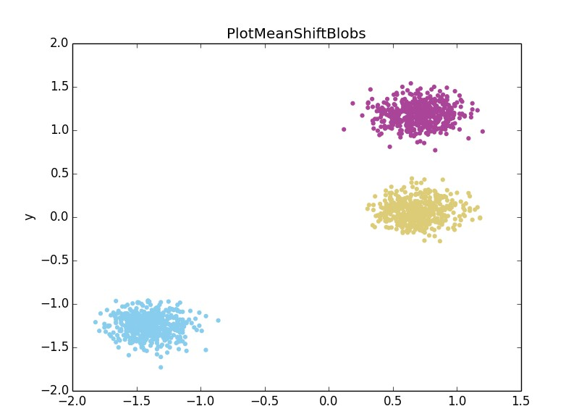
Means Shift Cluster Example Output

Slide 11
K-Means Clustering Example
This is the postprocessor that calculate the K-Means clustering:
< PostProcessorname="KMeans1"subType="DataMining">
< KDD lib="SciKitLearn">
< SKLtype >cluster| KMeans</ SKLtype >
< Features >output</ Features >
< n_clusters >5</ n_clusters >
< tol>1E -10</ tol>
< random_ state >1</ random_ state >
< init >k- means ++</ init >
< precom pute_ distances >True</ precom pute_ distances >
</ KDD >
</ PostProcessor >

Slide 12
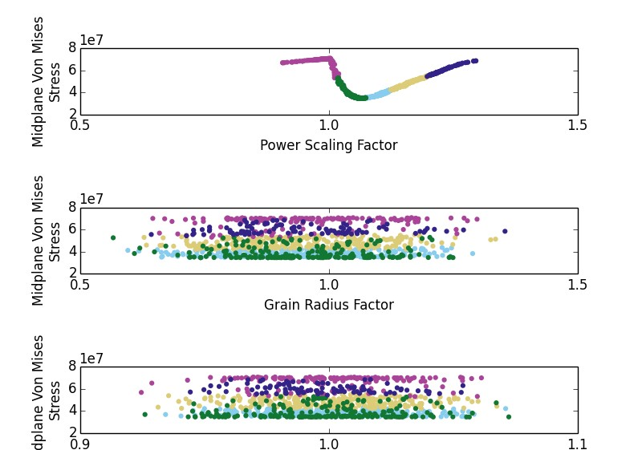
K-Means Cluster Example Output

Slide 13
Dimensionality Reduction Example
This is the postprocessor that decreases the dimentionality:
< PostProcessorname="PCA"subType="DataMining" verbosity ="quiet">
< KDD lib="SciKitLearn">
< Features >x1 , x2 , x3 , x4</ Features >
< SKLtype >decomposition | PCA</ SKLtype >
< n_ components >2</ n_ components >
</ KDD >
</ PostProcessor >

Slide 14
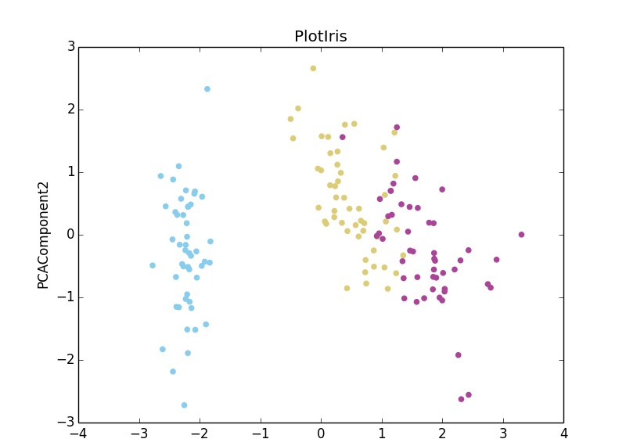
Exact PCA Dimensionality Reduction Example Output

Slide 15
Time Dependence Basic Statistics
RAVEN calculates statistics at each time
Allows trends in the data to be seen: during transients the relative importance of physical phenomena might change and it is important to understand how
The basic statistics capabilities have been extended time dependent data

Slide 16
Basic Statistics Example
This is the postprocessor that calculates the time statistics:
< PostProcessorname=’TDS’subType=’DataMining’>
< KDD lib=’tem poralBasicStatistics’>
< timeID >time</ timeID >
< parameters >x, y</ parameters >
< what >all</ what >
</ KDD >
</ PostProcessor >

Slide 17
Example Input
Contains 100 x,y coordinates
Has timestep data for 100 steps of 0.1 sec.
Embed Movie here

Slide 18
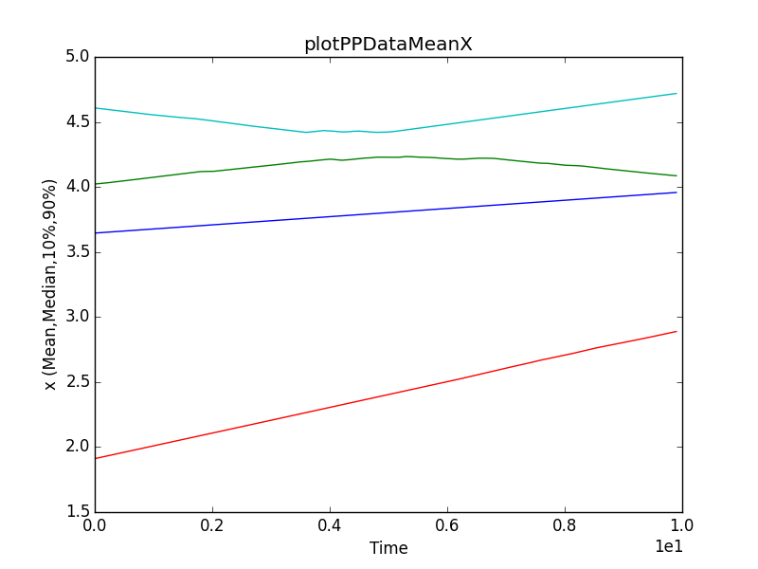
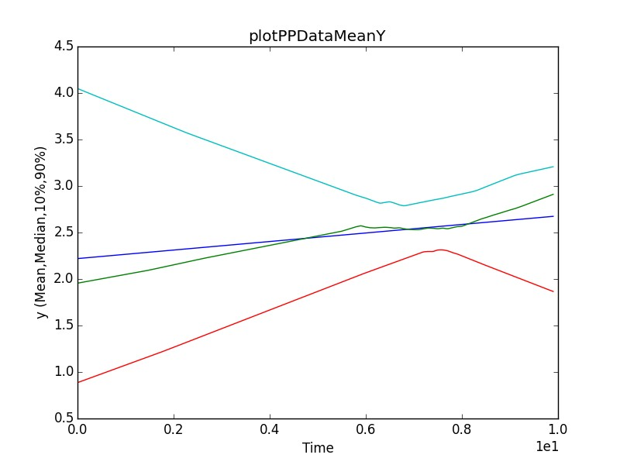
Example Output

Slide 19
Questions

