Slide 1

Reliability analysis and RAVEN
RAVEN Workshop
PSA 2015 - April 26th 2015, Sun Valley (ID)

Slide 2
Outline
Brief introduction on Reliability Analysis
Goal Oriented Sampling
Concept of Limit Surface
Convergence acceleration through ROMs
Reliability and RAVEN
Available Goal Oriented Samplers
Performing Reliability Analysis within RAVEN: workflow
Application examples of Reliability Analysis
RAVEN examples

Slide 3
Reliability Analysis: INTRODUCTION

Slide 4
Reliability Analysis: a quick introduction
Reliability theory describes the probability of a system completing its expected function during an interval of time.
Statistical models appropriate for the assessment of system device failure are generically called “time-to-event” models.
Failure is called an “event” or “transition”, and the goal is to project, forecast or assess the rate of events for a given population or the probability of an event for an individual.
Generally reliability period of any object is measured within the durability period of that object.
Main goal
Computing the transition (failure) probability

Slide 5
Reliability Analysis: Goal-oriented sampling
The evaluation of the transition probability might be computationally challenging, if traditional once-through sampling is employed:
Rare events (low probability) require an enormous number of input space explorations:
Computing a failure probability of 10⁻⁶ would require millions of Monte Carlo samples
The information entropy contained in the already-evaluated histories is not used to adapt the sampling strategy:
System response depends on many variables but often few are really important
Adaptive Sampling based on Reliability (Limit) Surface search

Slide 6
Reliability Analysis: Limit Surface Concept
The limit surface can be described as the hyper-surface that classifies the input space with respect transition regions:
The locus of points that divides the input domain with respect a boolean response (e.g. failure/success)
Consider
System characterization
The goal function is an object that is defined as a part of the system outcome space. In a safety context, the goal function usually represents the success or failure (transition) of the system.

Slide 7
Reliability Analysis: Limit Surface Concept (cont.)
Let’s consider as the transition surface in the output space with respect to the goal function
If the system evolution is represented by
It is possible to identify the set of pairs
Stochastic Parameters
Initial Conditions
in the input space, which leads the system outcome to match:

Slide 8
Reliability Analysis: Limit Surface Search
Training on initial small number of sampled points
A fine grid is classified (failure or success) based on an user-specified surrogate model (sampling of the surrogate)
The limit surface is identified by the location of transition between failure/success
The furthest point on the limit surface from any other already tested point is chosen to test the classifier (convergence test)
Process iterates (2➔4) until the limit surface converges
Failure
Limit surface
Success
Next point

Slide 9
Reliability Analysis: ROMs
For the Adaptive Sampling based on the Reliability (Limit) Surface search, special types of ROMs called “classifiers” are used:
A model (set of equations) that identifies to which category an object belongs in the feature (input) space
Let’s consider again a set of N data points
Based on the goal function :
Build a surrogate model of type “classifier”
Reduced Order Model
Boolean vector
In RAVEN, these ROMs are used as acceleration schemes for goal oriented sampling strategies ➔ they can be used to predict the location of the reliability (limit) surface

Slide 10
Reliability Analysis and RAVEN

Slide 11
Reliability Analysis and RAVEN: Samplers
RAVEN currently has 2 ways to perform Reliability Analysis based on Limit Surface Search:
Adaptive Sampler
Adaptive DET Sampler
Available
Available
All Coupled Codes
RELAP-7 only

Slide 12
Reliability Analysis: Limit Surface Workflow
Define the distributions. Distributions are used to:
Weigh the error estimation
Generate a probability-weighted metric for grid construction
Determine the probability of being inside one of the regions identified by the limit surface
Define the surrogate model to be used as the accelerator (of type Boolean or discrete)
Define the adaptive sampler:
Convergence control and grid
Import the acceleration ROM
Associate the distribution with the variables
Define a step
Post-process the data to compute the failure probability

Slide 13
Reliability Analysis: Applications

Slide 14
Reliability Analysis: Applications
Fuel Performance

Slide 15
Reliability Analysis: Applications
Pressurized Water Reactor Station Black Out
PWR SBO

Slide 16
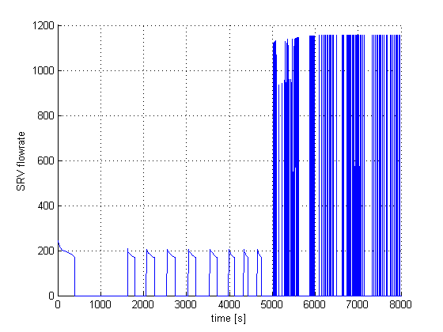
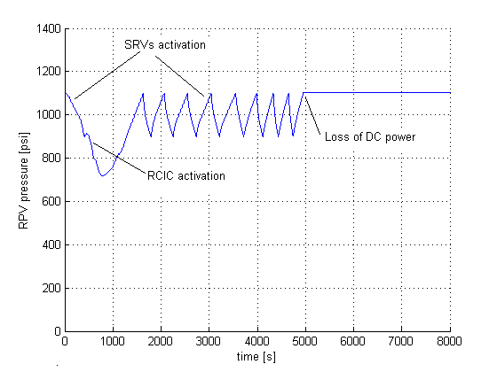
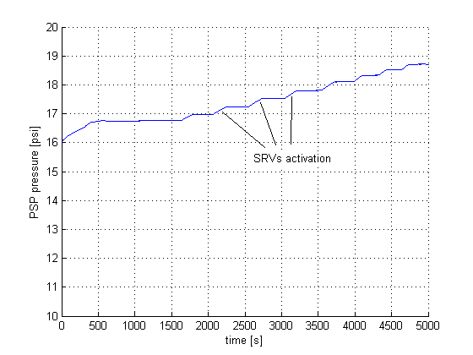
BWR SBO
Reliability Analysis: Applications
Boiling Water Reactor Station Black Out

Slide 17
RAVEN examples

Slide 18
Workflow
Sample a model and create a database
Use generated data to seed the Adaptive Sampling Step
Use the obtained Limit Surface to compute the failure probability
Train a ROM and compute the failure probability changing the stochastic parameters

Slide 19
1 - Create a data set from a model
Distributions
Model
Sampler
Databases
DataObjects
Steps
<Distributions>
<Normal name='x1_distrib'>
<mean>0.5</mean>
<sigma>0.1</sigma>
<lowerBound>0.0</lowerBound>
<upperBound>1.0</upperBound>
</Normal>
<Normal name='x2_distrib'>
<mean>2.0</mean>
<sigma>0.2</sigma>
</Normal>
<Uniform name='x3_distrib'>
<upperBound>4.0</upperBound>
<lowerBound>1.0</lowerBound>
</Uniform>
</Distributions>

Slide 20
1 - Create a data set from a model
Distributions
Model
Sampler
Databases
DataObjects
Steps
<Models>
<ExternalModel name='PythonModule' subType=’’ ModuleToLoad='workshop_fct’>
<variable>x1</variable>
<variable>x2</variable>
<variable>x3</variable>
<variable>y1</variable>
<variable>y2</variable>
<variable>y3</variable>
<variable>y4</variable>
<variable>y5</variable>
</ExternalModel>
</Models>

Slide 21
1 - Create a data set from a model
Distributions
Model
Sampler
Databases
DataObjects
Steps
<Samplers>
<Grid name='Grid_function'>
<variable name='x1' >
<distribution>x1_distrib</distribution>
<grid type='value' lowerBound='0.0' construction='equal' steps='5'>0.2</grid>
</variable>
<variable name='x2' >
<distribution>x2_distrib</distribution>
<grid type='value' lowerBound='1.0' construction='equal' steps='5'>0.4</grid>
</variable>
<variable name='x3' >
<distribution>x3_distrib</distribution>
<grid type='value' lowerBound='1.0' construction='equal' steps='5'>0.6</grid>
</variable>
</Grid>
</Samplers>

Slide 22
1 - Create a data set from a model
Distributions
Model
Sampler
Databases
DataObjects
Steps
<Databases>
<HDF5 name=‘out_db’/>
</Databases>
<DataObjects>
<TimePointSet name='outGRID'>
<Input>x1,x2,x3</Input>
<Output>y1,y2,y3,y4,y5</Output>
</TimePointSet>
<TimePointSet name=’inputPlaceHolder'>
<Input>x1,x2,x3</Input>
<Output>OutputPlaceHolder</Output>
</TimePointSet>
</DataObjects>

Slide 23
1 - Create a data set from a model
Distributions
Model
Sampler
Databases
DataObjects
Steps
<Steps>
<MultiRun name=’SeedDataSet'>
<Input class='DataObjects’type=’TimePoint’ >inputPlaceHolder</Input>
<Model class='Models' type='ExternalModel' >PythonModule</Model>
<Sampler class='Samplers' type='Grid' >Grid_function</Sampler>
<Output class='DataObjects’type='TimePointSet' >outGRID</Output>
<Output class='Databases' type='HDF5' >out_db</Output>
</MultiRun>
</Steps>

Slide 24
2- Use data to seed the Adaptive Sampling Step
Steps
Models
Functions
Sampler
Databases
DataObjects
<Models>
<ExternalModel name='PythonModule' subType=’’ ModuleToLoad='workshop_fct’>
<variable>x1</variable>
<variable>x2</variable>
<variable>x3</variable>
<variable>y1</variable>
<variable>y2</variable>
<variable>y3</variable>
<variable>y4</variable>
<variable>y5</variable>
</ExternalModel>
<ROM name=’AccelerationROM' subType='SciKitLearn'>
<Features>x1,x2,x3</Features>
<Target>goalFunction</Target>
<SKLtype>svm|SVC</SKLtype>
<C>10.0</C>
<tol>0.0001</tol>
</ROM>
</Models>

Slide 25
2- Use data to seed a Goal Oriented Sampling
Models
Functions
Sampler
Databases
DataObjects
Steps
<Functions>
<External name=’goalFunction’ file= ‘Adapt/goalFunctionWorkshop’>
<variable>x1</variable>
<variable>x2</variable>
<variable>x3</variable>
<variable>y3</variable>
</External>
</Functions>

Slide 26
2- Use data to seed the Adaptive Sampling Step
Models
Functions
Sampler
Databases
DataObjects
Steps
<Samplers>
<Adaptive name=’workshopAdaptive’>
<ROM class='Models' type='ROM’>accelerated_ROM</ROM>
<Function class='Functions' type='External’>goalFunction</Function>
<TargetEvaluation class='DataObjects' type='TimePointSet'>
outAdaptive
</TargetEvaluation>
<Convergence
limit='3000'
forceIteration='False'
weight='value'
persistence='25'>
1e-4
</Convergence>
<variable name='x1'><distribution>x1_distrib</distribution></variable>
<variable name='x2'><distribution>x2_distrib</distribution></variable>
<variable name='x3'><distribution>x3_distrib</distribution></variable>
</Adaptive>
</Samplers>

Slide 27
2- Use data to seed a Goal Oriented Sampling
Models
Functions
Sampler
Databases
DataObjects
Steps
<Databases>
<HDF5 name='out_db_adaptive' directory='path2DB/DBStorage/'/>
<HDF5 name='out_db’ filename='out_db.h5' directory='path2DB/DBStorage/'/>
<HDF5 name='out_db_ls’ directory='path2DB/DBStorage/'/>
</Databases>
<DataObjects>
<TimePointSet name='outAdaptive'>
<Input>x1,x2,x3</Input>
<Output>y3,y4,y5</Output>
</TimePointSet>
<TimePointSet name=’limitSurface'>
<Input>x1,x2,x3</Input>
<Output>goalFunction</Output>
</TimePointSet>
<TimePointSet name=’inputPlaceHolder'>
<Input>x1,x2,x3</Input>
<Output>OutputPlaceHolder</Output>
</TimePointSet>
</DataObjects>

Slide 28
2- Use data to seed a Goal Oriented Sampling
Models
Functions
Sampler
Databases
DataObjects
Steps
<Steps>
<IOStep name='extract_data_seed'>
<Input class='Databases' type='HDF5' >out_db</Input>
<Output class='DataObjects’ type='TimePointSet'>outAdaptive</Output>
</IOStep>
<MultiRun name=’GoalOrientedStep'>
<Input class=DataObjects’ type=’TimePoint' >inputPlaceHolder</Input>
<Model class='Models' type='ExternalModel’>PythonModule</Model>
<Sampler class='Samplers' type=’Adaptive' >workshopAdaptive</Sampler>
<Output class='DataObjects’type='TimePointSet’ >outAdaptive</Output>
<Output class='Databases' type='HDF5' >out_db_adaptive</Output>
<SolutionExport class='DataObjects’type='TimePointSet’ >
limitSurface
</SolutionExport >
</MultiRun>
<IOStep name=’push_limitsurface_in_database'>
<Input class='DataObjects' type='TimePointSet’ >limitSurface</Input>
<Output class='Databases' type='HDF5' >out_db_ls</Output>
</IOStep>
</Steps>>

Slide 29
3 – Compute Failure Probability from Limit Surface
Distributions
Model
Sampler
Databases
DataObjects
Steps
<Distributions>
<Normal name='x1_distrib'>
<mean>0.5</mean>
<sigma>0.1</sigma>
<lowerBound>0.0</lowerBound>
<upperBound>1.0</upperBound>
</Normal>
<Normal name='x2_distrib'>
<mean>2.0</mean>
<sigma>0.2</sigma>
</Normal>
<Uniform name='x3_distrib'>
<hi>4.0</hi>
<low>1.0</low>
</Uniform>
</Distributions>

Slide 30
3 - Compute Failure Probability from Limit Surface
Distributions
Models
Sampler
Databases
DataObjects
Steps
<Models>
<ROM name='pROM3' subType='SciKitLearn'>
<Features>x1,x2,x3</Features>
<Target>y3</Target>
<SKLtype>svm|LinearSVC</SKLtype>
<C>10.0</C>
<tol>0.0001</tol>
</ROM>
</Models>

Slide 31
3 - Compute Failure Probability from Limit Surface
Distributions
Model
Sampler
Databases
DataObjects
Steps
<Samplers>
<Grid name='Grid_function'>
<variable name='x1’>
<distribution>x1_distrib</distribution>
<grid type='value' lowerBound='0.0' construction='equal' steps='5'>0.2</grid>
</variable>
<variable name='x2’>
<distribution>x2_distrib</distribution>
<grid type='value' lowerBound='1.0' construction='equal' steps='5'>0.4</grid>
</variable>
<variable name='x3’>
<distribution>x3_distrib</distribution>
<grid type='value' lowerBound='1.0' construction='equal' steps='5'>0.6</grid>
</variable>
</Grid>
</Samplers>

Slide 32
3 - Compute Failure Probability from Limit Surface
Distributions
Model
Sampler
Databases
DataObjects
Steps
<Databases>
<HDF5 name="out_ROM3_db"/>
</Databases>
<DataObjects>
<TimePointSet name='outPROM_y3'>
<Input>x1,x2,x3</Input>
<Output>y3</Output>
</TimePointSet>
</DaDataObjectstas>

Slide 33
4 – Compute Safest Point from Limit Surface
Distributions
Model
Sampler
Databases
DataObjects
Steps
<Distributions>
<Normal name='x1_distrib'>
<mean>0.5</mean>
<sigma>0.1</sigma>
<lowerBound>0.0</lowerBound>
<upperBound>1.0</upperBound>
</Normal>
<Normal name='x2_distrib'>
<mean>2.0</mean>
<sigma>0.2</sigma>
</Normal>
<Uniform name='x3_distrib'>
<hi>4.0</hi>
<low>1.0</low>
</Uniform>
</Distributions>

Slide 34
4 - Compute Safest Point from Limit Surface
Distributions
Models
Sampler
Databases
DataObjects
Steps
<Models>
<ROM name='pROM3' subType='SciKitLearn'>
<Features>x1,x2,x3</Features>
<Target>y3</Target>
<SKLtype>svm|LinearSVC</SKLtype>
<C>10.0</C>
<tol>0.0001</tol>
</ROM>
</Models>

Slide 35
4 - Compute Safest Point from Limit Surface
Distributions
Model
Sampler
Databases
DataObjects
Steps
<Samplers>
<Grid name='Grid_function'>
<variable name='x1’>
<distribution>x1_distrib</distribution>
<grid type='value' lowerBound='0.0' construction='equal' steps='5'>0.2</grid>
</variable>
<variable name='x2’>
<distribution>x2_distrib</distribution>
<grid type='value' lowerBound='1.0' construction='equal' steps='5'>0.4</grid>
</variable>
<variable name='x3’>
<distribution>x3_distrib</distribution>
<grid type='value' lowerBound='1.0' construction='equal' steps='5'>0.6</grid>
</variable>
</Grid>
</Samplers>

Slide 36
4 - Compute Safest Point from Limit Surface
Distributions
Model
Sampler
Databases
DataObjects
Steps
<Databases>
<HDF5 name="out_ROM3_db"/>
</Databases>
<DataObjects>
<TimePointSet name='outPROM_y3'>
<Input>x1,x2,x3</Input>
<Output>y3</Output>
</TimePointSet>
</DaDataObjectstas>

