Slide 1

Reduced Order Models (ROMs) and RAVEN
RAVEN Workshop
PSA 2015 - April 26th 2015, Sun Valley (ID)

Slide 2
Outline
Brief introduction on ROMs
Application examples of ROMs
ROMs and RAVEN
Available ROMs
RAVEN ROM workflow
RAVEN examples
Create ROMs
Perform sampling of ROMs

Slide 3
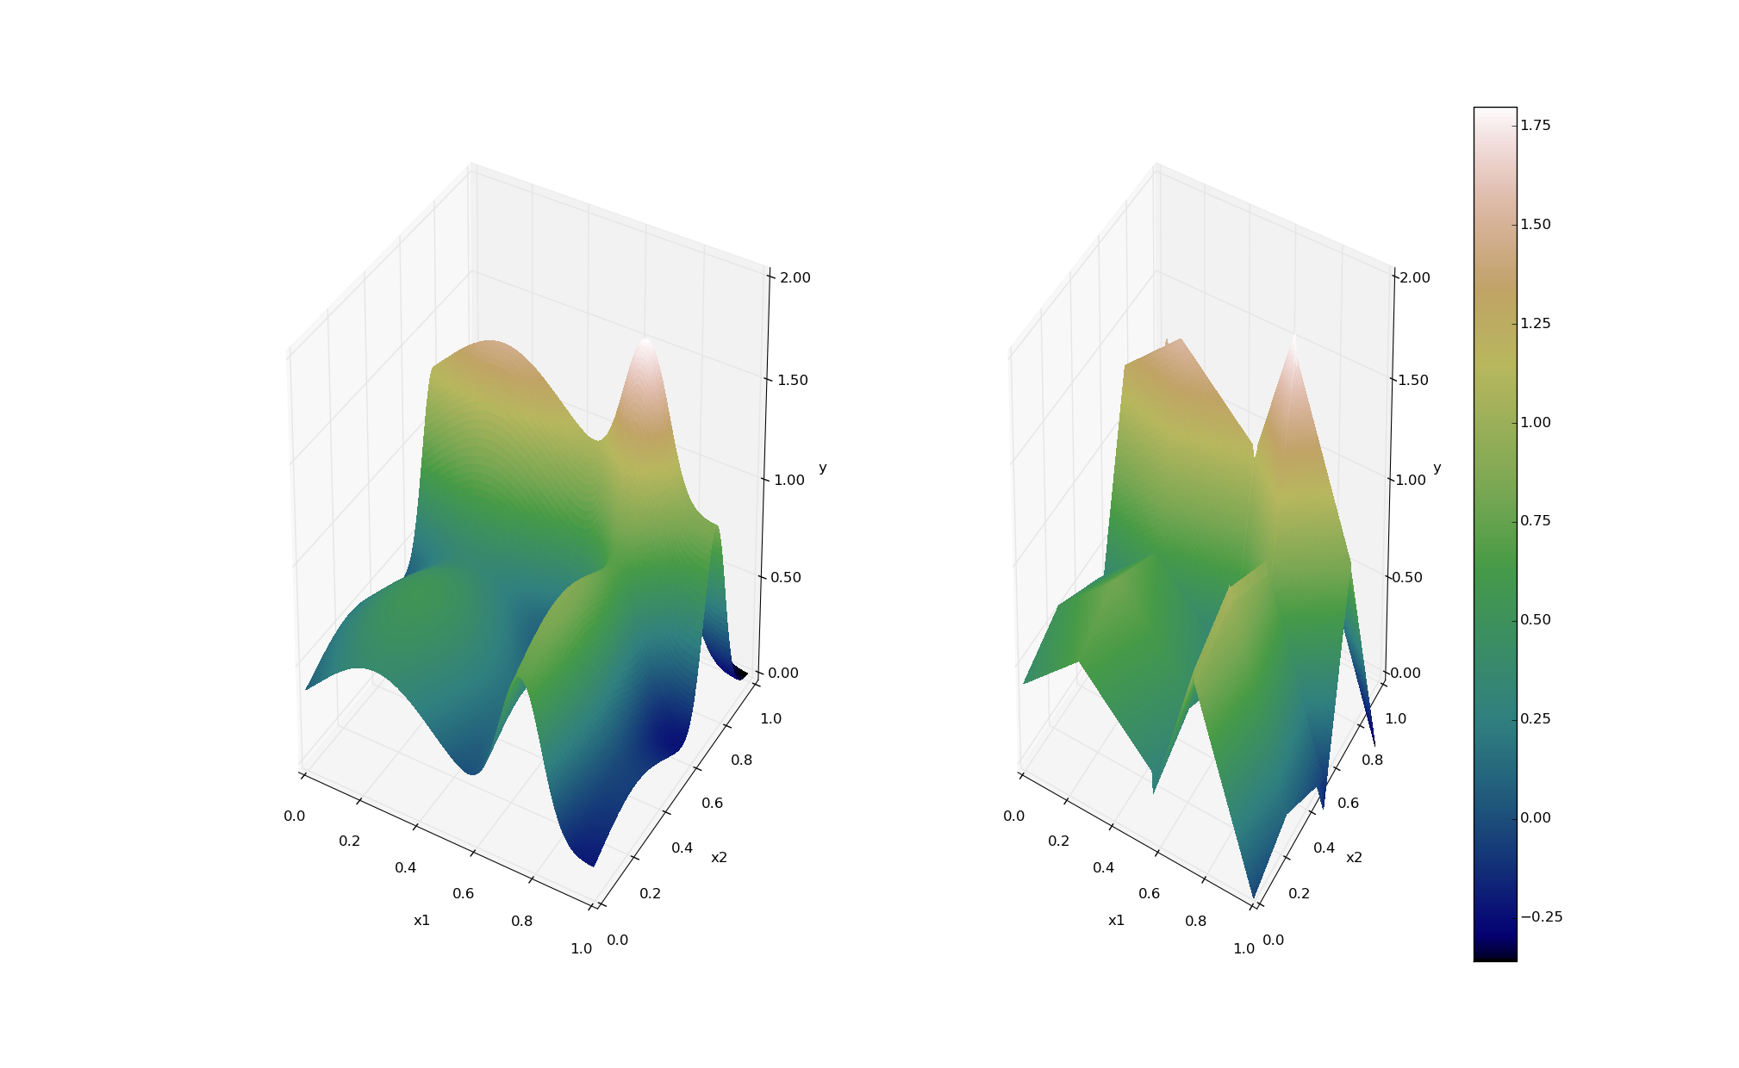
ROMs: a Quick Introduction
Output: Simulation outcome (success/failure, max clad temperature)
Consider a set of N data points
Build a surrogate model
Reduced Order Model
DataObjects
(TimePointSet)
Inputs: Initial and boundary conditions
≅

Slide 4
ROMs: a Quick Introduction
Basically we are trying to reduce the complexity of the original model
Pros:
Much faster computation of the output variable
Cons:
Presence of error in the ROM computed values
ROM (e.g., quadratic regressor)
≅
Original data (e.g., RELAP5)

Slide 5
Classes of ROMs
Model-Based
Prediction is performed using a blend of interpolation and regression algorithms
Examples:
Gaussian Process Models (GPMs)
Spline interpolator
Data-Based
Prediction is performed by solely considering the input data by using data searching algorithms
Examples:
Nearest neighbor

Slide 6
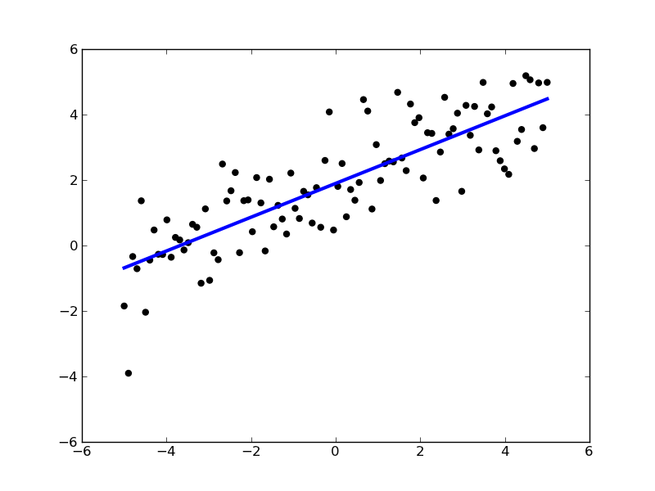
ROMs: Applications
Basic steps:
Sample original model
Train the ROM
Perform desired analysis with the ROM
instead of the original model
Range of applications:
Uncertainty quantification / Sensitivity analysis
Probabilistic Risk Analysis (PRA)
Accelerator for stochastic analysis (adaptive sampling)
Prediction models
Output y
Input x

Slide 7
ROMs Available in RAVEN
External libraries: Scikit-learn (http://scikit-learn.org)
Open source machine learning library for Python
Library for data mining and data analysis
Built on NumPy and SciPy
Internally C++ developed libraries: CROW
Generalized Polynomial Chaos
Multi-dimensional interpolators
ND Spline
ND Inverse-Weight

Slide 8
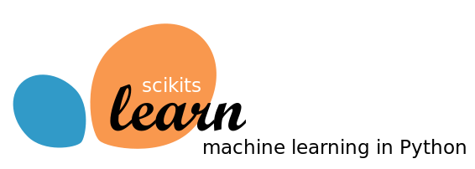
Scikit-Learn Library
Available:
Classification: identifying to which category an object belongs
Regression: predicting a continuous-valued attribute
Data clustering: grouping similar objects into sets
Dimensionality reduction: reducing the number of random variables
Data pre-processing: feature extraction and normalization
Examples:
Linear regression models
Support Vector Machines
Multi-Class classifiers
Naïve Bayes
Neighbors classifiers
Tree classifiers
Notes:
Add backup slides for some algorithms GPM and SVM

Slide 9
Scikit-Learn Library
Classification
Starting point: set of data points with labels
[features, class]_{i}
Objective: identify which class a new point [features] belong
Clustering
Starting point: set of data points
[features]_{I}
Objective: group data points based on a specific distance metrics
Y
(μ₁,σ₁²)
(μ₂,σ₂²)
X
Notes:
Add backup slides for some algorithms GPM and SVM

Slide 10
Scikit-Learn Library
Starting point: set of data points
[features]_{i}
Cardinality reduction
Objective: identify the most relevant features that keep data points unique
Outcome: Location of the points on the reduced space (e.g., line)
Regression
Objective: estimate the relationships among variables via a statistical process
Outcome: coefficients of the reduced space (e.g., m and c for linear interpolator )
Source: scikit-learn.org
Notes:
Add backup slides for some algorithms GPM and SVM

Slide 11
Generalized Polynomial Chaos
Objective: overcome limitations of Monte-Carlo sampling
High number of samples
Computationally expensive
Polynomial representation of an output variable
Simpler to evaluate
Easy to get statistical moments
Less effort and more accurate than Monte Carlo
index set of all desired polynomial orders up to order L

Slide 12
Multi-Dimensional Interpolators
CROW: Internally developed C++ library
Interpolation on any dimension
Response surface is created as an interpolation function given a set of data points defined on:
Sparse grid
Cartesian grid
Extension of the known 1-D interpolation schemes

Slide 13
Multi-Dimensional Interpolators
Two classes of algorithms
Inverse-Weight
No interpolation kernel is defined
Defined on sparse grid
Multi-Dimensional Spline
Defined on cartesian grid
Based on multi-dimensional spline kernel
Continuity of the derivative is preserved
where:

Slide 14
Database Storage in RAVEN
RAVEN framework provides the capability to store and retrieve data to/from an external database
Database format: HDF5
Data can be organized in two ways:
Parallel (e.g., if generated from a Monte-Carlo sampler)
Hierarchical (e.g., if generated from a Dynamic Event Tree sampler)
Database that is going to be created
<Databases>
<HDF5 name='out_ROM4_db'/>
<HDF5 name='out_ROM5_db'directory='/pathToDatabase/’/>
<HDF5 name='out_db' filename='out_db.h5' directory='/pathToDatabase/'/>
</Databases>
Existing database that is going to be retrieved

Slide 15
ROM Modeling Within RAVEN
All modeling steps that involve ROMs are available in RAVEN
Create ROMs from a database
Perform statistical analysis using ROMs

Slide 16
ROM Modeling Within RAVEN
Create a Database (TimePointSet)

Slide 17
ROM Modeling Within RAVEN
Create and train a ROM from a Database

Slide 18
ROM Modeling Within RAVEN
Perform statistical analysis using the ROM

Slide 19
ROM Pickle
Compression/serialization scheme
Pickled object contains all the information necessary to reconstruct the object in another python script
Pickled object can be saved as a file
RAVEN Scikit-Learn ROMs can be pickled
Applications:
Perform statistical analysis on a ROM after they have been generated and/or on a different machine
Use pickled ROMs on separate python script (external model for RAVEN)
Stochastic analysis for different distributions

Slide 20
RAVEN Examples

Slide 21
Workflow
Sample model Create database
sample_Function.xml
Train a ROM
Pickle ROM
Train a ROM
Sample ROM
rom_trainer.xml
sample_ROM.xml
Load ROM
Sample ROM
sample_pROM.xml

Slide 22
Workflow
Sample model Create database
sample_Function.xml
Train a ROM
Pickle ROM
Train a ROM
Sample ROM
rom_trainer.xml
sample_ROM.xml
Load ROM
Sample ROM
sample_pROM.xml

Slide 23
Sample a Model and Create a Database
Distributions
Models
Samplers
Databases
DataObjects
Steps
<Distributions>
<Normal name='normal_trunc'>
<mean>0.5</mean>
<sigma>0.1</sigma>
<lowerBound>0.0</lowerBound>
<upperBound>1.0</upperBound>
</Normal>
<Normal name='normal'>
<mean>2.0</mean>
<sigma>0.2</sigma>
</Normal>
<Uniform name='uniform'>
<upperBound>4.0</upperBound>
<lowerBound>1.0</lowerBound>
</Uniform>
</Distributions>
Truncation parameters
Input file name: sample_Function.xml

Slide 24
Sample a Model and Create a Database
Distributions
Models
Samplers
Databases
DataObjects
Steps
<Models>
<ExternalModel name='PythonModule' subType=’’ ModuleToLoad='workshop_model’>
<variable>x1</variable>
<variable>x2</variable>
<variable>x3</variable>
<variable>y1</variable>
<variable>y2</variable>
<variable>y3</variable>
<variable>y4</variable>
<variable>y5</variable>
</ExternalModel>
</Models>
Input variables
File name: workshop_model.py
Output variables
Input file name: sample_Function.xml

Slide 25
Sample a Model and Create a Database
Distributions
Models
Samplers
Databases
DataObjects
Steps
<variable name>
<distribution>
<grid points>
<Samplers>
<Grid name='Grid_function'>
<variable name='x1' >
<distribution>normal_trunc</distribution>
<grid type='value' lowerBound='0.0' construction='equal' steps='5'>0.2</grid>
</variable>
<variable name='x2' >
<distribution>normal</distribution>
<grid type='value' lowerBound='1.5' construction='equal' steps='5'>0.2</grid>
</variable>
<variable name='x3' >
<distribution>uniform</distribution>
<grid type='value' lowerBound='1.0' construction='equal' steps='5'>0.6</grid>
</variable>
</Grid>
</Samplers>
Input file name: sample_Function.xml

Slide 26
Sample a Model and Create a Database
Distributions
Models
Samplers
Databases
DataObjects
Steps
<Databases>
<HDF5 name='out_db'/>
</Databases>
<DataObjects>
<TimePointSet name='Data1'>
<Input>x1,x2,x3</Input>
<Output>OutputPlaceHolder</Output>
</TimePointSet>
<TimePointSet name='inputPlaceHolder'>
<Input>x1,x2,x3</Input>
<Output>y1,y2,y3,y4,y5</Output>
</TimePointSet>
</DataObjects>
<DataObjects>
<Inputs>
<Output>
Input file name: sample_Function.xml

Slide 27
Sample a Model and Create a Database
Distributions
Models
Samplers
Databases
DataObjects
Steps
<Steps>
<MultiRun name='FirstMRun'>
<Input class='DataObjects' type='TimePoint' >inputPlaceHolder</Input>
<Model class='Models' type='ExternalModel’>PythonModule</Model>
<Sampler class='Samplers' type='Grid' >Grid_function</Sampler>
<Output class='DataObjects’ type='TimePointSet’ >outGRID</Output>
<Output class='Databases' type='HDF5' >out_db</Output>
<Output class='OutStreamManager' type='Print' >out_dump</Output>
<Output class='OutStreamManager' type='Plot' >plotResponseFunction</Output>
</MultiRun>
</Steps>
Model file
Step
Database
Model info
Sampler
DataObjects
Input file name: sample_Function.xml

Slide 28
Workflow
Sample model Create database
sample_Function.xml
Train a ROM
Pickle ROM
Train a ROM
Sample ROM
rom_trainer.xml
sample_ROM.xml
Load ROM
Sample ROM
sample_pROM.xml

Slide 29
Train and Sample a ROM
Distributions
Models
Samplers
Databases
DataObjects
Steps
<Distributions>
<Normal name='normal_trunc'>
<mean>0.5</mean>
<sigma>0.1</sigma>
<lowerBound>0.0</lowerBound>
<upperBound>1.0</upperBound>
</Normal>
<Normal name='normal'>
<mean>2.0</mean>
<sigma>0.2</sigma>
</Normal>
<Uniform name='uniform'>
<upperBound>4.0</upperBound>
<lowerBound>1.0</lowerBound>
</Uniform>
</Distributions>
Truncation parameters
Input file name: sample_ROM.xml

Slide 30
Train and Sample a ROM
Distributions
Models
Samplers
Databases
DataObjects
Steps
<Models>
<ROM name='ROM4' subType='NDinvDistWeight'>
<Features>x1,x2,x3</Features>
<Target>y4</Target>
<p>3</p>
</ROM>
</Models>
Multi-dimensional interpolator (CROW)
Input file name: sample_ROM.xml

Slide 31
Train and Sample a ROM
Distributions
Models
Samplers
Databases
DataObjects
Steps
<Samplers>
<Grid name=’Grid_ROM'>
<variable name='x1’>
<distribution>normal_trunc</distribution>
<grid type='value' lowerBound='0.0' construction='equal' steps='10'>0.1</grid>
</variable>
<variable name='x2’>
<distribution>normal</distribution>
<grid type='value' lowerBound='1.5' construction='equal' steps='10'>0.1</grid>
</variable>
<variable name='x3’>
<distribution>uniform</distribution>
<grid type='value' lowerBound='1.0' construction='equal' steps='10'>0.3</grid>
</variable>
</Grid>
</Samplers>
Finer grid
Input file name: sample_ROM.xml

Slide 32
Train and Sample a ROM
Distributions
Models
Samplers
Databases
DataObjects
Steps
<Databases>
<HDF5 name='out_db' filename='out_db.h5' directory='path2DB/DBStorage/'/>
</Databases>
<DataObjects>
<TimePointSet name='outGRID_y4'>
<Input>x1,x2,x3</Input>
<Output>y4</Output>
</TimePointSet>
<TimePointSet name='outROM_y4'>
<Input>x1,x2,x3</Input>
<Output>y4</Output>
</TimePointSet>
<TimePointSet name='Data1'>
<Input>x1,x2,x3</Input>
<Output>OutputPlaceHolder</Output>
</TimePointSet>
</DataObjects>
Database containing training dataset
Training DataObject
ROM generated DataObject
Input file name: sample_ROM.xml

Slide 33
Train and Sample a ROM
Distributions
Models
Samplers
Databases
DataObjects
Steps
<Steps>
<IOStep name='extract_data4'>
<Input class='Databases' type='HDF5' >out_db</Input>
<Output class='DataObjects' type='TimePointSet' >outGRID_y4</Output>
</IOStep>
<RomTrainer name='rom_trainer4'>
<Input class='DataObjects' type='TimePointSet' >outGRID_y4</Input>
<Output class='Models' type='ROM' >ROM4</Output>
</RomTrainer>
<MultiRun name=’RunRom4'>
<Input class='DataObjects’ type='TimePointSet’ >Data1</Input>
<Model class='Models' type=’ROM’ >ROM4</Model>
<Sampler class='Samplers' type='Grid' >Grid_ROM</Sampler>
<Output class='DataObjects’ type='TimePointSet' >outROM_y4</Output>
</MultiRun>
</Steps>
Input file name: sample_ROM.xml

Slide 34
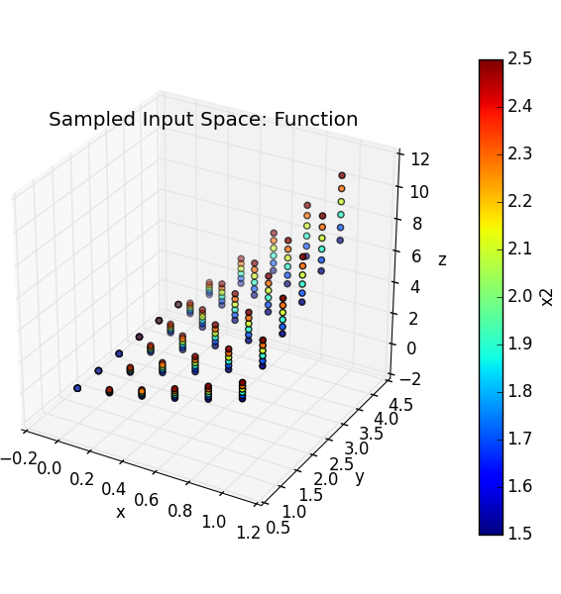
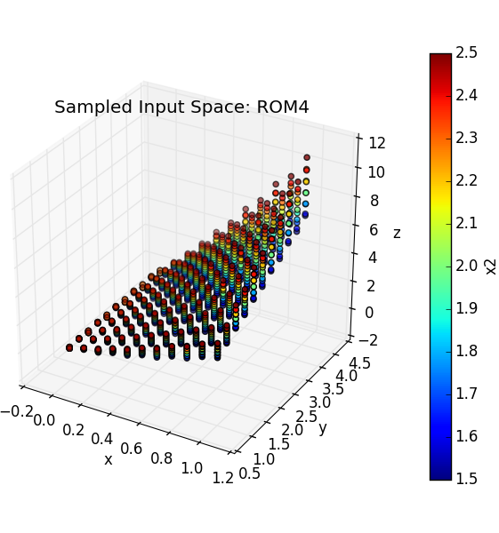
Train and Sample a ROM
Output: y₃
Inputs: x₁, x₂, x₃

Slide 35
Workflow
Sample model Create database
sample_Function.xml
Train a ROM
Pickle ROM
Train a ROM
Sample ROM
rom_trainer.xml
sample_ROM.xml
Load ROM
Sample ROM
sample_pROM.xml

Slide 36
Train and Pickle a ROM
Models
Databases
DataObjects
Steps
<Models>
<ROM name='ROM3' subType='SciKitLearn'>
<Features>x1,x2,x3</Features>
<Target>y3</Target>
<SKLtype>linear_model|LinearRegression</SKLtype>
<fit_intercept>True</fit_intercept>
<normalize>False</normalize>
</ROM>
</Models>
Inputs / Output
ROM type and parameters
Input file name: rom_trainer.xml
Notes:
Add multi target ROM

Slide 37
Train and Pickle a ROM
Models
Databases
DataObjects
Steps
<Databases>
<HDF5 name='out_db' filename='out_db.h5' directory='path2DB/DBStorage/'/>
</Databases>
<DataObjects>
<TimePointSet name='outGRID_y3'>
<Input>x1,x2,x3</Input>
<Output>y3</Output>
</TimePointSet>
</DataObjects>
File name and location of the existing database
<DataObjects>
<Multiple Inputs>
<Single Output>
Input file name: rom_trainer.xml

Slide 38
Train and Pickle a ROM
Models
Databases
DataObjects
Steps
Create a DataObject from the Dababase
<Steps>
<IOStep name='extract_data3'>
<Input class='Databases' type='HDF5' >out_db</Input>
<Output class='DataObjects’ type='TimePointSet'>outGRID_y3</Output>
</IOStep>
<RomTrainer name='rom_trainer3'>
<Input class='DataObjects’ type='TimePointSet'>outGRID_y3</Input>
<Output class='Models' type='ROM' >ROM3</Output>
</RomTrainer>
<IOStep name='pkDump3'>
<Input class='Models' type='ROM'>ROM3</Input>
<Output class='Files' type='' >ROM3pk</Output>
</IOStep>
</Steps>
Create and train a ROM from the DataObject
Pickle the ROM and save it as a file
Input file name: rom_trainer.xml

Slide 39
Workflow
Sample model Create database
sample_Function.xml
Train a ROM
Pickle ROM
Train a ROM
Sample ROM
rom_trainer.xml
sample_ROM.xml
Load ROM
Sample ROM
sample_pROM.xml

Slide 40
Load and Sample a Pickled ROM
Distributions
Models
Samplers
DataObjects
Steps
<Distributions>
<Normal name='normal_trunc'>
<mean>0.5</mean>
<sigma>0.1</sigma>
<lowerBound>0.0</lowerBound>
<upperBound>1.0</upperBound>
</Normal>
<Normal name='normal'>
<mean>2.0</mean>
<sigma>0.2</sigma>
</Normal>
<Uniform name='uniform'>
<upperBound>4.0</upperBound>
<lowerBound>1.0</lowerBound>
</Uniform>
</Distributions>
Input file name: sample_pROM.xml

Slide 41
Load and Sample a Pickled ROM
Distributions
Models
Samplers
DataObjects
Steps
<Models>
<ROM name='ROM3' subType='SciKitLearn'>
<Features>x1,x2,x3</Features>
<Target>y3</Target>
<SKLtype>linear_model|LinearRegression</SKLtype>
<fit_intercept>True</fit_intercept>
<normalize>False</normalize>
</ROM>
</Models>
Inputs / Output
ROM type and parameters
Input file name: sample_pROM.xml

Slide 42
Load and Sample a Pickled ROM
Distributions
Models
Samplers
DataObjects
Steps
<Samplers>
<Grid name='Grid_ROM'>
<variable name='x1’>
<distribution>normal_trunc</distribution>
<grid type='value' lowerBound='0.0' construction='equal' steps='10'>0.1</grid>
</variable>
<variable name='x2’>
<distribution>normal</distribution>
<grid type='value' lowerBound='1.5' construction='equal' steps='10'>0.1</grid>
</variable>
<variable name='x3’>
<distribution>uniform</distribution>
<grid type='value' lowerBound='1.0' construction='equal' steps='10'>0.3</grid>
</variable>
</Grid>
</Samplers>
Finer grid
Input file name: sample_pROM.xml

Slide 43
Load and Sample a Pickled ROM
Distributions
Models
Samplers
DataObjects
Steps
<DataObjects>
<TimePointSet name='outPROM_y3'>
<Input>x1,x2,x3</Input>
<Output>y3</Output>
</TimePointSet>
<TimePointSet name='Data1'>
<Input>x1,x2,x3</Input>
<Output>InputPlaceHolder</Output>
</TimePointSet>
</DataObjects>
Input file name: sample_pROM.xml

Slide 44
Load and Sample a Pickled ROM
Distributions
Models
Samplers
DataObjects
Steps
<Steps>
<IOStep name='pk3Load'>
<Input class='Files' type='' >ROM3pk</Input>
<Output class='Models' type='ROM'>pROM3</Output>
</IOStep>
<MultiRun name='RunPROM3'>
<Input class='DataObjects’ type='TimePointSet’>Data1</Input>
<Model class='Models' type='ROM' >pROM3</Model>
<Sampler class='Samplers' type='Grid' >Grid_ROM</Sampler>
<Output class='DataObjects’ type='TimePointSet’>outPROM_y3</Output>
<Output class='Databases’ type='HDF5' >out_ROM3_db</Output>
</MultiRun>
</Steps>
Load the pickled ROM
Sample the pickled ROM
ROM
Step
Database
Sampler
DataObjects
Input file name: sample_pROM.xml

Slide 45
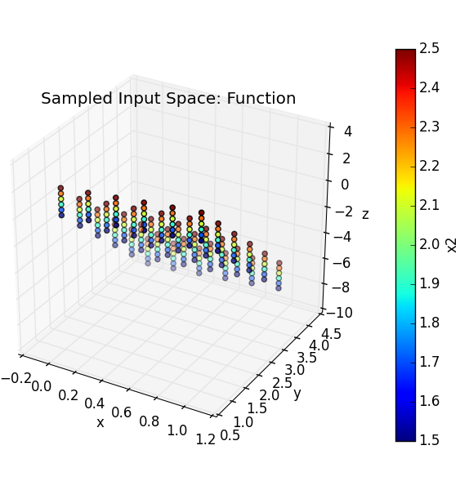
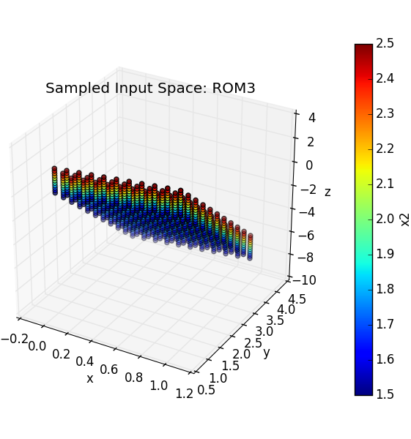
Load and Sample a Pickled ROM
Output: y₃
Inputs: x₁, x₂, x₃

Slide 46
Outline
Brief introduction on ROMs
Application examples of ROMs
ROMs and RAVEN
Available ROMs
RAVEN ROM workflow
RAVEN examples
Create ROMs
Perform sampling of ROMs

Slide 47
Backup slides

Slide 48
Generalized Polynomial Chaos
Effectiveness depends on:
Regularity of quantity of interest
Polynomial expansion order
Polynomial combination indices
Sparse Grid quadrature types (Gauss, Clenshaw)
Number of uncertain inputs
Improvements:
Use less polynomials
Sparse Grid Quadrature

