Slide 1

Advanced Reliability Analysis and RAVEN
RAVEN Workshop
PSA 2015 - April 26th 2015, Sun Valley (ID)

Slide 2
Outline
Advanced Reliability Analysis: brief introduction
Goal Oriented Sampling
Concept of Limit Surface
Convergence acceleration through ROMs
Reliability Analysis and RAVEN
Available Goal Oriented Samplers
Performing Reliability Analysis within RAVEN: workflow
Application examples of Reliability Analysis
RAVEN examples

Slide 3
Reliability Analysis: INTRODUCTION

Slide 4
Reliability Analysis: a quick introduction
Reliability theory evaluates the failure probability of a system given an interval of time
Failure is an “event”
Goal is to forecast/assess the failure events of a given population or the event failure probability
Main goal
Compute the failure probability

Slide 5
Reliability Analysis: Goal-oriented sampling
The evaluation of the failure probability might be computationally challenging, if traditional once-through sampling is employed:
Rare events (low probability) require an enormous number of input space explorations:
Computing a failure probability of 10⁻⁶ would require millions of Monte Carlo samples
The information entropy contained in the already-evaluated histories is not used to adapt the sampling strategy:
System response depends on many variables but often few are really important
Adaptive Sampling based on Reliability (Limit) Surface search

Slide 6
Reliability Analysis: Limit Surface Concept
The limit surface can be described as the hyper-surface that classifies the input space with respect transition regions:
The locus of points that divides the input domain with respect a boolean response (e.g. failure/success)
Consider
System characterization
The goal function is an object that is defined as a part of the system outcome space. In a safety context, the goal function usually represents the success or failure (transition) of the system.

Slide 7
Reliability Analysis: Limit Surface Concept (cont.)
Let’s consider as the transition surface in the output space with respect to the goal function
If the system evolution is represented by
It is possible to identify the set of pairs
Stochastic Parameters
Initial Conditions
in the input space, which leads the system outcome to match:

Slide 8
Reliability Analysis: Limit Surface Search
Training on initial small number of sampled points
A fine grid is classified (failure or success) based on an user-specified surrogate model (sampling of the surrogate)
The limit surface is identified by the location of transition between failure/success
The furthest point on the limit surface from any other already tested point is chosen to test the classifier (convergence test)
Process iterates (2➔4) until the limit surface converges
Failure
Limit surface
Success
Next point

Slide 9
Reliability Analysis: ROMs
For the Adaptive Sampling based on the Reliability (Limit) Surface search, special types of ROMs called “classifiers” are used:
A model (set of equations) that identifies to which category an object belongs in the feature (input) space
Let’s consider again a set of N data points
Based on the goal function :
Build a surrogate model of type “classifier”
Reduced Order Model
Boolean vector
In RAVEN, these ROMs are used as acceleration schemes for goal oriented sampling strategies ➔ they can be used to predict the location of the reliability (limit) surface

Slide 10
Reliability Analysis and RAVEN

Slide 11
Reliability Analysis and RAVEN: Samplers
RAVEN currently has 2 ways to perform Reliability Analysis based on Limit Surface Search:
Adaptive Sampler
Adaptive DET Sampler
Available
Available
All Coupled Codes
RELAP-7 only

Slide 12
Reliability Analysis: Limit Surface Workflow
Define the distributions. Distributions are used to:
Weigh the error estimation
Generate a probability-weighted metric for grid construction
Determine the probability of being inside one of the regions identified by the limit surface
Define the surrogate model to be used as the accelerator (of type Boolean or discrete)
Define the adaptive sampler:
Convergence control and grid
Import the acceleration ROM
Associate the distribution with the variables
Define a step
Post-process the data to compute the failure probability

Slide 13
Reliability Analysis: Applications

Slide 14
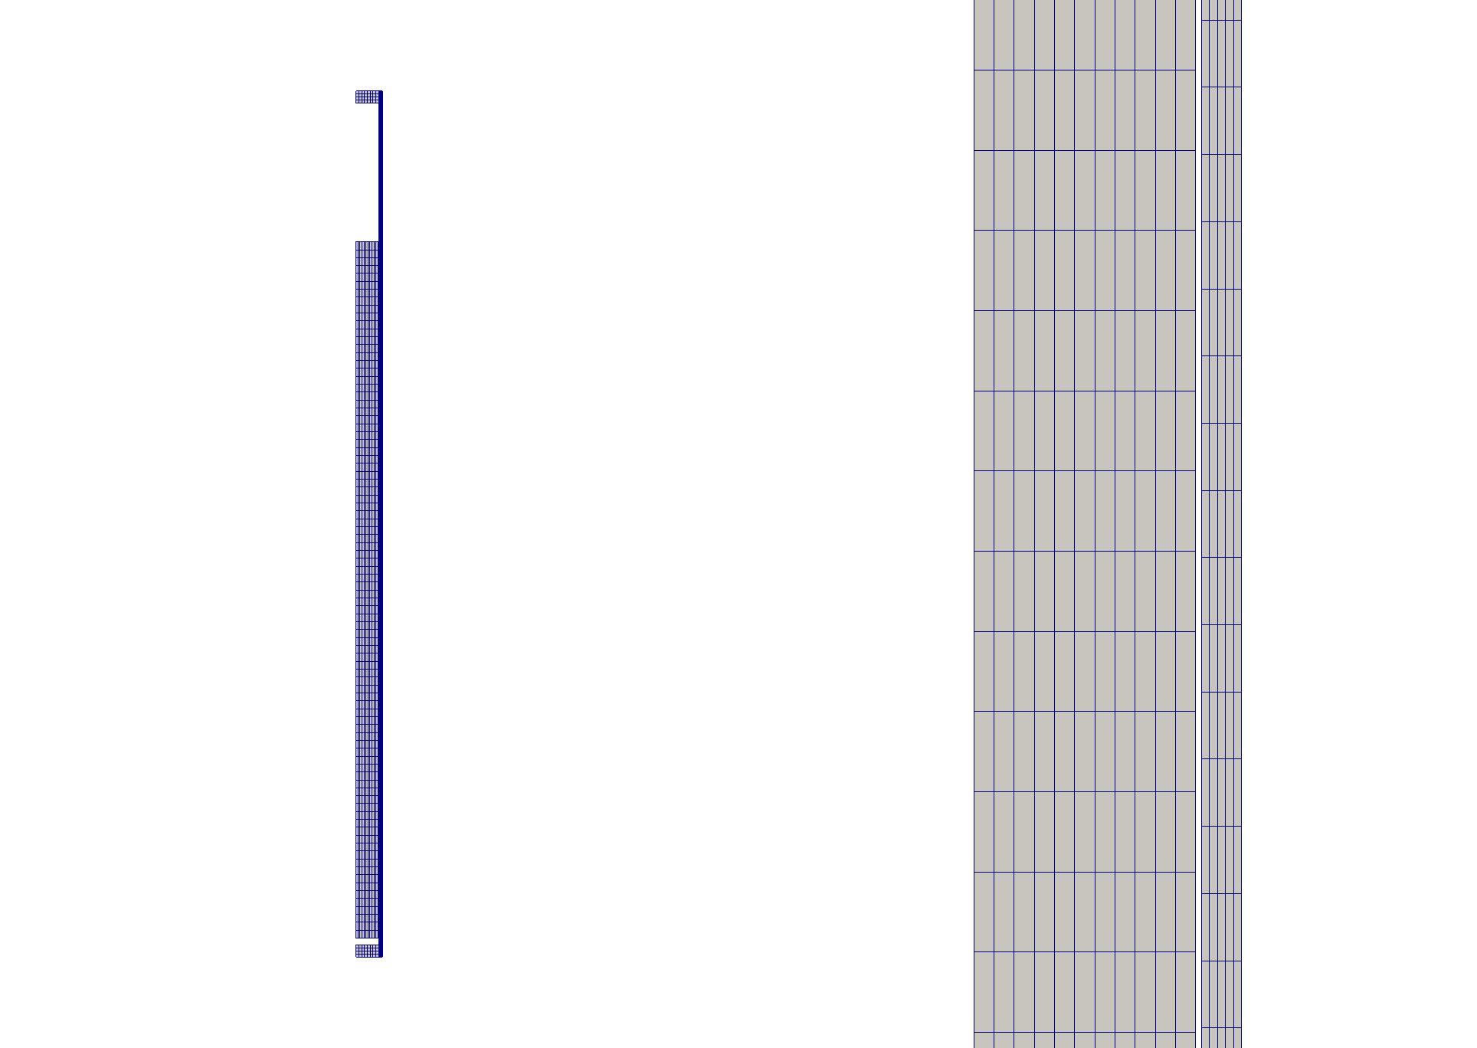
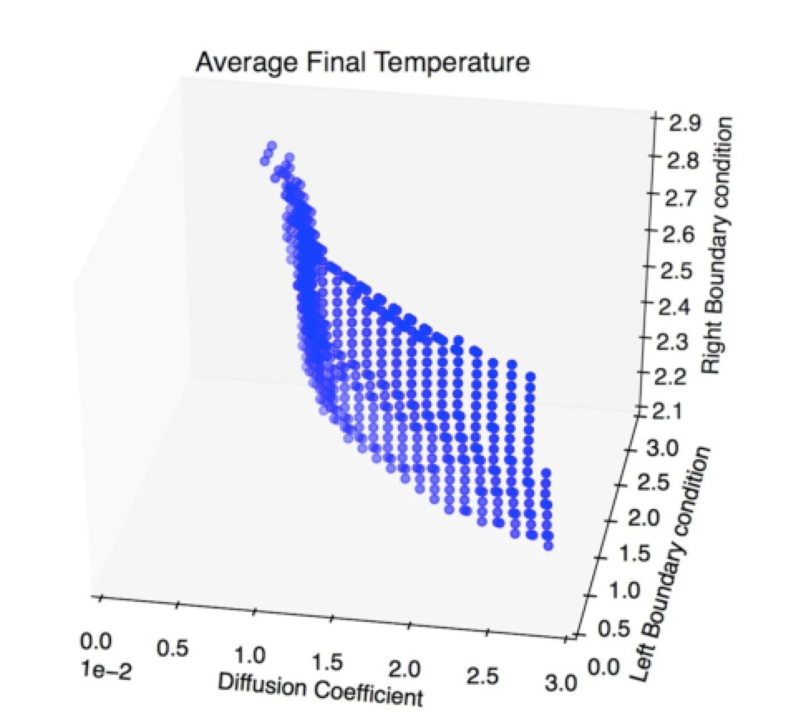
Reliability Analysis: Applications
Fuel Performance - BISON
Smeared pellet stack with hafnium insulator end pellets:
10 fuel pellets as a single, long pellet sandwiched between two insulator pellets.
10,000 second ramp from zero power to 25KW/m.
After the ramp the power was held constant to the end time of 1e8 seconds.
Notes:
Mesh:
The BISON mesh that was used was a smeared pellet stack with hafnium insulator end pellets. This stack simulated 10 fuel pellets as a single, long pellet sandwiched between two insulator pellets. The insulator pellets each consisted of 4 axial elements and 11 radial elements for a total of 44 elements. The fuel consisted of 80 axial element and 11 radial elements for a total of 880 elements. Lastly, the cladding consisted of 135 axial elements and 5 radial elements for a total of 670 elements. The complete mesh and a zoomed in view can be seen in Figure 1A and 1B, respectively.

Slide 15
Reliability Analysis: Applications
Pressurized Water Reactor Station Black Out
PWR SBO
100% Power
120% Power

Slide 16
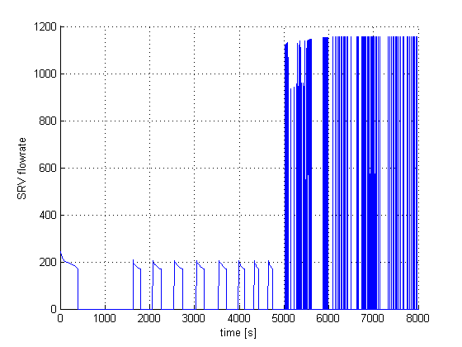
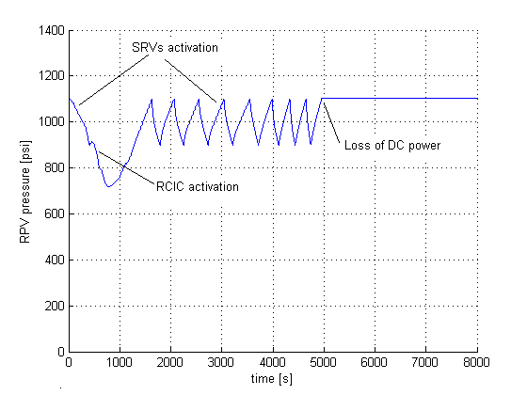
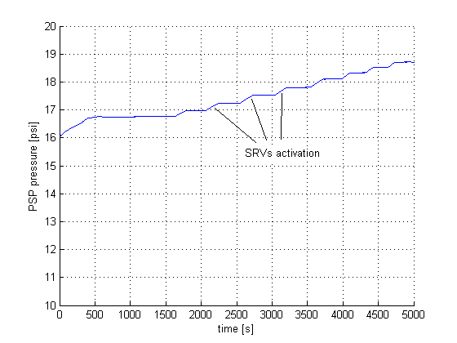
Reliability Analysis: Applications
Boiling Water Reactor Station Black Out
100% Power
120% Power
Notes:
Scenario: LOOP + loss of DGs
3 recovery strategies: off-site power recovery, DG recovery, FW recovery
After loss of DGs, cooling is provided by RCIC/HPCI (mid figure); pressure control provided by SRV (left figure).
Torus pool temperature increases at each SRV activation (right figure).
When pool TH limits are reached, the RPV is depressurized; no cooling can be provided other than FW if available

Slide 17
RAVEN Examples

Slide 18
Workflow
Sample a model and create a database
Use generated data to seed the Adaptive Sampling Step
Compute failure probability from converged Solution
Train a ROM and compute the failure probability changing the stochastic parameters

Slide 19
Exercise 1: Create a data set to seed the Adaptive Sampler

Slide 20
1 – Sample a Model to seed the Adaptive Sampler
Distributions
Models
Samplers
Databases
DataObjects
Steps
<Distributions>
<Normal name='normal_trunc'>
<mean>0.5</mean>
<sigma>0.1</sigma>
<lowerBound>0.0</lowerBound>
<upperBound>1.0</upperBound>
</Normal>
<Normal name='normal'>
<mean>2.0</mean>
<sigma>0.2</sigma>
</Normal>
<Uniform name='uniform'>
<upperBound>4.0</upperBound>
<lowerBound>1.0</lowerBound>
</Uniform>
</Distributions>
Truncation parameters
Input file name: 1-sample_Grid_seed_adaptive.xml

Slide 21
1 – Sample a Model to seed the Adaptive Sampler
Distributions
Models
Samplers
Databases
DataObjects
Steps
<Models>
<ExternalModel name='PythonModule' subType=’’ ModuleToLoad='workshop_model’>
<variables>
x1,
x2,
x3,
y1,
y2,
y3,
y4,
y5,
failure
</variables>
</ExternalModel>
</Models>
Input variables
File name: workshop_model.py
Output variables
Boolean Variable
Input file name: 1-sample_Grid_seed_adaptive.xml

Slide 22
1 – Sample a Model to seed the Adaptive Sampler
Distributions
Models
Samplers
Databases
DataObjects
Steps
<variable name>
<distribution>
<grid points>
<Samplers>
<Grid name='Grid_function'>
<variable name='x1' >
<distribution>normal_trunc</distribution>
<grid type='value’ construction='equal' steps='5'>0 1</grid>
</variable>
<variable name='x2' >
<distribution>normal</distribution>
<grid type='value' construction='equal' steps='5’>1.5 2.5</grid>
</variable>
<variable name='x3' >
<distribution>uniform</distribution>
<grid type='value' construction='equal' steps='5'>1 4</grid>
</variable>
</Grid>
</Samplers>
Input file name: 1-sample_Grid_seed_adaptive.xml

Slide 23
1 – Sample a Model to seed the Adaptive Sampler
Distributions
Models
Samplers
Databases
DataObjects
Steps
<Databases>
<HDF5 name='out_db'/>
</Databases>
<DataObjects>
<TimePointSet name='inputPlaceHolder'>
<Input>x1,x2,x3</Input>
<Output>OutputPlaceHolder</Output>
</TimePointSet>
<TimePointSet name=’outGRID'>
<Input>x1,x2,x3</Input>
<Output>y1,y2,y3,y4,y5,failure</Output>
</TimePointSet>
</DataObjects>
<DataObjects>
<Inputs>
<Output>
Input file name: 1-sample_Grid_seed_adaptive.xml

Slide 24
1 – Sample a Model to seed the Adaptive Sampler
Distributions
Models
Samplers
Databases
DataObjects
Steps
<Steps>
<MultiRun name='FirstMRun'>
<Input class='DataObjects' type='TimePoint' >inputPlaceHolder</Input>
<Model class='Models' type='ExternalModel’>PythonModule</Model>
<Sampler class='Samplers' type='Grid' >Grid_function</Sampler>
<Output class='DataObjects’ type='TimePointSet’ >outGRID</Output>
<Output class='Databases' type='HDF5' >out_db</Output>
<Output class='OutStreamManager' type='Print' >out_dump</Output>
<Output class='OutStreamManager' type='Plot' >plotResponse_y3</Output>
<Output class='OutStreamManager' type='Plot' >plotResponse_y4</Output>
<Output class='OutStreamManager' type='Plot' >plotResponse_y5</Output>
</MultiRun>
</Steps>
Model file
Step
Database
Model info
Sampler
DataObjects
Input file name: 1-sample_Grid_seed_adaptive.xml

Slide 25
Exercise 2: Use generated data to seed the Adaptive Sampling Step and perform Limit Surface search

Slide 26
2- Use data to seed the Adaptive Sampling Step
Steps
Models
Functions
Samplers
Databases
DataObjects
Steps
<Models>
<ExternalModel name='PythonModule' subType=’’
ModuleToLoad='workshop_model’>
<variables>
x1,
x2,
x3,
y1,
y2,
y3,
y4,
y5,failure
</variables>
</ExternalModel>
<ROM name=’AccelerationROM' subType='SciKitLearn'>
<Features>x1,x2,x3</Features>
<Target>goalFunction</Target>
<SKLtype>svm|SVC</SKLtype>
<kernel>rbf</kernel>
<C>10.0</C>
</ROM>
</Models>
def run(self,Input): …
if self.y4 < 5.0:
self.failure= 0.0
else:
self.failure= 1.0
Kernel Type
Transition definition:
0.0 -> success
1.0 -> failure
Penalty parameter of the error term
Input file name: 2-seeded_adaptive_sampling.xml

Slide 27
2- Use data to seed a Goal Oriented Sampling
Models
Functions
Samplers
Databases
DataObjects
Steps
<Functions>
<External name=’goalFunction’ file= ‘goalFunctionWorkshop’>
<variables>
y4,failure
</variables>
</External>
</Functions>
Variables that are needed for the evaluation
def __residuumSign(self): if self.y4 < 5.0: return 1
else : return -1
Transition definition:
1 -> success
-1 -> failure
Input file name: 2-seeded_adaptive_sampling.xml

Slide 28
2- Use data to seed the Adaptive Sampling Step
Models
Functions
Samplers
Databases
DataObjects
Steps
<Samplers>
<LimitSurfaceSearch name=’workshopAdaptive’>
<ROM class='Models' type='ROM’>accelerated_ROM</ROM>
<Function class='Functions' type='External’>goalFunction</Function>
<TargetEvaluation class='DataObjects' type='TimePointSet'>
outAdaptive
</TargetEvaluation>
<Convergence
limit='3000'
forceIteration='False'
weight='value'
persistence='25'>
1e-4
</Convergence>
<variable name='x1'><distribution>normal_trunc</distribution></variable>
<variable name='x2'><distribution>normal</distribution></variable>
<variable name='x3'><distribution>uniform</distribution></variable>
</LimitSurfaceSearch>
</Samplers>
Max Iterations
Goal function
Force Iteration until limit
Error Weighting: CDF or Value
Tolerance
Input file name: 2-seeded_adaptive_sampling.xml

Slide 29
2- Use data to seed a Goal Oriented Sampling
Models
Functions
Samplers
Databases
DataObjects
Steps
<Databases>
<HDF5 name='out_db_adaptive' directory=’DataBaseStorage/'/>
<HDF5 name='out_db’ filename='out_db.h5’ />
<HDF5 name='out_db_ls’ directory='DataBaseStorage/'/>
</Databases>
<DataObjects>
<TimePointSet name='outAdaptive'>
<Input>x1,x2,x3</Input>
<Output>y3,y4,y5,failure</Output>
</TimePointSet>
<TimePointSet name=’limitSurface'>
<Input>x1,x2,x3</Input>
<Output>goalFunction</Output>
</TimePointSet>
<TimePointSet name=’inputPlaceHolder'>
<Input>x1,x2,x3</Input>
<Output>OutputPlaceHolder</Output>
</TimePointSet>
</DataObjects>
Limit Surface Container
Input file name: 2-seeded_adaptive_sampling.xml

Slide 30
2- Use data to seed a Goal Oriented Sampling
Models
Functions
Samplers
Databases
DataObjects
Steps
<Steps>
<IOStep name=’load_seed_dataset'>
<Input class='Databases' type='HDF5' >out_db</Input>
<Output class='DataObjects’ type='TimePointSet'>outAdaptive</Output>
</IOStep>
<MultiRun name=’GoalOrientedStep'>
<Input class=DataObjects’type=’TimePoint' >inputPlaceHolder</Input>
<Model class='Models' type='ExternalModel’>PythonModule</Model>
<Sampler class='Samplers' type=’LimitSurfaceSearch’>workshopAdaptive</Sampler>
<Output class='DataObjects’type='TimePointSet’ >outAdaptive</Output>
<Output class='Databases' type='HDF5' >out_db_adaptive</Output>
<SolutionExport class='DataObjects’type='TimePointSet’>
limitSurface
</SolutionExport >
</MultiRun>
<IOStep name=’push_limitsurface_in_database'>
<Input class='DataObjects' type='TimePointSet’ >limitSurface</Input>
<Output class='Databases' type='HDF5' >out_db_ls</Output>
</IOStep>
</Steps>>
Input file name: 2-seeded_adaptive_sampling.xml

Slide 31
Exercise 3: Compute failure probability from Converged solution

Slide 32
3 –Failure Probability from Converged Solution
Models
Samplers
Databases
DataObjects
Steps
<Models>
<ROM name=’probabilityROm' subType='SciKitLearn'>
<Features>x1,x2,x3</Features>
<Target>failure</Target>
<SKLtype>svm|SVC</SKLtype>
<C>10.0</C>
<kernel>rbf</kernel>
</ROM>
<ExternalModel name='PythonModule' subType=’’
ModuleToLoad='workshop_model’>
…
</ExternalModel>
<PostProcessor name=’computePb' subType=’BasicStatistics'>
<what>expectedValue</what>
<parameters>failure</paramters>
</PostProcessor>
</Models>
Input file name: 3-compute_failure_pb_from_ls.xml

Slide 33
3 –Failure Probability from Converged Solution
Model
Samplers
Databases
DataObjects
Steps
<Samplers>
<MonteCarlo name=’Montecarlo_sampling'>
<sampler_init> <limit>17576</limit> </sampler_init>
<variable name='x1’>
<distribution>normal_trunc</distribution>
</variable>
<variable name='x2’>
<distribution>normal</distribution>
</variable>
<variable name='x3’>
<distribution>uniform</distribution>
</variable>
</MonteCarlo>
</Samplers>
Input file name: 3-compute_failure_pb_from_ls.xml

Slide 34
3 –Failure Probability from Converged Solution
Model
Samplers
Databases
DataObjects
Steps
<Databases>
<HDF5 name="out_ROM3_db"/>
<HDF5 name="out_db_montecarlo” directory=“DatabaseStorage/"/>
<HDF5 name="out_db_adaptive" filename="out_db_adaptive.h5” directory=“DatabaseStorage/"/>
</Databases>
<DataObjects>
<TimePointSet name=’outAdapt_failure'>
<Input>x1,x2,x3</Input>
<Output>failure</Output>
</TimePointSet>
<TimePointSet name=’outGrid_failure'>
<Input>x1,x2,x3</Input>
<Output>failure</Output>
</TimePointSet>
<TimePointSet name=’outMC_failure'>
<Input>x1,x2,x3</Input>
<Output>failure</Output>
</TimePointSet>
</DaDataObjectstas>
Input file name: 3-compute_failure_pb_from_ls.xml

Slide 35
Exercise 4: Compute failure probability from Converged solution changing Distributions

Slide 36
4 – Compute failure probability changing distributions
Distributions
<Distributions>
<Normal name='normal_trunc'>
<mean>0.5</mean>
<sigma>0.1</sigma>
<lowerBound>0.0</lowerBound>
<upperBound>1.0</upperBound>
</Normal>
<Normal name='normal'>
<mean>2.0</mean>
<sigma>0.2</sigma>
</Normal>
<Uniform name='uniform'>
<upperBound>4.0</upperBound>
<lowerBound>1.0</lowerBound>
</Uniform>
</Distributions>
<Distributions>
<Normal name='normal_trunc'>
<mean>0.5</mean>
<sigma>0.1</sigma>
<lowerBound>0.0</lowerBound>
<upperBound>1.0</upperBound>
</Normal>
<Normal name='normal'>
<mean>1.9</mean>
<sigma>0.1</sigma>
</Normal>
<Uniform name='uniform'>
<upperBound>3.8</upperBound>
<lowerBound>1.0</lowerBound>
</Uniform>
</Distributions>
Input file name: 4-compute_pb_with_rom_and_changed_dists.xml

Slide 37
Thank you Questions?

