Slide 1

RAVEN interaction with External Models and Applications
RAVEN Workshop
Presenter: Andrea Alfonsi
PHYSOR 2016 – May 1st 2016, Sun Valley (ID)

Slide 2
Outline
Overview of RAVEN interaction with external Applications
Available APIs: External Model and Code APIs
Using the External Model Entity
Introduction
Implementing the Python module
Available methods
Interaction with RAVEN
Coupling a new Application through a Code Interface
Introduction
Code requirements
Interfaces that need to be implemented
Interaction with RAVEN

Slide 3
RAVEN Interaction with External Applications
RAVEN has two preferential APIs to interact with external Applications
External Model: An external Python “entity” that can act as, for example, a system model
External Code: API to drive external system codes
Both APIs are written in PYTHON
RAVEN
External Model
External Code

Slide 4
External Model

Slide 5
External Model Entity: Introduction
The ExternalModel object represents an entity that is embedded in RAVEN at runtime
This object allows the user to create a PYTHON module that is going to be treated as a pre-defined internal Model
It becomes part of the RAVEN framework
imported
External Model
RAVEN

Slide 6
External Model Entity: RAVEN Input
<Models>
<ExternalModel name='PythonModule' subType=’’ ModuleToLoad='workshop_model’>
<variable>x1</variable>
<variable>y1</variable>
<newCustomXmlNode>
<aConstant>
20021986
</aConstant>
<anotherConstant>
2004
<anotherConstant>
</newCustomXmlNode>
</ExternalModel>
</Models>
Model variables tracked by RAVEN
File name
(with or without path): workshop_model.py
Variables that RAVEN is able to “see” and “check”
Custom piece of XML Input

Slide 7
External Model Entity: Python Module
In the External Python module, the user can implement all the methods that are needed for the functionality of the model
Only these methods are called by the framework:
def _readMoreXML(self,xmlNode)
Optional
def initialize(self,runInfo,inputs)
Optional
def createNewInput(self,inputs,samplerType,**Kwargs)
Optional
def run(self,inputs)
Required
Each variable defined in the XML input is available in “self”
y1 = self.x1

Slide 8
External Model Entity: _readMoreXML
Needed only if the XML input that belongs to the External Model needs to be extended to contain other information
Input data needs to be stored in “self” in order to be available to all the other methods
def _readMoreXML(self,xmlNode):
# get the node
ourNode = xmlNode.find(’newCustomXmlNode’) # get the information in the subnodes
for child in ourNode:
if child.tag == ‘aConstant’:
self.aConstant = int(child.text)
elif child.tag == ‘anotherConstant’:
self.anotherConstant = int(child.text)
else: raise IOError(“unknown node tag”)
Optional
<newCustomXmlNode> is unknown (in RAVEN)

Slide 9
External Model Entity: initialize
This method initializes the model
For example, it can be used to compute a quantity needed by the “run” method:
List of Inputs defined in the Step entity
def initialize(self,runInfo,inputs):
# initialize some quantities
self.sigma = 10.0 self.rho = 5.0
self.newVar= self.sigma*self.rho
Optional
Info read in <RunInfo> XML input
Variables not listed in the XML input files
Notes:
Io aggiungenerei anche una riga del tipo
Self.newVar = self.sigma*self.rho

Slide 10
External Model Entity: createNewInput
Can be used to create a custom Input with the information coming from RAVEN
The generated input is transferred to the “run” method
Type of Sampler
Container of Info coming from RAVEN
def createNewInput(self,inputs,samplerType,**Kwargs):
if samplerType == ‘MonteCarlo’:
aVariable = inputs[‘anInput’]*self.sigma
else:
aVariable = inputs[‘anInput’]*self.rho
aLocalVar = Kwargs[‘SampledVars’][‘x1’]
returnVar = aVariable*aLocalVar
return returnVar
Optional
From initialize method

Slide 11
External Model Entity: run
In this function, the user needs to implement the algorithm that RAVEN will execute
The run method is generally called after having inquired the createNewInput method (internal or the user-implemented)
List of Inputs generated in creatNewInput method
def run(self,inputs):
input = inputs[0]
self.y1 = input**2
return
Optional
Required
Outcome stored in “self” => RAVEN can collect it

Slide 12
Code Interface

Slide 13
Coupling an App with RAVEN: Introduction
The procedure of coupling a new Application with RAVEN is a straightforward process
The coupling is performed through a Python Interface
The Interface has two functions:
Interpret the information coming from RAVEN
Translate such information in the input of the driven code
The coupling procedure does not require any modification of RAVEN
embedded
External Code
RAVEN
Interpreting information coming from RAVEN
Translating them in the Application Input

Slide 14
Coupling an App with RAVEN: Requirements
Input requirements:
Python-compatible parser for Application input
Decide the syntax your Code Interface will be able to interpret
Input Parser Example
Input Text
class simpleInputParser():
def __init__(self,filen):
self.keyDict = {} lines=open(filen).readlines() for line in lines:
key=line.split("=”)[0] value=line.split("=”)[1]
self.keyDict[key]=value
def modifyInternalDict(self,inDictionary):
for key,newvalue in inDictionary.items():
self.keyDict[key]=newvalue
def writeNewInput(self,filen):
fileobject = open(filen)
for key,value in self.keyDict.items():
fileobject.write(key+‘‘=’’+str(value)+‘‘\n’’)
Key1 = aValue1
Key2 = aValue2
Key3 = aValue3

Slide 15
Coupling an App with RAVEN: Requirements
Output requirements:
RAVEN handles Comma Separated Values (CSV) files
If your code output is not in CSV format, your interface needs to convert it into CSV format
Input Parser Example
Output Text
def convertOutputFileToCSV(outfile):
keywordDict = {} fileobject = open(outputfile)
outputCSVfile = open (outputfile + ’.csv’)
lines = fileobject.readlines()
for line in lines:
listSplitted = line.split("=")
keyword = listSplitted[0] value = listSplitted[1]
keyDict[keyword] = value
outputCSVfile.write(’,’.join(keyDict.keys()))
outputCSVfile.write(’,’.join(keyDict.values()))
result1= aValue1
result2= aValue2
Output CSV
result1,result2
aValue1,aValue2

Slide 16
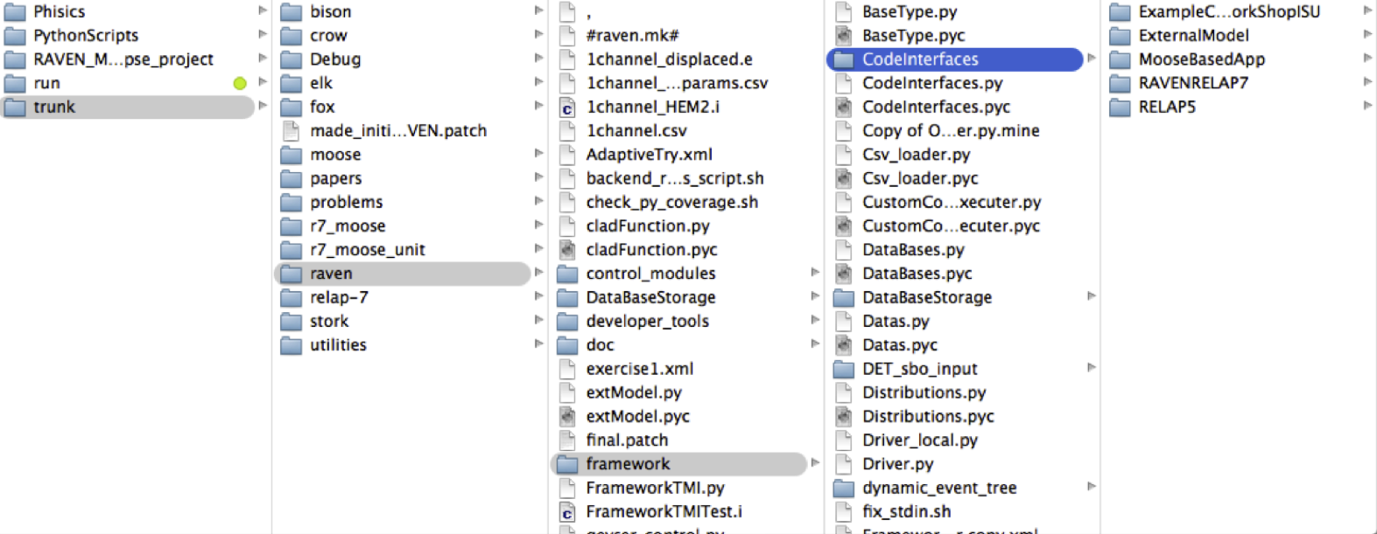
Coupling an App with RAVEN: Interfaces
RAVEN becomes aware of the codes it can use as Models only at run-time
RAVEN looks for code interfaces and loads them automatically
The code interface needs to be placed in a new folder under the directory “./raven/framework/CodeInterfaces”

Slide 17
Coupling an App with RAVEN: Methods
RAVEN imports all the “Code Interfaces” at run-time, without actually knowing the syntax of the driven codes
In order to make RAVEN able to drive a new Application, a Python module containing few methods (strict syntax) needs to be implemented:
class newApplication(CodeInterfaceBase):
def generateCommand(self,input,exe,clargs,fargs)
Required
def createNewInput(self,inputs,samplerType,**Kwargs)
Required
def finalizeCodeOutput(self,command,output,workDir)
Optional
def checkForOutputFailure(self,output,workDir)
Optional
def getInputExtension(self)
Optional
def setInputExtension(self, exts)
Optional

Slide 18
Coupling an App with RAVEN: generateCommand
Used to retrieve the command needed to launch the driven App and the root of the output file
The return data type must be a TUPLE
List of input files
Optional Arguments
Optional
def generateCommand(self,input,exe,clargs,fargs):
inp = input[0]
outfile=’out ̃’+os.path.split(inp)[1].split(’.’)[0]
executeCommand = (exe+ ‘ -i ‘ +os.path.split(inp)[1])
return (executeCommand,outfile)
Required
Executable

Slide 19
Coupling an App with RAVEN: createNewInput
Used to generate an input based on the information that RAVEN passes
This method needs to return a list containing the path and filenames of the modified input files
List of inputs
Type of Sampler
Dictionary of info from RAVEN
def createNewInput(self,inputs,samplerType,**Kwargs):
parser = simpleInputParser(currentInputFiles[0])
sampledVars = Kwargs[’SampledVars’]
parser.modifyInternalDictionary(sampledVars)
temp = str(inputs[index][:])
newInputFiles = copy.copy(inputs)
newInputFiles[0] = os.path.join(os.path.split(temp)
[0], Kwargs[’prefix’]+" ̃"+os.path.split(temp)[1])
parser.writeNewInput(newInputFiles[0]) return newInputFiles
Optional
Optional
Required
Notes:
It needs to modify the input file, accordingly with respect to the variables RAVEN is providing.

Slide 20
Coupling an App with RAVEN: finalizeCodeOutput
Used to convert the whatever App output format into a CSV
RAVEN checks if a string is returned
RAVEN interprets that string as the new output file name (CSV)
Command created by generateCommand
Optional
Optional
def finalizeCodeOutput(self,command,output,workDir):
outputfile = os.path.join(workingDir,output+’.o’)
convertOutputFileToCSV(outfile)
Working directory
Output root name
Notes:
It needs to modify the input file, accordingly with respect to the variables RAVEN is providing.

Slide 21
Coupling an App with RAVEN: checkForOutputFailure
Used to check if a run failed even if the returncode = 0
It must return a Boolean value. True if failure, False otherwise
Output root name
Working directory
Optional
Optional
def checkForOutputFailure(self,output,workDir):
try:
fileName = os.path.join(workingDir,output+'.o’)
fileObj = open(fileName)
except: return failure
failure =
not b_any(’****Error’ in x.strip() for x in
fileObj.readlines())
return failure
Notes:
This method is called by RAVEN at the end of each run if the return code is == 0.
This method needs to be implemented by the codes that, if the run fails, return a return code that is 0
This can happen in those codes that record the failure of the job (e.g. not converged, etc.) as normal termination (returncode == 0)
This method can be used, for example, to parse the outputfile looking for a special keyword that testifies that a particular job got failed

Slide 22
Thank you Questions?

