Slide 1

Coupling a code with RAVEN
A. Alfonsi, C. Rabiti, J.Cogliati, D.Mandelli, R. Kinoshita
ISU workshop, July 2014

Slide 2
Outline
How it works
Code Pre-requisites
What you need to write
How you need to interact with the code
Example
Chosen Example Code used for this example:
HOBO
Input Syntax
Output Syntax
Step by Step RAVEN-Example Code coupling
Conclusions

Slide 3
How it works Code Pre-requisites
In order to couple your Application to the RAVEN code, your code needs to satisfy some (FEW) pre-requisites.
CLASSIFICATION:
Input pre-requisites:
You need to know your code input syntax :D. Hence, you can write a Python-compatible parser for you input (a module that is able to read and modify your code input)
You need to decide the syntax your Code Interface will be able to interpret
Output pre-requisites:
RAVEN is able to handle CSV files (as outputs)
If your code output is not in CSV format, your interface needs to be able to convert it in a CSV format

Slide 4
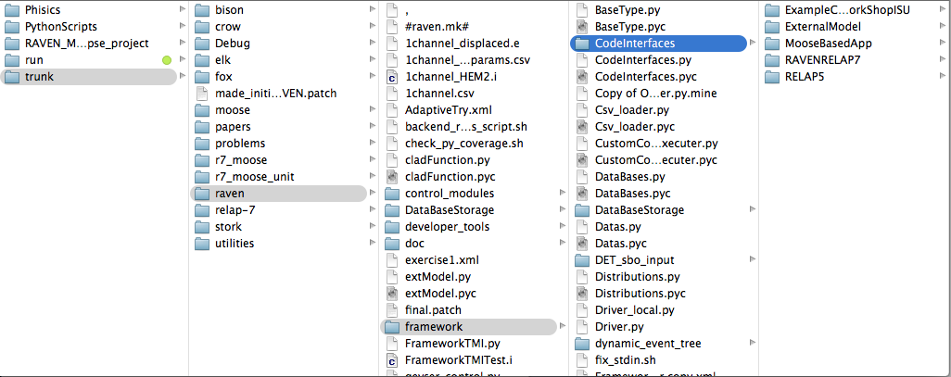
How it works What you need to write
The RAVEN code has been built in a highly modular fashion.
For this reason, the coupling of an external code is quite straightforward (from a RAVEN point of view)
RAVEN framework gets aware of the Codes it can use as Models (i.e. codes that RAVEN can use) only at run-time stage, since it looks for code interfaces and loads them automatically
You do not need to touch the code itself. RAVEN is able to load a customized external interface for your code with few required (and optional) methods.
The code interface needs to be placed in a newer folder under the directory “./raven/framework/CodeInterfaces”

Slide 5
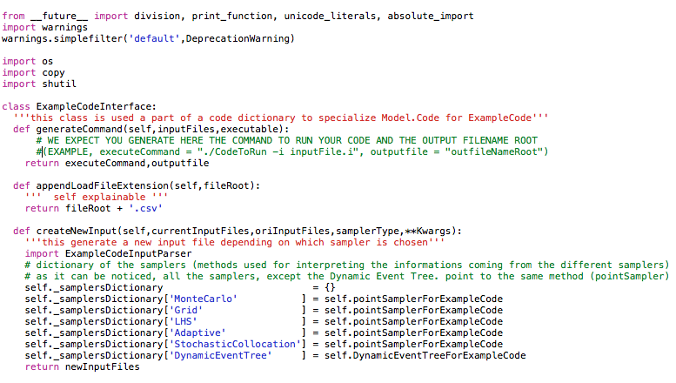
How it works How you need to interact with the code
As already mentioned, RAVEN can load your Code Interface automatically, without being aware of it in the source code.
RAVEN expects, in your interface, to find few methods (that are going to be analyzed, in details, later on in this Presentation):
generateCommand(self,inputFiles,executable)
appendLoadFileExtension(self,fileRoot)
createNewInput(self,currentInputFiles,oriInputFiles,samplerType,**Kwargs)
actionsAtTheEnd(self, currentInputFiles,oriInputFiles,samplerType,**Kwargs)
RAVEN passes in these methods all the information needed for perturbing and handling the input files of your code (for example, the variables that got sampled, etc.)

Slide 6
Example HOBO
0-dimensional “nuclear fuel performance code”
Developed for testing purposes by D. Pizzocri and G. Pastore
Focus is on Fission Gas Behavior
Release (FGR)
Swelling
HOBØ

Slide 7
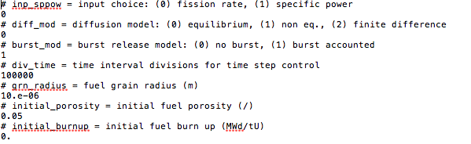
Example Input Syntax
For this example, it has been decided to make only one input file (named 1_settings.txt) perturb-able by RAVEN.
So far, HOBO has not the capability to accept user defined input and output file names => The coupling needs few adaptations (like copying the executable, etc.)
The syntax of 1_settings.txt is quite simple:

Slide 8
Example Output Syntax
HOBO directly provides CSV files for outputting the solution evolution.
GREAT! We do not to do anything…
RAVEN is already capable to load CSV!!!

Slide 9
Example Step by Step RAVEN-Example Code coupling
Let’s put our hands on the code.
Let’s write it

Slide 10
Conclusions
You should conclude it
Thanks
Questions?

