Slide 1

BLFormer improves
billiards break prediction
Why this model family fits the task
A geometry-aware joint set transformer for clear, win, and potted-count prediction from table layouts.
Object-set tokens
Geometry-biased attention
Bu Yizhe
Joint 40-state head
Tang Wentao
Wang Mingyang

Slide 2
2
The task is to read a post-break layout, not an image
Break-shot prediction is a small-data physical reasoning problem with three coupled outputs.
Dataset
- 1,940 accepted post-break layouts
- 776 train and 1,164 held-out test
- 6 to 10 active balls per scene
Clear
rack cleared or not
Win
match win or not
Why it is hard
Potted count
- The scene is unordered and relational
- Labels are correlated rather than independent
- Potted-count classes are heavily imbalanced
0 to 9 balls after break
Observed layout after the break shot
The model sees a set of objects,
not a stable image raster.

Slide 3
3
From raw data to one clean table state
The model sees only the filtered, normalized object set after alignment and packing.
Raw files
Clean model input
One accepted post-break state, normalized to [0,1], then packed as tokens.
Frame
Potted
Clear
Win
Remarks
align
CLS
1
0
0
1
9
ball
filter
ball
2
0
0
0
<pad>
3
7
0
0
foul
pocket
normalize
2
pocket
3
7
0
0
duplicate
3
packed token matrix + attention mask
Frame 1.xml
pack
<ball id="2" x="137.2" y="64.8"/>
<ball id="9" x="95.1" y="17.3"/> orientation=V
accepted post-break layout
x_norm
y_norm
exists
ball_id / pocket
1,940 layouts
776 train
1,164 test

Slide 4
4
BLFormer changes both representation and supervision
It is built around scene structure and label coupling rather than generic token processing.
1
Tokenize only what matters
Active balls become variable-size tokens, six pockets are appended, and padding is masked away.
Where baselines stall
2
Inject geometry into attention
- BLCNN treats layout tokens like a local convolutional sequence
- MLP discards spatial interactions after flattening
- Vanilla Transformer has no billiards-specific geometry bias
Pairwise distance, dx, dy, angle, blocked path, and edge type become additive attention bias.
3
Pool the whole layout
A CLS token is combined with the mean over valid tokens to reduce dependence on one summary slot.
4
Predict a joint outcome state
A 40-state head models clear, win, and potted count together, then recovers three marginals.
Selected configuration: 2 encoder layers, 4 heads, d_model 80, FFN 160, dropout 0.1, CLS+mean pooling, auxiliary joint supervision.

Slide 5
5
BLFormer: tokens + pair geometry -> joint head
Embedding, bias MLP, 2 encoder layers, CLS/mean pooling, and a 40-way output.
Token construction
type id
ball id
x, y
BLFormer encoder layer x2
joint head
+ +
LayerNorm
Pooling
9
CLS
Geo-MHSA (4 heads)
CLS
ball
+ residual
mean
ball
2
<pad>
LayerNorm
concat ->
160-D
40 logits = 2 x 2 x 10
pkt
pkt
FFN 80 -> 160 -> 80
3
marginals
d_model = 80, variable valid-token count
+ residual
clear / win
post-break layout
pair_features (10-D)
bias MLP 10 -> 32 -> 4 heads
potted
distance, dx, dy, angle, blocked path, edge type
Selected model: d_model 80, 4 heads, 2 encoder layers, FFN 160, CLS+mean pooling, joint 40-state supervision, 121,426 parameters.

Slide 6
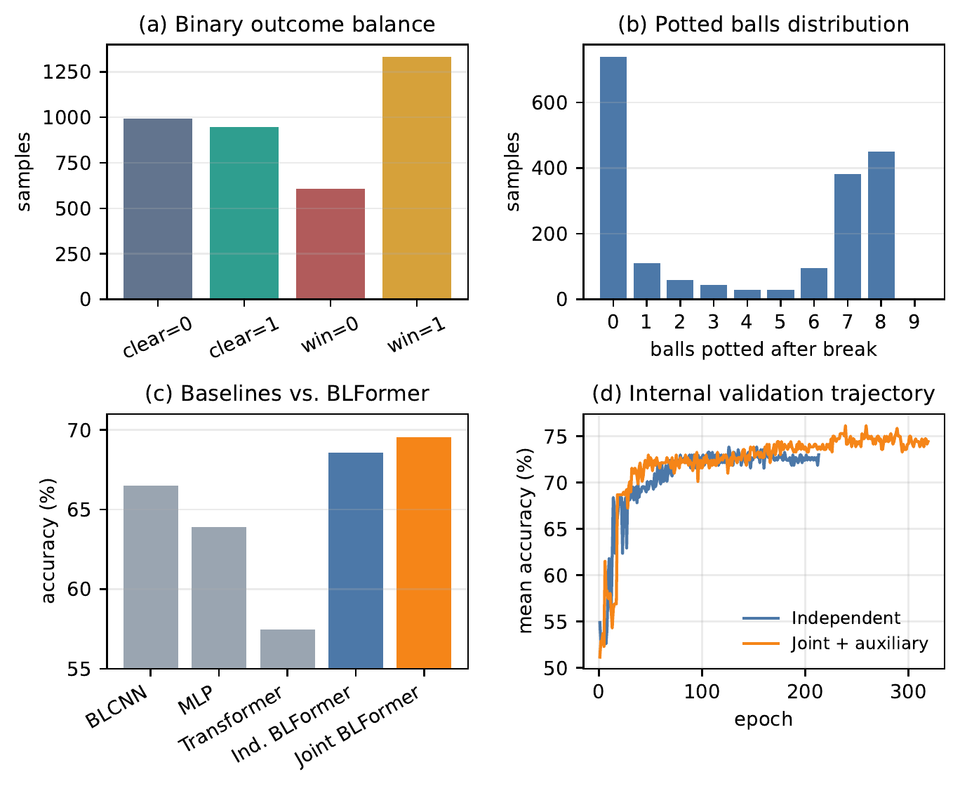
6
BLFormer wins on held-out accuracy
The report dashboard adds data-balance and validation-curve context.
Parameter footprint
BLFormer 121k joint
Others total: BLCNN 143k | MLP 155k | Transformer 160k
Held-out test accuracy by task
Model
Clear
Win
Potted
Mean
BLCNN
71.48
66.75
61.25
66.49
MLP
69.33
67.18
55.24
63.92
Transformer
65.81
66.41
40.12
57.45
BLFormer
71.82
69.67
67.10
69.53
Training: AdamW, lr 3e-4, weight decay 0.01, batch size 64, cosine annealing, dropout 0.1, gradient clipping 1.0, early stopping patience 60, up to 400 epochs.

Slide 7
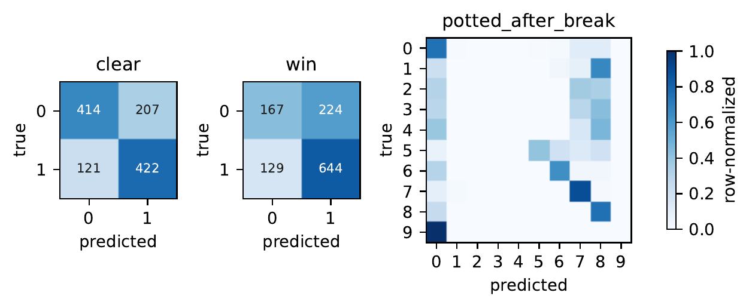
7
Rare potted counts remain the main failure mode
The final report confusion matrices show that the model is accurate on dominant classes but still weak on the long tail.
Confusion matrices
Observed failure modes
- Potted macro-F1 is only 0.338 even though exact accuracy reaches 67.10%.
- The model never predicts class 9 on the held-out test split.
- Win is noisy because many positive layouts still diverge later in the rack.
Evaluation limits
- Internal model selection uses only 660 train and 116 validation samples.
- The report is based on one fixed split rather than multi-seed confidence intervals.
- Class 9 appears only four times in the full cleaned dataset.
What should come next
Add multi-seed confidence intervals, calibrate rare potted classes, and test stronger imbalance-aware objectives.
Hitting plan to win the game base on ball layout

