Slide 1
04. 探索页表
关于编写 x64 Windows 10 驱动以了解虚拟内存这件事

Slide 2


2⁵²
0
2⁵²
0
 | 2⁴⁸
 | 0
 | 2⁴⁸
 | 0

Slide 3
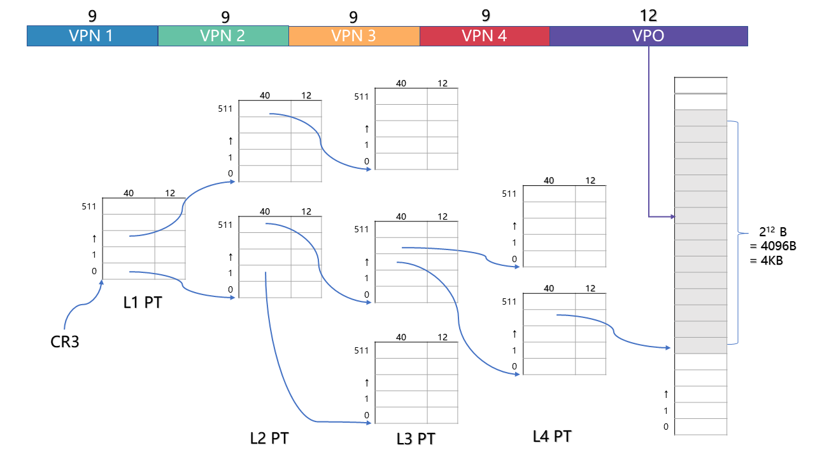
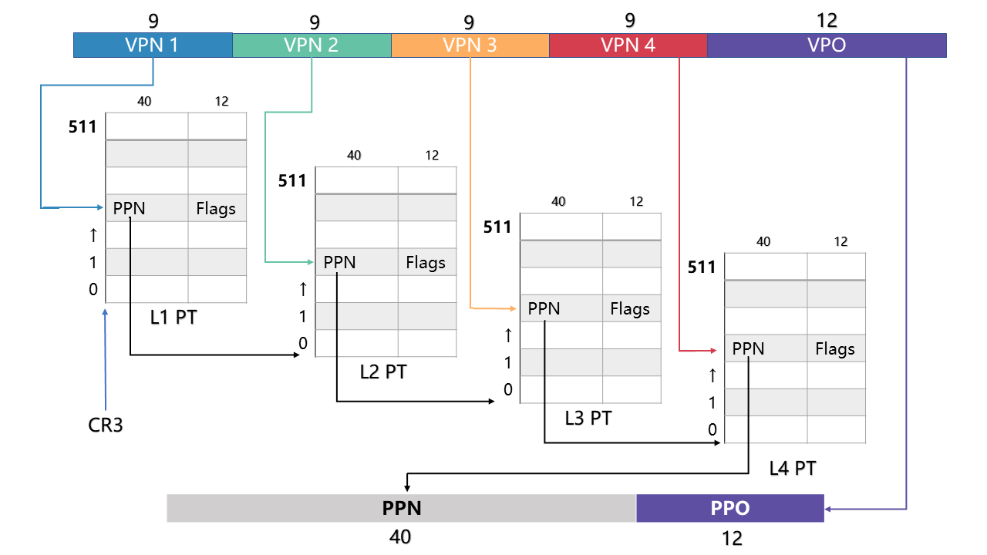
VaToPa
Pa = VaToPa(Va, PageTable)
PageTable

Slide 4
9
9
9
9
12
VPN 1
VPN 2
VPN 3
VPN 4
VPO
 | 40 | 12
511
↑
1
0
↑
1
0
 | 40 | 12
511
↑
1
0
 | 40 | 12
511
↑
1
0
 | 40 | 12
511
↑
1
0
 | 40 | 12
511
↑
1
0
 | 40 | 12
511
↑
1
0
2¹² B
= 4096B
= 4KB
 | 40 | 12
511
↑
1
0
L1 PT
CR3
 | 40 | 12
511
↑
1
0
L2 PT
L3 PT
L4 PT

Slide 5
缩写 | 英文 | 中文
PPN | Physical Page Number | 物理页号
PP0 | Physical Page Offset | 物理页偏移

Slide 6
0 |  |  |  |  |  |  |  | 1 |  |  |  |  |  |  |  | 2
 |  |  |  |  |  |  |  |  |  |  |  |  |  |  |  | 2
 |  |  |  |  |  |  |  |  |  |  |  |  |  |  |  | 2
0 | 1 | 2 | 3 | …

Slide 7
 | = 页的首地址 >> 12
 | = 页的首地址 / 2¹²
 | = 页的首地址 / 4096
 | = 页的首地址 / 4K
页号 | = 页的首地址 / 页大小
52-2^{n} | 2^{n}
2¹²=4K
2²¹=2M
2³⁰=1G

