Slide 1
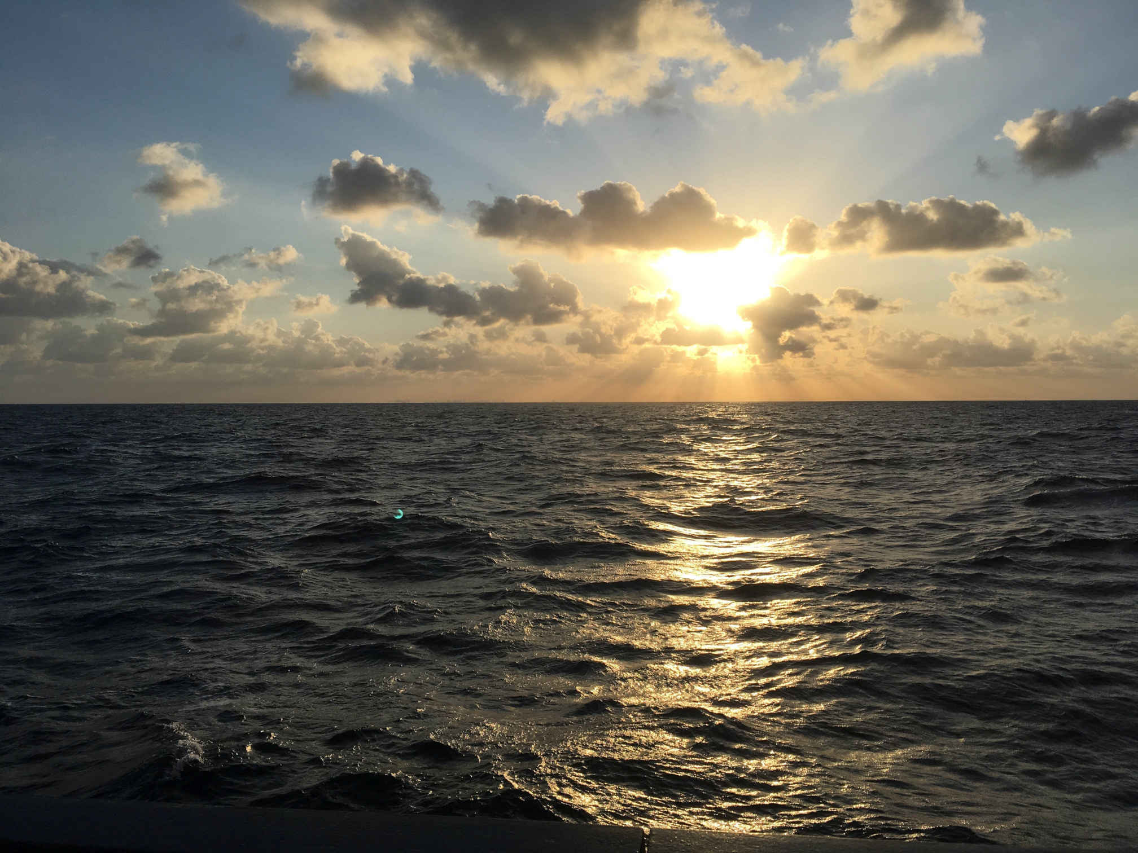
AWI-CM3 hands-on-course:
Part 1 Introduction
Jan Streffing 08.09.2022

Slide 2
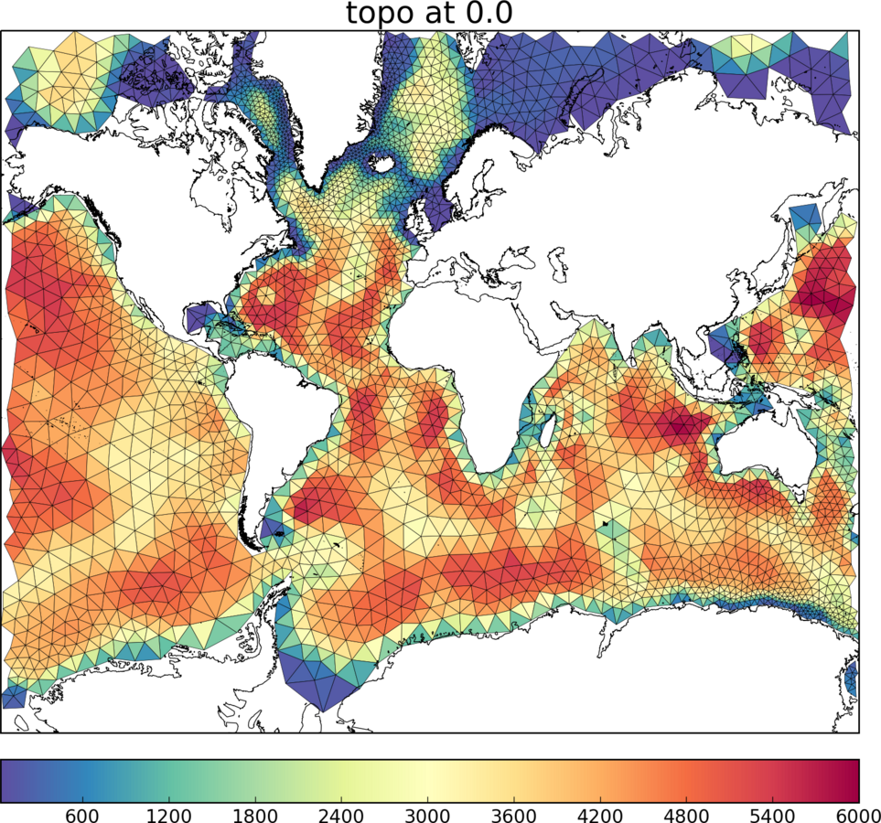
Introduction
Major participating models for CMIP6:
ACCESS-CM2, AWI-CM1-MR, AWI-ESM1-LR, BCC-SM2-MR, CAMS, CanESM5, CAS-ESM2-0, CESM2, CIESM, CMCC-CM2-SR5, CNRM-CM6-1-HR, E3SM-1-1, EC-Earth3, FGOALS-f3-L, FIO-ESM-2-0, GISS-E2-1-G, HadGEM3MM, ICON-ESM-LR, IITM-ESM, INM5, IPSL-CM6A-LR, KIOST-ESM, MCMUA1, MIROC6, MPI-ESM1-2-HR, MRI-ESM2-0, NESM3, NOAA-GFDL, NorESM2-MM, SNU, TaiESM1
 | Practical resolutions:
AWI-CM1 | FESOM1: 120-10 km ECHAM6: 200-100 km

Slide 3
Introduction
Major participating models for CMIP6:
ACCESS-CM2, AWI-CM1-MR, BCC-SM2-MR, CAMS, CanESM5, CAS-ESM2-0, CESM2, CIESM, CMCC-CM2-SR5, CNRM-CM6-1-HR, E3SM-1-1, EC-Earth3, FGOALS-f3-L, FIO-ESM-2-0, GISS-E2-1-G, HadGEM3MM, ICON-ESM-LR, IITM-ESM, INM5, IPSL-CM6A-LR, KIOST-ESM, MCMUA1, MIROC6, MPI-ESM1-2-HR, MRI-ESM2-0, NESM3, NOAA-GFDL, NorESM2-MM, SNU, TaiESM1
 | Practical resolutions:
AWI-CM1 | FESOM1: 100-10 km ECHAM6: 200-100 km
AWI-CM2 | FESOM2: 100-1 km ECHAM6: 200-100 km

Slide 4
Introduction
Major participating models for CMIP6:
ACCESS-CM2, AWI-CM1-MR, BCC-SM2-MR, CAMS, CanESM5, CAS-ESM2-0, CESM2, CIESM, CMCC-CM2-SR5, CNRM-CM6-1-HR, E3SM-1-1, EC-Earth3, FGOALS-f3-L, FIO-ESM-2-0, GISS-E2-1-G, HadGEM3MM, ICON-ESM-LR, IITM-ESM, INM5, IPSL-CM6A-LR, KIOST-ESM, MCMUA1, MIROC6, MPI-ESM1-2-HR, MRI-ESM2-0, NESM3, NOAA-GFDL, NorESM2-MM, SNU, TaiESM1
 | Practical resolutions:
AWI-CM1 | FESOM1: 100-10 km ECHAM6: 200-100 km
AWI-CM2 | FESOM2: 100-1 km ECHAM6: 200-100 km
AWI-CM3 | FESOM2: 100-1 km OpenIFS: 120-9km

Slide 5
Introduction Coupling schematic
Parallel IO
XIOS 2.5
Ocean
FESOM2
Atmosphere
OpenIFS 43r3
Sea ice
FESIM
Waves
WAM
Runoff mapper
Hydrology
H-TESSEL

Slide 6

Introduction Coupling schematic
Oasis: Interpolation library by CERFACS & Los Alamos Labratory
Parallel IO
XIOS 2.5
Ocean
FESOM2
Atmosphere
OpenIFS 43r3
Sea ice
FESIM
Waves
WAM
Runoff mapper
Hydrology
H-TESSEL

Slide 7
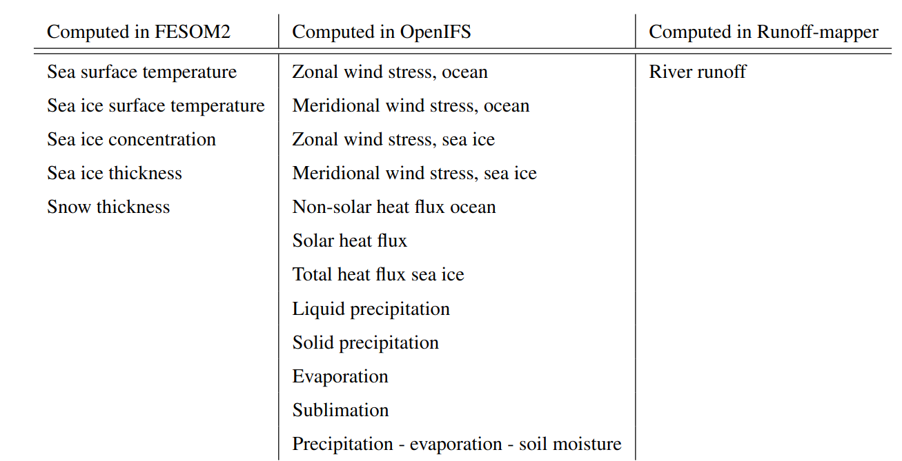


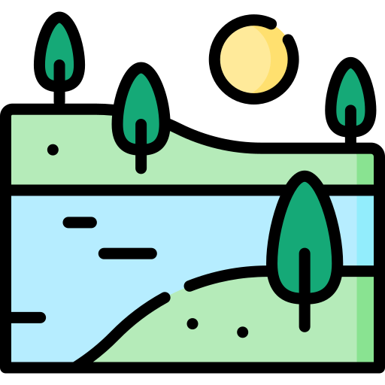

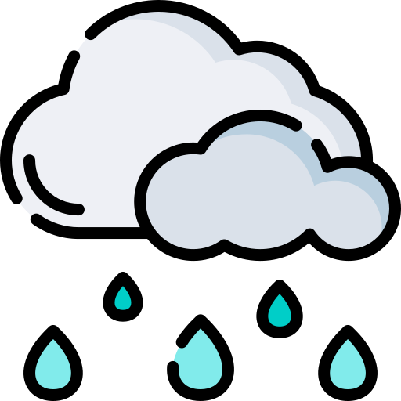
Introduction Basic coupling

Slide 8
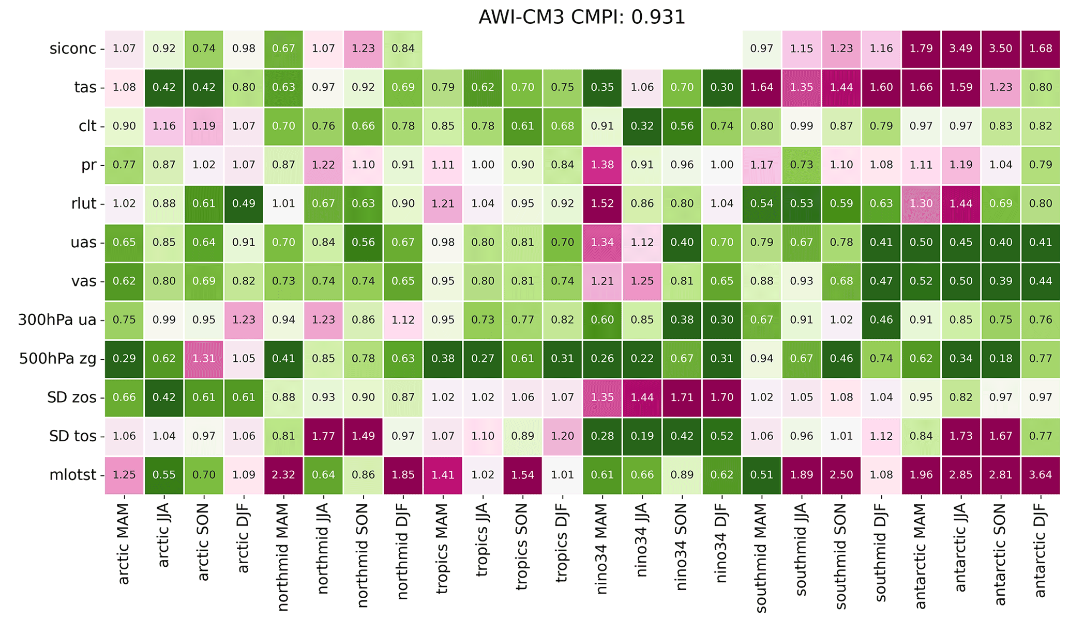
Introduction v3.0 performance
Green = better than CMIP6 average
Magenta = worse than CMIP6 average
Number = Factor by how much
https://github.com/JanStreffing/cmpi-tool/

Slide 9
Introduction v3.0 performance
Green = better than CMIP6 average
Magenta = worse than CMIP6 average
Number = Factor by how much
https://github.com/JanStreffing/cmpi-tool/
More details in: Streffing, J., Sidorenko, D., Semmler, T., Zampieri, L., Scholz, P., Andrés-Martínez, M., Koldunov, N., Rackow, T., Kjellsson, J., Goessling, H., Athanase, M., Wang, Q., Sein, D., Mu, L., Fladrich, U., Barbi, D., Gierz, P., Danilov, S., Juricke, S., Lohmann, G., and Jung, T.: AWI-CM3 coupled climate model: Description and evaluation experiments for a prototype post-CMIP6 model, EGUsphere [preprint], https://doi.org/10.5194/egusphere-2022-32, 2022.

Slide 10
Introduction v3.0 performance
Green = better than CMIP6 average
Magenta = worse than CMIP6 average
Number = Factor by how much
https://github.com/JanStreffing/cmpi-tool/

Slide 11
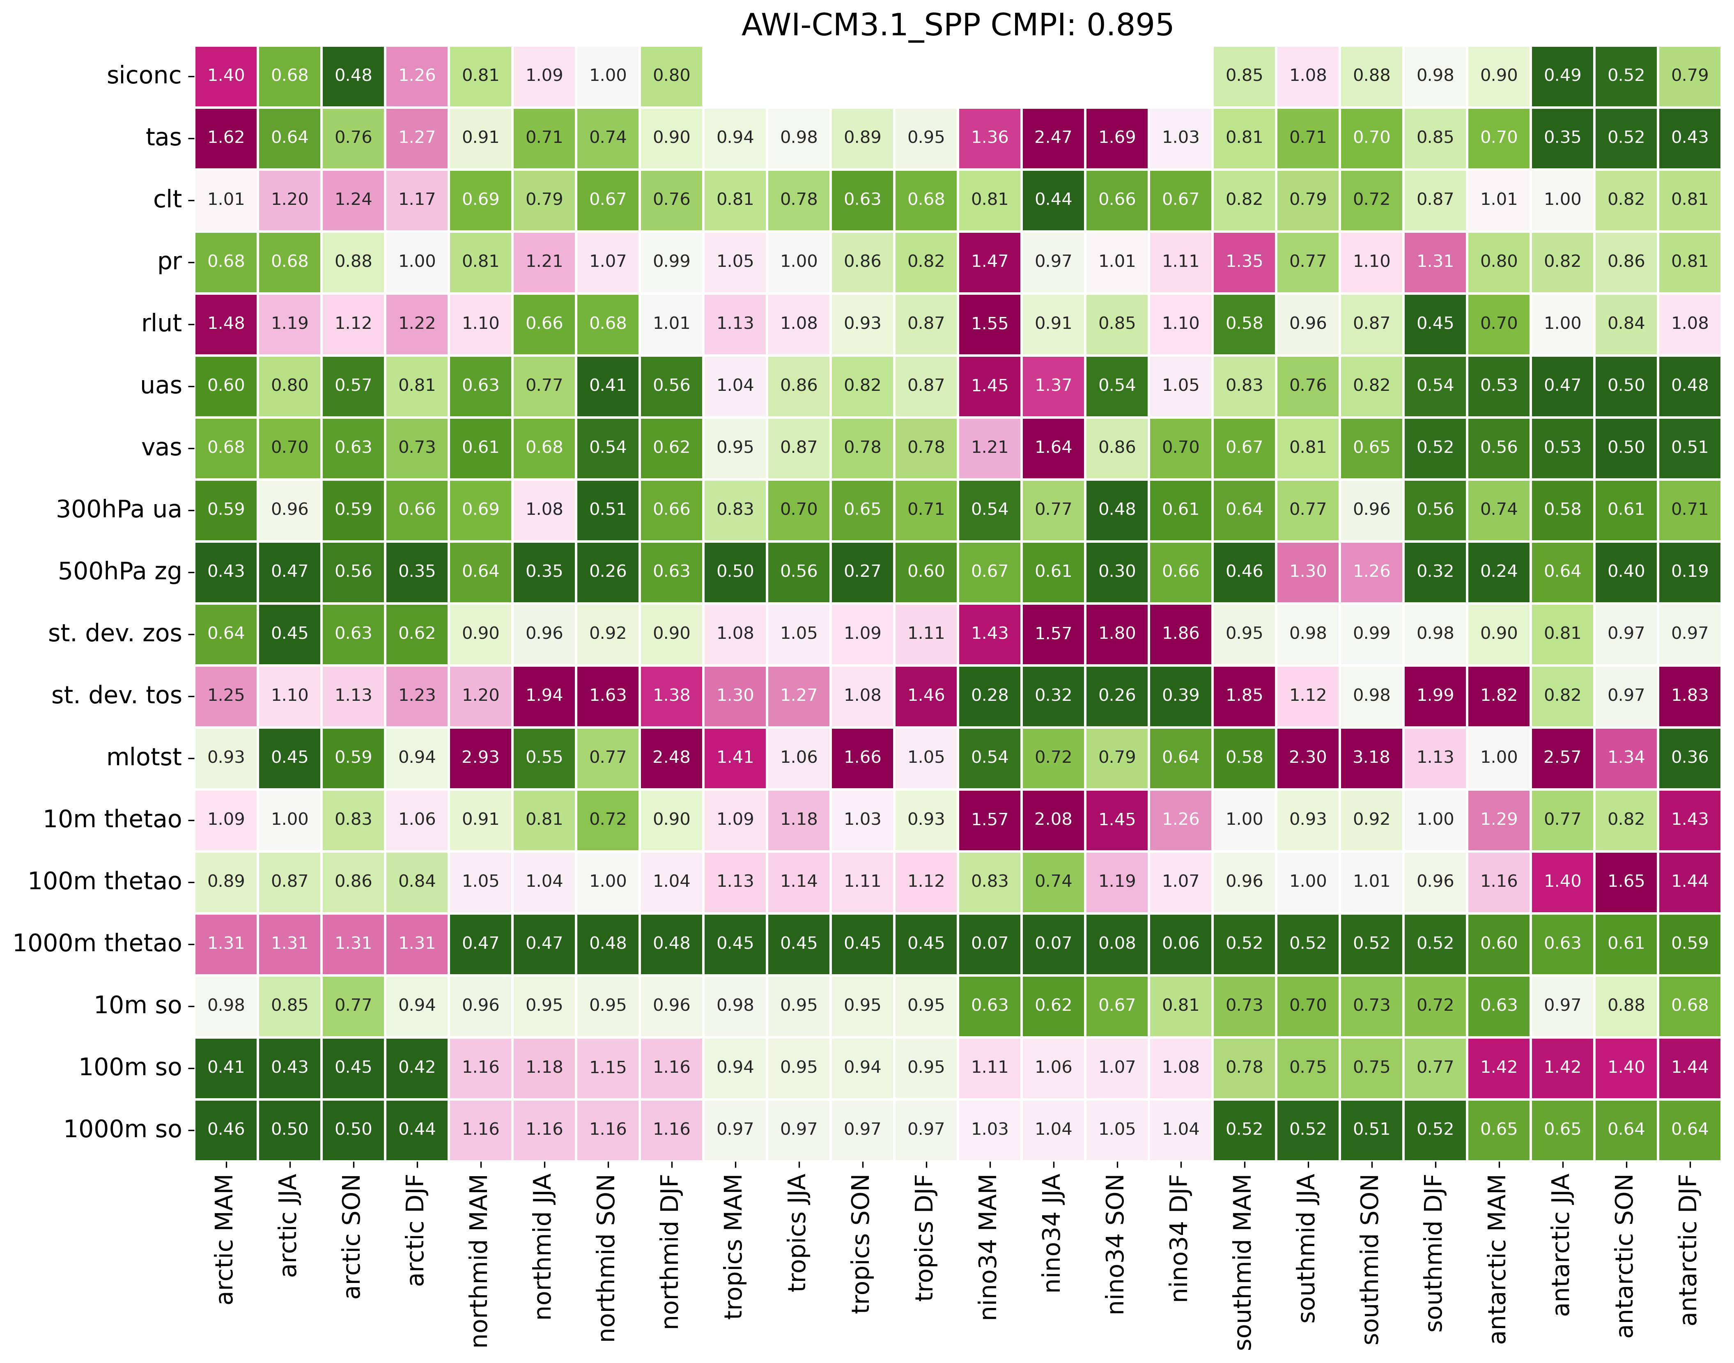
Introduction v3.1 performance
Green = better than CMIP6 average
Magenta = worse than CMIP6 average
Number = Factor by how much
https://github.com/JanStreffing/cmpi-tool/

Slide 12
Introduction Wider infrastucture
AWI-ESM-3
FESOM2 +
ICEPACK
RECOM
PISM
LPJ-G
FOCI
OpenIFS 43r3 +
WAM + CAMS +
H-TESSEL
ECE-4
NEMO3.6 +
AGRIF +
LIM2
NEMO4 + SI³
XIOS 2.5
PISCES
Runoff mapper

