Slide 1
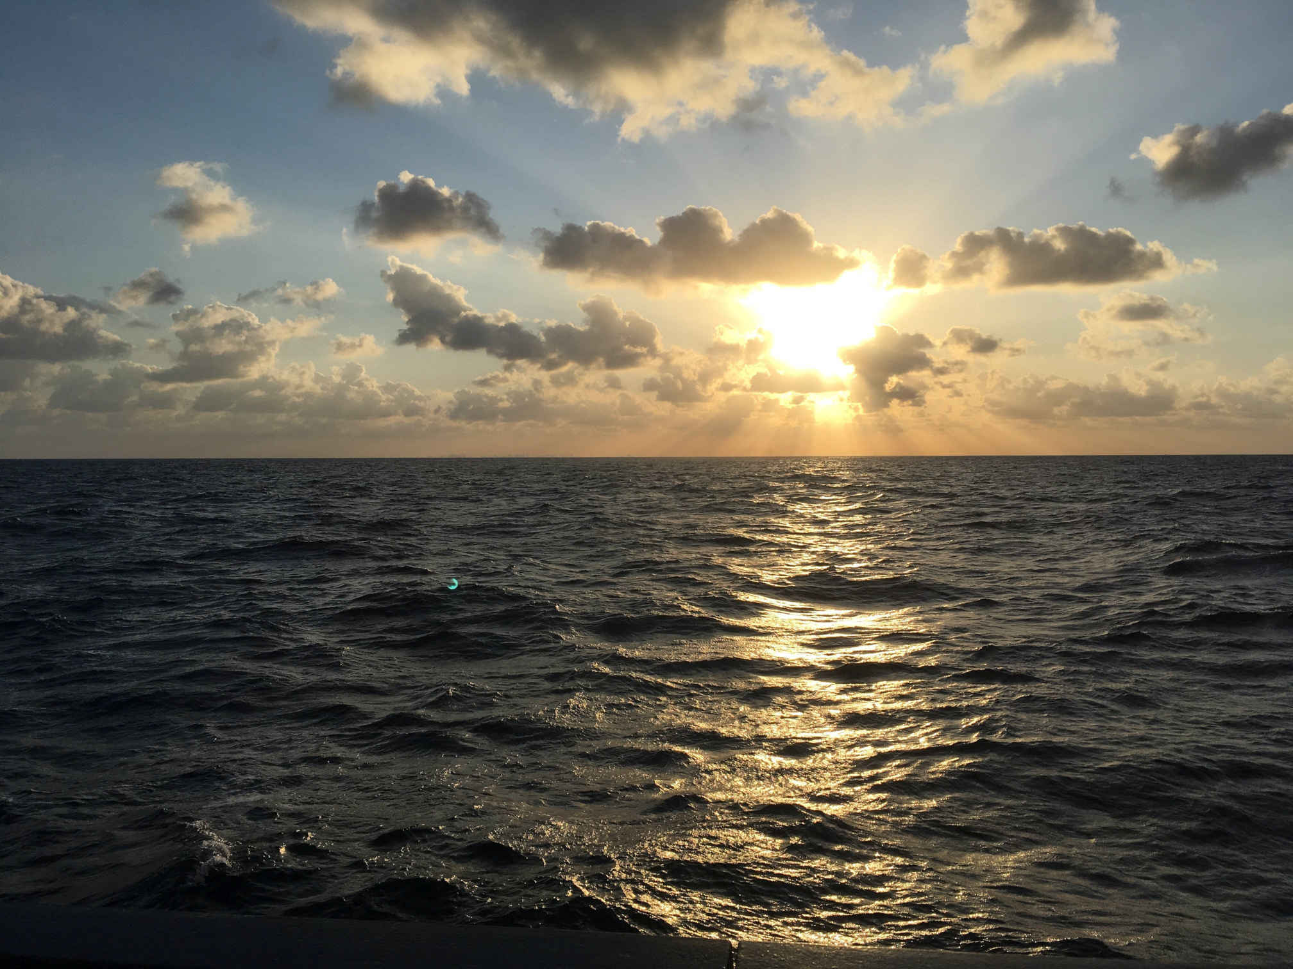
AWI-CM3 hands-on-course:
Part 4 Running AWI-CM3
Jan Streffing 08.09.2022

