Slide 1
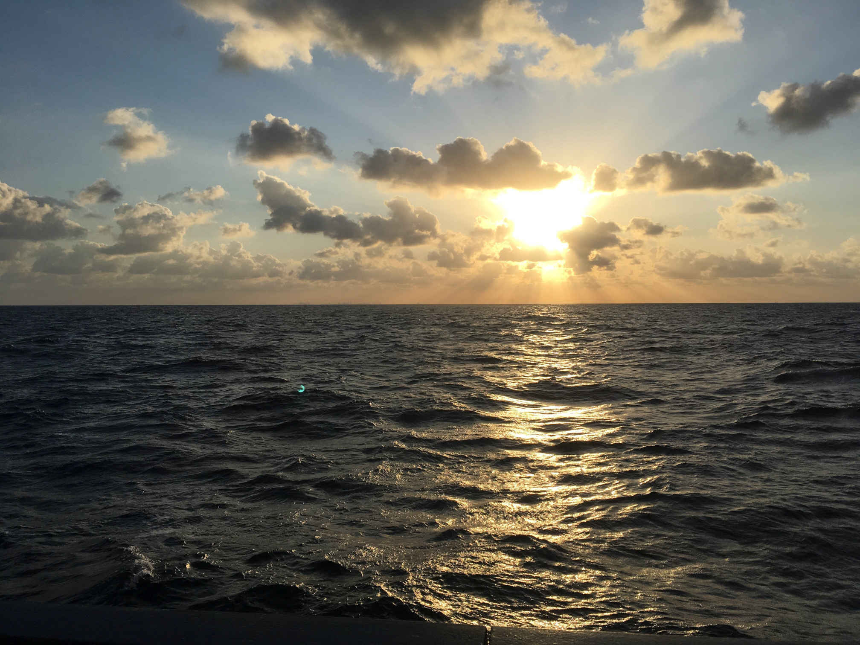
AWI-CM3 hands-on-course:
Part 5 Source code modifications
for scientific work
Jan Streffing 08.09.2022

Slide 2
Source code modifications for paper
Major participating models for CMIP6:
ACCESS-CM2, AWI-CM1-MR, AWI-ESM1-LR, BCC-SM2-MR, CAMS, CanESM5, CAS-ESM2-0, CESM2, CIESM, CMCC-CM2-SR5, CNRM-CM6-1-HR, E3SM-1-1, EC-Earth3, FGOALS-f3-L, FIO-ESM-2-0, GISS-E2-1-G, HadGEM3MM, ICON-ESM-LR, IITM-ESM, INM5, IPSL-CM6A-LR, KIOST-ESM, MCMUA1, MIROC6, MPI-ESM1-2-HR, MRI-ESM2-0, NESM3, NOAA-GFDL, NorESM2-MM, SNU, TaiESM1

