Slide 1
AWI-CM3 hands-on-course:
Part 1 Introduction
Jan Streffing 08.09.2022

Slide 2
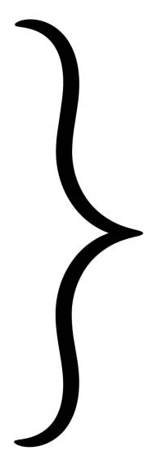
Goals of the day
Install esm_tools
Install awicm3-v3.1
Run a default simulation
Modify namelists and run a simulation
Learn how to contribute
Learn about visualization
Learn about documentation & support
Hands-on
Hands-off

Slide 3
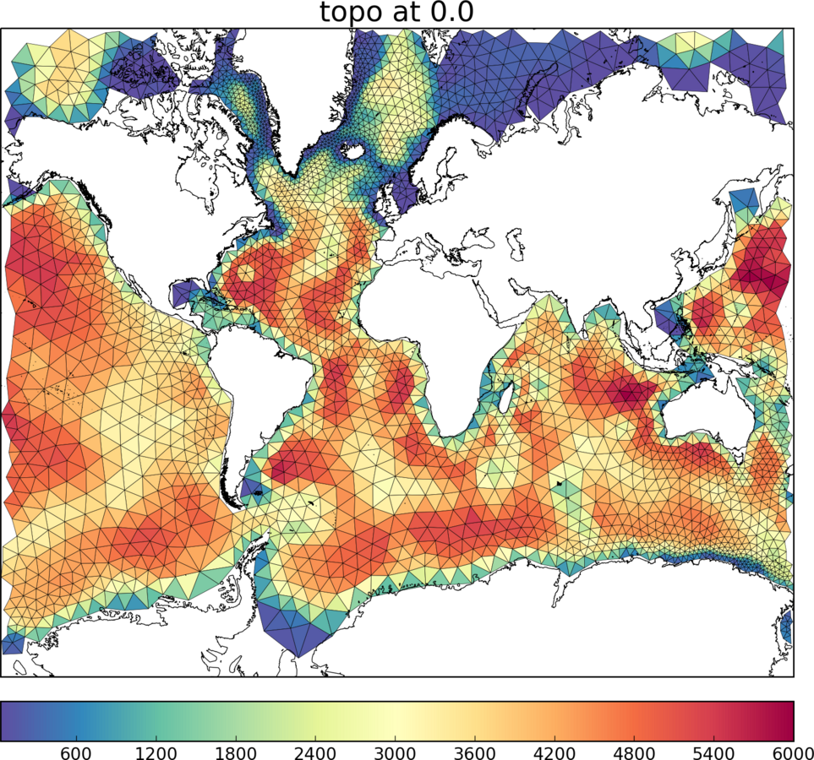
Introduction
Major participating models for CMIP6:
ACCESS-CM2, AWI-CM1-MR, AWI-ESM1-LR, BCC-SM2-MR, CAMS, CanESM5, CAS-ESM2-0, CESM2, CIESM, CMCC-CM2-SR5, CNRM-CM6-1-HR, E3SM-1-1, EC-Earth3, FGOALS-f3-L, FIO-ESM-2-0, GISS-E2-1-G, HadGEM3MM, ICON-ESM-LR, IITM-ESM, INM5, IPSL-CM6A-LR, KIOST-ESM, MCMUA1, MIROC6, MPI-ESM1-2-HR, MRI-ESM2-0, NESM3, NOAA-GFDL, NorESM2-MM, SNU, TaiESM1
 | Practical resolutions:
AWI-CM1 | FESOM1: 120-10 km ECHAM6: 200-100 km

Slide 4
Introduction
Major participating models for CMIP6:
ACCESS-CM2, AWI-CM1-MR, AWI-ESM1-LR, BCC-SM2-MR, CAMS, CanESM5, CAS-ESM2-0, CESM2, CIESM, CMCC-CM2-SR5, CNRM-CM6-1-HR, E3SM-1-1, EC-Earth3, FGOALS-f3-L, FIO-ESM-2-0, GISS-E2-1-G, HadGEM3MM, ICON-ESM-LR, IITM-ESM, INM5, IPSL-CM6A-LR, KIOST-ESM, MCMUA1, MIROC6, MPI-ESM1-2-HR, MRI-ESM2-0, NESM3, NOAA-GFDL, NorESM2-MM, SNU, TaiESM1
 | Practical resolutions:
AWI-CM1 | FESOM1: 120-10 km ECHAM6: 200-100 km
AWI-CM2 | FESOM2: 120-1 km ECHAM6: 200-100 km

Slide 5
Introduction
Major participating models for CMIP6:
ACCESS-CM2, AWI-CM1-MR, AWI-ESM1-LR, BCC-SM2-MR, CAMS, CanESM5, CAS-ESM2-0, CESM2, CIESM, CMCC-CM2-SR5, CNRM-CM6-1-HR, E3SM-1-1, EC-Earth3, FGOALS-f3-L, FIO-ESM-2-0, GISS-E2-1-G, HadGEM3MM, ICON-ESM-LR, IITM-ESM, INM5, IPSL-CM6A-LR, KIOST-ESM, MCMUA1, MIROC6, MPI-ESM1-2-HR, MRI-ESM2-0, NESM3, NOAA-GFDL, NorESM2-MM, SNU, TaiESM1
 | Practical resolutions:
AWI-CM1 | FESOM1: 120-10 km ECHAM6: 200-100 km
AWI-CM2 | FESOM2: 120-1 km ECHAM6: 200-100 km
AWI-CM3 | FESOM2: 120-1 km OpenIFS: 120-9km

Slide 6
Introduction Coupling schematic
Parallel IO
XIOS 2.5
Ocean
FESOM2
Atmosphere
OpenIFS 43r3
Sea ice
FESIM
Waves
WAM
Runoff mapper
Hydrology
H-TESSEL

Slide 7

Introduction Coupling schematic
Oasis: Interpolation library by CERFACS & Los Alamos Labratory
Parallel IO
XIOS 2.5
Ocean
FESOM2
Atmosphere
OpenIFS 43r3
Sea ice
FESIM
Waves
WAM
Runoff mapper
Hydrology
H-TESSEL

Slide 8
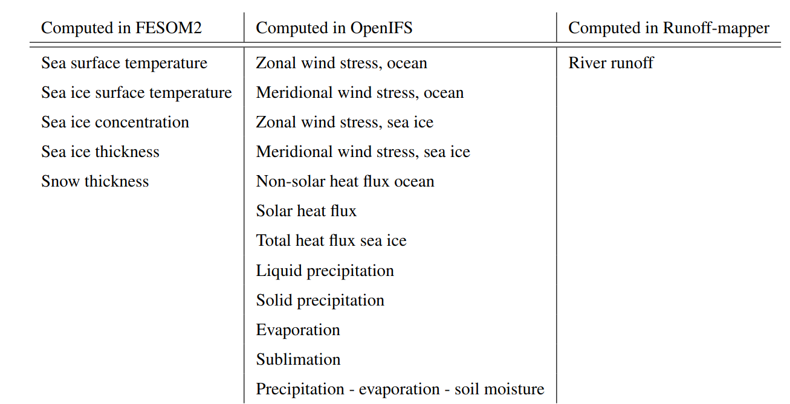


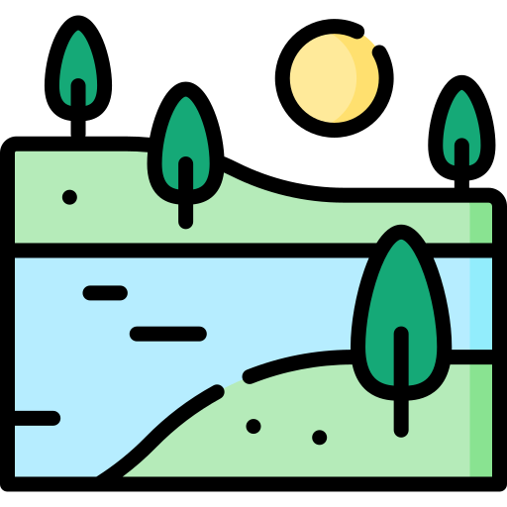

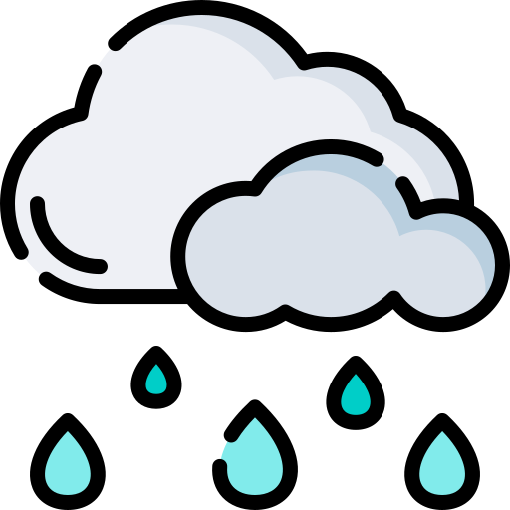
Introduction Basic coupling

Slide 9
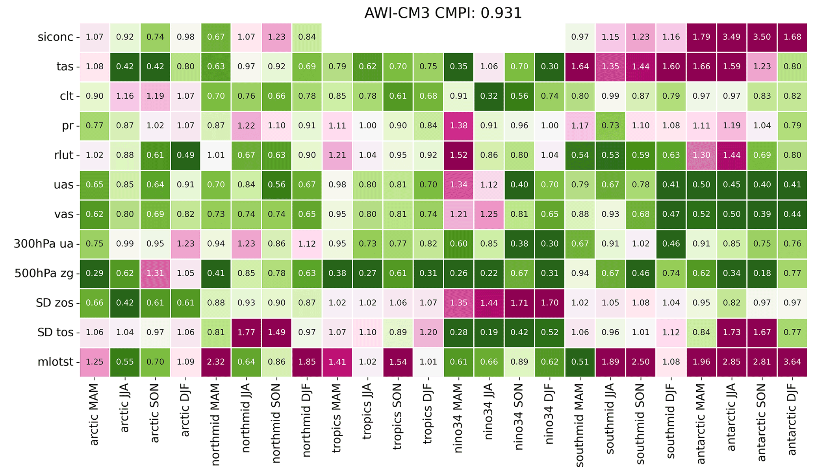
Introduction v3.0 performance
Green = better than CMIP6 average
Magenta = worse than CMIP6 average
Number = Factor by how much
https://github.com/JanStreffing/cmpi-tool/

Slide 10
Introduction v3.0 performance
Green = better than CMIP6 average
Magenta = worse than CMIP6 average
Number = Factor by how much
https://github.com/JanStreffing/cmpi-tool/
More details in: Streffing, J., Sidorenko, D., Semmler, T., Zampieri, L., Scholz, P., Andres-Martinez, M., … Jung, T. (2022). AWI-CM3 coupled climate model: description and evaluation experiments for a prototype post-CMIP6 model. Geoscientific Model Development, 15 (16), 6399–6427. Retrieved from https://gmd.copernicus.org/articles/15/6399/2022/ doi: 10.5194/gmd-15-6399-2022

Slide 11
Introduction v3.0 performance
Green = better than CMIP6 average
Magenta = worse than CMIP6 average
Number = Factor by how much
https://github.com/JanStreffing/cmpi-tool/

Slide 12
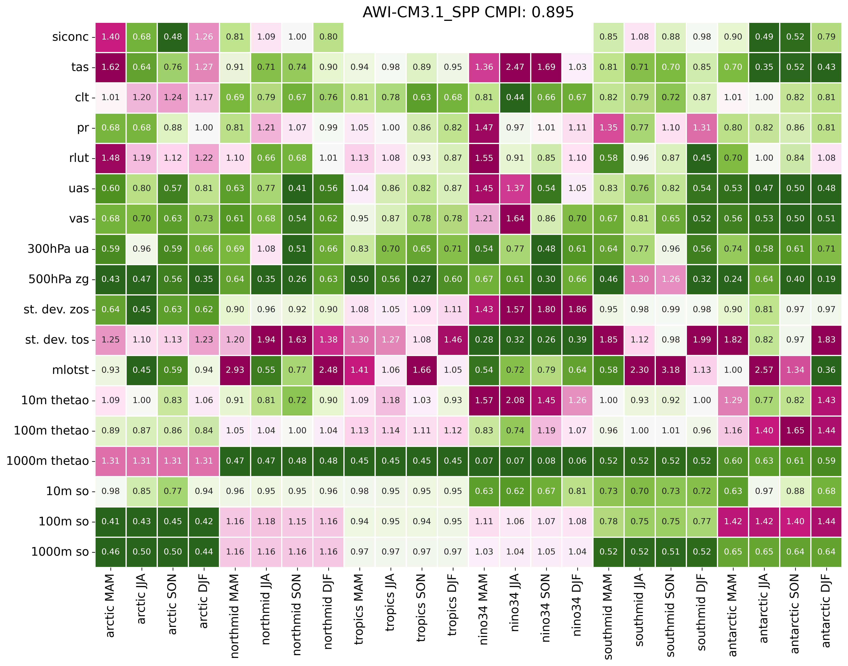
Introduction v3.1 performance
Green = better than CMIP6 average
Magenta = worse than CMIP6 average
Number = Factor by how much
https://github.com/JanStreffing/cmpi-tool/

Slide 13
Introduction Longterm plan
AWI-ESM-3
FESOM2 +
ICEPACK
RECOM
PISM
LPJ-G
FOCI-OIFS
OpenIFS 43r3 +
WAM + CAMS +
H-TESSEL
ECE-4
NEMO3.6 +
AGRIF +
LIM2
NEMO4 + SI³
XIOS 3
PISCES
CaMa-Flood

