Slide 1
AWI-CM3 hands-on-course:
Part 2 esm_tools
Jan Streffing 08.09.2022

Slide 2
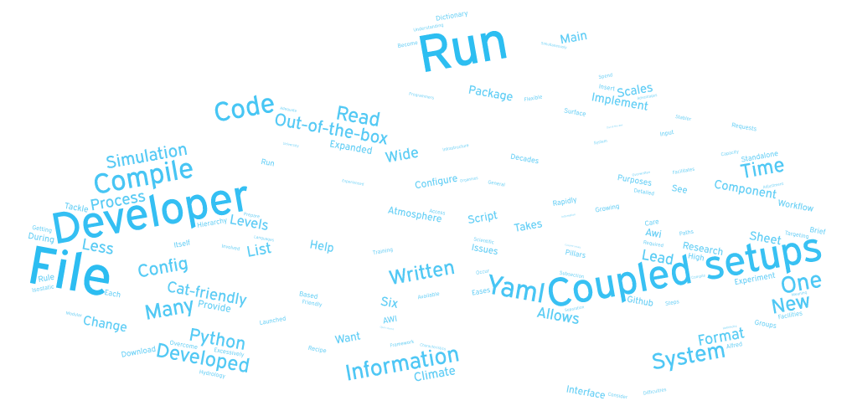
Why do we need ESM-Tools?
1
Earth System Modelling Tools
Modular software infrastructure
  Download
  Configure/compile
  Run simulations
  Organize exp. output/restart
  Calendar operations
Standalone Earth system models
ESM coupled setups
in different HPC systems
Advantages
- Unified infrastructure for ESM modelling
- Eases consistent workflows and experiment reproducibility
- Easy to implement new models/coupled setups
- Identical simulation-folder structure across different models/simulations
- Supports standalone models and coupled setups
- One software to rule them all
- Adequate for educational purposes (easy-to-run ESMs) and research (highly modular and flexible)
Notes:
Miguel

Slide 3
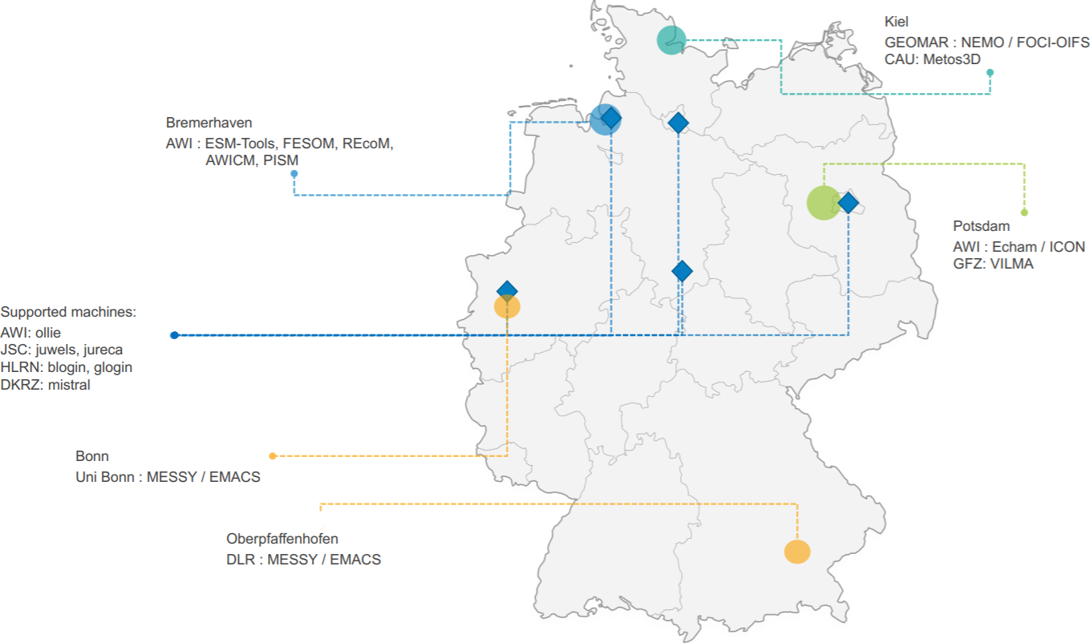
Supported Models & Couplings, Partners
1
Coupled Systems | Components
AWI-CM1 | ECHAM
AWI-CM3 | FESOM
AWI-ESM-2.1 | ICON
FESOM-REcoM | NEMO
FOCI | OASIS3MCT
FOCI-OIFS | OpenIFS
 | PISM
 | REcoM
 | RNFMAP
 | VILMA
 | xios
 | YAC
Notes:
Miguel

Slide 4



VS
Old Workflow
ESM-Tools workflow
Obtain the model source code (usually a tar ball)
Build the model
  configure
  make
  FAIL: Read the HPC documentation and repeat (libraries, compilers, modules, ...)
Prepare the data folders (input, boundary conditions, output, ...)
Setup the namelist for the models
Submit your job to the HPC system
  Warning: environment mismatch
Resubmit / Iterative coupling
Move the data to the storage disk
Postprocessing of the results
Repeat the whole process for the next run or write a shell script for automatization.
Obtain and build the model code (from a repository)
Uniform environment for both installation and running
→ guaranteed integrity.
esm_master install-awicm3-v3.1
Prepare YAML based runscript
[OPTIONAL] Check if your run would run successfully:
esm_runscripts my_awicm_runscript.yaml -e my_first_test -c
Submit your job to the system:
esm_runscripts my_awicm_runscript.yaml -e my_first_test
Monitor your log files
Postprocess the results (esmviz, in progress)
Notes:
Deniz

Slide 5
VS
Old Workflow
ESM-Tools workflow
echam_prepare_forcing()
{
# forcing
if [[ "v$setup_name" = "vecham_standalone" ]]; then
case $SCENARIO_echam in
1850 | PI-CTRL*)
add_to ${echam_INPUT_DIR}/${RES_echam}/${RES_echam}${OCERES_echam}_piControl-LR_sst_1880-2379.nc unit.20
add_to ${echam_INPUT_DIR}/${RES_echam}/${RES_echam}${OCERES_echam}_piControl-LR_sic_1880-2379.nc unit.96
;;
HIST )
...
...
for ((yr = YR0_echam + -2; yr <= YRN_echam + 2; ++yr)); do
if [ $yr -le 1849 ] ; then
eval add_to ${echam_INPUT_DIR}/${RES_echam}/ozone/$ozonefile_1850 ozon$yr
elif [ $yr -le 2014 ] ; then
eval add_to ${echam_INPUT_DIR}/${RES_echam}/ozone/$ozonefile_hist ozon$yr
else
eval add_to ${echam_INPUT_DIR}/${RES_echam}/ozone/$ozonefile_scen ozon$yr
fi
if [ $yr -le 1849 ] ; then
add_to ${echam_INPUT_DIR}/${RES_echam}/volcano_aerosols/strat_aerosol_ir_${RES_echam}_1850.nc strat_aerosol_ir_${yr}.nc
add_to ${echam_INPUT_DIR}/${RES_echam}/volcano_aerosols/strat_aerosol_sw_${RES_echam}_1850.nc strat_aerosol_sw_${yr}.nc
elif [ $yr -le 2024 ] ; then
add_to ${echam_INPUT_DIR}/${RES_echam}/volcano_aerosols/strat_aerosol_ir_${RES_echam}_${yr}.nc strat_aerosol_ir_${yr}.nc
add_to ${echam_INPUT_DIR}/${RES_echam}/volcano_aerosols/strat_aerosol_sw_${RES_echam}_${yr}.nc strat_aerosol_sw_${yr}.nc
elif [ $yr -gt 2024 ] ; then
add_to ${echam_INPUT_DIR}/${RES_echam}/volcano_aerosols/strat_aerosol_ir_${RES_echam}_2024.nc strat_aerosol_ir_${yr}.nc
add_to ${echam_INPUT_DIR}/${RES_echam}/volcano_aerosols/strat_aerosol_sw_${RES_echam}_2024.nc
... and many more
general:
setup_name: "awicm3"
compute_time: "00:15:00"
initial_date: "2000-01-01"
final_date: "2000-02-29"
base_dir: "/work/ollie/dural/sample_work_dir/"
nmonth: 1
nyear: 0
awicm:
version: "CMIP6"
postprocessing: false
scenario: "PI-CTRL"
model_dir: "/work/ollie/dbarbi/modelcodes/awicm-CMIP6/"
fesom:
pool_dir: "/work/ollie/pool/FESOM/"
mesh_dir: "/work/ollie/pool/FESOM/meshes_default/core/"
restart_rate: 1
restart_unit: "m"
restart_first: 1
further_reading:
- "fesom_output_control.yaml"
Notes:
Deniz

Slide 6


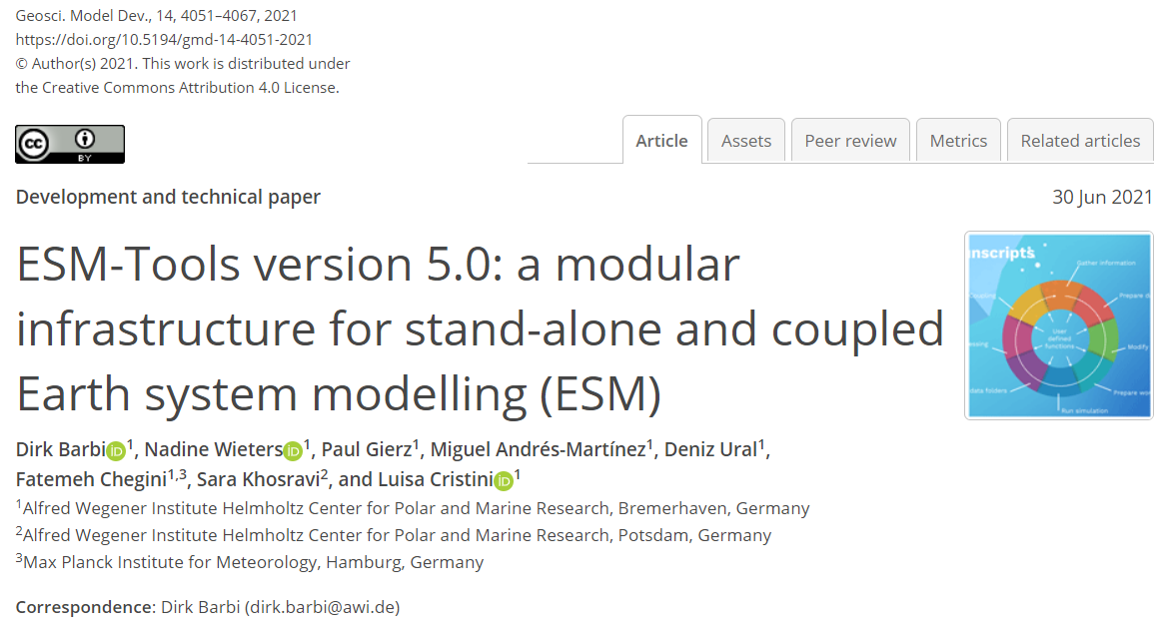




Contact & Community
1
https://github.com/esm-tools
https://github.com/esm-tools/esm_tools/discussions
https://github.com/esm-tools/esm_tools/issues
https://esm-tools.readthedocs.io
https://www.esm-tools.net
https://gmd.copernicus.org/articles/14/4051/2021/
@ToolsEsm
Barbi et. al., GMD (2021): https://doi.org/10.5194/gmd-14-4051-2021
Zenodo: https://doi.org/10.5281/zenodo.5787476
ESMTools
Notes:
Deniz

Slide 7

Let’s Get Started: Installation
2
https://esm-tools.readthedocs.io
source .bash_profile source .bashrc
❸
❹
git clone https://github.com/esm-tools/esm_tools.git
❶
cd to your ${HOME} directory
❷
In your .bash_profile or .bashrc add:
❺
cd esm_tools
./install.sh
This will install ESM-Tools and all of the dependencies
export PATH=${PATH}:~/.local/bin
export LC_ALL=en_US.UTF-8
export LANG=en_US.UTF-8
❻
esm_tools --version
Verify the installation
module load git
module unload netcdf_c #(only on ollie)
module load python3

Slide 8
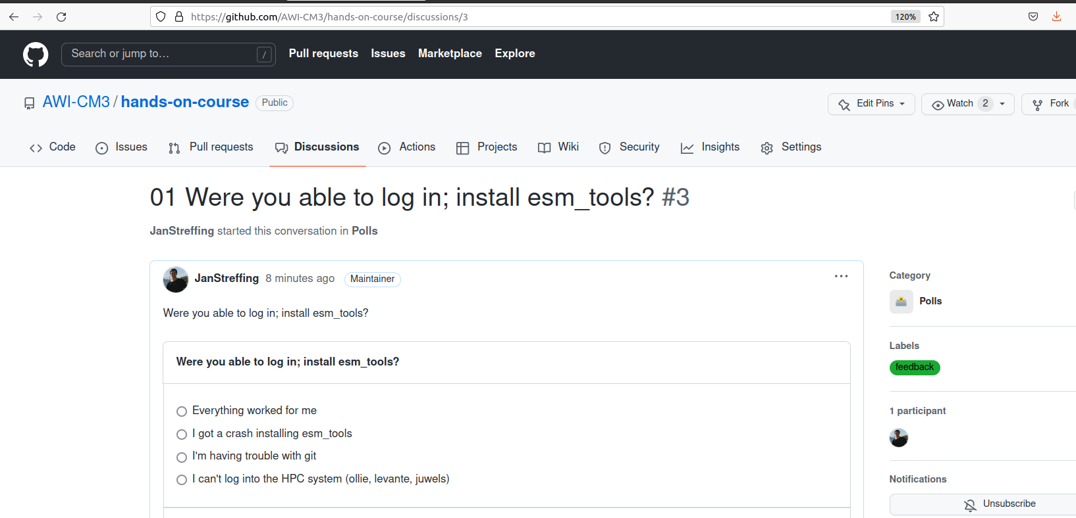
Were you able to log in and install?
Provide feedback at:
https://github.com/AWI-CM3/hands-on-course/discussions/1

