Slide 1
AWI-CM3 hands-on-course:
Part 3: Installing AWI-CM3
Jan Streffing 08.09.2022

Slide 2

Licence and registration
OpenIFS is not in fact open source
The license is given only to research institutes and universities
It is free of charge and valid for all institute members & guests
Some proof of AWI member or guest status is required!
One of the following Colleagues has to add your DKRZ user id to the repository on https://gitlab.dkrz.de/
      Jan Streffing <jan.streffing@awi.de>
      Christian Stepanek <Christian.Stepanek@awi.de>
      Dmitry Sidorenko <Dmitry.Sidorenko@awi.de>
      Miguel Andrés-Martínez <miguel.andres-martinez@awi.de>
      Paul Gierz <paul.gierz@awi.de>

Slide 3
Installation
❶
On ollie & levante cd your ${HOME} directory
On juwels cd to your own folder inside the project folder (e.g. /p/project/chhb19/streffing1)
❷
Optional & recommended:
git config --global credential.helper cache
mkdir model_codes
cd model_modes
❸
Download and compile model:
esm_master install-awicm3-v3.1
Under normal load on login nodes compiliation should take 10-15 minutes
During the workshop load might be higher than normal
-> Time for a coffee break

Slide 4
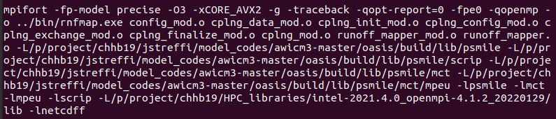
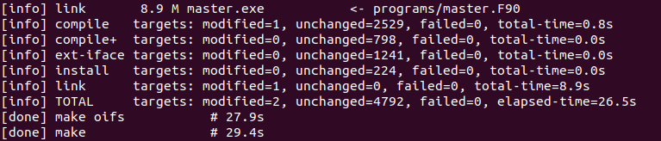
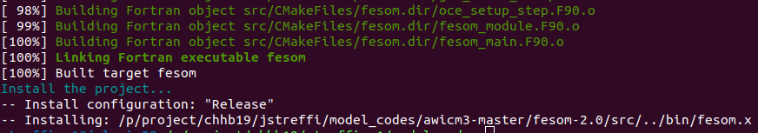
Example output

Slide 5
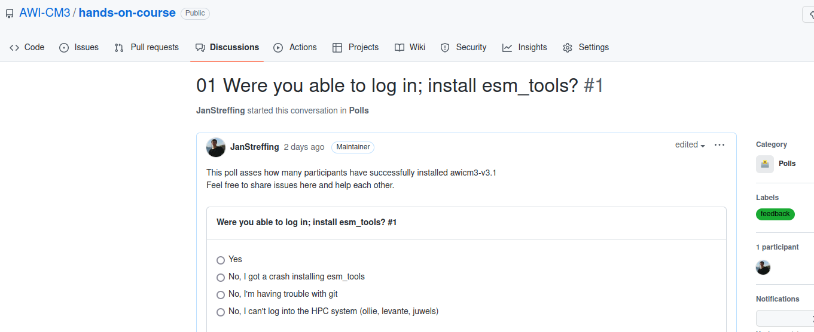
Feedback
Provide feedback at:
https://github.com/AWI-CM3/hands-on-course/discussions/2

