Slide 1
AWI-CM3 hands-on-course:
Part 4: Running AWI-CM3
Jan Streffing 08.09.2022

Slide 2

Default run
❶
cd your ${HOME} directory
cd to esm_tools/runscripts/awicm3/v3.1
❷
Open awicm3-v3.1-${HPC}-TCO95L91-CORE2.yaml in the editor of your choice.
Check that all is well
paths
project account
❸
❹
Exit and make a check run with -c
esm_runscripts awicm3-v3.1-${HPC}-TCO95L91-CORE2.yaml -e default1 --open-run -c
❺
If the check run was successful, start without -c
esm_runscripts awicm3-v3.1-${HPC}-TCO95L91-CORE2.yaml -e default1 --open-run
Use –open-run for tests and –contained-run for production simulations
More info see esm_tools documentation: https://esm-tools.readthedocs.io/

Slide 3
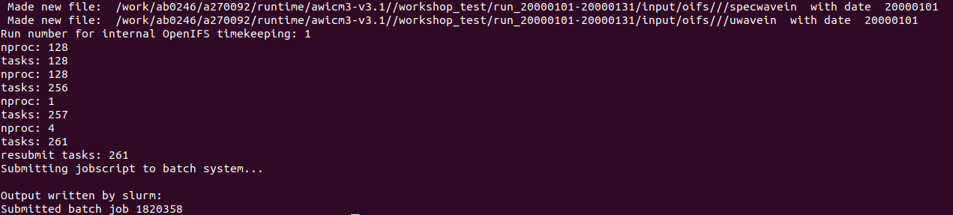
Default run
Example output upon successful job submission:
Your path will be slightly different and starts with ${base_dir} from your yaml file.
Once in the queue, this job will write its logfile at:
cd /work/ab0246/a270092/runtime/awicm3-v3.1/workshop_test/
cd /work/ab0246/a270092/runtime/awicm3-v3.1/workshop_test/
The simulation is running at:
cd /work/ab0246/a270092/runtime/awicm3-v3.1/workshop_test/run_20000101-20000131/work/
Once the simulation is done, output files will be moved to:
cd /work/ab0246/a270092/runtime/awicm3-v3.1/workshop_test/output/

Slide 4
Namelists Changes
Available FORTRAN namelists are:
FESOM2: namelist.config namelist.forcing namelist.ice namelist.io namelist.oce
OpenIFS: fort.4 wam_namelist
Runoff mapper: namelist.runoffmapper
Modification from the default is best done using esm_tools add_namelist_changes
OpenIFS uses XIOS parallel IO server. XIOS makes use of XML “namelists“ which cannot yet be modified
through esm_tools.

Slide 5
namelist_changes
a yaml dictionary with an extended functionality in ESM-Tools
Allows changing the namelists through the runscripts and the configuration files
Syntax
namelist_changes:
<namelist_name>:
<namelist_section-1>:
<variable-1>: <value-1>
<variable-2>: <value-2>
…

Slide 6
namelist_changes
Use cases
In the runscripts:
  Make modifications in the namelists specific to the current experiment
Example
Purpose
User only needs to modify the runscript -> reproducibility
namelist.config
&paths
MeshPath='/work/ollie/projects/clidyn/FESOM2/meshes/core2/'
ClimateDataPath='/work/ollie/projects/clidyn/FESOM2/hydrography/phc3.0/'
ResultPath='../result_tmp/'
/
your_runscript.yaml
fesom:
namelist_changes:
namelist.config:
paths:
MeshPath: "/work/ab0995/a270152/fesom2/input/FESOM2/meshes/core2"

Slide 7
namelist_changes
Use cases
In the configuration files:
  Define the yaml variables through the ESM-Tools extended-syntax (i.e. choose_ blocks, variable calls, …)
  Use those variables to make automatic changes into the namelists
Example
fesom:
add_namelist_changes:
namelist.oce:
oce_dyn:
easy_bs_return: "2”
leith_c: "2”
oce_tra:
use_momix: true

Slide 8
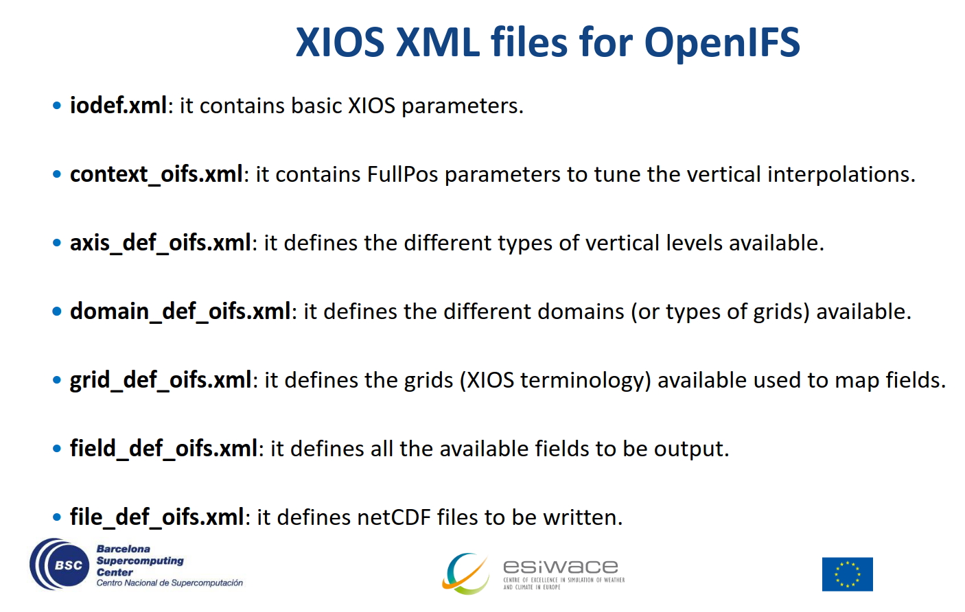
Namelists Changes
For XML namelist changes you currently have to change the template files under:
esm_tools/namelists/oifs/43r3/xios/${OIFS_resolution}_${FESOM2_mesh}

Slide 9
Namelists Changes
In esm_tools/namelists/oifs/43r3/xios/TCO95_CORE2/file_def.xml
Find section for monthly pressure level output
Add compression level line:
<file
enabled="true"
timeseries="only"
output_freq="1mo"
name_suffix="_1m_pl"
compression_level=“1“
description="ECE4/OIFS 6hourly pressure level fields">
<field_group grid_ref="regular_pl" freq_op="6h" operation="average">
<field field_ref="z_pl" name="z"/>
<field field_ref="t_pl" name="t"/>
<field field_ref="u_pl" name="u"/>
<field field_ref="v_pl" name="v"/>
<field field_ref="q_pl" name="q"/>
<field field_ref="w_pl" name="w"/>
<field field_ref="vo_pl" name="vo"/>
<field field_ref="r_pl" name="r"/>
</field_group>
</file>

Slide 10
Submit modified run
❶
cd your ${HOME} directory
cd to esm_tools/runscripts/awicm3/v3.1
❷
Run the model (check with -c first if you like)
esm_runscripts awicm3-v3.1-${HPC}-TCO95L91-CORE2.yaml -e modified1 --open-run

Slide 11
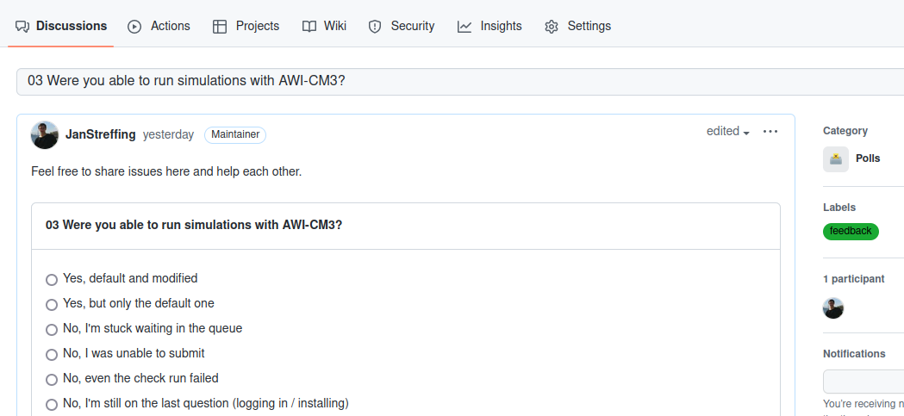
Feedback
Provide feedback at:
https://github.com/AWI-CM3/hands-on-course/discussions/3

