Slide 1
AWI-CM3 hands-on-course:
Part 5: Visualizing AWI-CM3 output
Jan Streffing 08.09.2022

Slide 2
FESOM2
Visualization is no different from AWI-ESM2.
Unstructured mesh, recommended tools are:
Pyfesom2: https://github.com/FESOM/pyfesom2
SpheRlab: https://github.com/FESOM/spheRlab
For a first quick glance at the data FESOM2 output can be interpolated:
Export gridfile=/work/ab0246/a270092/input/fesom2/core2/core2_griddes_nodes.nc
cdo genycon,r180x91 -selname,sst -setgrid,${gridfile} sst.fesom.2000.nc weights_sst_unstr_2_r180x91.nc
cdo -L -remap,r180x91,weights_sst_unstr_2_r180x91.nc -setgrid,${gridfile} sst.fesom.2000.nc sst.fesom.2000_r.nc
ncview sst.fesom.2000_r.nc
❶
❷
❸
❹

Slide 3
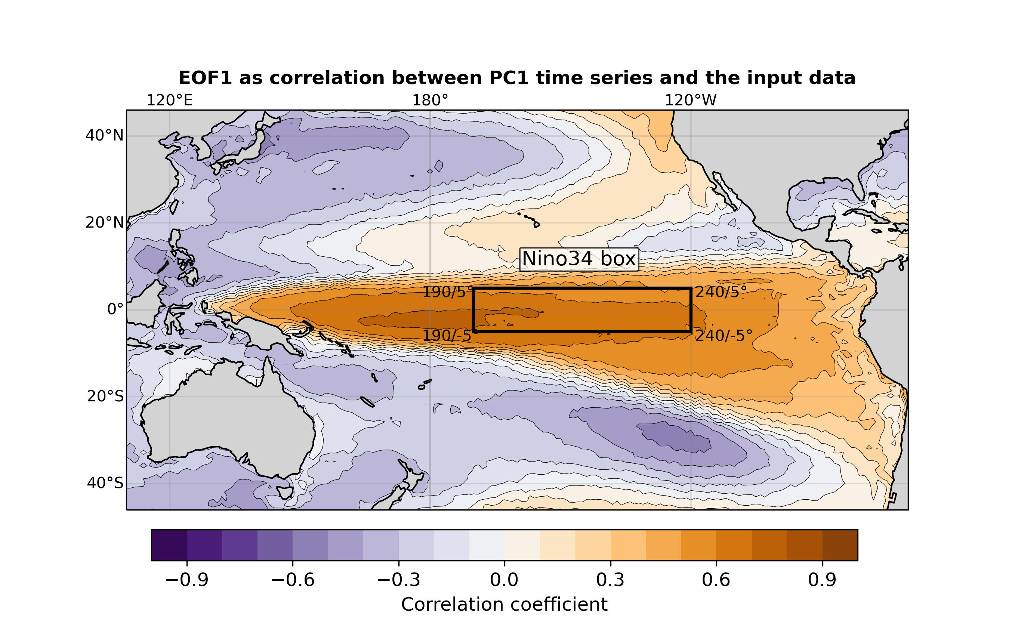
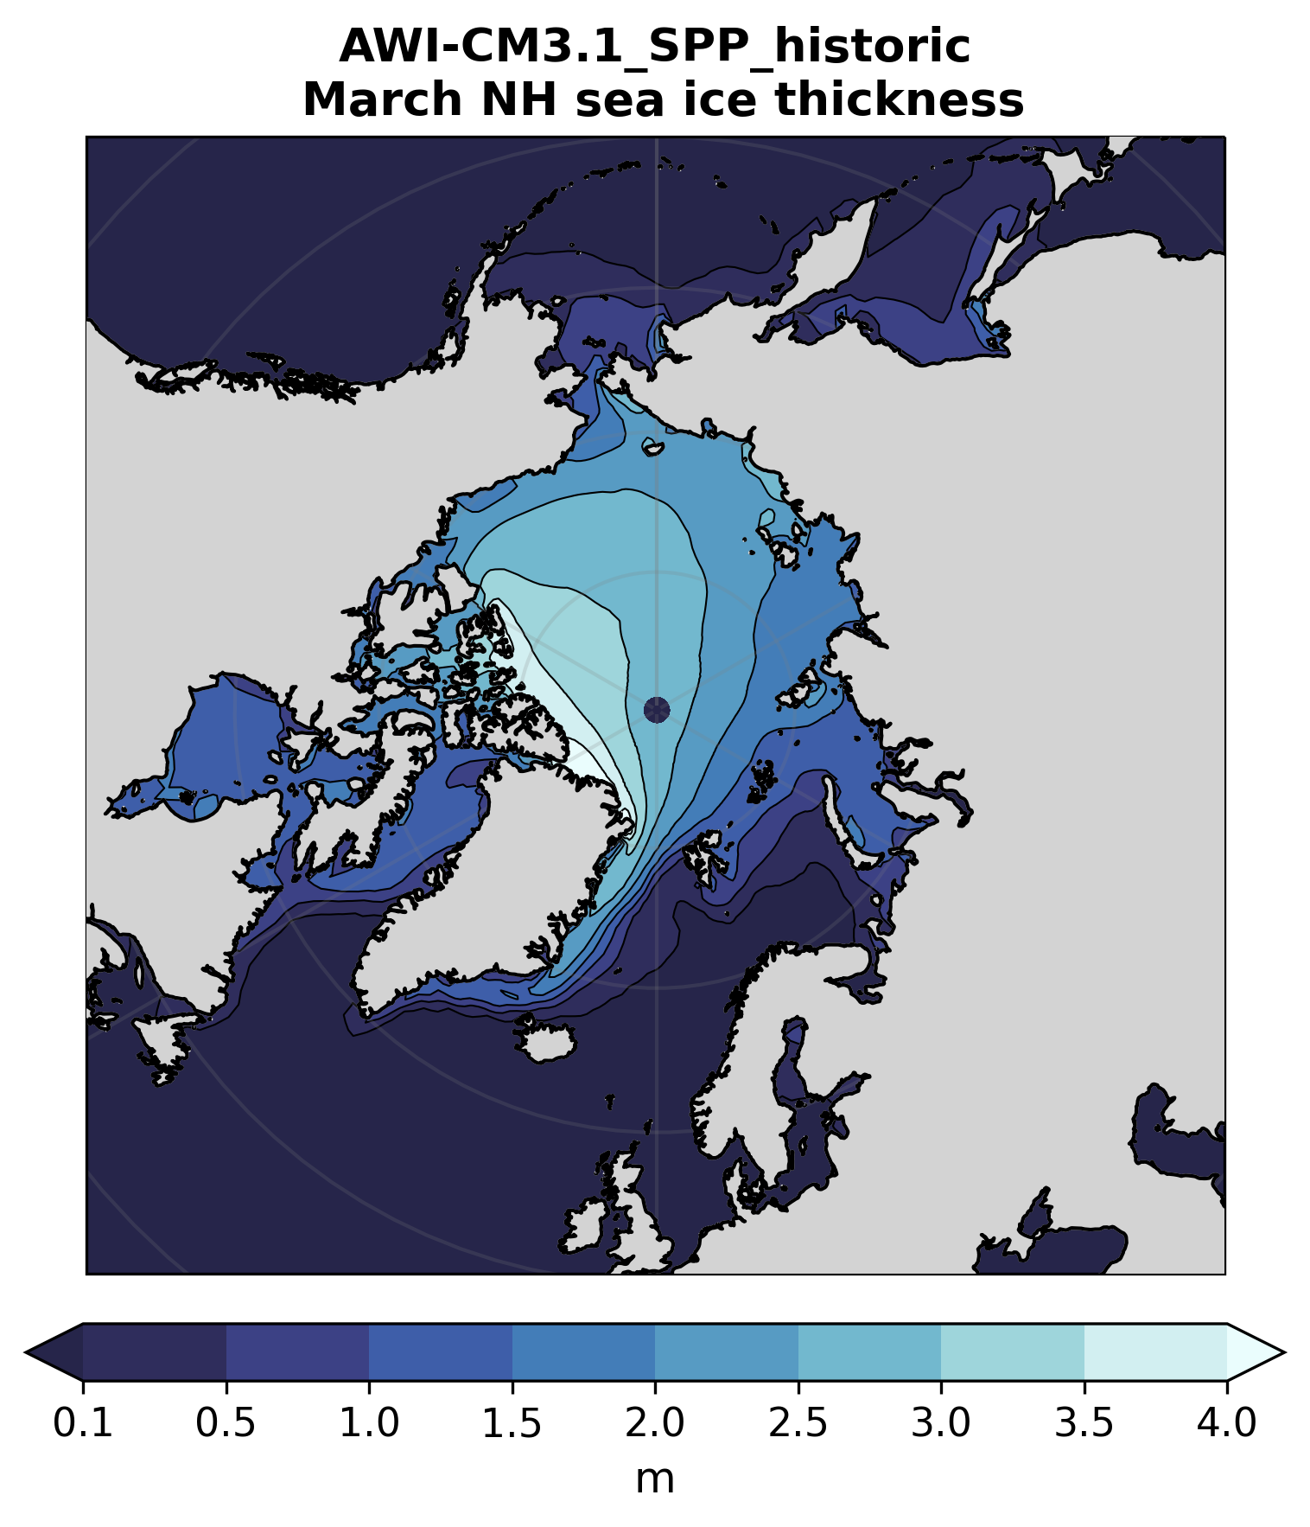
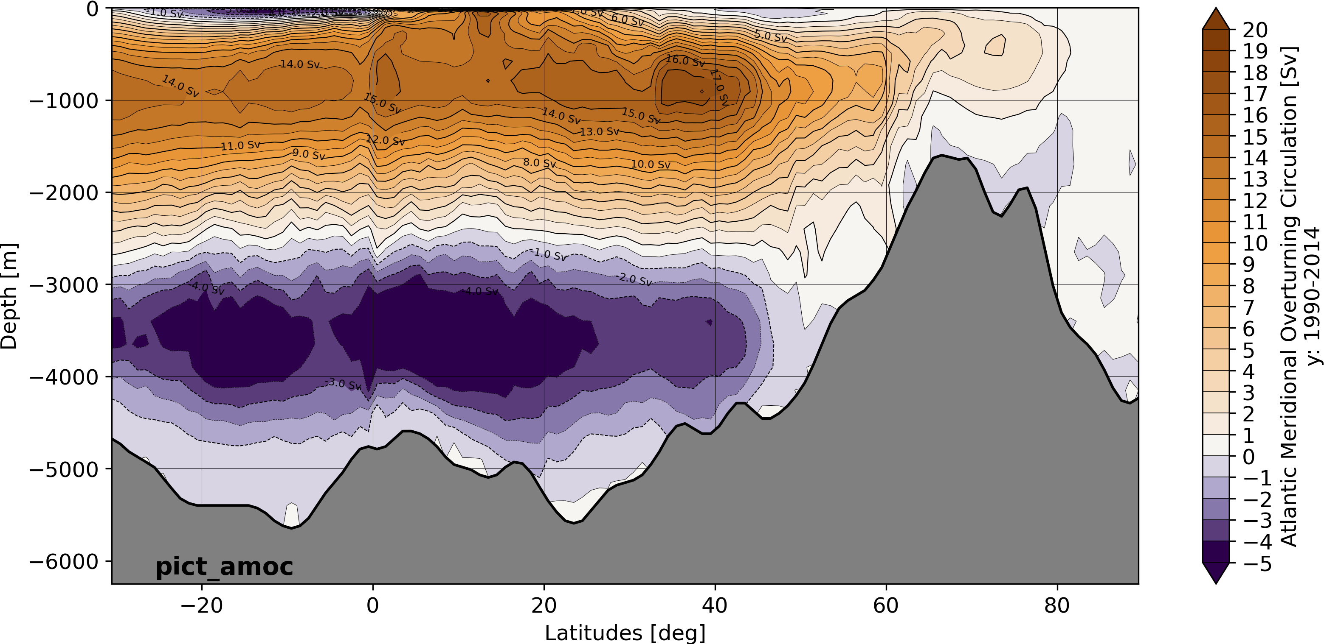
Pyfesom2 Examples

Slide 4
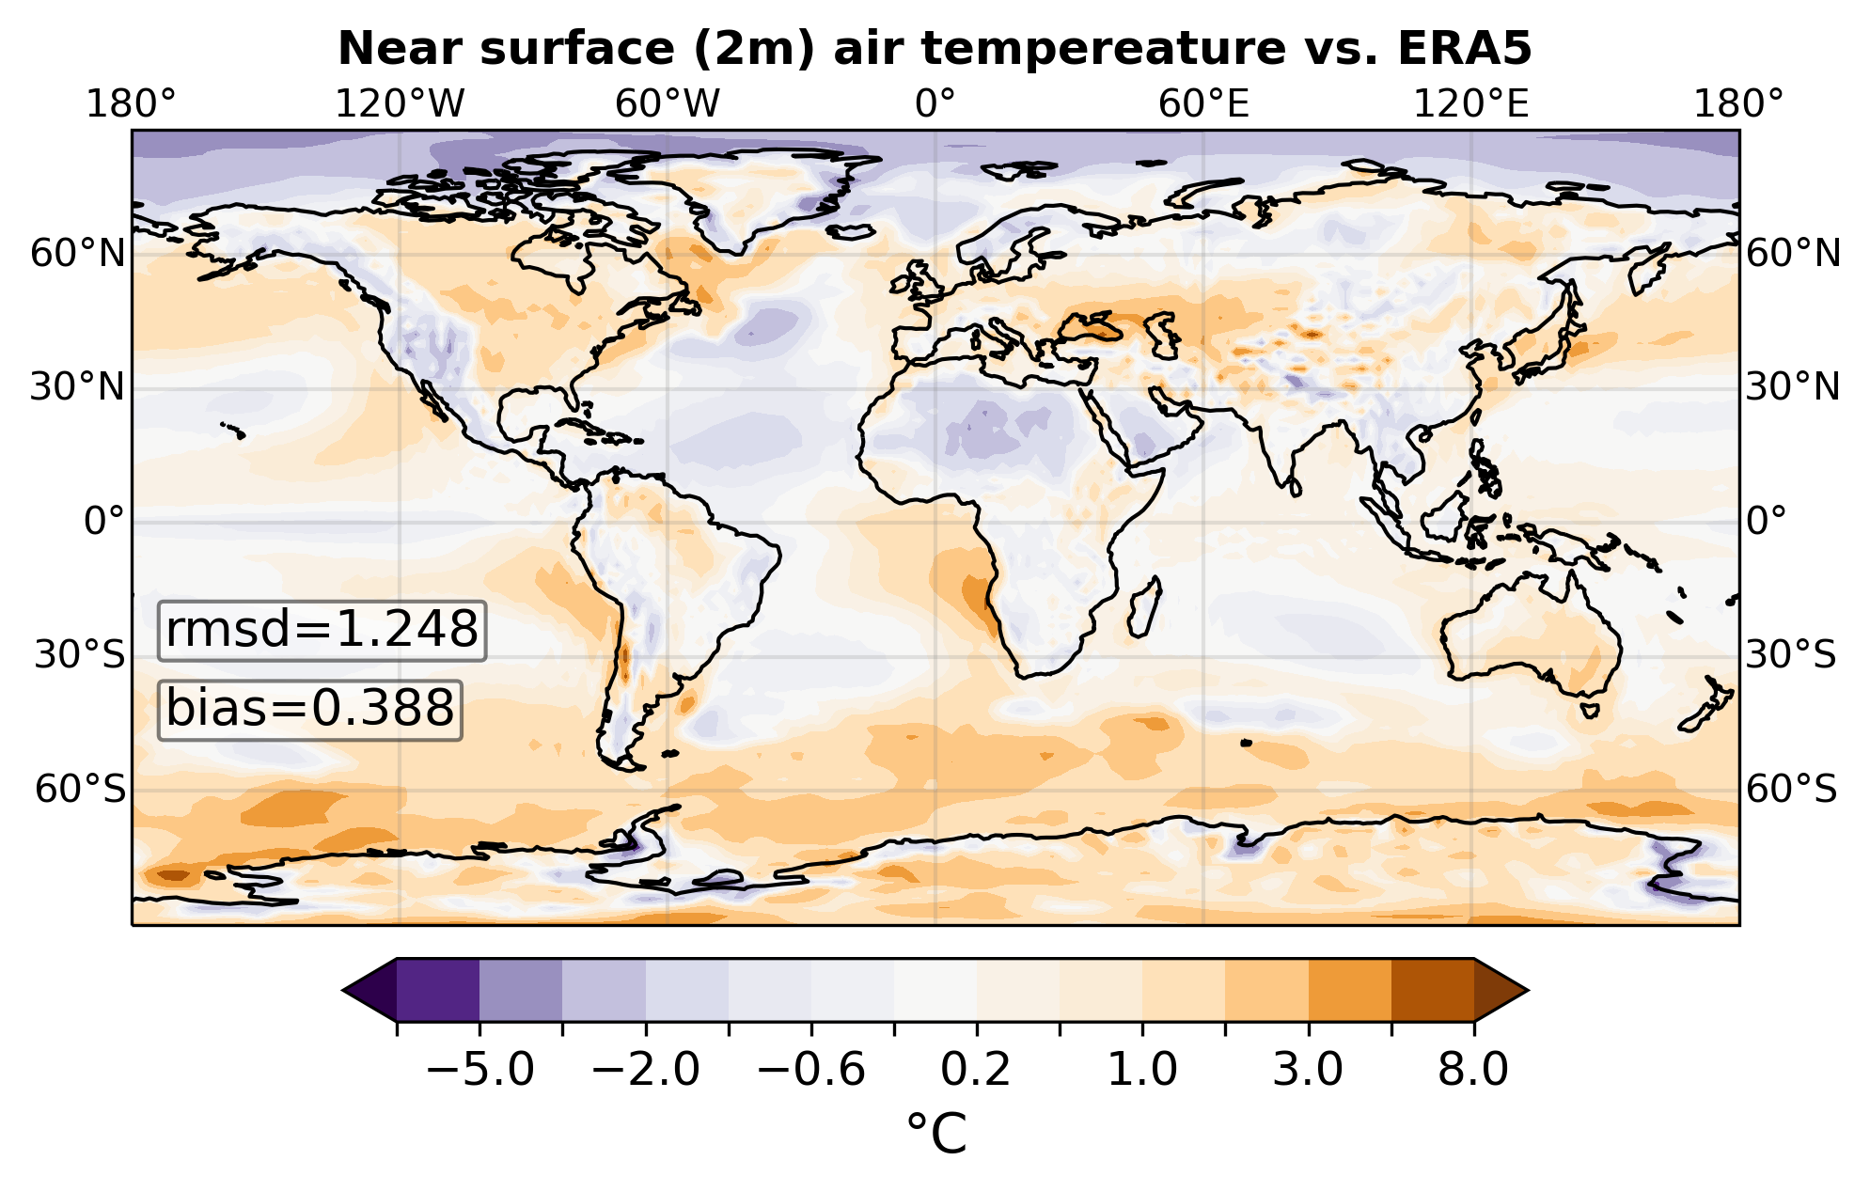
OpenIFS
Data comes on regular lat/lon grid in NetCDF files
→ Pretty much any tool for visualization of gridded data will work
Ncview
Python e.g. xarray.open_mfdataset + cartopy
R
NCL
GrADS
Panoply
ArcGIS
Etc. etc.

Slide 5
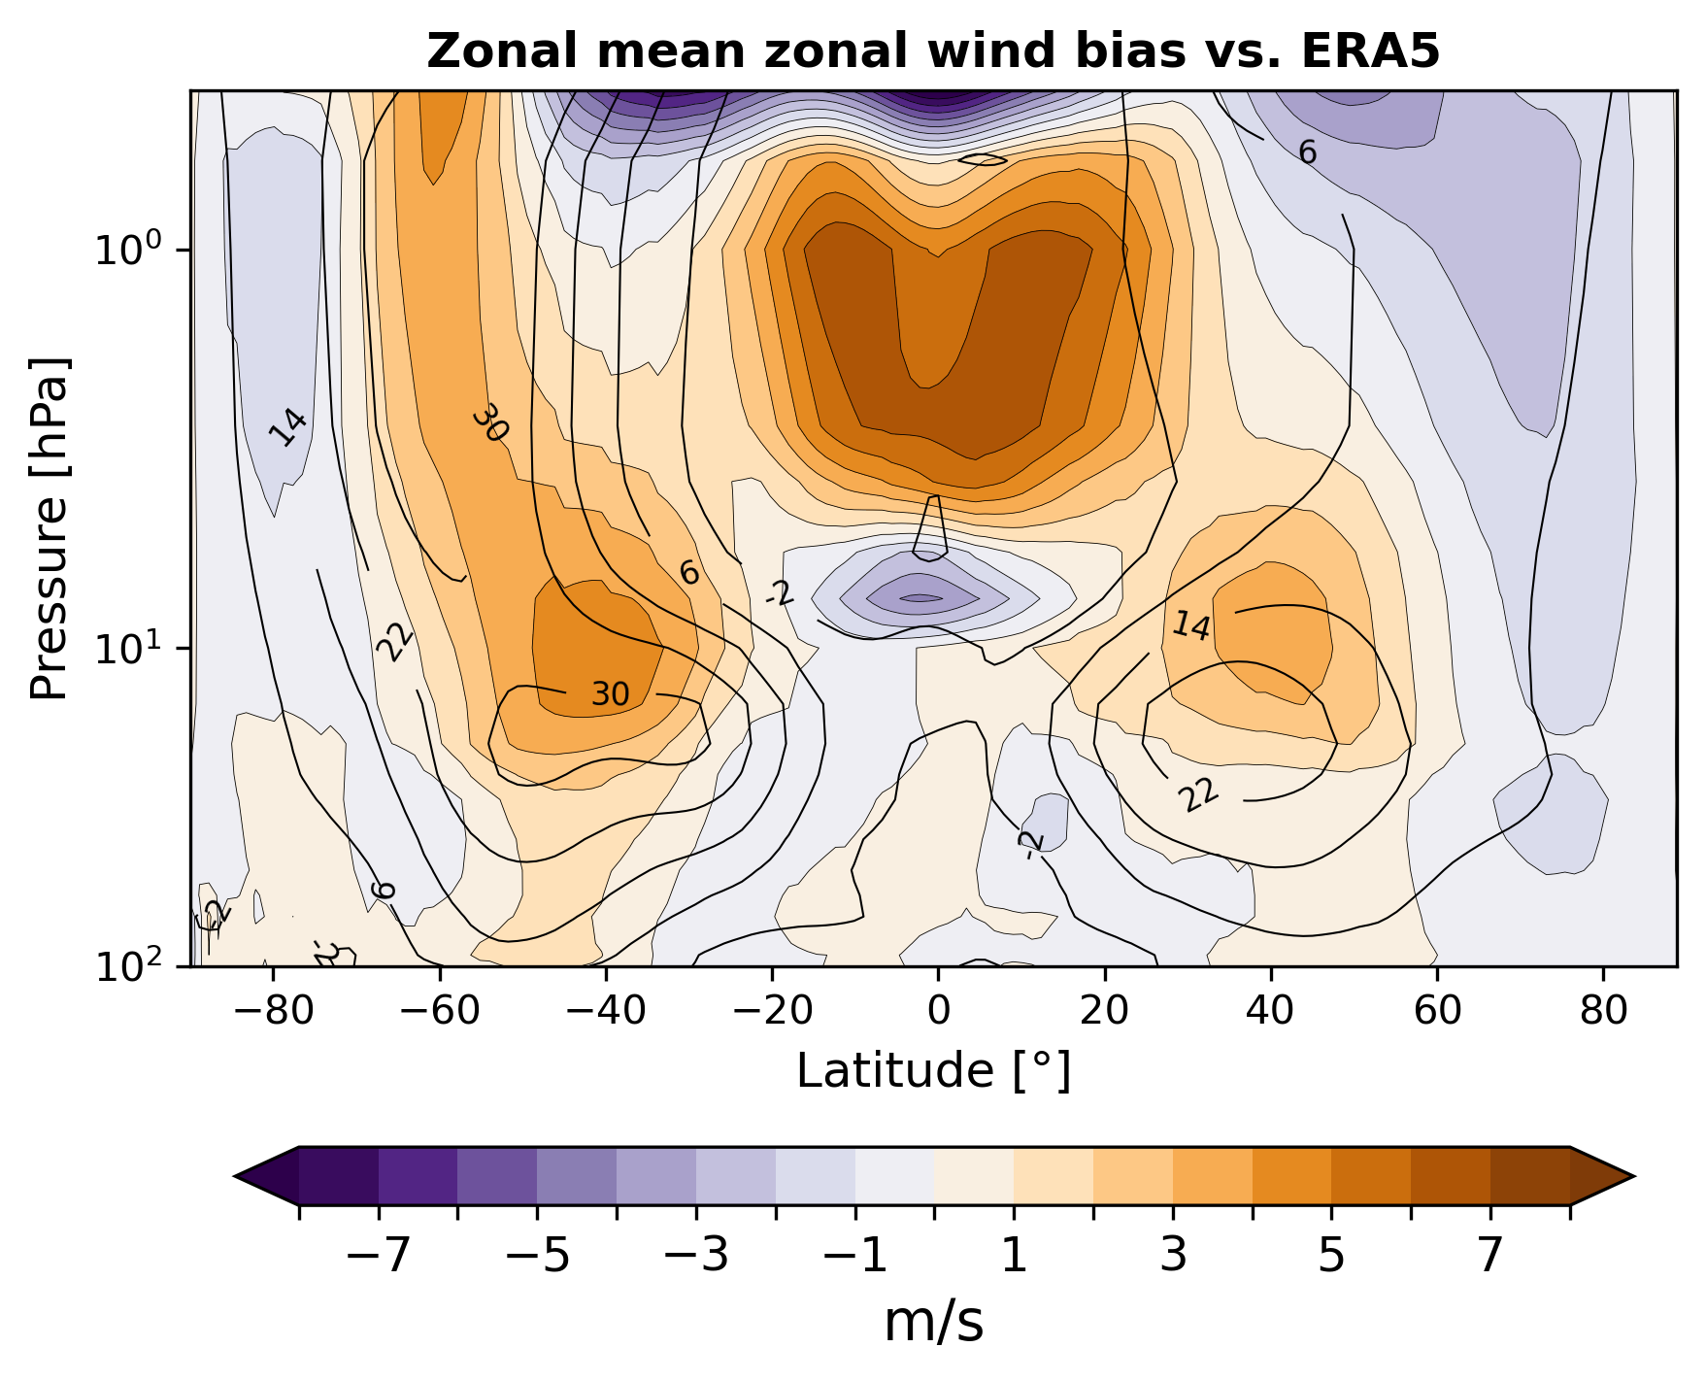
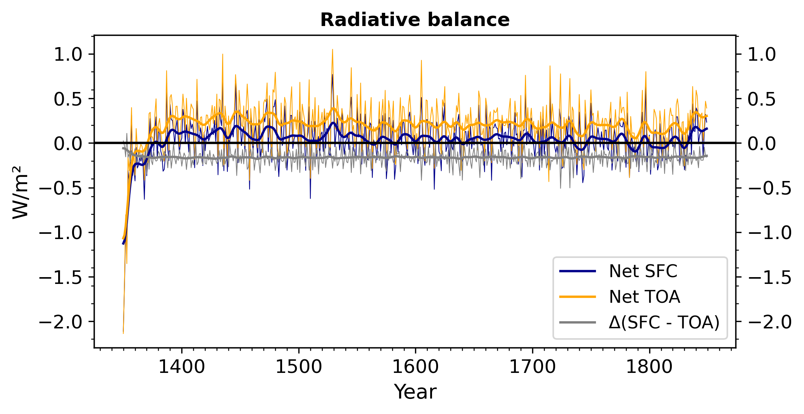
OpenIFS Python Examples

