Slide 1
AWI-CM3 hands-on-course:
Part 6 Source code modifications
Jan Streffing 08.09.2022

Slide 2
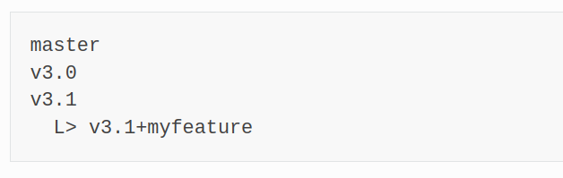

Personal changes / Scientific work
Start from latest tagged version
Make a branch based off the tag
Modify code
Run simulations
Move on
Your changes are not fed back to the master branch
Changes are not part of any tagged version
Changes don‘t interfer with colleagues work

Slide 3
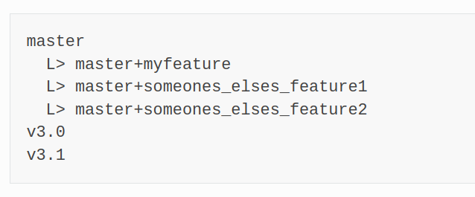
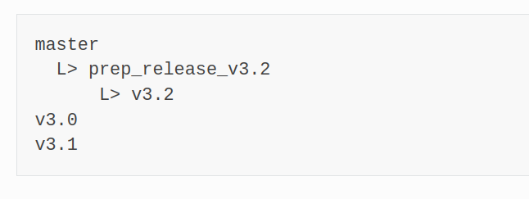
New permanent feature
Start from latest master
Make a branch based off the master
Develop feature
Test
Make merge request
Feature is merged back to master
Once we have enough / big enough changes we will tune & run evalulation experiments (~1000 model years in total).
When we are happy with the results a new tagged version e.g. v3.2 will be made from master.
Your modifications can never make it into already existing tag!

Slide 4
New permanent feature
If you base your scientific work on the master branch, expect other merged features to interfer.
The master branch ≠ best branch!
Extensive tests for major releases can not be done too often.
→ Release schedule ~6 Months

