Slide 1
AWI-CM3 hands-on-course:
Part 7 resources
Jan Streffing 08.09.2022

Slide 2
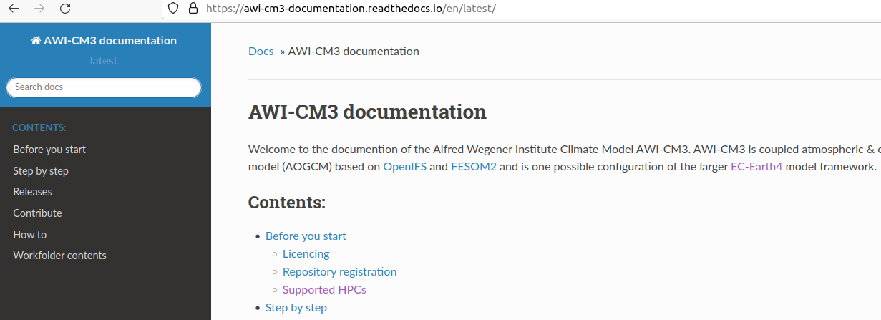
Where to find documentation?
For the basics of AWI-CM3:
https://awi-cm3-documentation.readthedocs.io
Open to read, register to edit on github

Slide 3
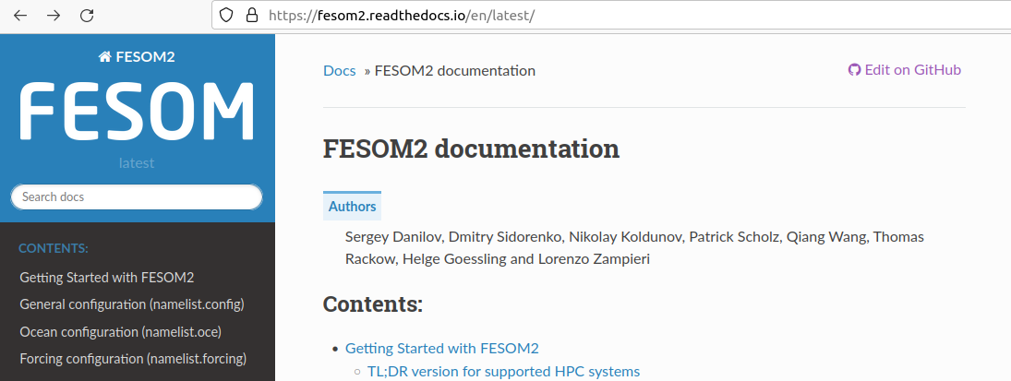
Where to find documentation?
For the specifics of FESOM2:
https://fesom.readthedocs.io
Open to read, register to edit on github

Slide 4
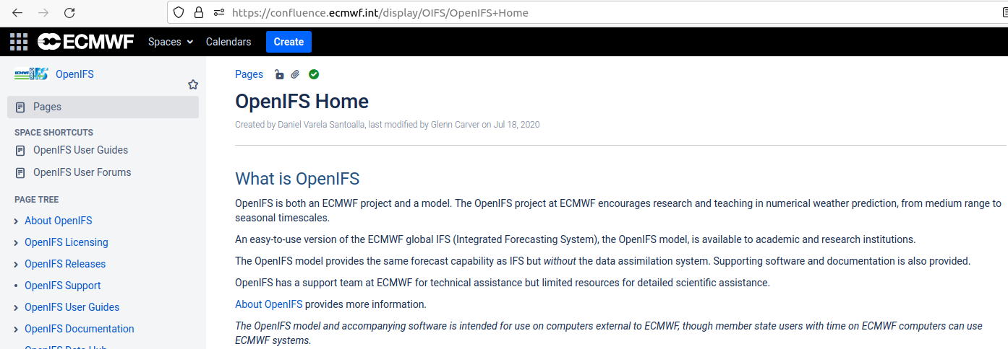
Where to find documentation?
For the specifics of OpenIFS:
https://confluence.ecmwf.int/display/OIFS/
Open to read, no editing

Slide 5
Where to find documentation?
Summary
AWI-CM3: https://awi-cm3-documentation.readthedocs.io
FESOM2: https://fesom.readthedocs.io
OpenIFS: https://confluence.ecmwf.int/display/OIFS/
esm_tools: https://esm-tools.readthedocs.io
XIOS: https://forge.ipsl.jussieu.fr/ioserver
Oasis3MCT: https://www.cerfacs.fr/oa4web/oasis3-mct_4.0/oasis3mct_UserGuide.pdf

Slide 6
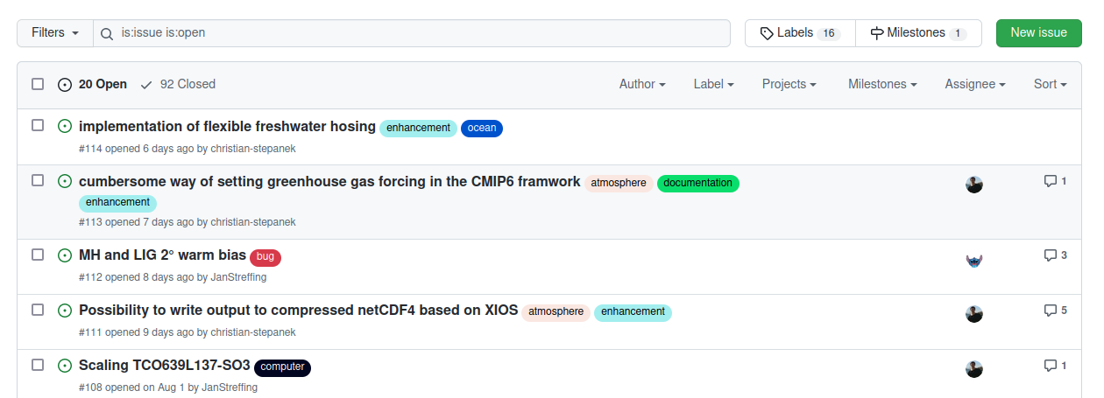
Where ask for support?
For AWI-CM3/ESM related issues: (until 19th of September)
https://github.com/AWI-CM3/project_management/issues
Register and email me to read and post

Slide 7
Where ask for support?
For AWI-CM3/ESM related issues: (from 19th of September onwards)
https://github.com/AWI-ESM/support/issues
Register and email me to read and post

Slide 8
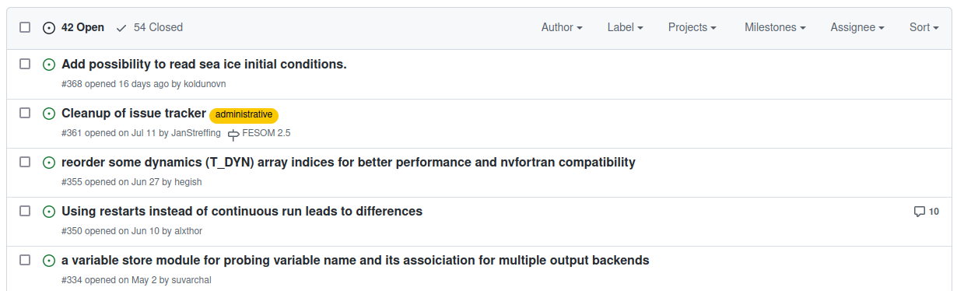
Where ask for support?
For FESOM2 related issues:
https://github.com/FESOM/fesom2/issues/
Open to read, register to post

Slide 9
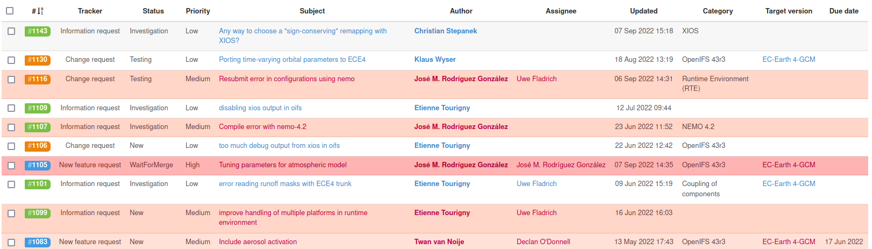
Where ask for support?
For EC-Earth related issues / coordination:
https://dev.ec-earth.org/projects/ec-earth-4
Email me to be registered to read and post

Slide 10
Where to ask for help?
Summary
AWI-CM3/ESM: https://github.com/AWI-CM3/project_management/issues (till 19.09.22)
AWI-CM3/ESM: https://github.com/AWI-ESM/support/issues (from 19.09.22)
EC-Earth: https://dev.ec-earth.org/projects/ec-earth-4
FESOM2: https://github.com/FESOM/fesom2/issues
OpenIFS: https://jira.ecmwf.int/projects/OIFSSUP/issues
esm_tools: https://github.com/esm-tools/esm_tools/issues
Oasis3MCT: https://www.cerfacs.fr/site-oasis/forum/oa_main.php

Slide 11
Thank you for joining, and good luck out there!
Let me know what you thought of the course,
and how to improve it for next time:
https://github.com/AWI-CM3/hands-on-course/discussions/4

