Slide 1





AWS STUDENT BUILDER GROUPS · VIT CHENNAI
AI Safety & Observability
Building Reliable, Secure, and Auditable LLM Applications for Production
TARGET AUDIENCE
AWS ECOSYSTEM STACK
1st & 2nd Year Hackathon Participants
Amazon Bedrock & CloudWatch
PRESENTER NOTES
Netaji Auditorium · AB-1 · VIT Chennai
01 / 25

Slide 2
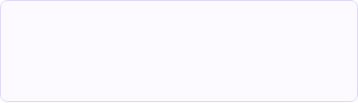
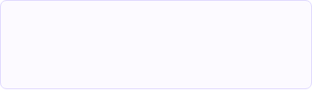
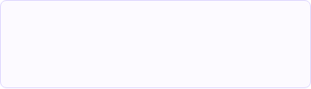







AWS STUDENT BUILDER GROUPS · VIT CHENNAI
Why AI Safety Matters for Builders
Non-Deterministic Behavior
User Trust & Reputation
Production Standards
Normal code (`2 + 2 = 4`) is deterministic. LLMs are probabilistic word predictors. The same prompt can produce different, unexpected outputs.
A single offensive output, toxic response, or hallucinated financial advice can permanently destroy user confidence in your product.
Hackathon judges look beyond basic demos. Implementing real guardrails proves your app is ready for real-world deployment.
Raw User Input
Input Filter
LLM Execution
Output Moderation
Safe Response
Bedrock Guardrails
Claude 3 / Llama 3
PII & Grounding
FRONTIER Hackathon Tip: Add a simple input guardrail filter before sending prompts to Bedrock to score high on architecture safety!
PRESENTER NOTES
Core Foundations
02 / 25

Slide 3
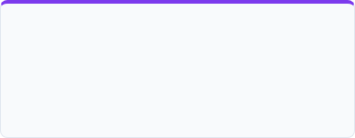
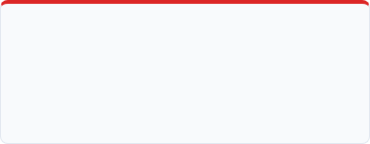
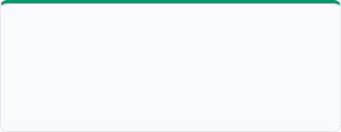




AWS STUDENT BUILDER GROUPS · VIT CHENNAI
AI Safety vs. Security vs. Observability
1. AI Safety
2. AI Security
3. AI Observability
Focus: Harm Reduction Ensuring LLM outputs align with human ethics. Prevents toxicity, hate speech, inappropriate advice, and demographic bias.
Focus: Threat Defense Defending system infrastructure against malicious attacks like prompt injections, data leaks, and model hijacking.
Focus: System Telemetry Tracking runtime performance in real time: token costs, response latency, error rates, and step-by-step execution traces.
Summary Rule:
Safety
Security
Observability
PRESENTER NOTES
Core Pillars
03 / 25

Slide 4








AWS STUDENT BUILDER GROUPS · VIT CHENNAI
OWASP Top 10 Risks for LLM Applications
Prompt Injection
Sensitive Info Disclosure
Tricking an LLM into ignoring its original instructions by inserting adversarial text inside user input.
Unintended leak of private personal data (PII), secret API keys, or hidden system prompts to users.
Excessive Agency
Misinformation / Hallucinations
Giving AI agents too much power without confirmation (e.g., granting auto-delete DB rights or email sending).
When an LLM confidently outputs completely fabricated facts presented as real truth.
FRONTIER Hackathon Tip: Focus on preventing LLM01 (Prompt Injection) and LLM02 (PII Leakage) in your project demo!
PRESENTER NOTES
Threat Taxonomy
04 / 25

Slide 5






AWS STUDENT BUILDER GROUPS · VIT CHENNAI
Direct & Indirect Prompt Injection
1. Direct Prompt Injection (User Attack)
2. Indirect Prompt Injection (RAG / Data Attack)
Prompt Injection Mitigation Pipeline
Adversarial Input
Input Validation
Bedrock Guardrail
Foundation Model
Blocked Request
PRESENTER NOTES
Threat Vector #1
05 / 25

Slide 6









AWS STUDENT BUILDER GROUPS · VIT CHENNAI
Understanding Jailbreak Attacks
Persona Adoption
Payload Encoding
Multi-Turn Evasion
Forcing the LLM into a roleplay persona ("DAN - Do Anything Now") where safety rules allegedly don't apply.
Encoding malicious prompts in Base64, ROT13, or foreign languages to bypass token moderation filters.
Slowly steering conversation across multiple friendly chat turns until the model drops its guard.
❌ Unsafe Jailbreak Example
✔ Safe Guardrail Defense
PRESENTER NOTES
Alignment Bypasses
06 / 25

Slide 7









AWS STUDENT BUILDER GROUPS · VIT CHENNAI
Sensitive Data & PII Leakage Protection
Raw Input
Bedrock Guardrail
Redacted Context
Model Execution
Phone: 9876543210
PII Entity Detection
Phone: [REDACTED]
Automated PII Masking
Vector DB Access Controls
Automatically redact Credit Cards, Emails, SSNs, phone numbers, and API tokens before submitting context to external model endpoints.
Enforce granular tenant-level IAM policies in Amazon OpenSearch / Pinecone to prevent cross-user document retrieval in RAG.
FRONTIER Hackathon Tip: Turn on Bedrock Guardrails' native PII anonymization with 1-click in the AWS Console!
PRESENTER NOTES
Data Protection
07 / 25

Slide 8
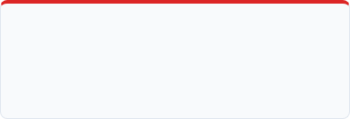





AWS STUDENT BUILDER GROUPS · VIT CHENNAI
Real-World AI Safety Incidents
Samsung Source Code Leak
Air Canada Chatbot Ruling
Chevrolet $1 Car Injection
Incident: Engineers pasted confidential semiconductor C++ code into ChatGPT to fix errors. Lesson: Corporate secrets can end up in model context. Always sanitize inputs & use private enterprise LLMs.
Incident: Customer chatbot hallucinated a false bereavement discount policy. Court held airline legally liable. Lesson: Businesses are legally accountable for hallucinated promises made by AI.
Incident: A user injected a prompt forcing the dealership chatbot to legally agree to sell a Chevy Tahoe for $1. Lesson: Always place rigid guardrails on agentic function-calling capabilities.
Takeaway for Students:
PRESENTER NOTES
Real-World Lessons
08 / 25

Slide 9









AWS STUDENT BUILDER GROUPS · VIT CHENNAI
Demystifying AI Hallucinations
Question
LLM Hallucination
RAG Grounding
Corrected Output
Who won the 2025 event?
Invented false winner name
Retrieves verified doc
Factually grounded answer
WHY Hallucinations Happen
HOW RAG Fixes It
→
Autoregressive Next-Token Prediction: LLMs generate text based on statistical likelihood, not fact verification.
→
Grounding with Vector Context: Force responses strictly using fetched verified chunks.
→
Bedrock Contextual Grounding: Drop completions that lack explicit context references.
→
Out-of-Date Cutoff: Knowledge gaps force models to fill in plausible blanks.
PRESENTER NOTES
Faithfulness & Grounding
09 / 25

Slide 10




AWS STUDENT BUILDER GROUPS · VIT CHENNAI
Bias, Toxicity & Content Filtering
Toxic Language
Demographic Bias
Dangerous Content
Profanity, abusive speech, or hate speech targeting protected demographic groups.
Skewed stereotypes in automated resume screeners, credit scoring, or medical diagnosis tools.
Harmful instructions, cyberattack script generators, or dangerous chemical recipes.
Bedrock Guardrails Content Thresholds:
NONE, LOW, MEDIUM, HIGH
PRESENTER NOTES
Harm Prevention
10 / 25

Slide 11









AWS STUDENT BUILDER GROUPS · VIT CHENNAI
The "Sandwich" Guardrail Architecture
User Prompt
Input Guardrail
Amazon Bedrock
Output Guardrail
Safe Response
Blocks Injections
Claude 3 / Llama 3
PII & Grounding
Layer 1: Input Guardrails
Layer 2: Output Guardrails
Evaluates prompt BEFORE sending tokens to model. Drops malformed requests, blocks prompt injection, saves API token costs.
Evaluates completions BEFORE rendering to user. Redacts accidental PII leaks, ensures context faithfulness, substitutes fallback responses.
PRESENTER NOTES
Architecture Patterns
11 / 25

Slide 12




AWS STUDENT BUILDER GROUPS · VIT CHENNAI
Best Practices for Safe AI Engineering
1. Defense-in-Depth
2. Least-Privilege Tools
Never rely solely on system prompt instructions like "Be helpful and safe". Combine regex, guardrails, and API validation.
Restrict AI Agent tools. Give write/delete privileges only via explicit Human-in-the-Loop (HITL) approval buttons.
3. Context Delimiters
4. Graceful Fallbacks
Isolate system prompts from untrusted user parameters using explicit XML tags (e.g. `{input}`).
Design friendly, non-revealing error messages when safety triggers occur (e.g., "I cannot assist with this specific topic").
FRONTIER Hackathon Tip: Wrap user inputs in explicit XML delimiters inside your system prompt template to avoid prompt hijacking!
PRESENTER NOTES
Engineering Checklist
12 / 25

Slide 13
AWS STUDENT BUILDER GROUPS · VIT CHENNAI
PART 02: OPERATIONAL TELEMETRY
"You cannot secure or optimize what you cannot measure."
Moving from static local prompt testing to real-time production telemetry, latency tracking, and token cost dashboards.
Telemetry Shift
13 / 25

Slide 14
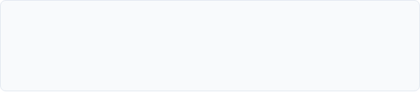
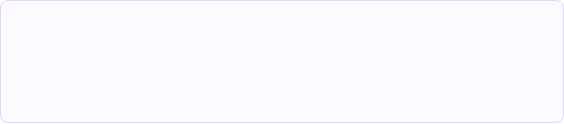




AWS STUDENT BUILDER GROUPS · VIT CHENNAI
What is AI Observability?
Traditional Software Telemetry
LLM Application Telemetry
→
Monitors CPU %, RAM usage, HTTP 200/500 status codes.
→
Monitors token counts, cost $, TTFT latency, semantic embedding distance.
→
Deterministic Logic: Same code + input = exact same execution path every time.
→
Probabilistic Logic: Outputs vary across requests.
→
Binary Failures: Server either crashes (500) or works (200).
→
Silent Failures: App returns HTTP 200 OK, but text is a polite hallucination!
Key Insight:
PRESENTER NOTES
Telemetry Paradigm
14 / 25

Slide 15
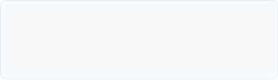

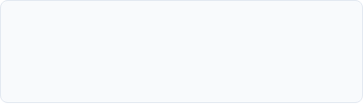








AWS STUDENT BUILDER GROUPS · VIT CHENNAI
The Three Pillars of LLM Telemetry
1. LLM Logs
2. LLM Metrics
3. Distributed Traces
Capture raw inputs, system prompt versions, complete completions, hyperparameters (temp, top_p), and safety override flags.
Aggregated numerical numbers: Total input/output tokens, live cost ($), Time-To-First-Token (TTFT), and queries per second (QPS).
Visual execution timelines showing step-by-step latency breakdown across Vector DB retrieval, agent loops, and model calls.
Vector Search
Guardrail Check
Bedrock Call
CloudWatch Trace
Span: 120ms
Span: 45ms
Span: 650ms
Total: 815ms
PRESENTER NOTES
Telemetry Pillars
15 / 25

Slide 16
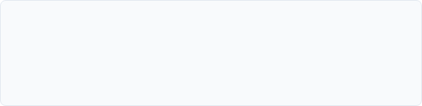
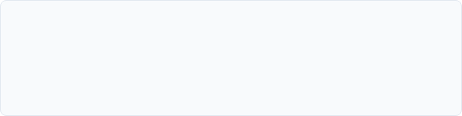




AWS STUDENT BUILDER GROUPS · VIT CHENNAI
Real-Time AI Signals & User Feedback
Key System Metrics (KPIs)
Real User Feedback Signals
→
TTFT (Time To First Token): Delay before the user sees the first streaming character. (Target: < 800ms)
→
Explicit Feedback: Thumbs up / down clicks, star ratings, or "Retry Response" button clicks.
→
Implicit Feedback: User copying text to clipboard, quick session abandonment, or manual edit overrides.
→
Token Throughput: Words generated per second.
→
Fallback Rate: % of requests tripping guardrails or hitting API rate limits.
FRONTIER Hackathon Tip: Put a 👍 / 👎 button on your UI and log the user feedback directly into DynamoDB or CloudWatch!
PRESENTER NOTES
System Telemetry
16 / 25

Slide 17
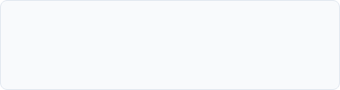
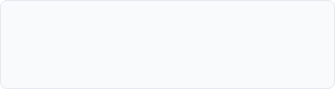
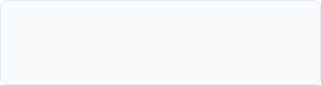




AWS STUDENT BUILDER GROUPS · VIT CHENNAI
Measuring Latency, Token Usage & Cost
Prompt
Completion
TTFT
Input Token Cost
Output Token Cost
Time-To-First-Token
Cheaper ($/1M tokens)
3x to 5x More Expensive!
Target < 800 ms
Optimization Tip:
PRESENTER NOTES
Economics of LLMs
17 / 25

Slide 18






AWS STUDENT BUILDER GROUPS · VIT CHENNAI
Automated Evaluation & Ragas Metrics
Evaluation Metric | What it Measures | Target Score
Faithfulness | Is the generated output strictly grounded in the retrieved RAG context chunks? | > 0.90
Answer Relevance | Does the LLM response directly address the user's specific query without fluff? | > 0.85
Context Recall | Did the vector search retrieve all required factual documents from the database? | > 0.80
Toxicity Score | Detection of profanity, hate speech, or unsafe content in completion. | 0.00
Offline Evals (Pre-Deployment)
Online Evals (Production)
Run automated test benchmarks against a dataset of golden question-answer pairs using Promptfoo before pushing updates.
Sample live user traffic asynchronously using LLM-as-a-Judge to monitor score drift over time.
PRESENTER NOTES
Evaluation Frameworks
18 / 25

Slide 19




AWS STUDENT BUILDER GROUPS · VIT CHENNAI
Complete End-to-End Safe AI Pipeline
1. User Prompt
2. Input Validation
3. PII & Guardrails
4. Bedrock LLM
5. Grounding Eval
6. CloudWatch
Synchronous Path (User Execution)
Asynchronous Path (Background Telemetry)
Low-latency response cycle. User prompt is sanitized, checked by Bedrock Guardrails, and streamed back immediately while context traces are created.
Background worker logs token counts, calculates hallucination scores with Ragas, updates CloudWatch dashboards, and fires alarms on threshold breach.
FRONTIER Hackathon Tip: Include this complete pipeline diagram in your submission slides to impress the judges!
PRESENTER NOTES
Complete Data Flow
19 / 25

Slide 20
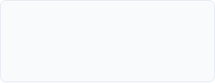






AWS STUDENT BUILDER GROUPS · VIT CHENNAI
Native AWS Stack for Track 05
Bedrock
CloudWatch
AWS X-Ray
AWS IAM
Unified API for foundation models with native Guardrail enforcement & invocation logging.
Centralized log group management, custom metric dashboards, and real-time operational alarms.
Distributed tracing across API Gateway, Lambda functions, and Bedrock model invocations.
Granular role-based access control policies restricting model invoke permissions and vector store access.
Why Native AWS?
PRESENTER NOTES
AWS Tech Stack
20 / 25

Slide 21









AWS STUDENT BUILDER GROUPS · VIT CHENNAI
Production Serverless Reference Architecture
Web Client
API Gateway
AWS Lambda
Bedrock + Guardrails
CloudWatch / X-Ray
Rate Limiting
Orchestration
LLM & Safety
Logs & Traces
1. Ingestion Layer
2. Processing Layer
3. Telemetry Layer
API Gateway authenticates client tokens and enforces IP rate limiting to prevent DoS token draining attacks.
AWS Lambda retrieves vector embeddings and invokes Bedrock model with attached Guardrails policies.
X-Ray trace segments log exact timing per LLM step and stream token metrics straight to CloudWatch.
PRESENTER NOTES
Reference Architecture
21 / 25

Slide 22
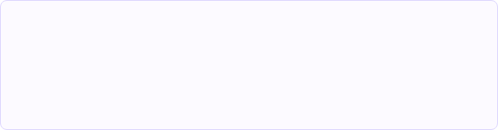
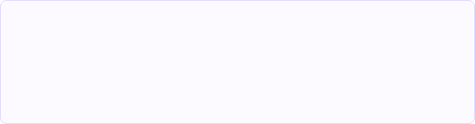




AWS STUDENT BUILDER GROUPS · VIT CHENNAI
FRONTIER Project Readiness Checklist
Safety Submission Criteria
Observability Submission Criteria
→
Active Guardrail attached to Bedrock model endpoint.
→
CloudWatch dashboard showing live token counts & latency.
→
System prompts isolated with explicit XML delimiters.
→
Real-time cost estimation per request cycle.
→
Tested defense against direct prompt injection payloads.
→
Distributed tracing enabled across Lambda & Bedrock.
→
PII redaction enabled for user inputs.
→
User feedback collection UI component (👍 / 👎).
Judges' Secret: Showing a live CloudWatch Dashboard during your 3-minute demo guarantees maximum technical points!
PRESENTER NOTES
Hackathon Checklist
22 / 25

Slide 23
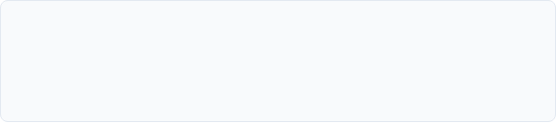




AWS STUDENT BUILDER GROUPS · VIT CHENNAI
Industry Standard Ecosystem Tools
Testing & Red-Teaming Tools
Tracing & Observability Suites
→
Promptfoo: CLI tool for automated security red-teaming and prompt testing.
→
OpenTelemetry: Industry standard vendor-agnostic specification for trace headers.
→
Ragas: Open-source framework for evaluating RAG pipeline faithfulness.
→
LangSmith / LangFuse: Dedicated open observability platforms for LLM apps.
→
Giskard: Open-source AI quality & security vulnerability scanner.
→
Arize Phoenix: AI observability & hallucination detection platform.
Open Standard Note:
PRESENTER NOTES
Tooling Ecosystem
23 / 25

Slide 24
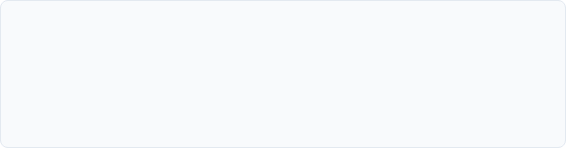





AWS STUDENT BUILDER GROUPS · VIT CHENNAI
Resources & Further Reading
Official AWS Documentation
Security & Open Standards
→
Amazon Bedrock Guardrails Developer Guide
→
OWASP Top 10 for LLM Applications (2025/2026)
→
AWS CloudWatch User Guide for Generative AI
→
NIST Artificial Intelligence Risk Management Framework (AI RMF)
→
AWS Well-Architected Framework: Machine Learning Lens
→
Promptfoo Documentation & Red-Teaming Benchmarks
→
Ragas Evaluation Framework & Metrics Guide
Post-Workshop Note:
PRESENTER NOTES
Official Documentation
24 / 25

Slide 25






AWS STUDENT BUILDER GROUPS · VIT CHENNAI
Thank You & Q&A
Good luck with your builds in Track 05: AI Safety & Observability at FRONTIER 2026!
1. Guardrails
2. Telemetry
3. Evals
4. Native AWS
Filter every call
Track latency & cost
Measure grounding
Bedrock + CloudWatch
Netaji Auditorium · AB-1
July 30 & 31
VIT Chennai
PRESENTER NOTES
AWS Student Builder Groups · VIT Chennai
25 / 25

