Slide 1
AWS STUDENT BUILDER GROUPS
VIT CHENNAI
· JULY 30-31
FRONTIER
B U I L D T H E N E X T
A I
04
DEV PRODUCTIVITY
NETAJI AUDITORIUM · AB-1 · VIT CHENNAI
JULY 30 & 31
Notes:
Cover slide. Fill in the project title, team name, one-line pitch, your track, and every member's name and registration number. Delete the four tracks you are not competing on so only your track is left. Do not change the layout, colours or logos.

Slide 2
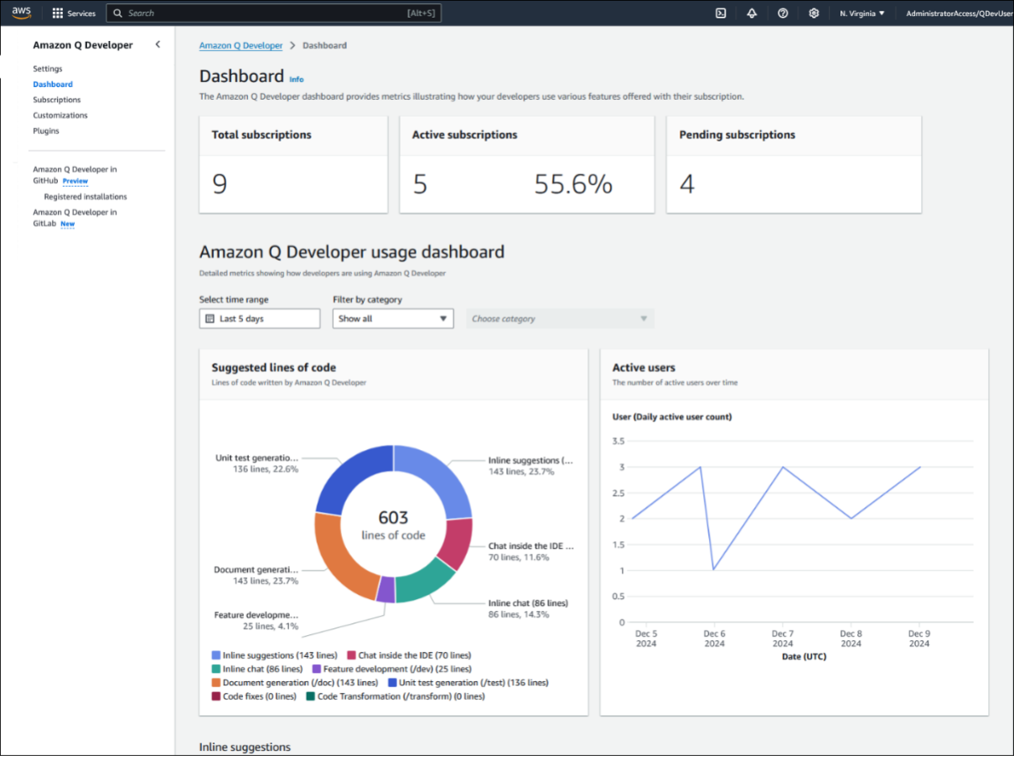
AWS STUDENT BUILDER GROUPS
VIT CHENNAI
FRONTIER · TRACK -04
0
Developer
Productivity
Empowering Developers with AI to Build Better Software - Faster
What You'll Explore
Write Better Code
Automate Repetitive Tasks
Improve Team Collaboration
Accelerate Software Delivery
FRONTIER 2026 · BUILD THE NEXT AI · VIT CHENNAI
02 / 12
Notes:
Slide 1 of your pitch. One clear paragraph. The four prompts below the box are what a judge will look for inside your answer — you do not need to answer them separately.

Slide 3
AWS STUDENT BUILDER GROUPS
VIT CHENNAI
FRONTIER · TRACK -04
Why Developer Productivity Matters??
REDUCE REPETITIVE WORK
FASTER SOFTWARE DELIVERY
Developers spend significant time on debugging, documentation, code reviews, and repetitive coding instead of building new features.
AI-powered tools automate routine tasks, helping teams develop, test, and deploy software more efficiently.
BETTER DEVELOPER EXPERIENCE
HIGHER QUALITY CODE
By reducing context switching and simplifying workflows, developers can focus on solving real world problems and innovation.
AI assists with code reviews, testing, and best practice recommendations, helping teams build more reliable and maintainable software.
FRONTIER 2026 · BUILD THE NEXT AI · VIT CHENNAI
03 / 12
Notes:
Slide 2 of your pitch. Be concrete. Avoid phrases like "AI-powered platform" — say what it does and for whom.

Slide 4





AWS STUDENT BUILDER GROUPS
VIT CHENNAI
FRONTIER · TRACK -04
04
The Evolution of Developer Tools
Version Control
AI-Assisted
Development
CI / CD
Editor, Compiler,
Debugger
Cloud Development
Build and debug applications using core development tools.
Track code changes, collaborate efficiently, and manage project history.
Automate building, testing, and deploying applications with confidence.
Develop and scale applications using cloud-native platforms and services.
Leverage AI to generate code, debug faster, automate tasks, and boost productivity.
FRONTIER 2026 · BUILD THE NEXT AI · VIT CHENNAI
04 / 12
Notes:
Slide 3 of your pitch. The diagram carries this slide — draw it even if it is rough. Name real services and models, not categories.

Slide 5
AWS STUDENT BUILDER GROUPS
VIT CHENNAI
FRONTIER · TRACK -04
WHERE DEVELOPERS LOSE TIME
the reality check
Developers spend more time supporting software than writing it.
FRONTIER 2026 · BUILD THE NEXT AI · VIT CHENNAI
05 / 12
Notes:
Slide 4 of your pitch. Judges reward honesty. Name the limitation before they find it.

Slide 6
AWS STUDENT BUILDER GROUPS
VIT CHENNAI
FRONTIER · TRACK -04
06
AI Across the Software Development Lifecycle
AI throughout the development journey
Idea
Design
Planning
Coding
Testing
Maintenance
Deployment
Brainstorm ideas, validate concepts, and identify user requirements before development begins.
Define project scope, estimate effort, and organise tasks into a clear development roadmap.
Design system architecture, APIs, database schemas, and user interfaces for scalable solutions.
Generate, explain, refactor, and optimise code to accelerate software development.
Create test cases, detect bugs, and improve software quality through automated validation.
Automate builds, CI/CD pipelines, cloud deployments, and release management.
Monitor applications, resolve issues, update documentation, and continuously improve performance.
FRONTIER 2026 · BUILD THE NEXT AI · VIT CHENNAI
06 / 12
Notes:
Slide 5 of your pitch. Replace 00% with your headline figure and say how you measured it. An estimate is fine if you show the working.

Slide 7
AWS STUDENT BUILDER GROUPS
VIT CHENNAI
FRONTIER · TRACK -04
Measuring What Matters
the dora framework for developer productivity
DEPLOYMENT FREQUENCY
LEAD TIME FOR CHANGES
How often your team ships code to production. Elite teams deploy on demand, multiple times a day, instead of once a month.
The time from a code commit to it running in production. Shorter lead times mean faster feedback and quicker fixes.
CHANGE FAILURE RATE
MEAN TIME TO RECOVERY
The share of deployments that trigger a rollback or hotfix. Speed should never come at the cost of stability.
How fast a team restores service after an incident. Elite performers recover in under an hour, not days.
FRONTIER 2026 · BUILD THE NEXT AI · VIT CHENNAI
07 / 12

Slide 8
AWS STUDENT BUILDER GROUPS
VIT CHENNAI
FRONTIER · TRACK -04
The Data-Backed Payoff
real results, not just promises
25%
increase in developer productivity
54%
fewer security vulnerabilities
350K+
lines of legacy code modernized
Real AWS case study: Altisource, powered by Amazon Q Developer.
FRONTIER 2026 · BUILD THE NEXT AI · VIT CHENNAI
08 / 12

Slide 9
AWS STUDENT BUILDER GROUPS
VIT CHENNAI
FRONTIER · TRACK -04
09
Inside Amazon Q Developer
core capabilities, up close
Your AI pair programmer, built right into the IDE.
Chat & Contextual Q&A — natural-language answers grounded in your own codebase.
Real-Time Inline Suggestions — full-function code completions across 15+ languages.
Automated Code Transformation — upgrades legacy Java and .NET apps across major versions.
Security Vulnerability Scanning — catches OWASP Top 10 issues with one-click fixes.
CLI & Terminal Support — command completions and natural-language-to-bash translation.
One tool, the whole workflow. Bring it into your IDE and see what it can do.
FRONTIER 2026 · BUILD THE NEXT AI · VIT CHENNAI
09 / 12

Slide 10
AWS STUDENT BUILDER GROUPS
VIT CHENNAI
FRONTIER · TRACK -04
Challenges & Guardrails
what responsible adoption has to reckon with
SECURITY BLIND SPOTS
CONFIDENT BUT WRONG
Independent research has found a meaningful share of AI-suggested code contains exploitable vulnerabilities if merged without review.
Generated code can compile, pass basic tests, and still hide subtle logic errors that are easy to miss on a quick read.
OVER-RELIANCE & SKILL FADE
REVIEW CAN’T KEEP PACE
Leaning on AI for every line can erode the hands-on fluency developers need to catch what the AI cannot see.
DORA’s own research links rising AI adoption to higher change failure rates when review capacity doesn’t scale with it.
FRONTIER 2026 · BUILD THE NEXT AI · VIT CHENNAI
10 / 12

Slide 11
AWS STUDENT BUILDER GROUPS
VIT CHENNAI
FRONTIER · TRACK -04
Best Practices for Responsible AI Use
how to adopt AI-assisted development well
Five habits that keep speed and quality moving together.
Review Every Suggestion — treat AI output as a draft from a junior teammate, not a merge-ready patch.
Keep Tests Independent — write and run tests that don't just confirm what the AI already assumed.
Keep Architecture Human-Led — use AI for implementation, not for decisions about design and trade-offs.
Prompt With Your Own Context — point it at your codebase and standards instead of generic examples.
Track the Metrics That Matter — measure DORA metrics before and after adoption to prove real impact.
Speed and quality aren't a trade-off. Build the habits and both go up together.
FRONTIER 2026 · BUILD THE NEXT AI · VIT CHENNAI
11 / 12

Slide 12
AWS STUDENT BUILDER GROUPS
VIT CHENNAI
FRONTIER · TRACK -04
12
AWS RESOURCES FOR DEV PRODUCTIVITY
research and references
Build smarter with AWS-powered developer tools
Amazon Q Developer - https://docs.aws.amazon.com/amazonq/latest/qdeveloper-ug/what-is.html
Amazon Bedrock - https://docs.aws.amazon.com/bedrock/
AWS CodePipeline - https://docs.aws.amazon.com/codepipeline/latest/userguide/welcome.html
AWS Lambda - https://docs.aws.amazon.com/lambda/latest/dg/welcome.html
AWS CodeBuild - https://docs.aws.amazon.com/codebuild/latest/userguide/welcome.html
Now it's your turn. Use these tools to build something amazing at Frontier 2026!
FRONTIER 2026 · BUILD THE NEXT AI · VIT CHENNAI
12 / 12
Notes:
Slide 6 of your pitch. Uncredited work is disqualifying. List everything you leaned on and be clear about what you wrote yourselves.

