Slide 1
AWS Core services with IAM

Slide 2
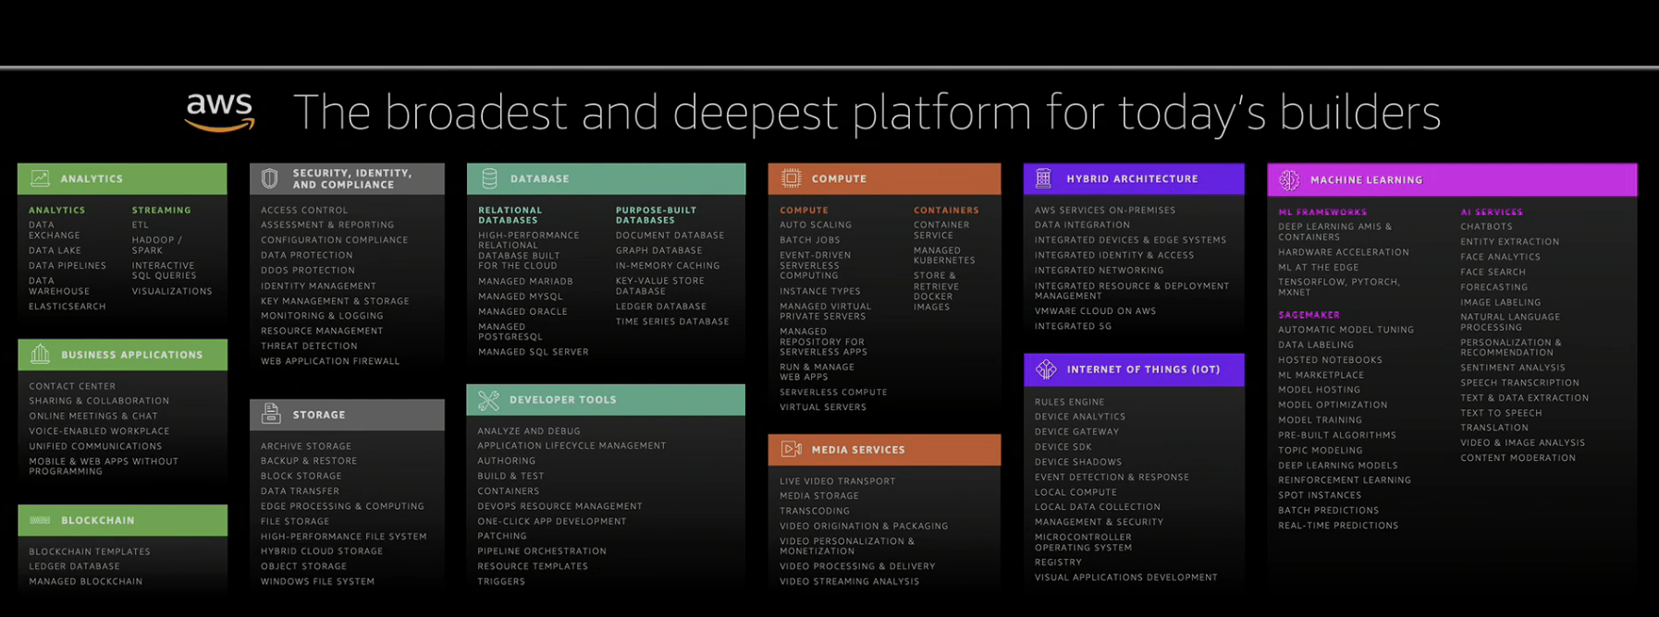
AWS Services
Notes:
All services explained: https://www.whizlabs.com/blog/aws-cheat-sheet

Slide 3
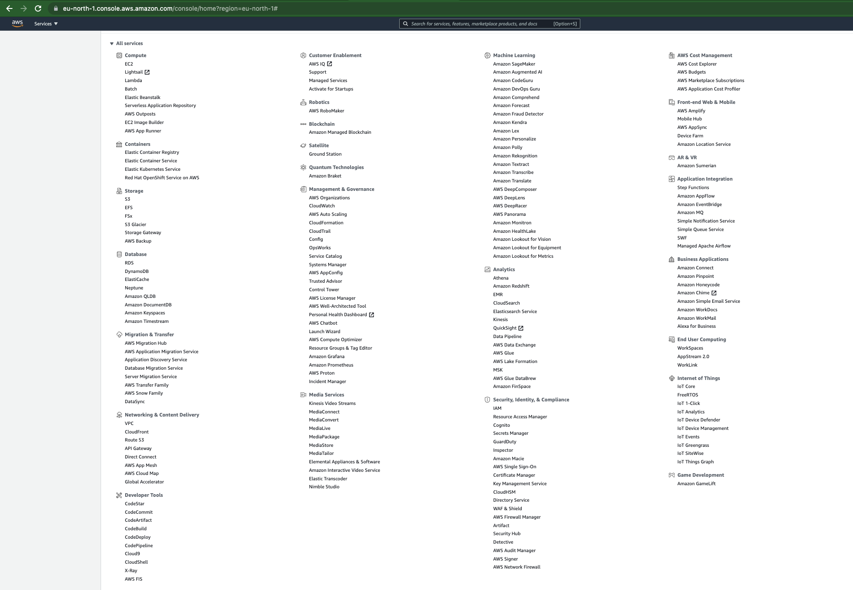
193 services in 25 categories (2021-06-11)

Slide 4
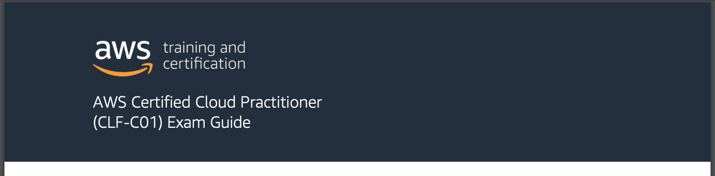

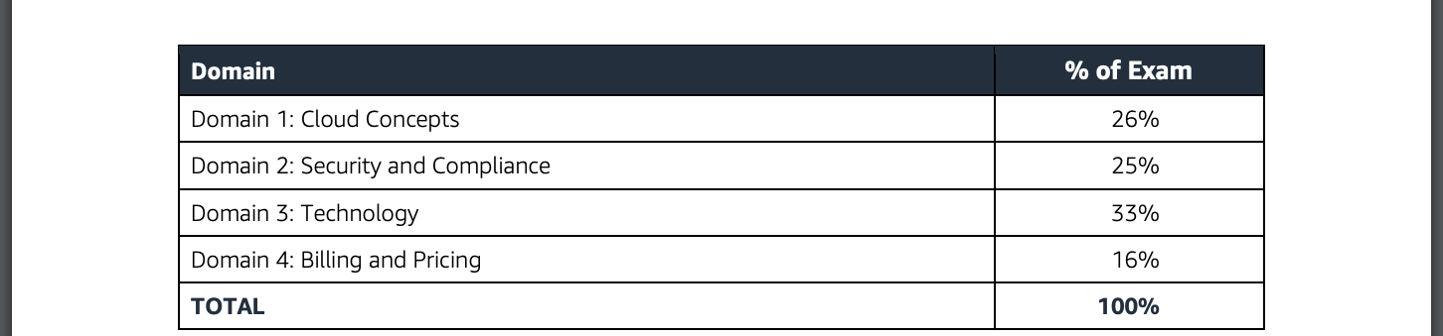






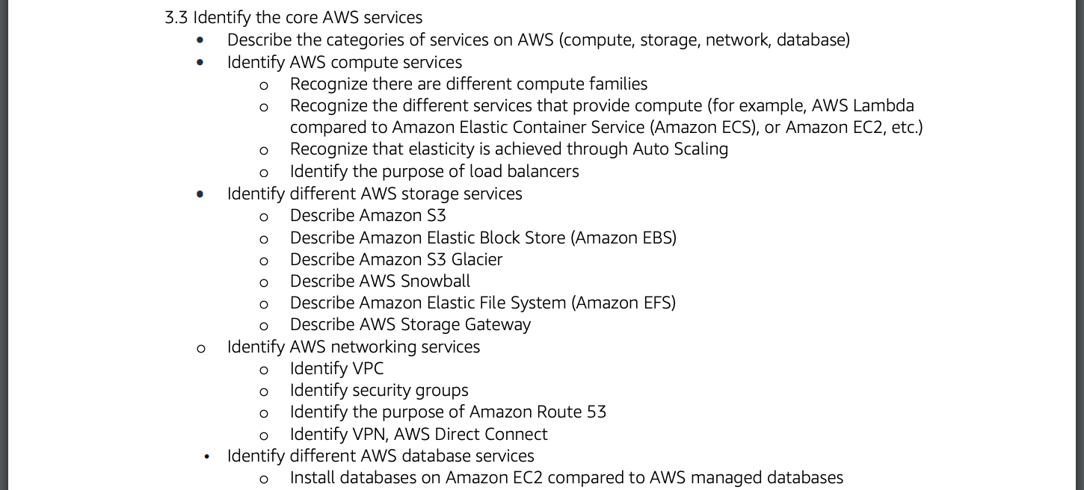






From AWS-Certified-Cloud-Practitioner_Exam-Guide.pdf
Security services
Identity and Access Management (IAM)
Compute services
Storage services
Elastic Compute Cloud (EC2)
Lambda
Simple Storage Service (S3)
Elastic File System (EFS)
Elastic Container Service (EC2)
Elastic Block Store (EBS)
Networking services
Database services
Virtual Private Cloud (VPC)
CloudFront
Relational Database Service (RDS)
Redshift
Route 53
DynamoDB
Notes:
https://d1.awsstatic.com/training-and-certification/docs-cloud-practitioner/AWS-Certified-Cloud-Practitioner_Exam-Guide.pdf

Slide 5
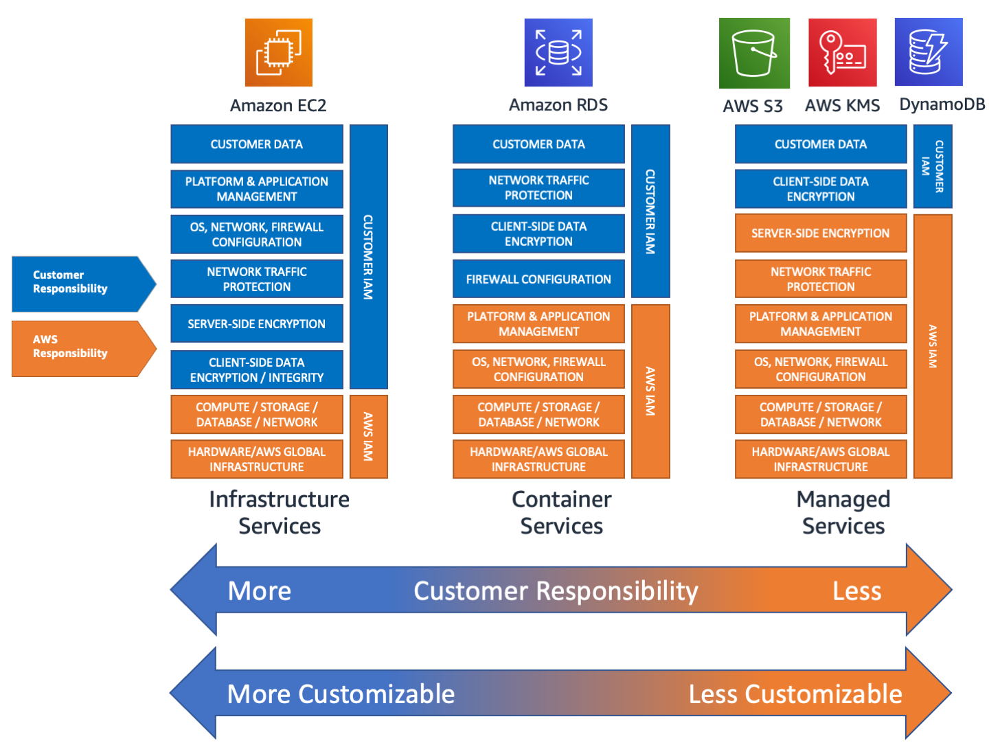

Slide 6




Demo
AWS Cloud account
Availability Zone 1
Availability Zone 2
Availability Zone 3
VPC
Public subnet 1
Public subnet 2
Public subnet 3
A record
Route 53
Security group
Port 80 – 0.0.0.0/0
aws s3api put-object
EC2 web server
S3 bucket

Slide 7
DEMO
Create an EC2
Install web server software
Publish simple web page
Make server publicly available
Assign DNS record
Log in to server via Session Manager
Put object into s3 bucket from server

Slide 8
Weaknesses & Challenges
AWS Cloud account
Availability Zone 1
Availability Zone 2
Availability Zone 3
Single server → static resources
VPC
Public subnet 1
Public subnet 2
Public subnet 3
Single server → single point of failure
A record
Route 53
Security group
Port 80 – 0.0.0.0/0
EC2 machine need patch maintenance
Unencrypted web traffic (port 80)
aws s3api put-object
EC2 web server
Do not expect a server to have static IP
S3 bucket
Infrastructure was created manually

Slide 9
AWS Core services summary…

Slide 10



