Slide 1
Infrastructure as Code

Slide 2
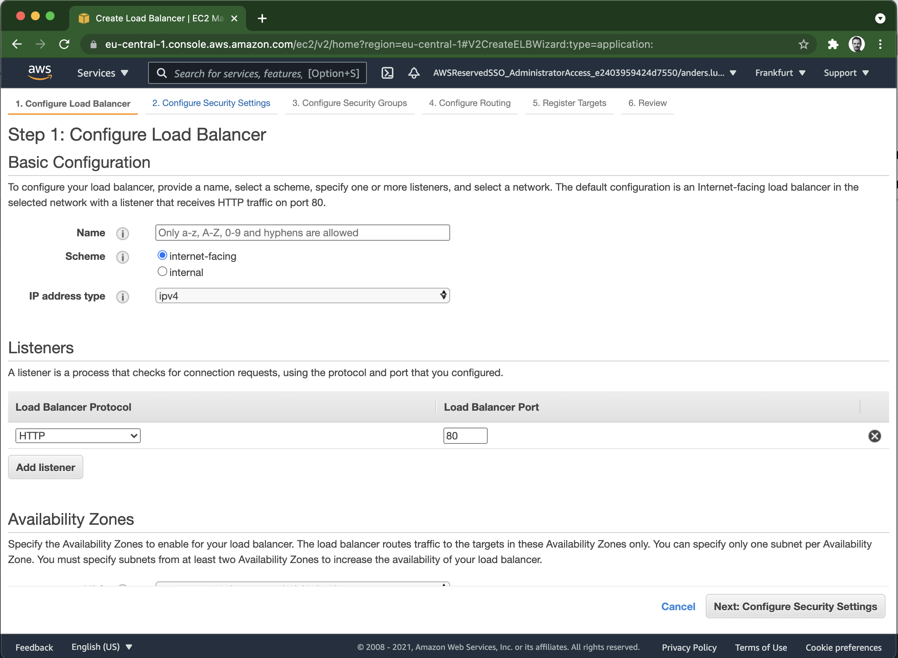
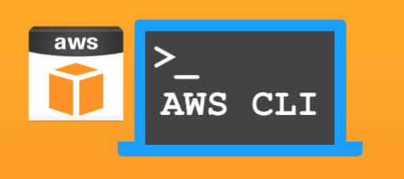
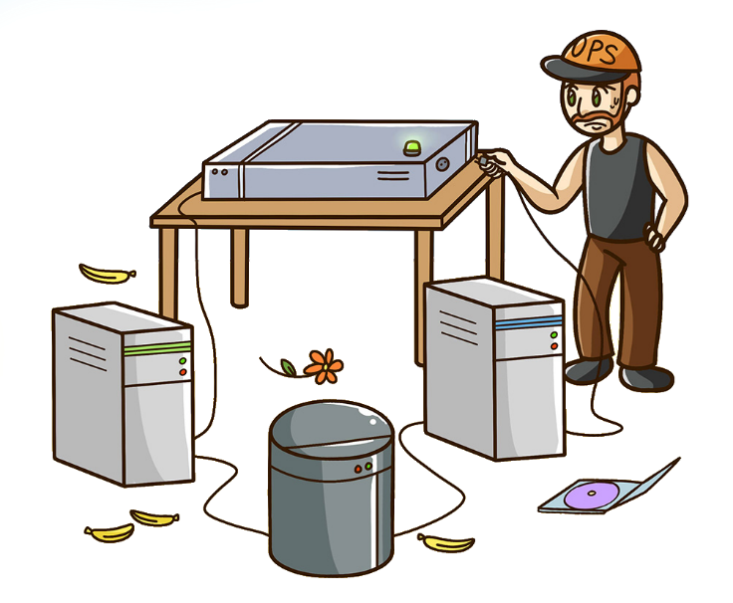

Infrastructure as Code (IaC) - Executive summary
Resources:
ElasticLoadBalancer:
Type: AWS::ElasticLoadBalancing::LoadBalancer
Properties:
SecurityGroups:
- !Ref LoadBalancerSecurityGroup
Subnets:
- !ImportValue: PublicSubnet1A
- !ImportValue: PublicSubnet1B
Listeners:
LoadBalancerPort: 443
InstancePort: 8080
Protocol: HTTPS
SSLCertificateId: !ImportValue CertificateId
HealthCheck:
Target: 'HTTP:80/'
HealtyThreshold: 2
UnhealtyThreshold: 3
Interval: 20
Timeout: 10
Automate manual steps
Manual
Infrastructure as Code
[AWS CloudFormation]
Code
Tests
Infrastructure

Slide 3

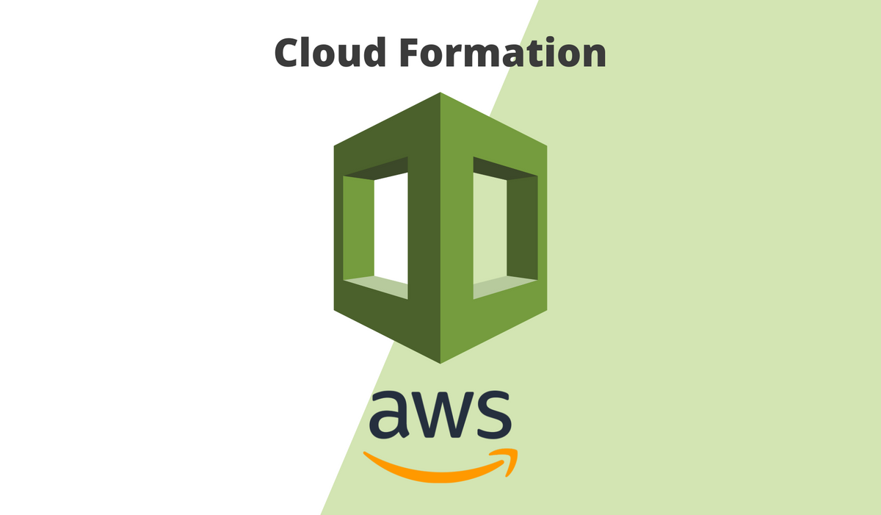




Infrastructure as Code (IaC) - Tools
Resources:
ElasticLoadBalancer:
Type: AWS::ElasticLoadBalancing::LoadBalancer
Properties:
SecurityGroups:
- !Ref LoadBalancerSecurityGroup
Subnets:
- !ImportValue: PublicSubnet1A
- !ImportValue: PublicSubnet1B
Listeners:
LoadBalancerPort: 443
InstancePort: 8080
Protocol: HTTPS
SSLCertificateId: !ImportValue CertificateId
HealthCheck:
Target: 'HTTP:80/'
HealtyThreshold: 2
UnhealtyThreshold: 3
Interval: 20
Timeout: 10
[AWS CloudFormation]

Slide 4
Infrastructure as Code (IaC) - Tools
Resources:
ElasticLoadBalancer:
Type: AWS::ElasticLoadBalancing::LoadBalancer
Properties:
SecurityGroups:
- !Ref LoadBalancerSecurityGroup
Subnets:
- !ImportValue: PublicSubnet1A
- !ImportValue: PublicSubnet1B
Listeners:
LoadBalancerPort: 443
InstancePort: 8080
Protocol: HTTPS
SSLCertificateId: !ImportValue CertificateId
HealthCheck:
Target: 'HTTP:80/'
HealtyThreshold: 2
UnhealtyThreshold: 3
Interval: 20
Timeout: 10
AWS Native
Cloud agnostic
Open Source
[AWS CloudFormation]

Slide 5
Infrastructure as Code - Benefits
Have version control as source of truth for infrastructure
Define infrastructure in desired state reduce complexity
Developers can manage infrastructure
Reduce risk for manual misconfigurations
Speed the provisioning of small or complex architectures

Slide 6
DEMO
Create KMS key manually in web console
Explore AWS CloudFormation documentation
Create CloudFormation YAML template
Create KMS key with CloudFormation
Update KMS key with CloudFormation
Delete CloudFormation stack

Slide 7



