Slide 1
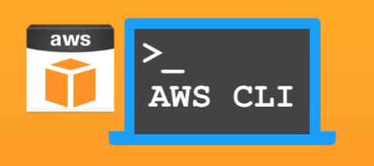
AWS CLI and SDKs

Slide 2




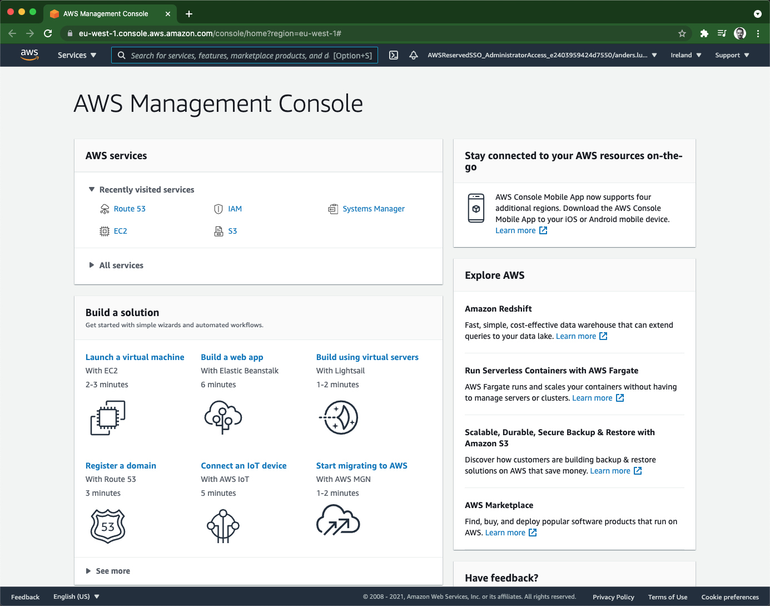
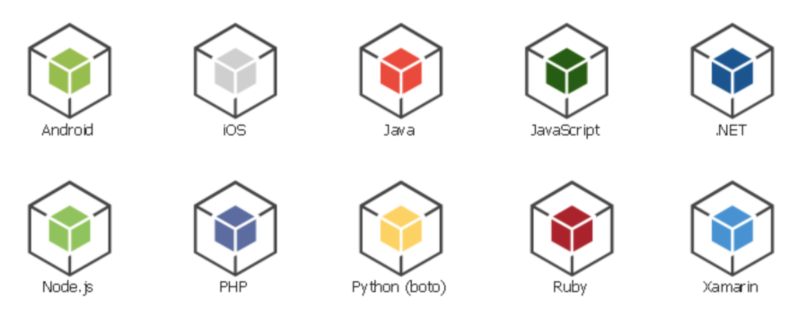

Ways to access AWS services
create-bucket
list-buckets put-object …
run-instances stop-instances create-snapshot …
create-vpc create-subnet create-route …
create-table list-tables put-item …
S3
EC2
VPC
DynamoDB
APIs via HTTPS
Access Keys
Username + Password
Cloud Engineer
Notes:
AWS CLI reference: https://docs.aws.amazon.com/cli/latest/reference/index.html#cli-aws

Slide 3
Experiences with AWS CLI
Very homogeneous across all services
Good source for understanding the services
Is “partly” Infrastructure as Code

Slide 4
AWS CLI & SDKs config priority
Command line parameters
Environment variables
~/.aws/ configuration files
Instance profile
More details here AWS Command Line Interface
Notes:
https://docs.aws.amazon.com/cli/latest/userguide/cli-configure-quickstart.html#cli-configure-quickstart-precedence

Slide 5
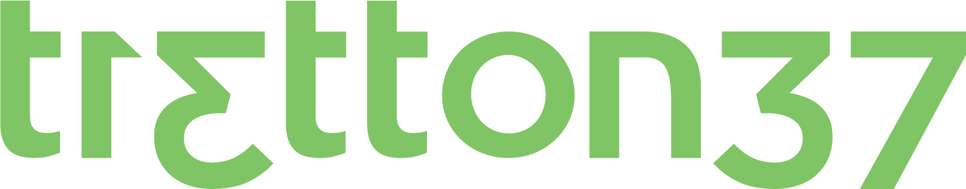


Slide 6
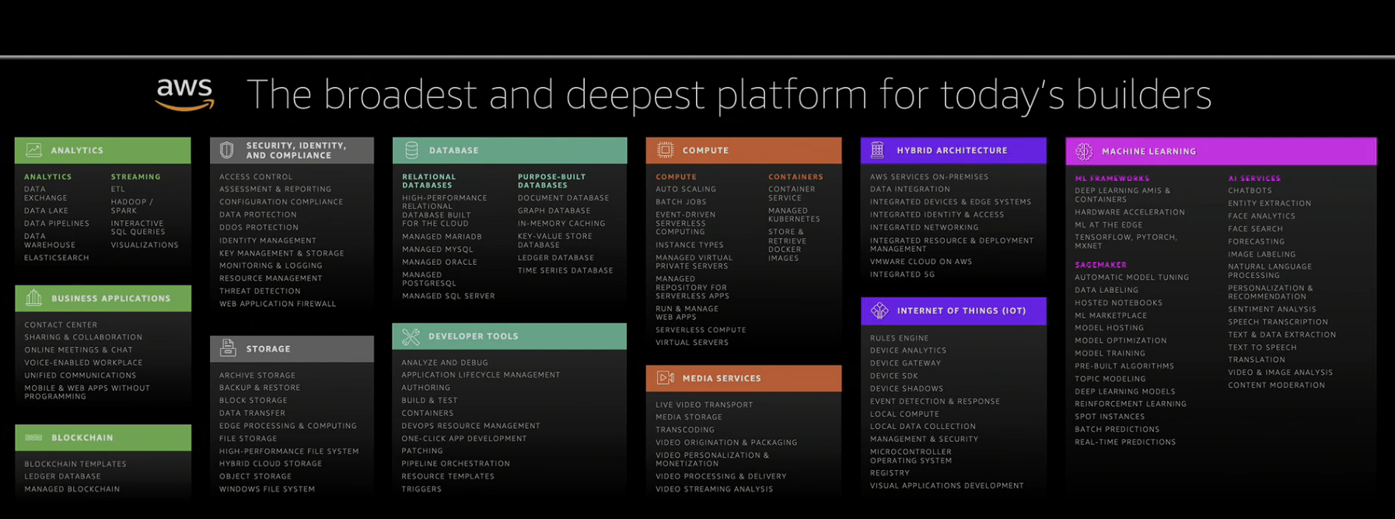
AWS Services
Notes:
All services explained: https://www.whizlabs.com/blog/aws-cheat-sheet

Slide 7
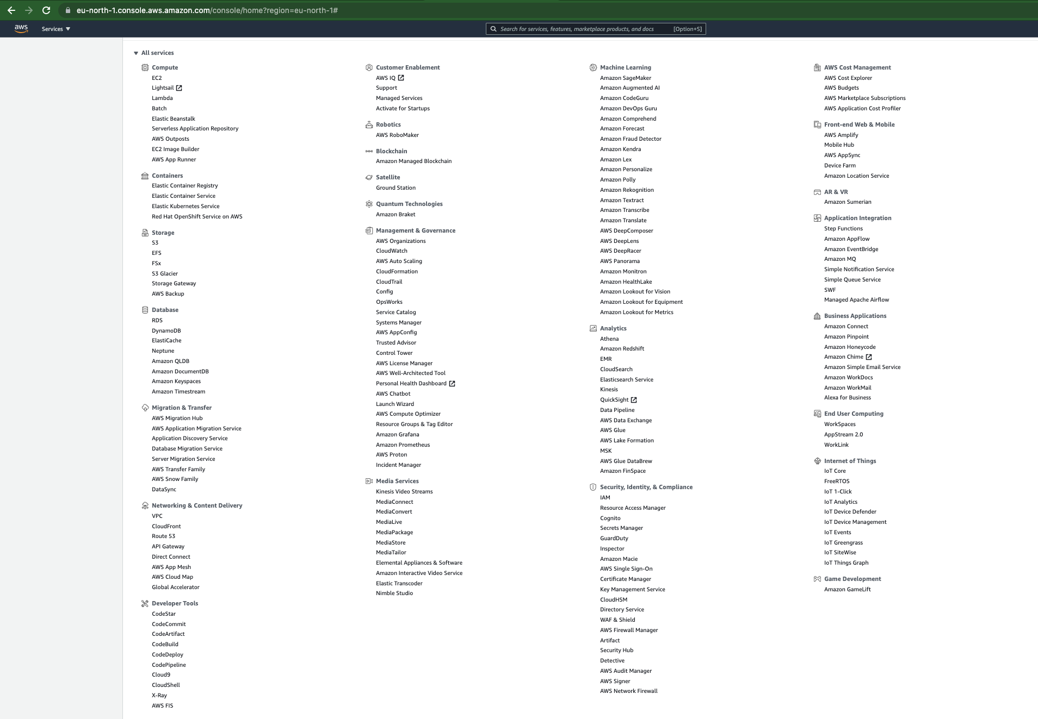
193 services in 25 categories (2021-06-11)

Slide 8
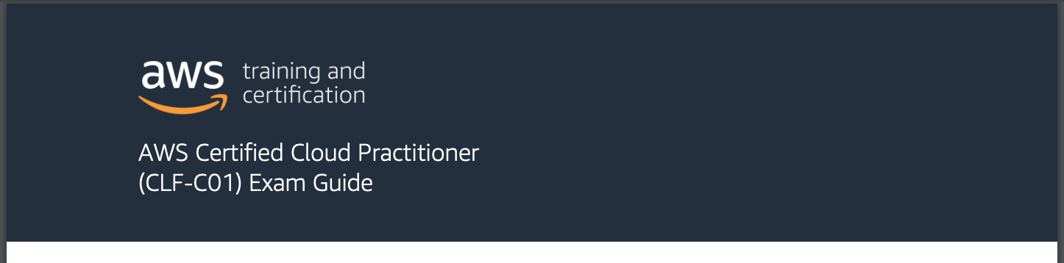

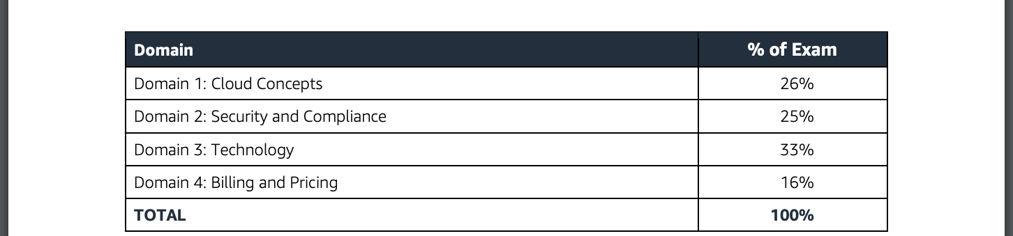
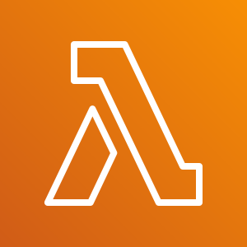
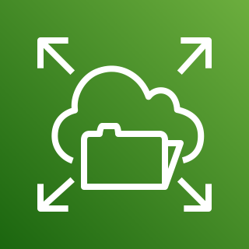

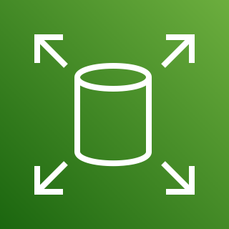
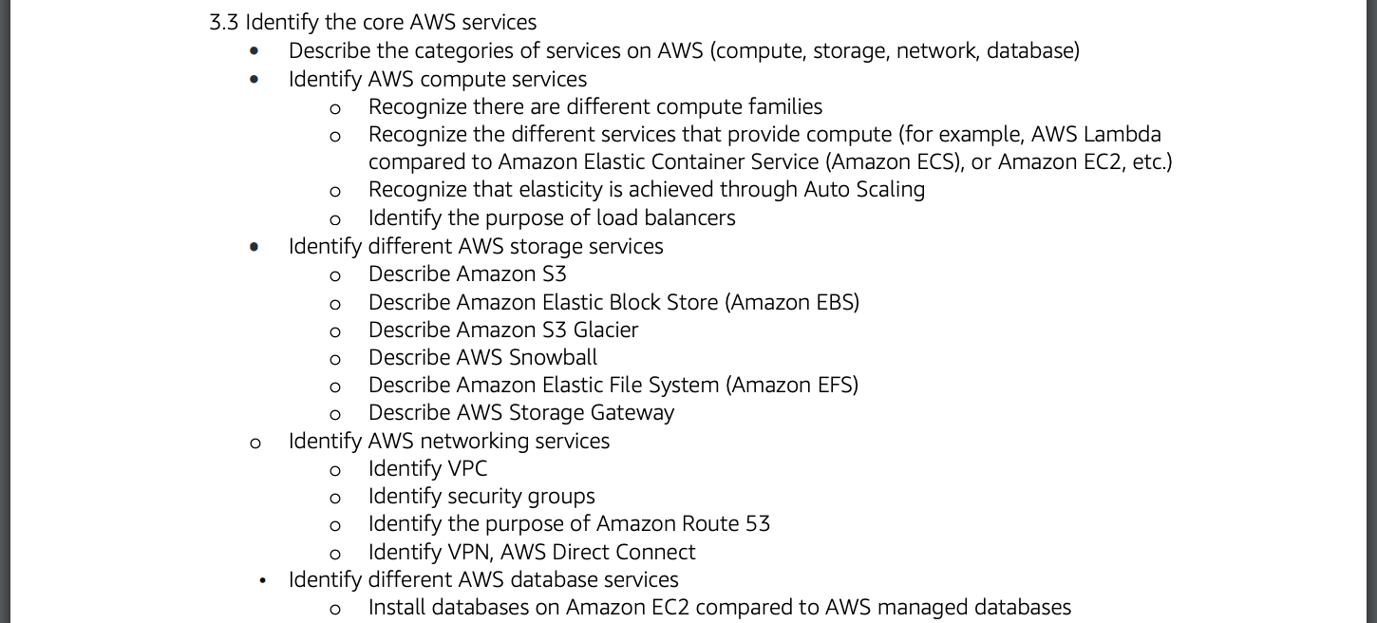

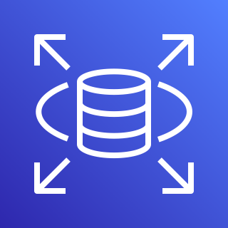


From AWS-Certified-Cloud-Practitioner_Exam-Guide.pdf
Security services
Identity and Access Management (IAM)
Compute services
Storage services
Elastic Compute Cloud (EC2)
Lambda
Simple Storage Service (S3)
Elastic File System (EFS)
Elastic Container Service (EC2)
Elastic Block Store (EBS)
Networking services
Database services
Virtual Private Cloud (VPC)
CloudFront
Relational Database Service (RDS)
Redshift
Route 53
DynamoDB
Notes:
https://d1.awsstatic.com/training-and-certification/docs-cloud-practitioner/AWS-Certified-Cloud-Practitioner_Exam-Guide.pdf

Slide 9

Well Architected Frontend deployment
S3
CloudFront
Route 53
DynamoDB
Notes:
https://d1.awsstatic.com/training-and-certification/docs-cloud-practitioner/AWS-Certified-Cloud-Practitioner_Exam-Guide.pdf

Slide 10



Well Architected Frontend deployment
Route 53
DynamoDB
DNS queries
Store Data
Might looks overwhelming…
All services are managed by AWS
You don’t have to understand them in detail
Very cheap
Scales “infinite”
Can be defined as code and reused
Fetch frontend
HTTP GET
CloudFront
S3
Authentication
SSL termination
OWASP protection
Cognito
ACM
WAF
Notes:
https://d1.awsstatic.com/training-and-certification/docs-cloud-practitioner/AWS-Certified-Cloud-Practitioner_Exam-Guide.pdf

Slide 11
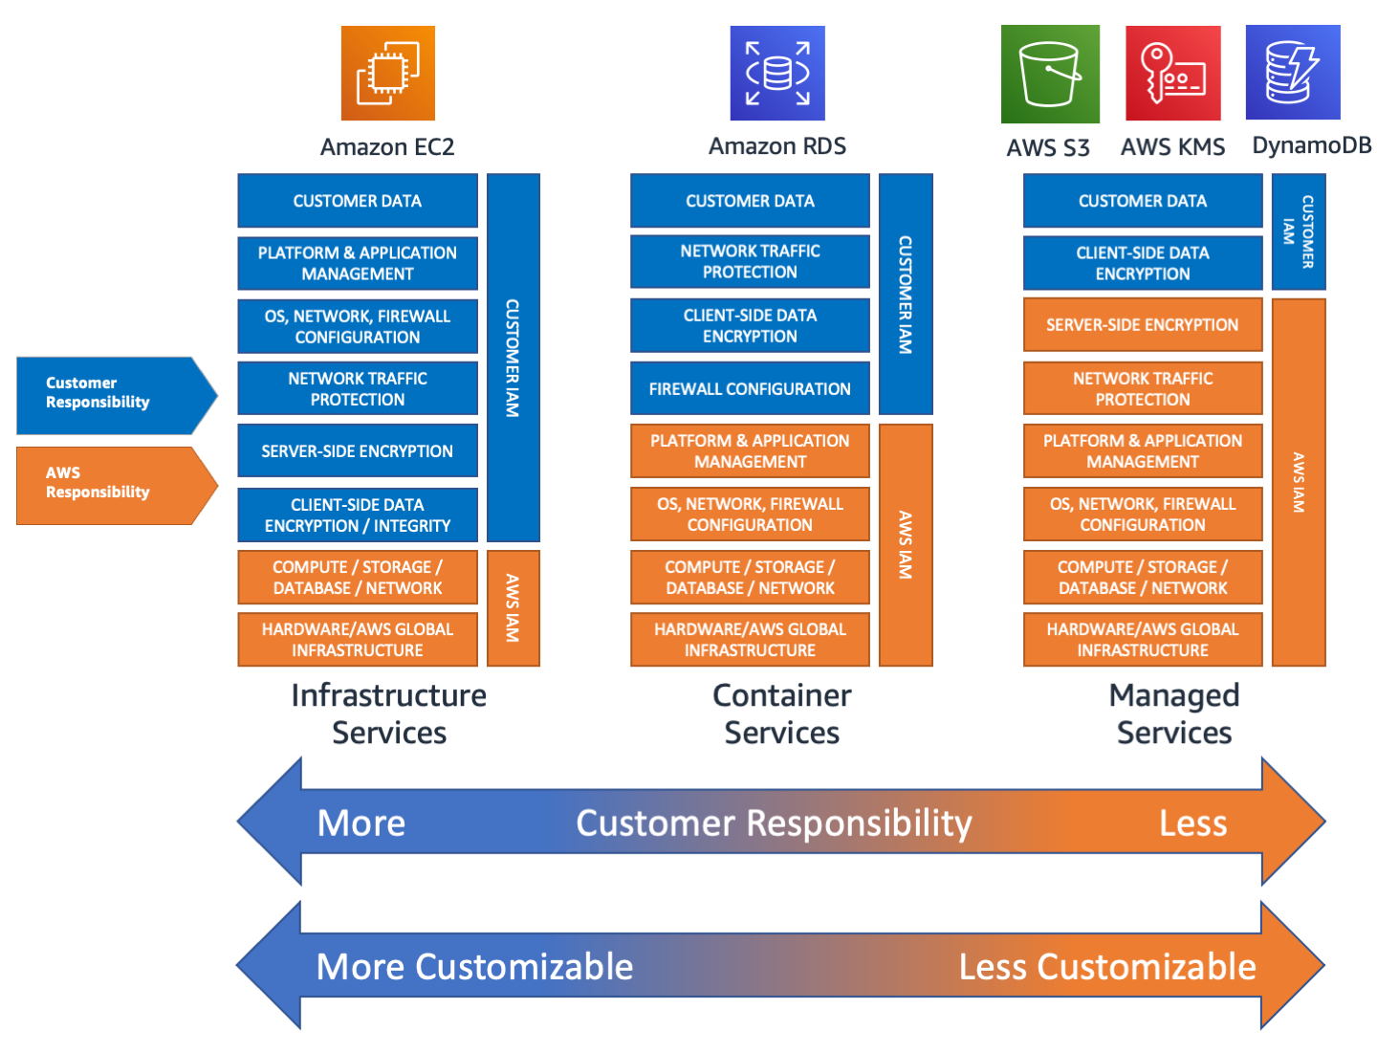

Slide 12





Demo
AWS Cloud account
Availability Zone 1
Availability Zone 2
Availability Zone 3
VPC
Public subnet 1
Public subnet 2
Public subnet 3
A record
Route 53
Security group
Port 80 – 0.0.0.0/0
aws s3api put-object
EC2 web server
S3 bucket
Attach
IAM Role
Katrineholm
Eskilstuna
Västerås

Slide 13
DEMO
Create an EC2
Install web server software
Publish simple web page
Make server publicly available
Assign DNS record
Log in to server via Session Manager
Put index.html into s3 bucket from server

Slide 14
Weaknesses & Challenges
AWS Cloud account
Availability Zone 1
Availability Zone 2
Availability Zone 3
VPC
Single server → static resources
Public subnet 1
Public subnet 2
Public subnet 3
A record
Single server → single point of failure
Route 53
Security group
Port 80 – 0.0.0.0/0
EC2 machine need patch maintenance
Unencrypted web traffic (port 80)
aws s3api put-object
EC2 web server
Do not expect a server to have static IP
S3 bucket
Attach
Infrastructure was created manually
IAM Role

Slide 15
AWS Core services summary
Learn but avoid create and maintain your own EC2 machies
Learn! You will use S3 a lot
Elastic Compute Cloud (EC2)
Simple Storage Service (S3)

