Slide 1
Identity & Access Management

Slide 2





Core IAM concepts
AWS Cloud Account
{
"Version": "2012-10-17",
"Statement": [
{
"Action": [
"s3:GetObject",
"s3:ListBucket"
],
"Effect": "Allow",
"Resource": "arn:aws:s3:::my-unique-bucket"
}
]
}
IAM User
has
has
IAM Group
IAM Policy
has
IAM Role
Notes:
Policy Generator: https://awspolicygen.s3.amazonaws.com/policygen.html

Slide 3
AWS Cloud Account
Everything created in AWS is connected to an account
Security boundary
Cost boundary
AWS Organization
Development account(s)
Production account(s)
All AWS accounts have the same capabilities
AWS Cloud Account
– Development
AWS Cloud Account – Production

Slide 4
IAM User
AWS Cloud Account
≠
IAM User

Slide 5
IAM User
Interacts with
AWS Cloud Account
IAM User
Interacts with
IAM User
Interacts with
IAM User
Many persons typically log in to the same AWS accounts

Slide 6
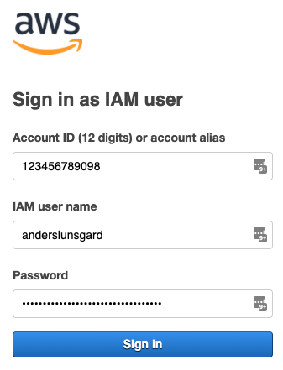


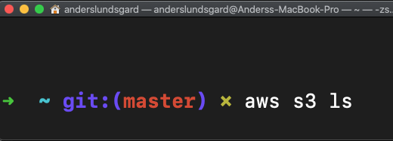

IAM User
AWS Cloud Account
Username + Password
Cloud Engineer
IAM User
Long-term access keys
AWS CLI

Slide 7

IAM User – Best practice is No IAM User
Federation
AWS Cloud Account
Active Directory
Cloud Engineer
Temporary credentials
IAM Role
Web console + AWS CLI
Trust policy

Slide 8
DEMO
Creation of IAM User
Login to AWS Console
Familiarize with IAM Policies

Slide 9
IAM User summary…
Avoid IAM Users!

Slide 10
IAM User summary…
AWS Cloud Account
Life cycle management
Password & access keys rotation
No password
Automatic credentials rotation
Integrates with other AWS services
IAM User
IAM Role
Username + Password
Trust policy
Long-term access keys
Short-term credentials

Slide 11



